Slide 1
Machine Learning: Examples
Sang-Hoon Oh
Division of Information Communication Convergence Engineering
Mokwon University

Slide 2
Contents
Introduction
K-Nearest Neighbor Algorithm
LDA(Linear Discriminant Analysis)
Perceptron
Feed-Forward Neural Networks
RNN(Recurrent Neural Networks)
SVM(Support Vector Machine)
Ensemble Learning
CNN(Convolutional Neural Network)
PCA(Principal Component Analysis)
ICA(Independent Component Analysis)
Clustering
GAN(Generative Adversarial Network)

Slide 3
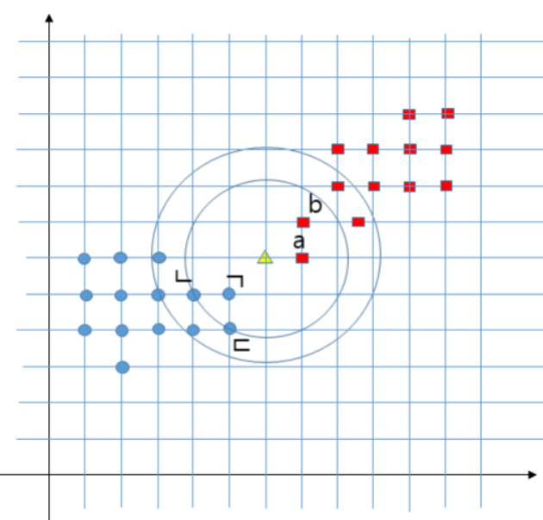

Slide 6
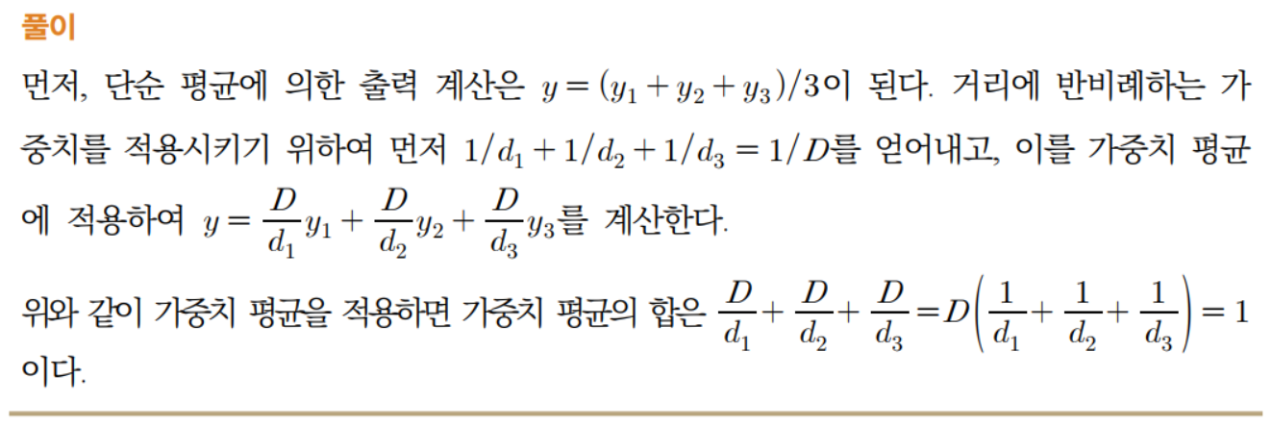

Slide 9
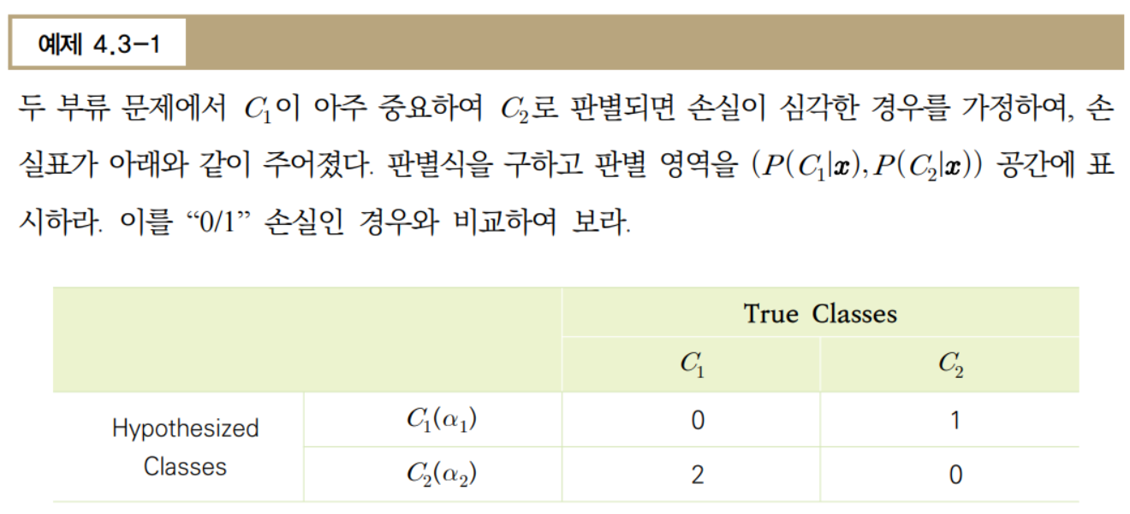

Slide 10
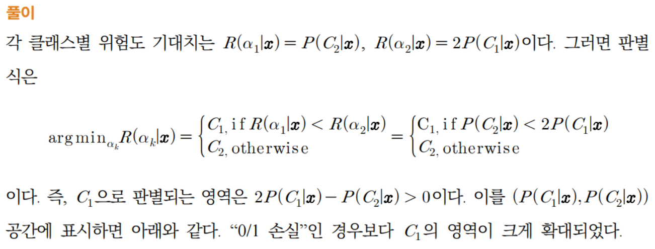
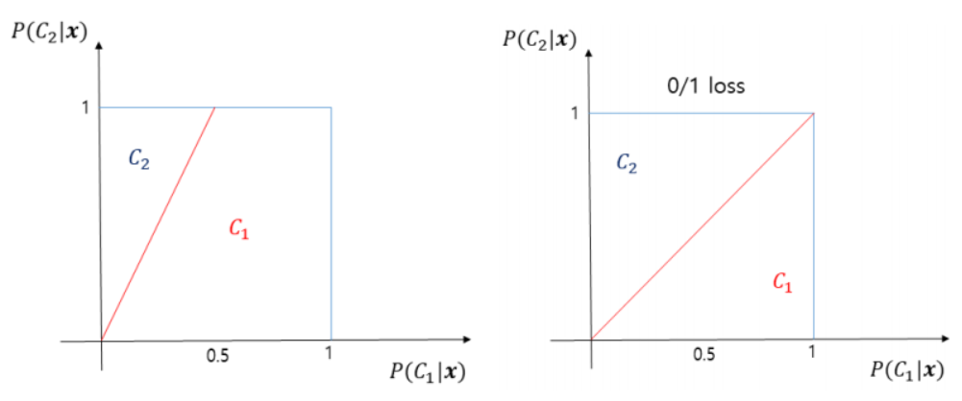

Slide 11
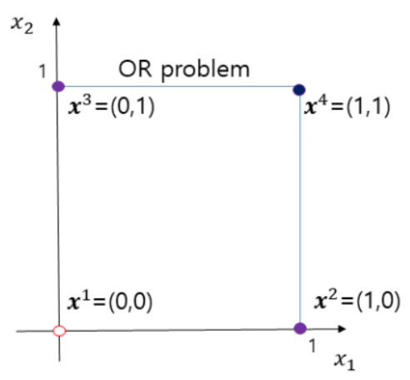

Slide 12
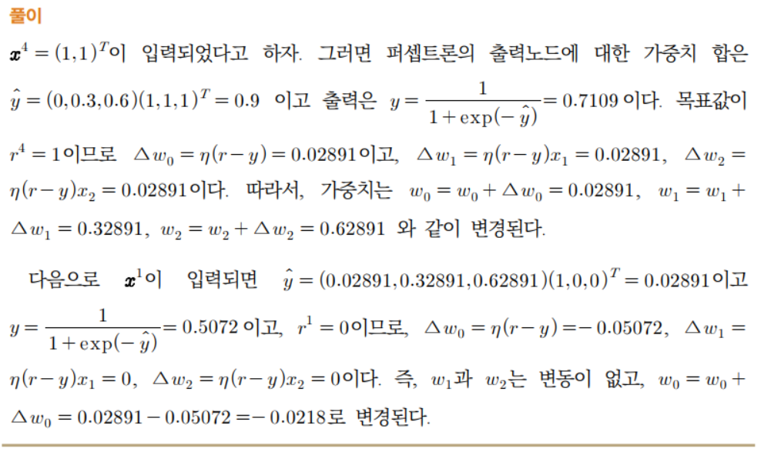

Slide 14
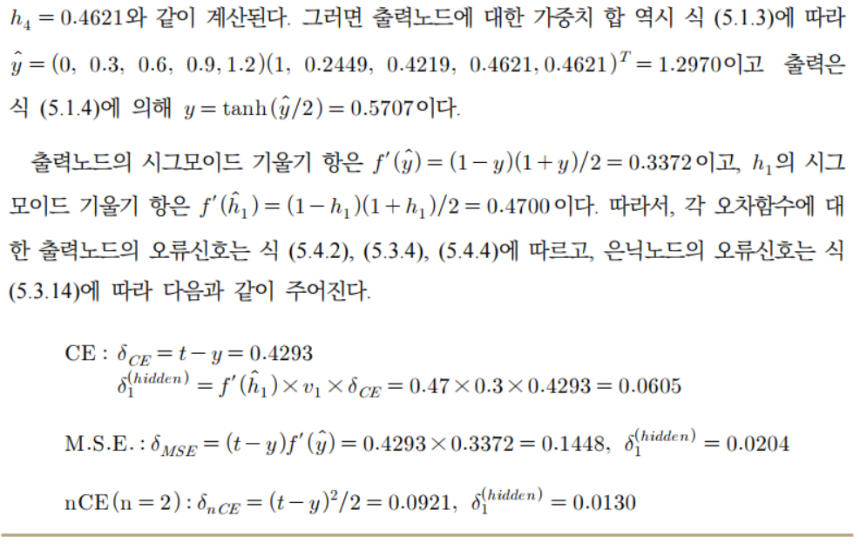

Slide 18
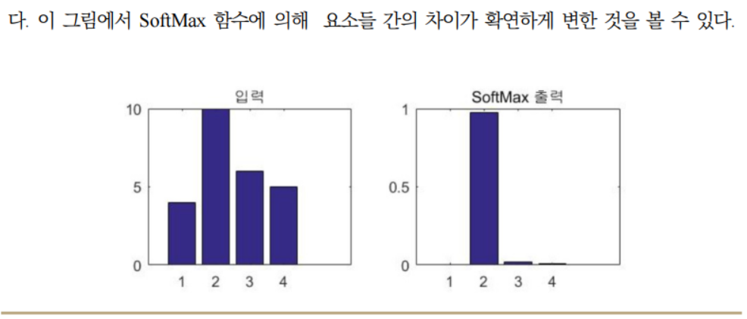

Slide 19
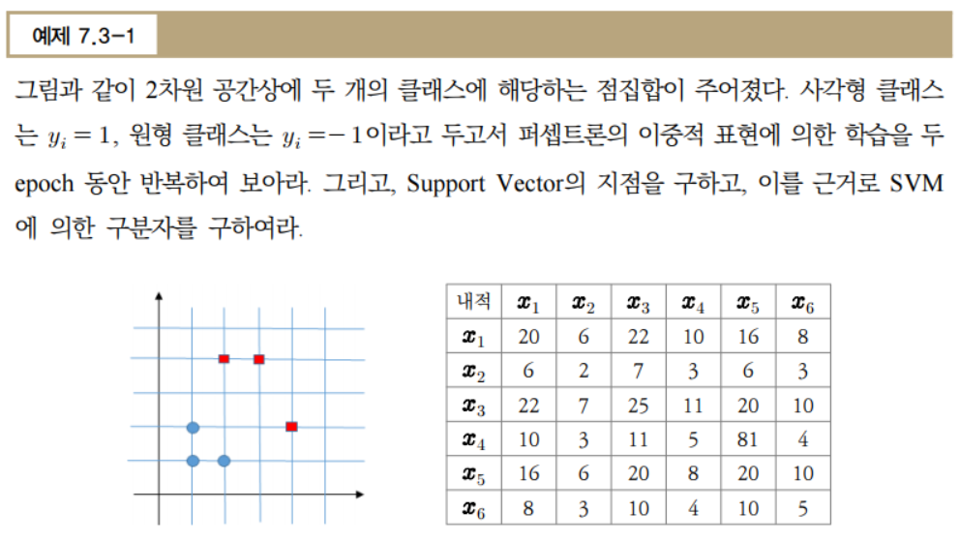

Slide 21
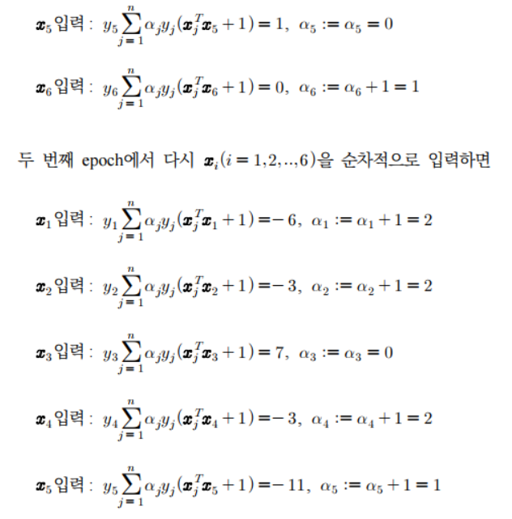

Slide 24
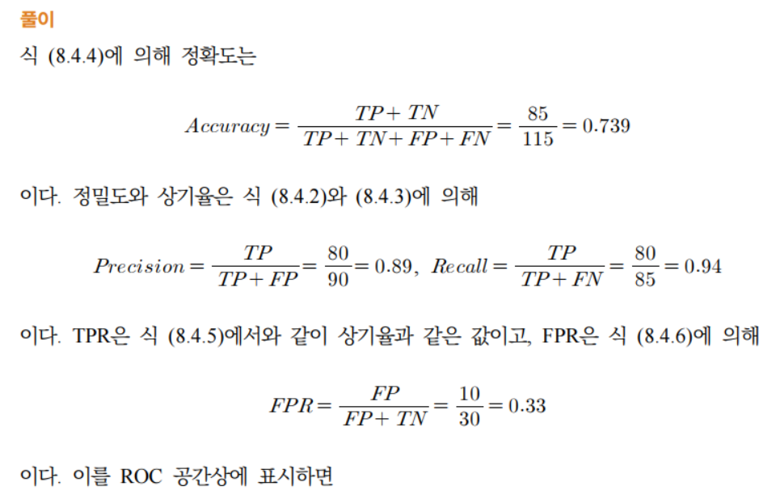

Slide 25
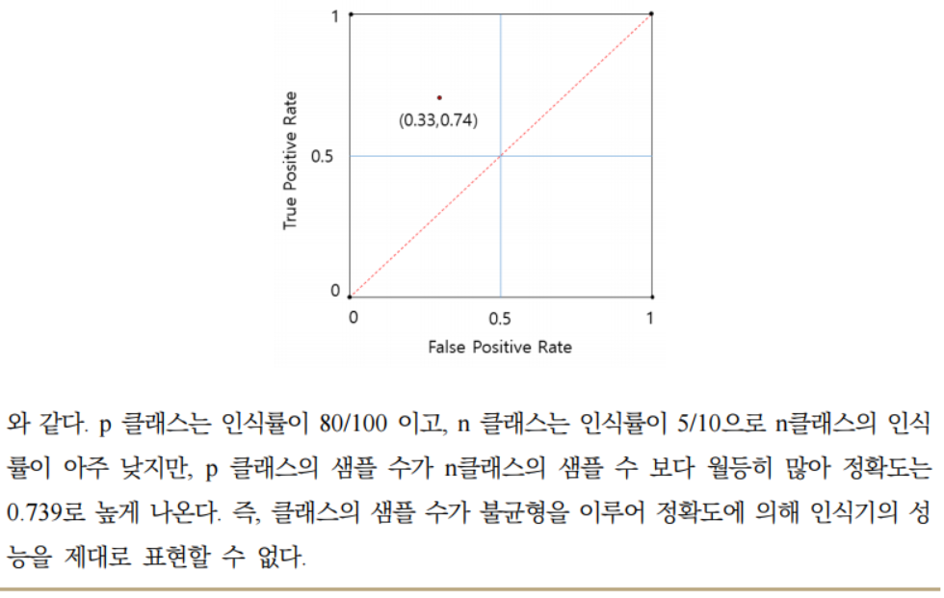

Slide 29
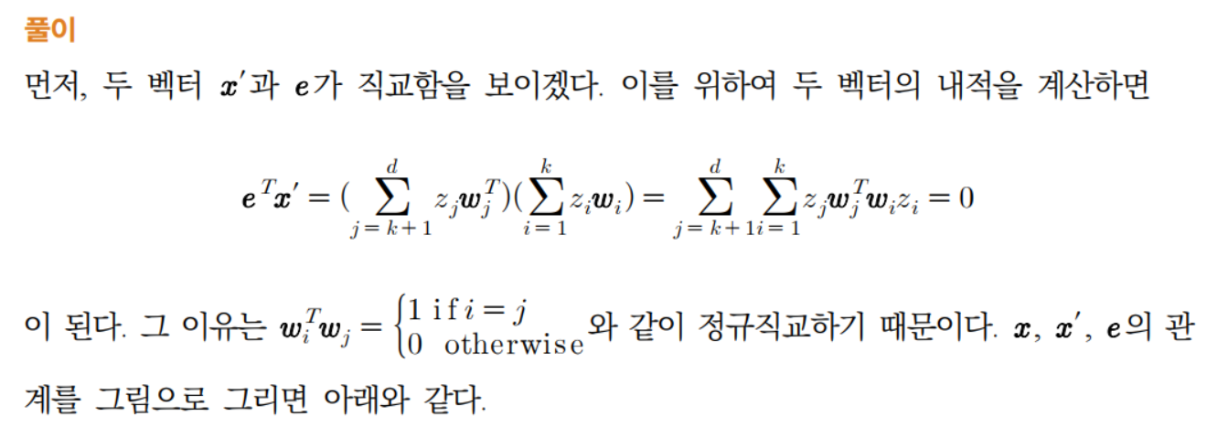
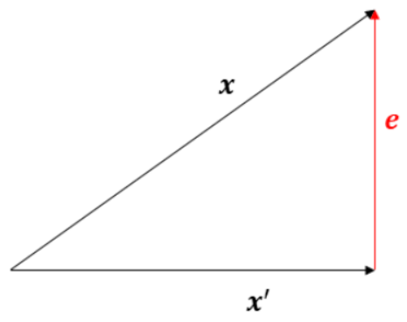

Slide 32
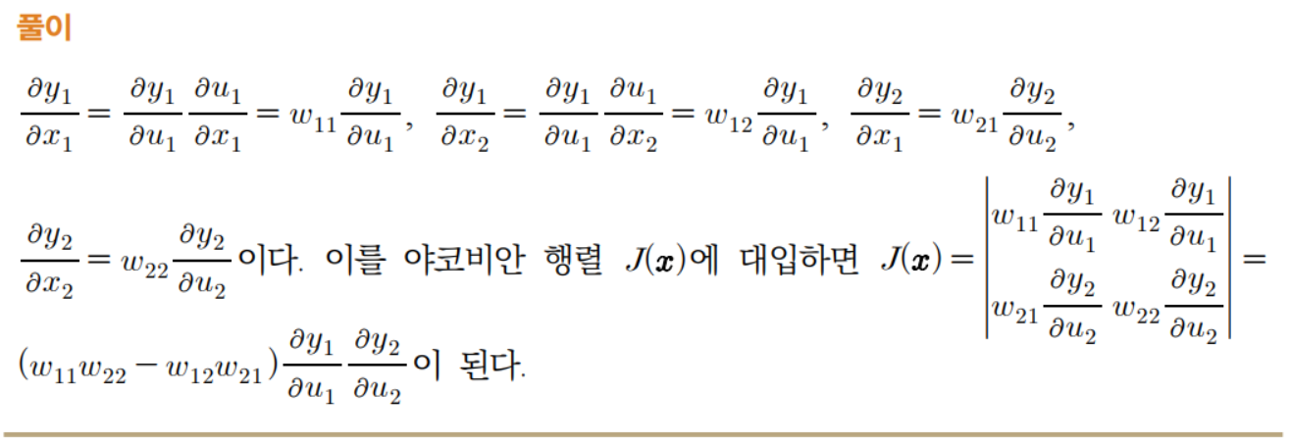

Slide 34
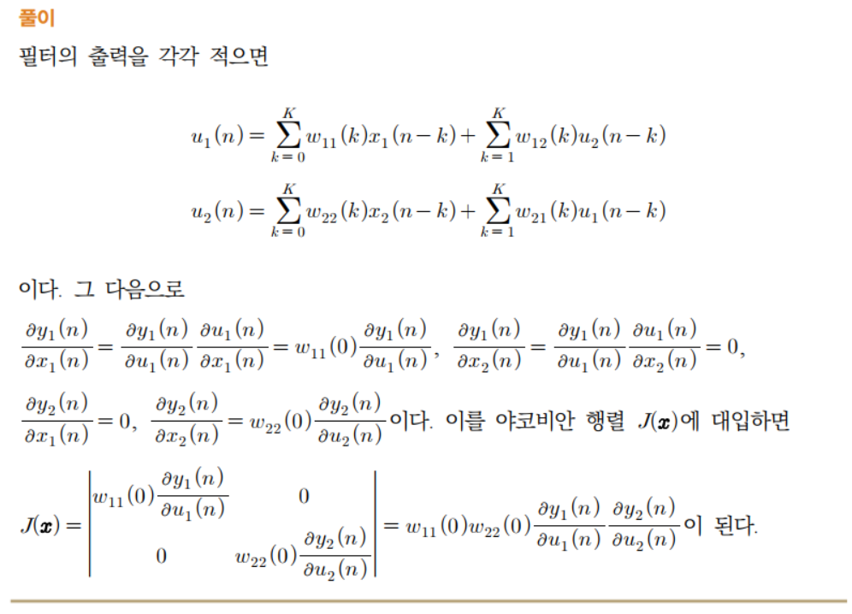

Slide 35
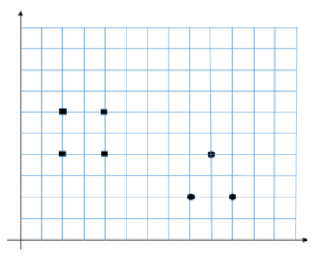

Slide 37
