Slide 1

Machine Learning

Slide 2

Contents
Introduction
K-Nearest Neighbor Algorithm
LDA(Linear Discriminant Analysis)
Perceptron
Feed-Forward Neural Networks
RNN(Recurrent Neural Networks)
SVM(Support Vector Machine)
Ensemble Learning
CNN(Convolutional Neural Network)
PCA(Principal Component Analysis)
ICA(Independent Component Analysis)
Clustering
GAN(Generative Adversarial Network)

Slide 3

8.1. Why?
There are various types of learners which use different
  Algorithms
  Hyper-parameters
  Representations
  Training sets
  Subproblems
⇒ Different learners attain different performance!
No Free Lunch Theorems for Machine Learning
  If an algorithm performs well on a certain class of problems then it necessarily pays for that with degraded performance on the set of all remaining problems
  There is no single algorithm that always shows the most accurate performance.
  Fine tuning of algorithms → there are instances the algorithm is inaccurate and there may be another algorithm that is accurate on those
Generating a group of base learners and combining them for higher accuracy

Slide 4





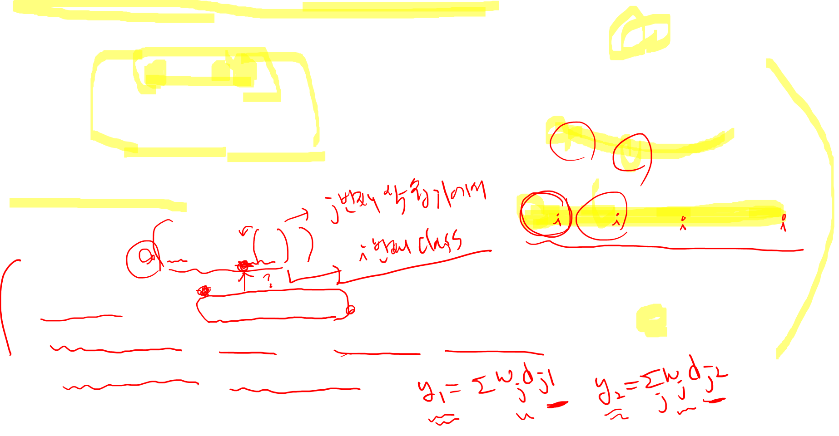








8.2. Voting
Linear combination of outputs (learners)
Classification
  Simple voting: equal weight
  Plurality voting: class with max vote is the winner
  Majority voting (2 class problem)
$$y$$
+
$$w_{1}$$
$$w_{L}$$
$$w_{2}$$
$$w_{3}$$
$$d_{1}$$
$$d_{2}$$
$$d_{3}$$
$$d_{L}$$
$$x$$

Slide 5
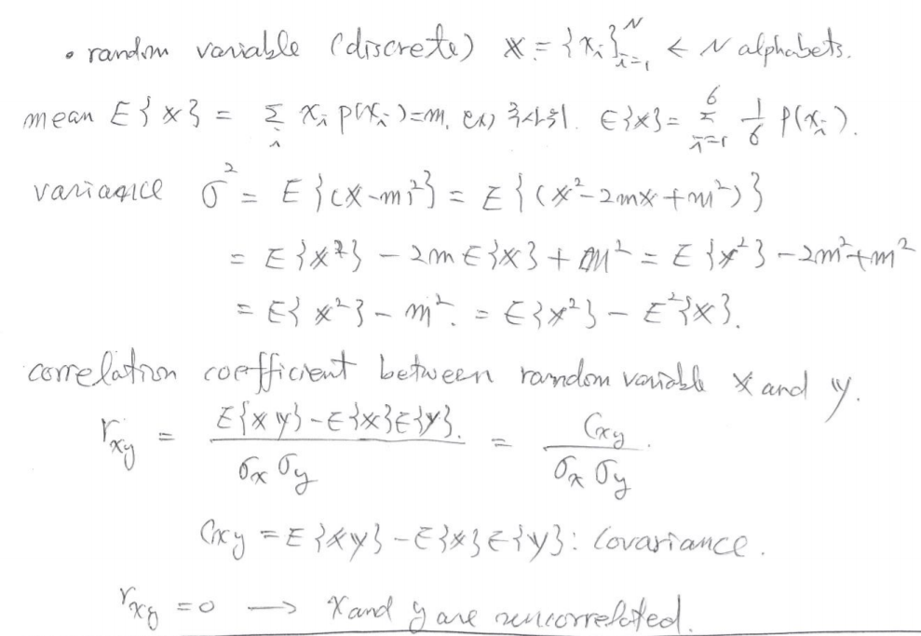


Slide 6

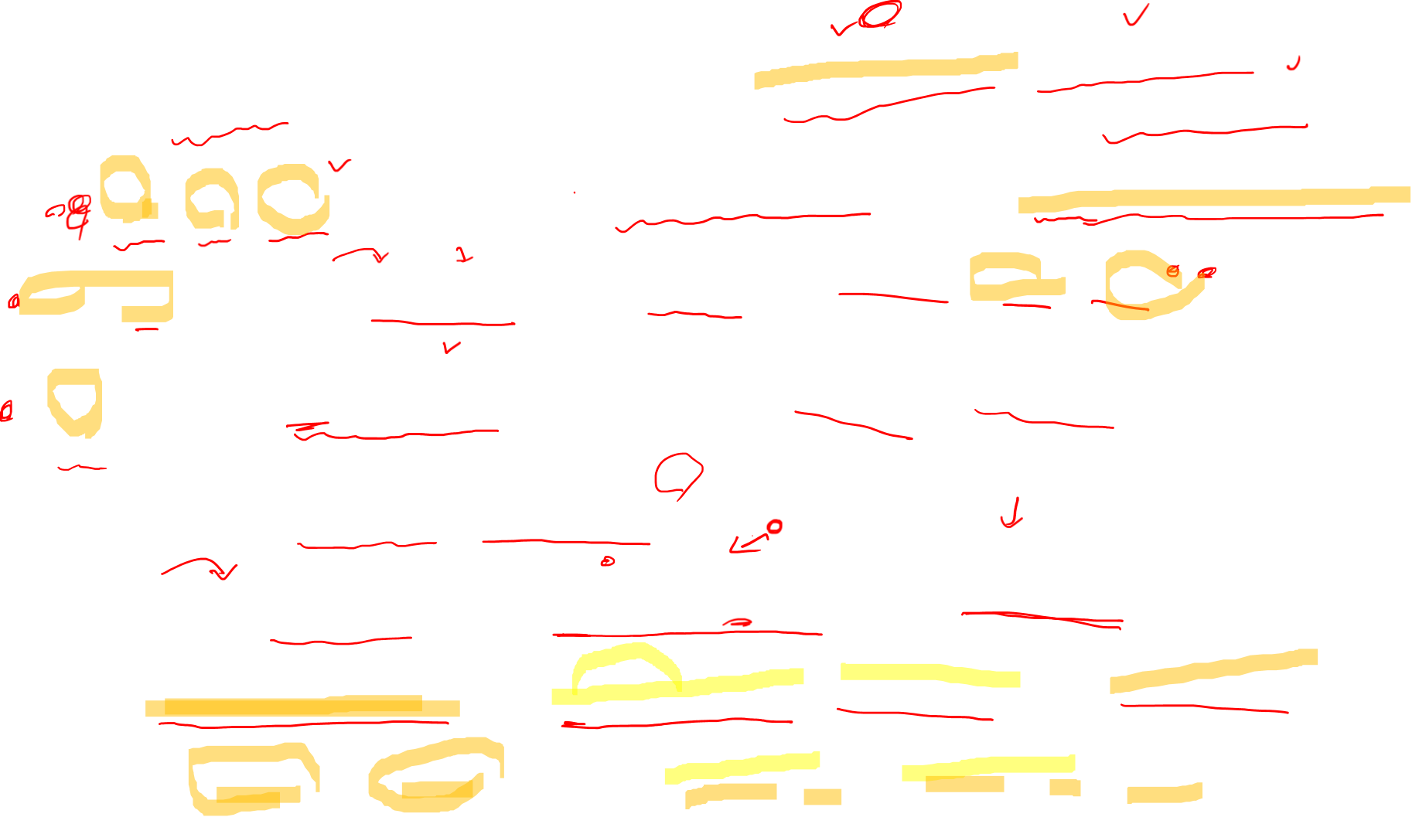



Slide 7
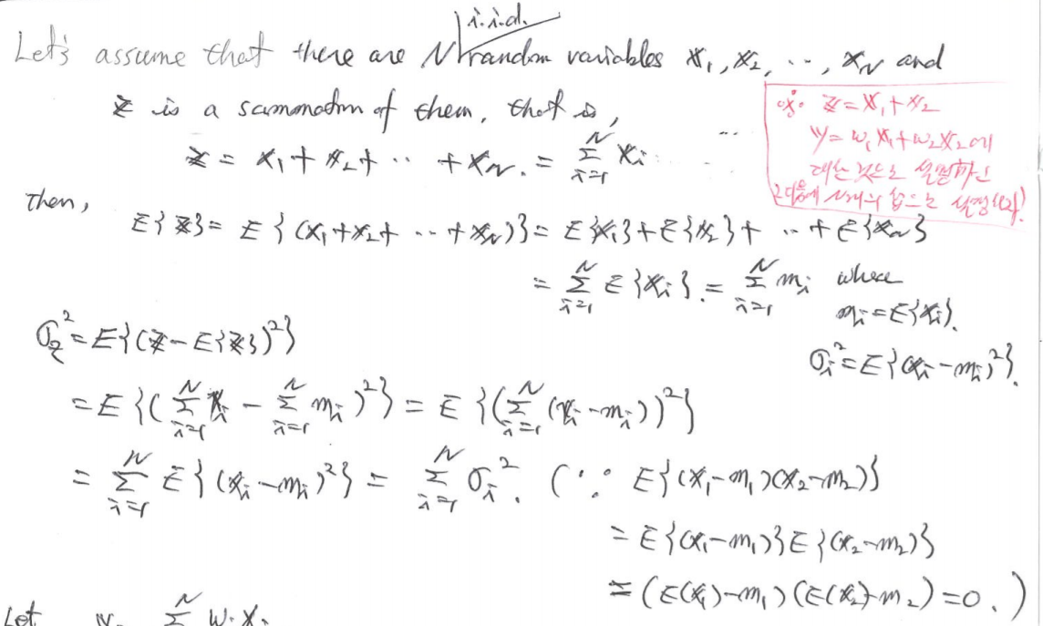


Slide 8
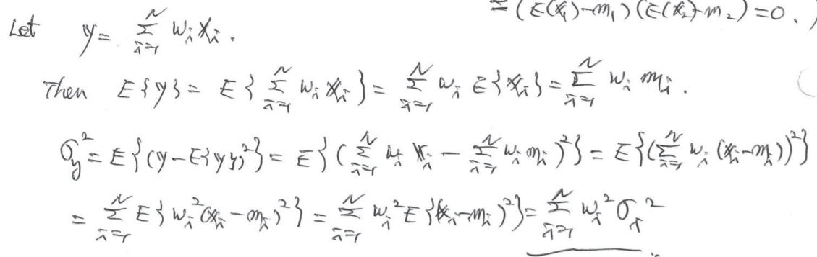
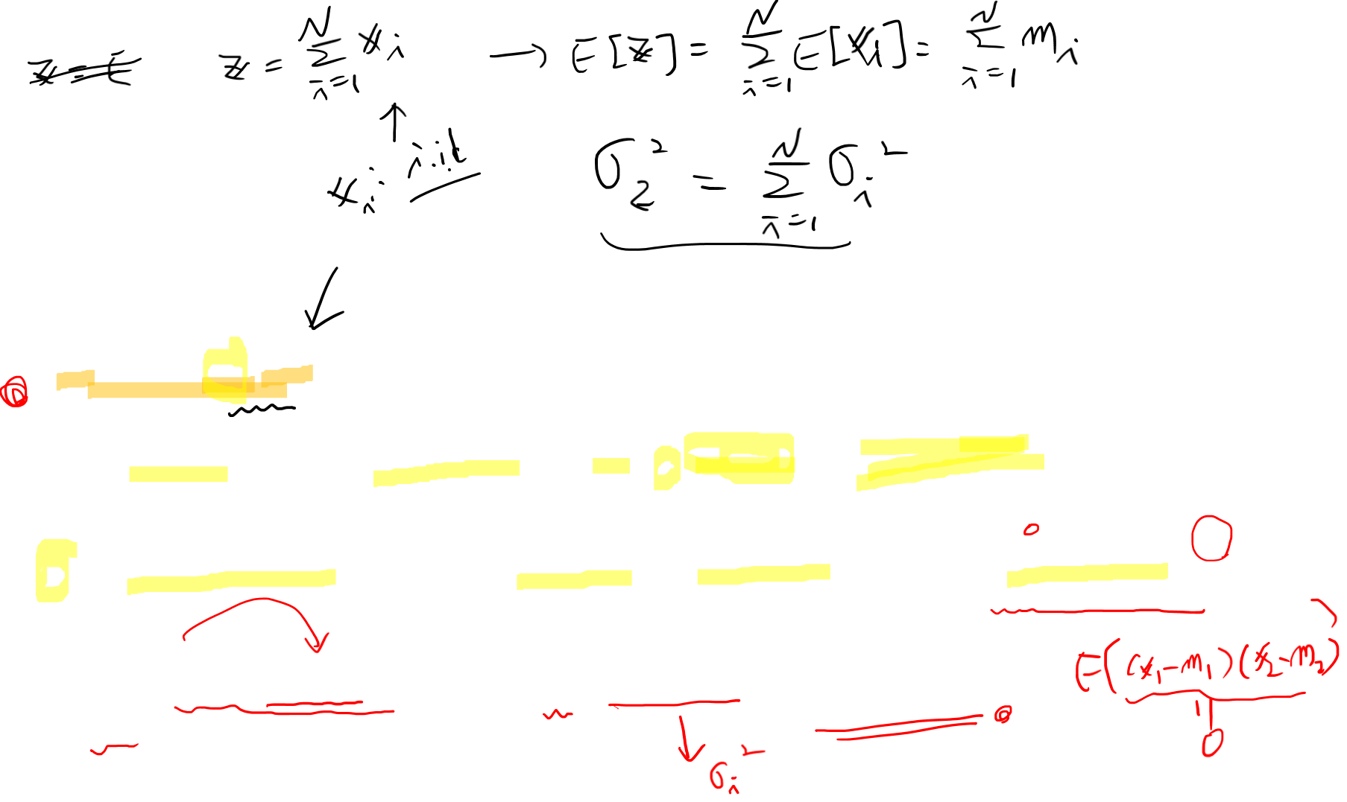

Slide 9

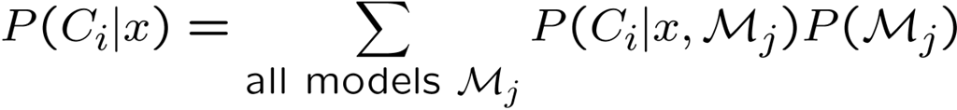

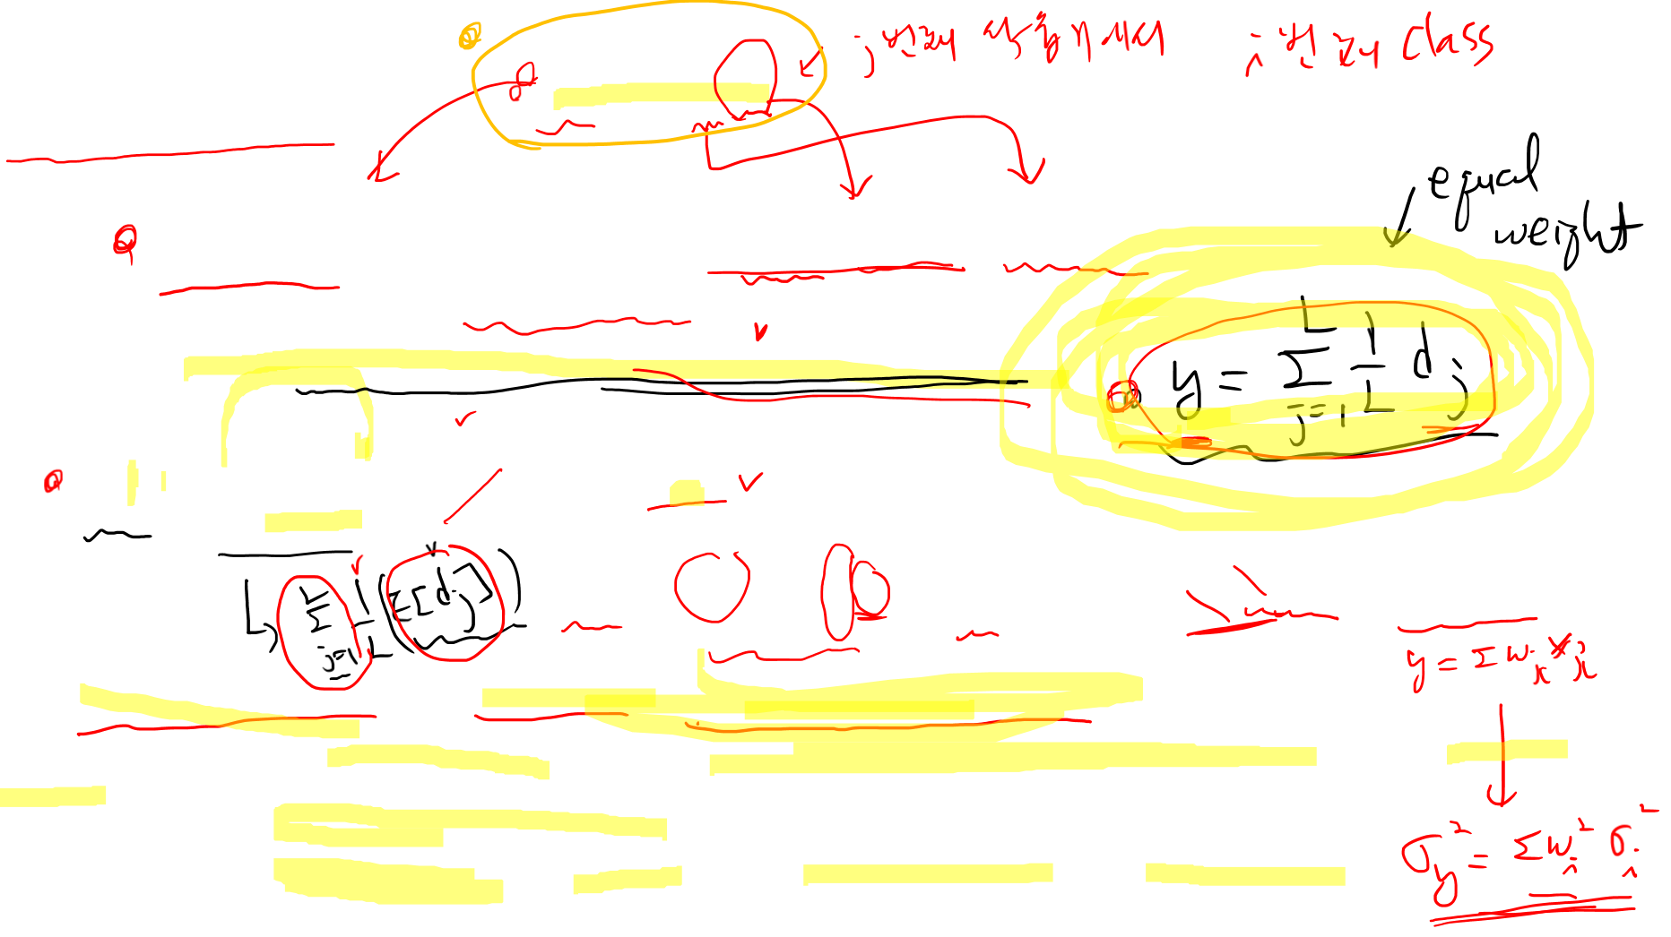
Bayesian model
If are i.i.d.(independent, identically distributed)
  Bias → no change, variance → decreasing by factor L
Supposing that base learners are discriminant/regression function with random noises
  Then, we are averaging over noise
  If noises are uncorrelated with 0 mean, the noise effect average out to zero

Slide 10


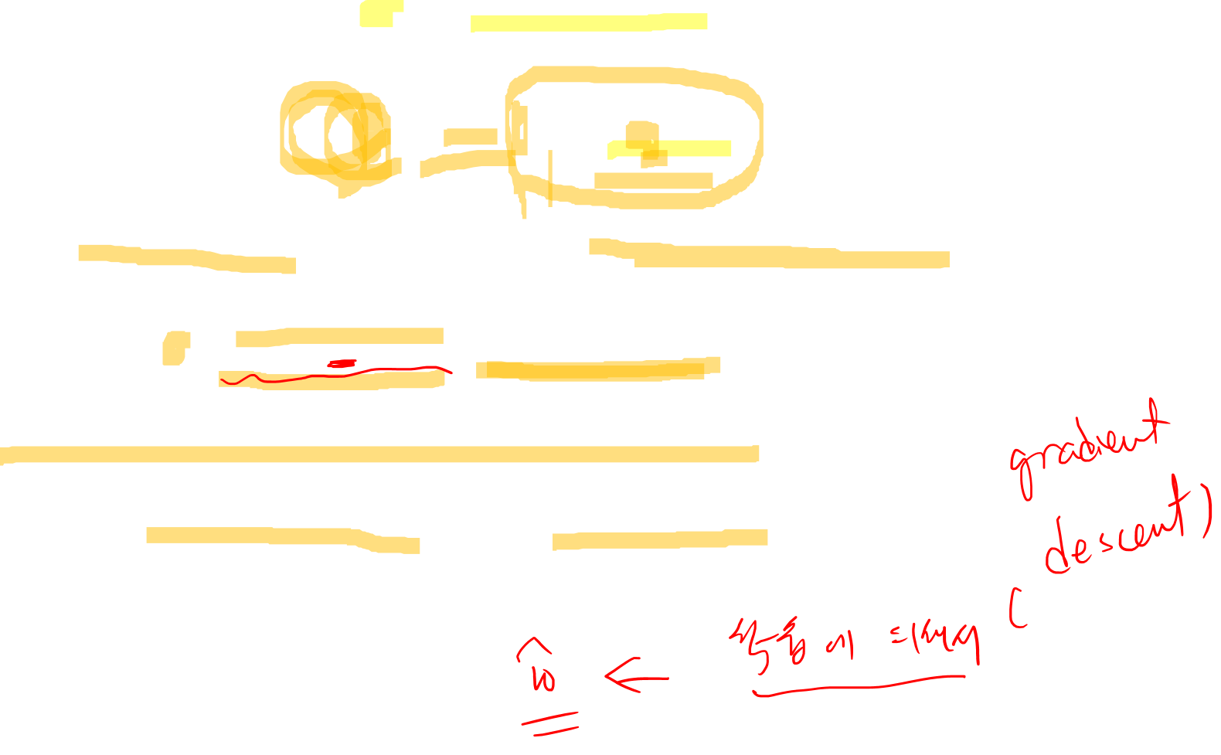
Given an input value x and L base learners, seek the weights such that
  Expectation done with regard to the true input distribution
  Note
Input distribution is not available in practice
  Use empirical distribution from training dataset

Slide 11
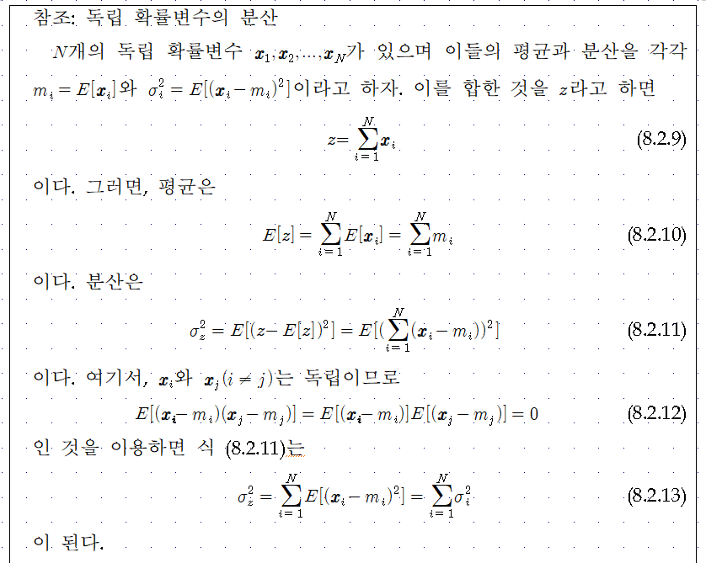


Slide 12
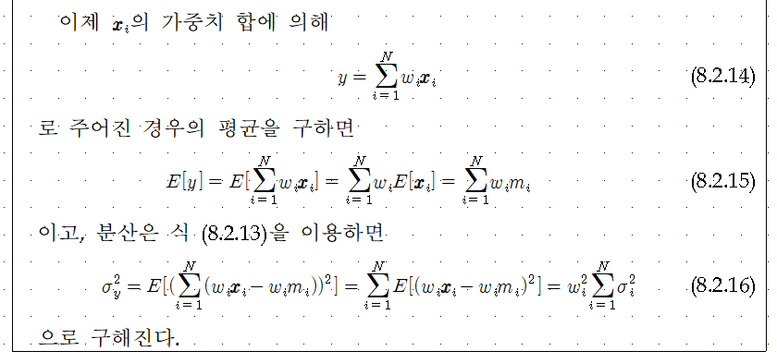
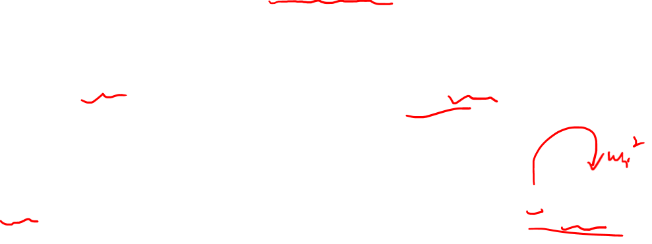

Slide 13
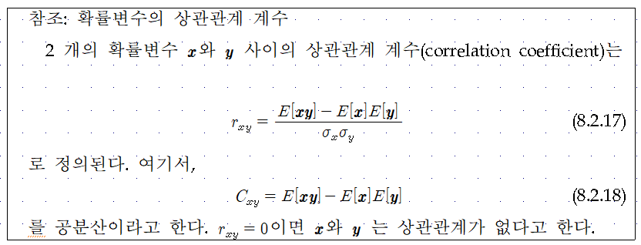


Slide 14




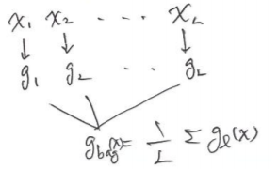

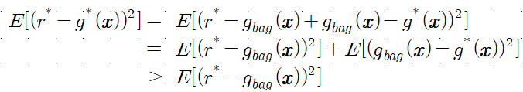
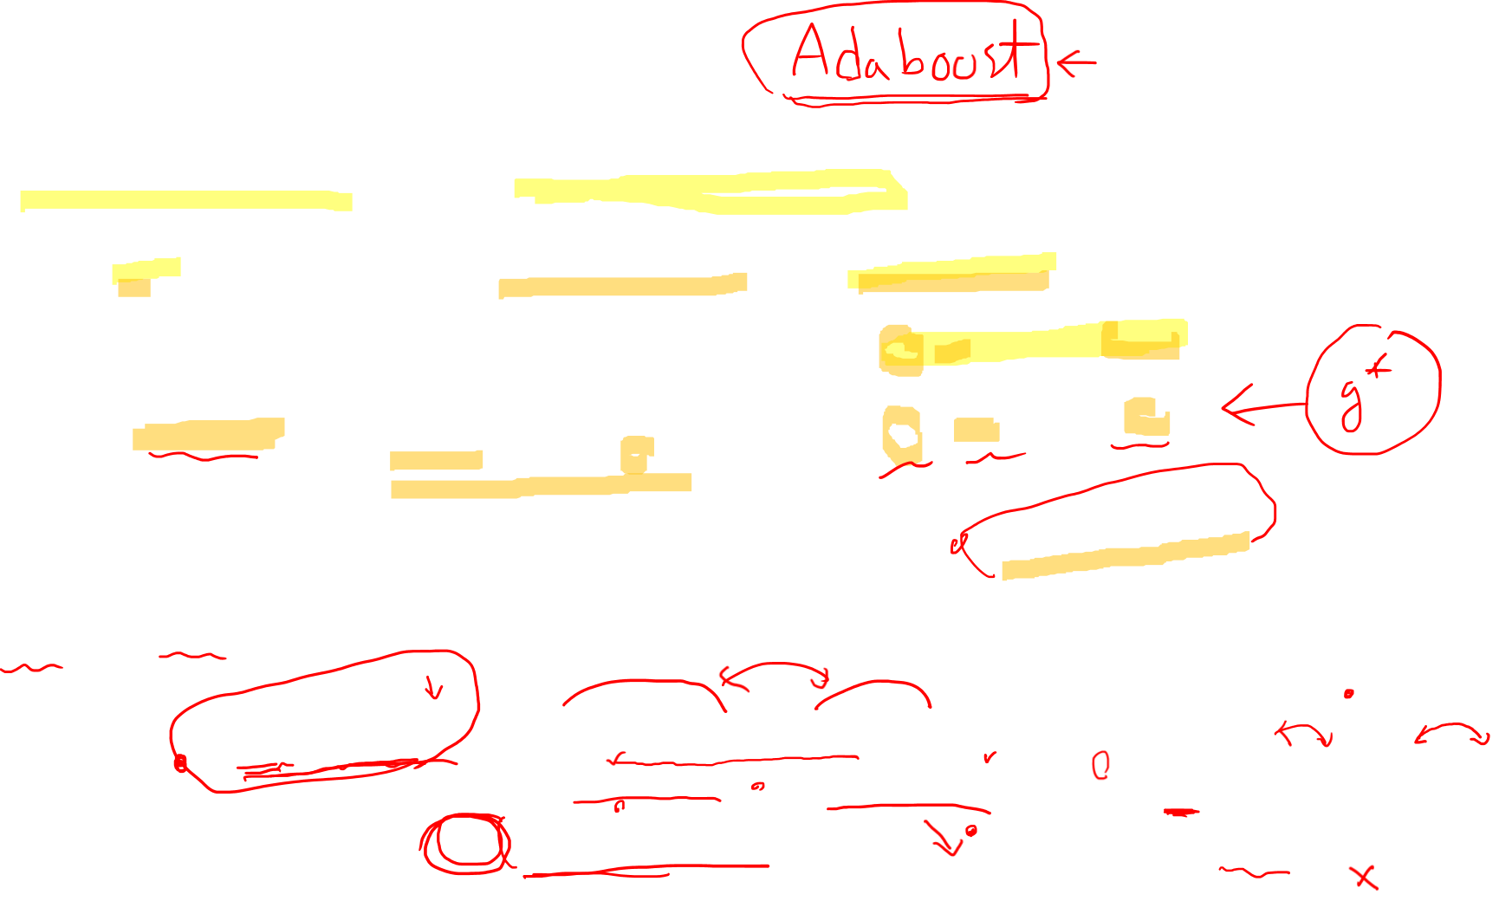

8.3. Bagging
Bootstrapping method
  Generate training sets, train one base-learner with each, and combine them
  From , generate with replacement
  Train L base-learners for →
  Output: average
Why?
  $g^{∗}(x)$ the best base-learner (expectation with regard to the input distribution)

Slide 15



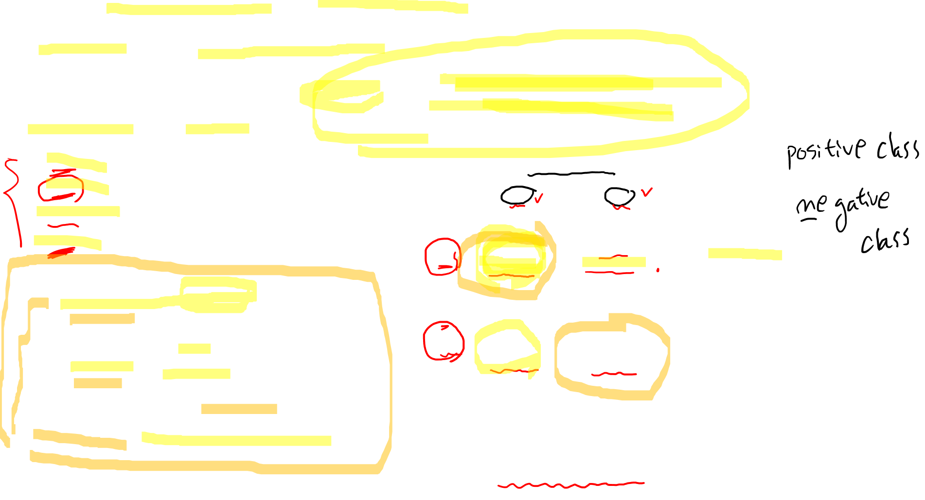
8.4. Evaluation of Classifiers
“Accuracy” or “Recognition Ratio”
“Precision and Recall”
  TP : True Positive
  FP : False Positive
  TN : True Negative
  FN : False Negative Positive
True Class
p
n
Hypothesized Class
True Positive
False Positive
Precision
P
False Negative
True Negative
N
Recall
False Alarm
[Confusion Matrix]

Slide 16
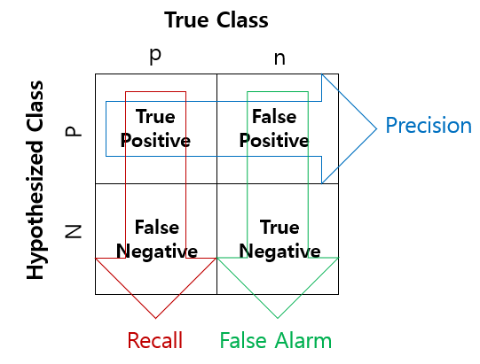
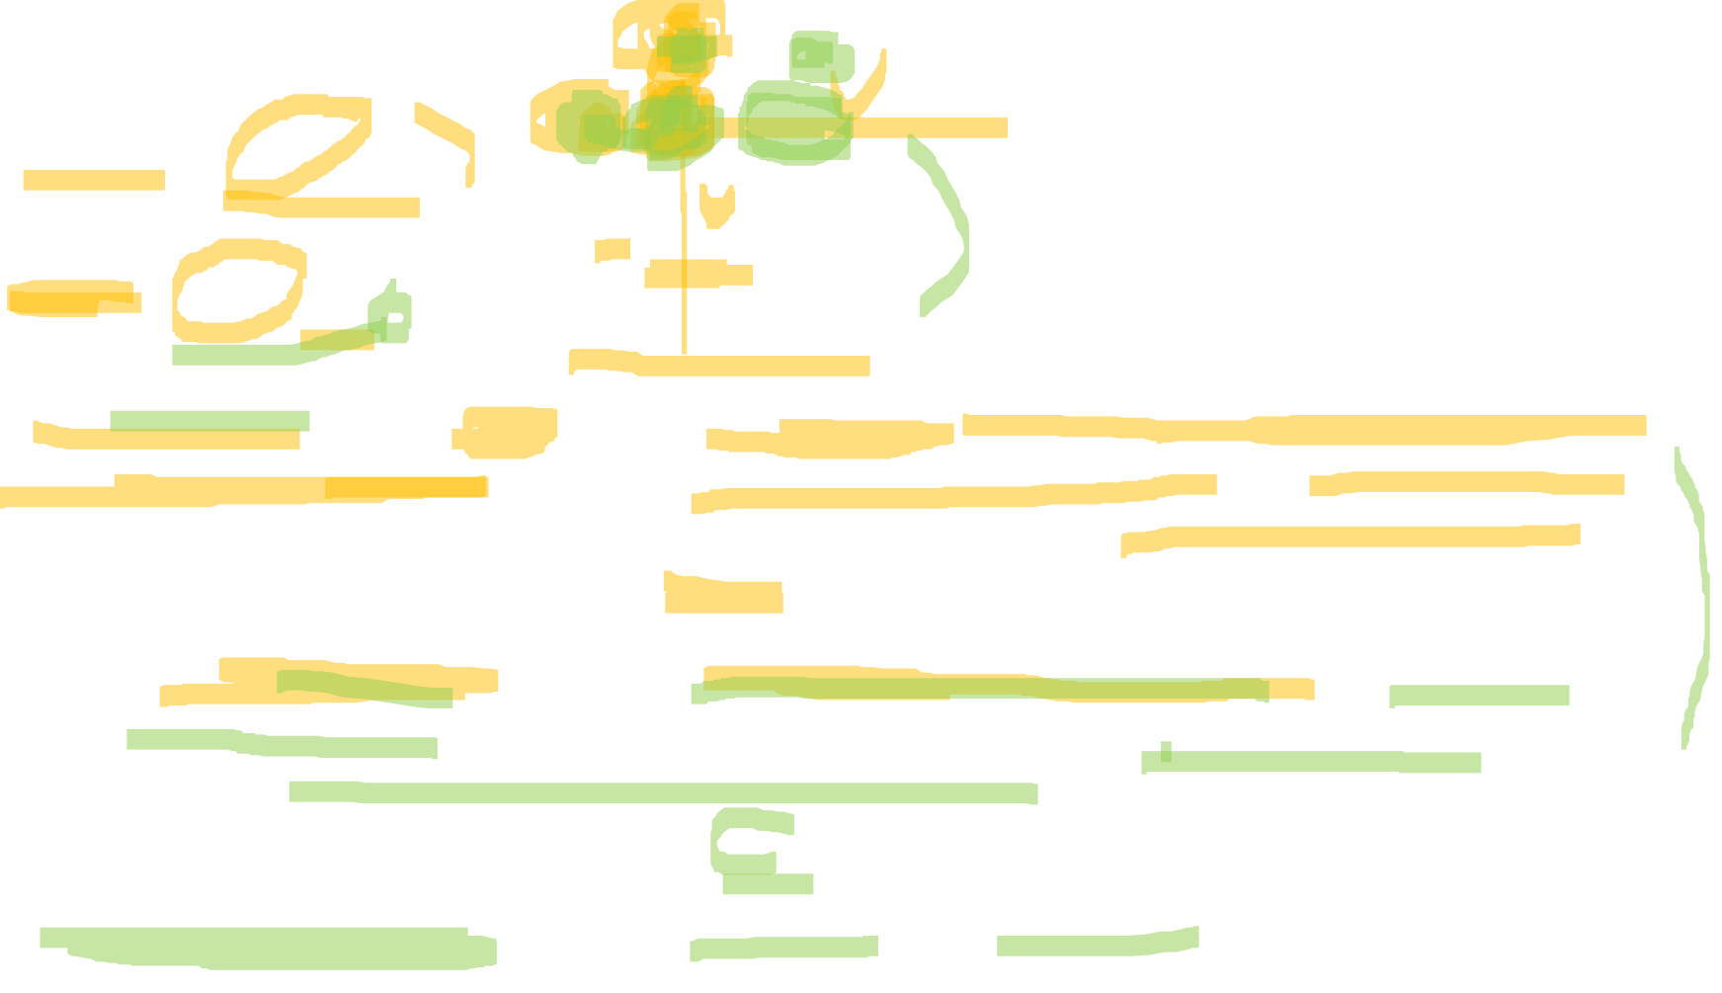
A precision score of 1.0 for a class C means that every item labeled as belonging to class C does indeed belong to class C (but says nothing about the number of items from class C that were not labeled correctly).
A recall of 1.0 means that every item from class C was labeled as belonging to class C (but says nothing about how many other items were incorrectly also labeled as belonging to class C)
An inverse relationship between precision and recall, where it is possible to increase one at the cost of reducing the other.

Slide 17

Brain surgery provides an illustrative example of the tradeoff. Consider a brain surgeon tasked with removing a cancerous tumor from a patient’s brain. The surgeon needs to remove all of the tumor cells since any remaining cancer cells will regenerate the tumor. Conversely, the surgeon must not remove healthy brain cells since that would leave the patient with impaired brain function.
The surgeon may be more liberal in the area of the brain he removes to ensure he has extracted all the cancer cells. This decision increases recall but reduces precision.
On the other hand, the surgeon may be more conservative in the brain he removes to ensure he extracts only cancer cells. This decision increases precision but reduces recall.
That is to say, greater recall increases the chances of removing healthy cells (negative outcome) and increases the chances of removing all cancer cells (positive outcome). Greater precision decreases the chances of removing healthy cells (positive outcome) but also decreases the chances of removing all cancer cells (negative outcome).

Slide 18
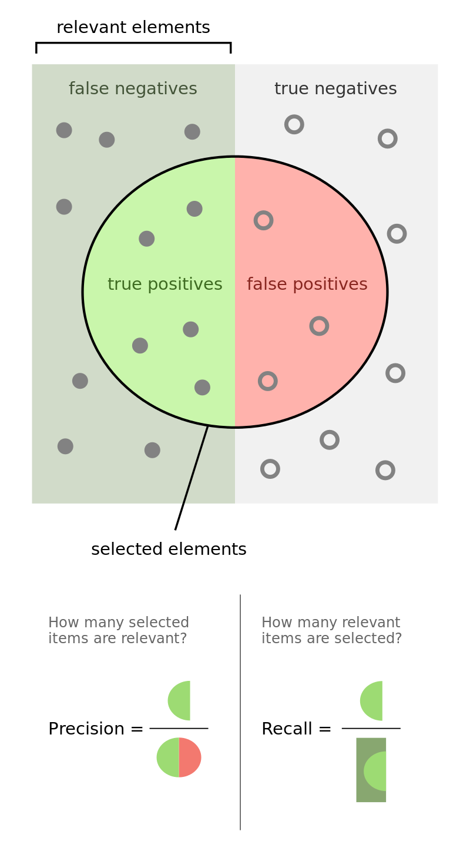
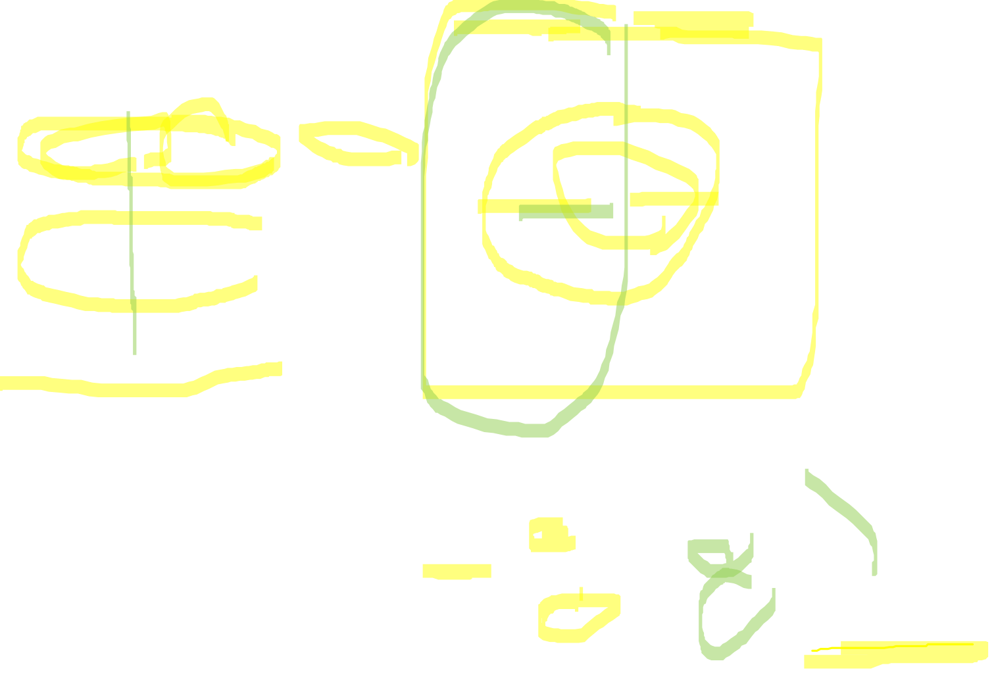
[from Wikipedia]

Slide 19


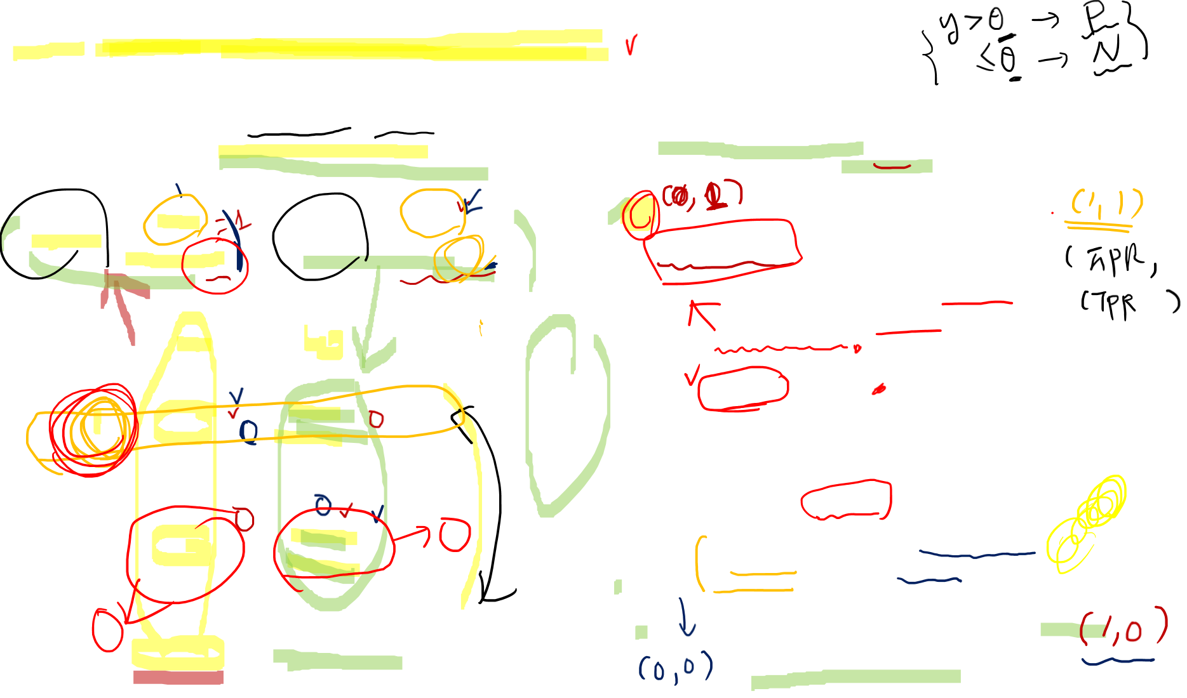
ROC(Receiver Operating Characteristic)
  a graphical plot that illustrates the diagnostic ability of a binary classifier system as its discrimination threshold is varied.
  plotting the true positive rate (TPR) against the false positive rate (FPR) at various threshold settings.
1
Perfect Classifier
A Classifier of Unconditionally Issuing Positive Class
True Class
p
n
Random Guess
Hypothesized Class
Better
0.5
True Positive
False Positive
True Positive Rate
P
Worse
False Negative
True Negative
A Classifier of Never Issuing a Positive Class
A Never-Guessing Classifier
N
0
0
0.5
1
Recall
False Alarm
False Positive Rate

Slide 20


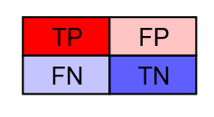
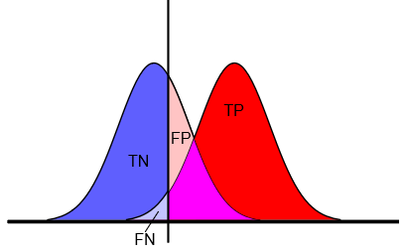




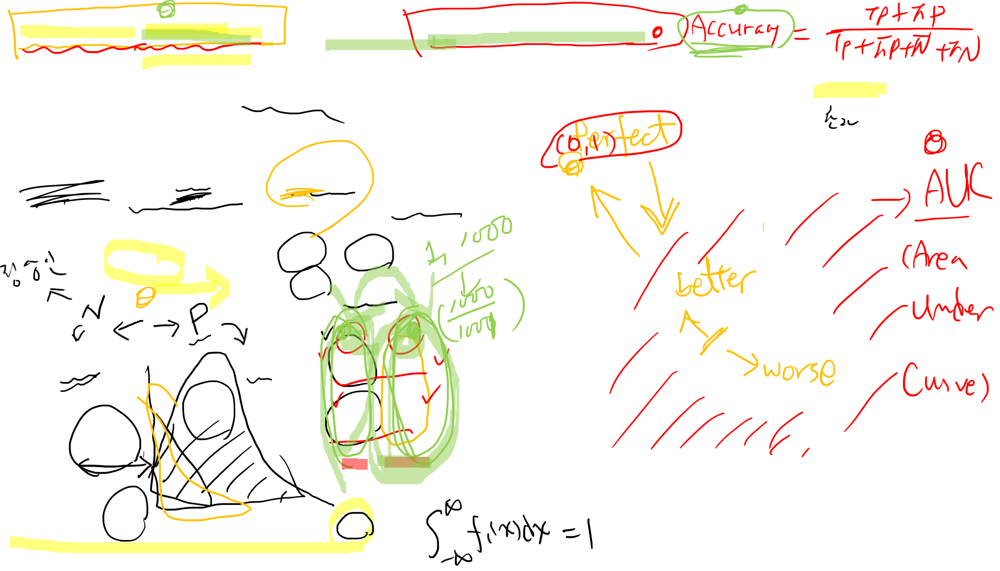
Curves in ROC Space : Useful for Imbalanced Data!
  Given a threshold T, the instance is classified as “positive” if X>T, and “negative” otherwise.
  X follows a probability density $f_{1}(x)$ if the instance actually belongs to class “positive”, and $f_{0}(x)$ if otherwise.
1
Threshold
T
0.5
True Positive Rate
$$f_{0}(x)$$
$$f_{1}(x)$$
0
0
0.5
1
$$x$$
False Positive Rate

Slide 21
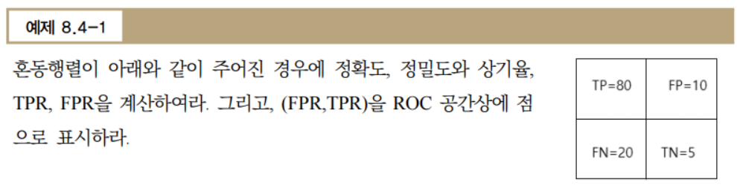
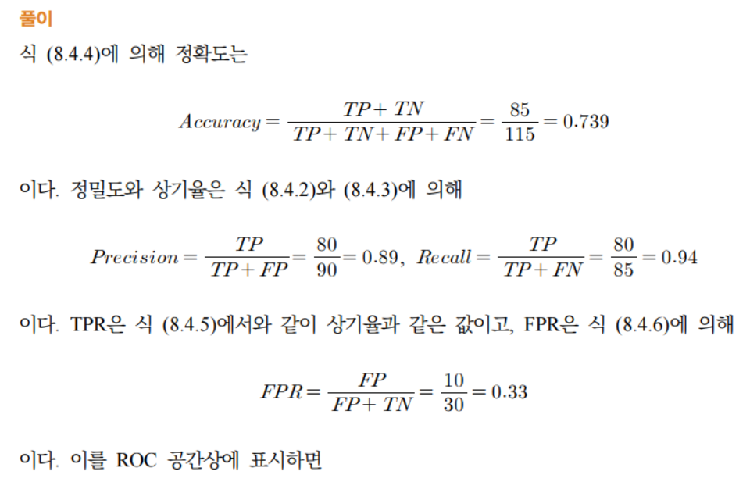


Slide 22
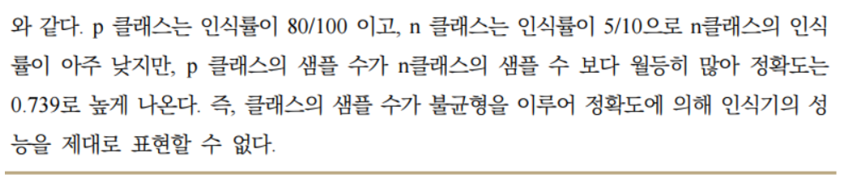
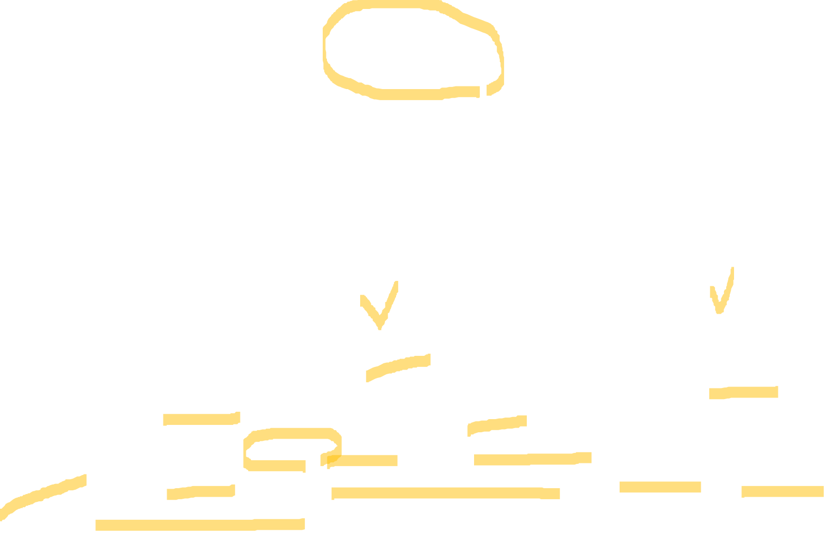
1
(0.33,0.94)
0.5
True Positive Rate
0
0
0.5
1
False Positive Rate

