Slide 1
Machine Learning

Slide 2
Contents
Introduction
K-Nearest Neighbor Algorithm
LDA(Linear Discriminant Analysis)
Perceptron
Feed-Forward Neural Networks
RNN(Recurrent Neural Networks)
SVM(Support Vector Machine)
Ensemble Learning
CNN(Convolutional Neural Network)
PCA(Principal Component Analysis)
ICA(Independent Component Analysis)
Clustering
GAN(Generative Adversarial Network)

Slide 3
7.1. Characteristics of Support Vector Machine
Feed-forward Neural Network (Perceptron, MLP, RBFN..)
  Stochastic algorithm
  Generalizes well but need a lot of tuning
  Can be learned in incremental fashion
  To learn complex functions: use hidden layers
SVM
  Deterministic algorithm
  Nice Generalization with few parameters to tune
  Hard to learn – quadratic programming techniques
  Using kernel tricks to learn very complex functions

Slide 4



















7.2. Linear Separator and Perceptron
$$x_{2}$$
Linear Separator
  For any two points $x_{1},x_{2}∈L$
  Define unit normal vector
  For any point $x_{0}∈L$,
  Distance of any x to L,
  The geometric margin of example with respect to the hyperplane
  A point is misclassified iff its margin is negative
$$L=\{g\left(x\right)=0\}$$
$${|w}_{0}|/|\left|w\right||$$
$$x_{0}$$
$${x−x}_{0}$$
$$x$$
$$w^{∗}$$
$$x_{p}$$
$$\left|g(x)\right|/|\left|w\right||$$
$$x_{1}$$

Slide 5



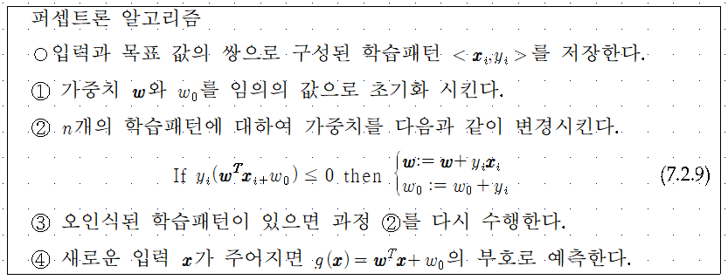
Perceptron Learning Algorithm
To minimize
Gradient

Slide 6




Perceptron Algorithm: Dual Representation
$α_{i}$ : a count of the number of times that example i was misclassified
Initial weights are all zeros
Then, final weights are
The output of linear predictor is

Slide 7
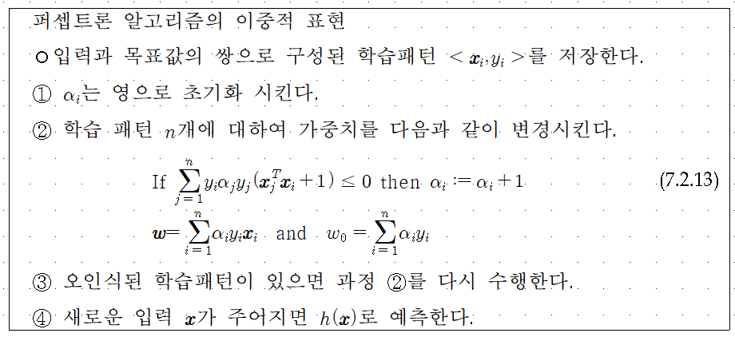

Slide 8











7.3. Support Vector Machine
Maximizing the margin
The decision boundary: determined by a subset of the data points, known as support vectors (indicated by the circles).
$$x_{2}$$
d
$$x_{2}$$
b
c
$\{x|w^{T}x$+$w_{0}=+1\}$
$\{x|w^{T}x$+$w_{0}=−1\}$
a
$$C_{1}$$
$$C_{1}$$
$$\frac{1}{|\left|w\right||}$$
$$C_{2}$$
margin
$$w$$
$$C_{2}$$
$$x_{1}$$
$\{x|w^{T}x$+$w_{0}=0\}$
$$x_{1}$$

Slide 9


Support Vector Machine
Support vector machines
  Names a whole family of algorithms of the maximum margin separator. The idea is to find the separator with the maximum margin from all the data points.
Optimization problem
Set $\left\|w\right\|$ to 1/C
$$x_{2}$$
$\{x|w^{T}x$+$w_{0}=+1\}$
$\{x|w^{T}x$+$w_{0}=−1\}$
$$C_{1}$$
$$\frac{1}{|\left|w\right||}$$
$$w$$
$$C_{2}$$
$\{x|w^{T}x$+$w_{0}=0\}$
$$x_{1}$$

Slide 10




Support Vector Machine: Formulation
Quadratic optimization problem
Lagrangian formulation of constrained optimization
Kuhn-Tucker Theorem

Slide 11



Support Vector Machine: Formulation & Solution

Slide 12



Support Vector Machine: Formulation & Solution
Finding optimal $α_{i}$ : computationally tractable quadratic programming problem
Support Vector: points with margin=1

Slide 13
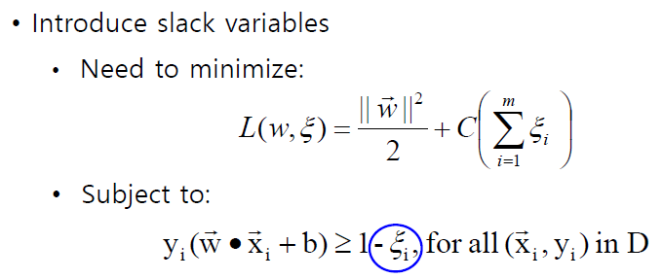
Support Vector Machines
What if the problem is not linearly separable?

Slide 14
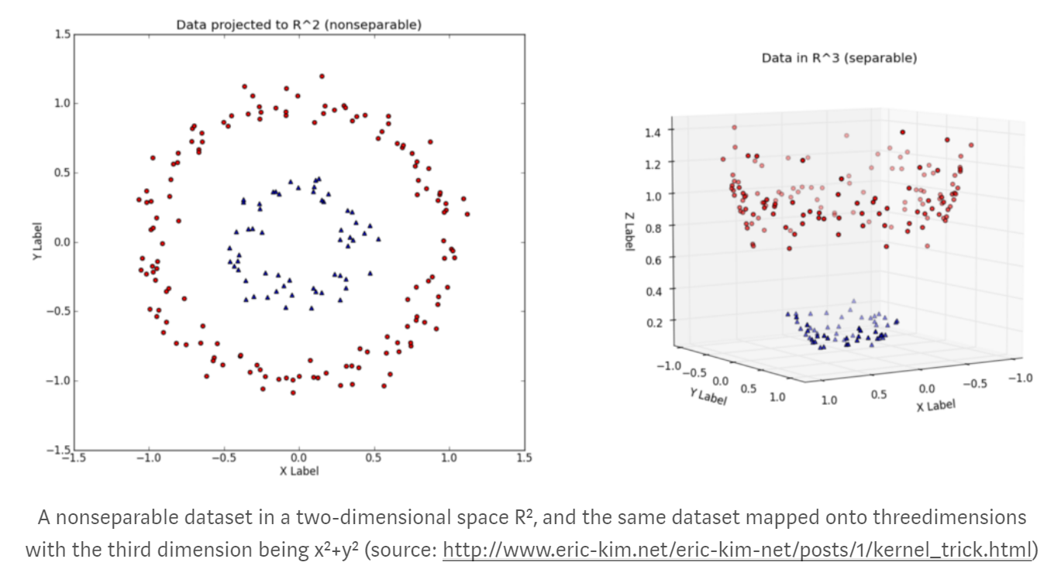
Support Vector Machines
What if decision boundary is not linear?

Slide 15
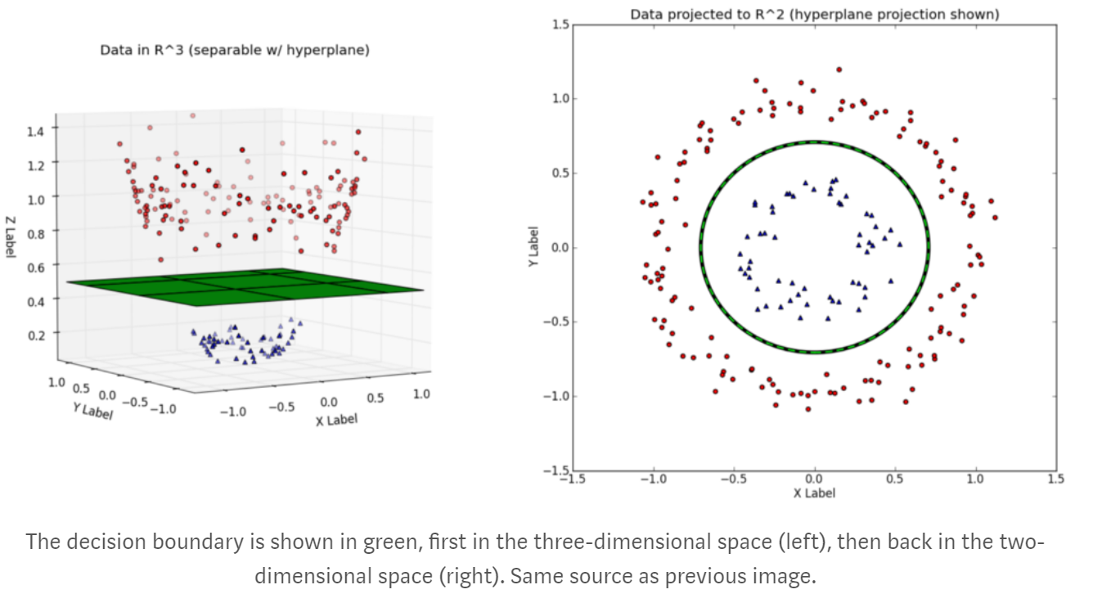

Slide 16
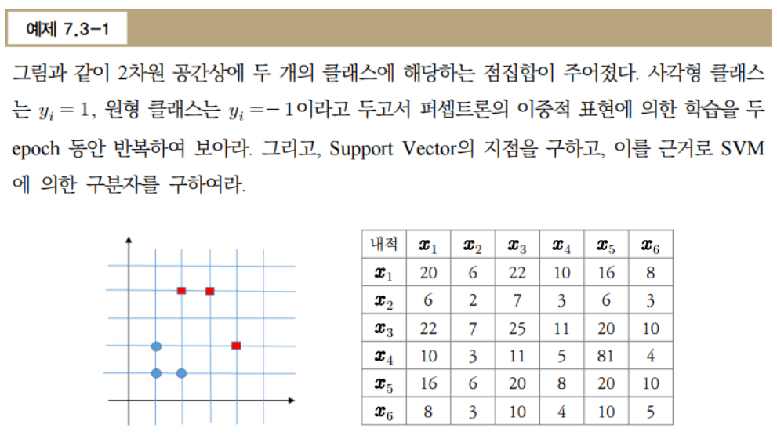

Slide 17
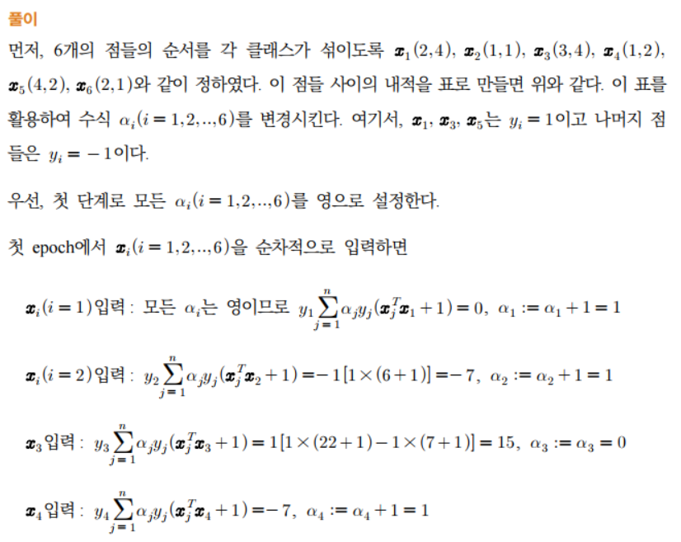

Slide 18
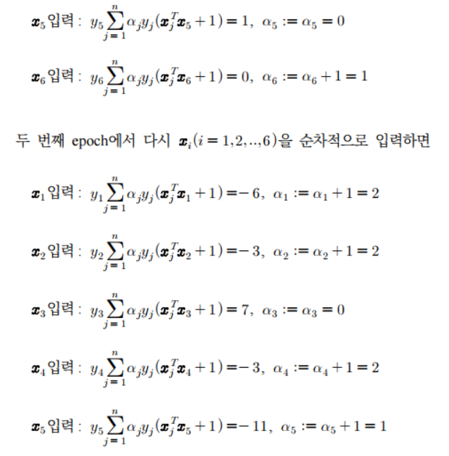

Slide 19
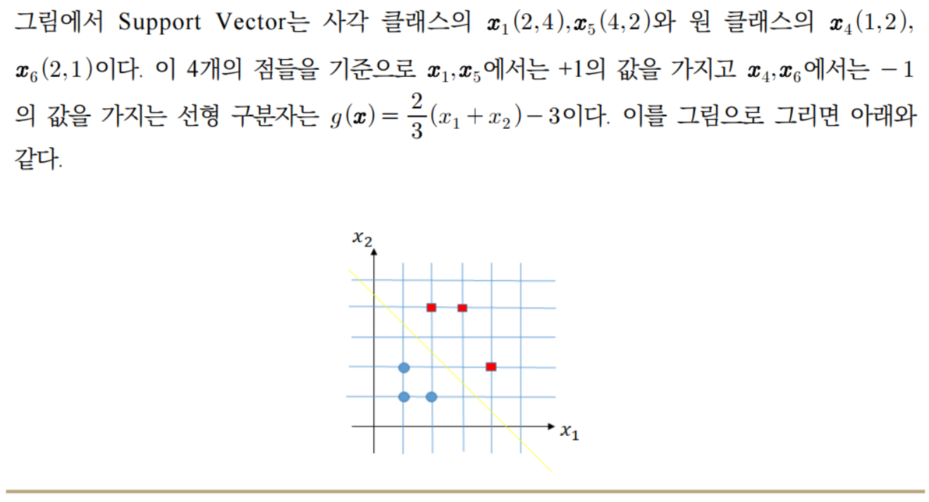

Slide 20

7.4. Application of SVM[10]
Objective: Discriminate agreement and disagreement to the given self-relevant sentence in the single-trial level.
Stimuli: 74 Korean sentences from the Minnesota Multiphasic Personality inventory-II (MMPI-II). Sentence contents are related to personal experience.
Presentation: Considering the Subject-object-verb (SOV) typology of the Korean language, each sentence was separated into two parts: the verb (sentence ending) and the remainder of the sentence (contents).
(a) Positive ending | Contents | Sentence ending
Stimulus sentence (Korean) | 돈에 대해 걱정한 적이 | 있다
English translations in SOV form | The experience of worrying over money | Does exist
Original English MMPI-2 sentence | I worry a great deal over money.
(b) Negative ending | Contents | Sentence ending
Stimulus sentence (Korean) | 기절한 적이 | 없다
English translations in SOV form | The experience of having a fainting spell | Does not exist
Original English MMPI-2 sentence | I have never had a fainting spell.

Slide 21
Experiment Procedure
Experiment Design
fMRI Experiment
EEG Experiment
Related brain regions
Feature Selection
Single-trial Classification
Agreement or Disagreement?

Slide 22
Experiment Procedure
fMRI Experiment (19 subjects)
Image acquisition
3T MR scanner (Siemens Magnetom Vero, Germany)
MR-compatible goggle (NordicNeuroLab Visual systmes, Norway)
Gradient-echo echo-planar imaging (EPI) sequence (36 slices; thickness = 4 mm; no gap between slices; FOV = 220 × 220 mm; matrix = 64 × 64; TE = 28 ms; TR = 2.0 s; flip angle = 90 °; voxel size 3.4 mm × 3.4 mm × 4 mm)
Preprocessing
(SPM8) Realign, coregister, segmentation, normalize, and smooth
[11]
EEG Experiment (9 subjects)
Data acquisition
BrainAmp system (Brain Products GmbH, Germany)
32-channel EEG cap (BrainCap)
Eyetracker x120 (Tobii Technology, Sweden)
Preprocessing
60Hz notch filtering and 1Hz high-pass filtering
Offline re-referencing to average (except EOG and ECG)
Artifact Removal: EOG and ECG-related independent components
Trial rejection: Reject trials whose absolute amplitude is over 70 μV
[12]

Slide 23
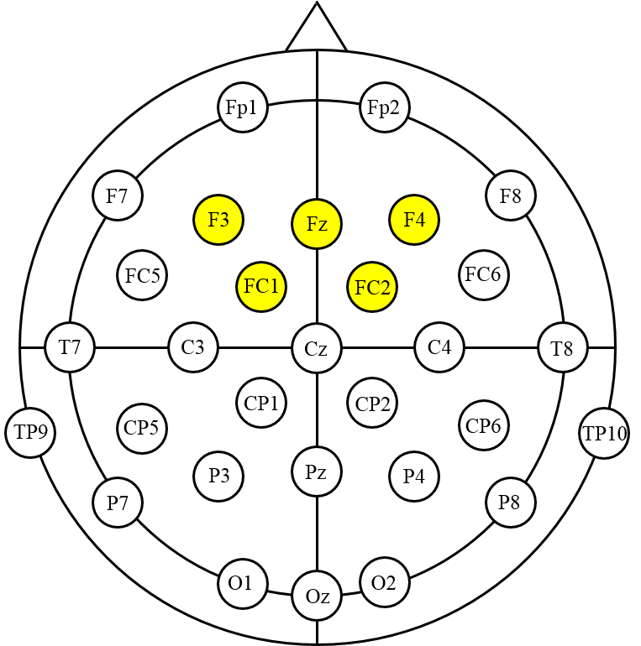
Feature Selection
Referring to the fMRI results, responses at frontal channels are considered.
Time-frequency Representations (TFRs)
Select 5 feature candidates
(a) gamma 35-45Hz 350-550ms
(b) beta2 20-26Hz 300-450ms
(c) beta1 14-17Hz 800-1,000ms
(d) alpha 9-12Hz 300-700ms
(e) theta 5-7Hz 400-1,000ms
Average TFR difference: Agree - Disagree
(a)
(a) Gamma 35-45Hz 350-550ms
(b)
(c)
(d)
(e)
(b) Beta2 20-26Hz 300-450ms
(c) Beta1 14-17Hz 800-1,000ms
(d) Alpha 9-12Hz 300-700ms
(e) Theta 5-7Hz 400-1,000ms

Slide 24
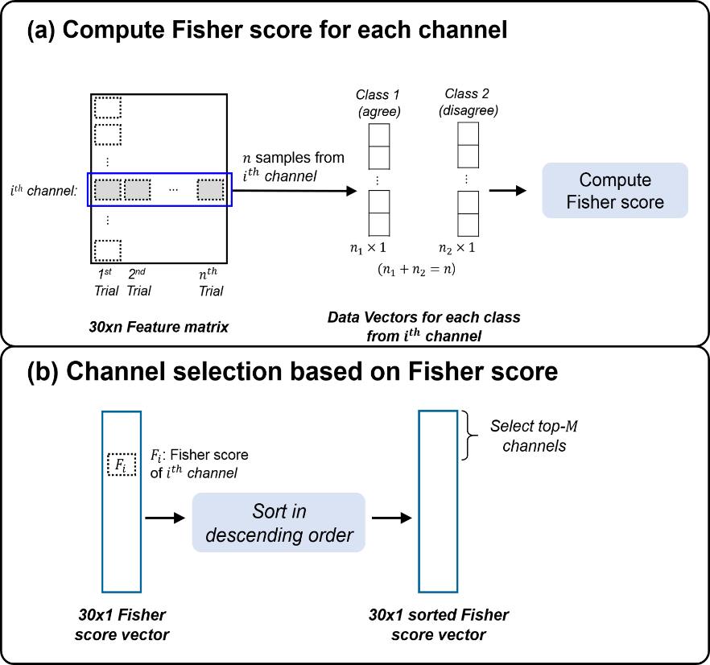
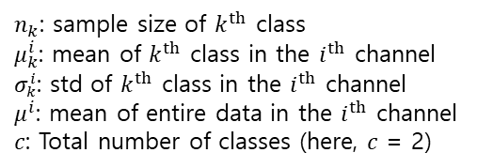

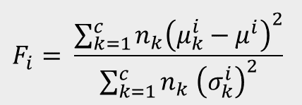
Channel Selection
Method & Analysis
Channel selection using the Fisher score
[19]
$n_{k}$: sample size of $k^{th}$ class
$μ_{k}^{i}$: mean of $k^{th}$ class in the $i^{th}$ channel
$σ_{k}^{i}$: std of $k^{th}$ class in the $i^{th}$ channel
$μ^{i}$: mean of entire data in the $i^{th}$ channel
$c$: Total number of classes (here, $c$ = 2)
The Fisher score for the $i^{th}$ channel:
$$F_{i}= \frac{\sum_{k=1}^{c}{n_{k}{\left(μ_{k}^{i}−μ^{i}\right)}^{2}}}{\sum_{k=1}^{c}{n_{k} {\left(σ_{k}^{i}\right)}^{2}}}$$
Rank | Theta |  | Alpha |  | Beta1 |  | Beta2 |  | Gamma
 | Channel | Fisher score | Channel | Fisher score | Channel | Fisher score | Channel | Fisher score | Channel | Fisher score
1 | C3 | 0.028 | C3 | 0.028 | P7 | 0.034 | C3 | 0.030 | F3 | 0.040
2 | CP5 | 0.027 | Fz | 0.027 | T8 | 0.026 | CP5 | 0.029 | T8 | 0.030
3 | CP2 | 0.025 | CP1 | 0.026 | F4 | 0.022 | FC1 | 0.026 | FC5 | 0.027
4 | P7 | 0.025 | FC1 | 0.025 | FC1 | 0.022 | Fp2 | 0.025 | FC2 | 0.024
5 | P3 | 0.023 | F4 | 0.025 | F3 | 0.020 | Fp1 | 0.025 | CP5 | 0.023

Slide 25
Classification
Subject-dependent classification with increasing the number of selected channels
Average accuracy using 5-fold cross validation
SVM classifier with linear and RBF kernels (LIBSVM)
Component | Classifier
 | Linear SVM | RBF SVM
Theta | 67.03% (30) | 70.89% (2)
Alpha | 66.39% (30) | 73.86% (4)
Beta1 | 62.88% (30) | 71.30% (4)
Beta2 | 65.07% (30) | 73.49% (3)
Gamma | 67.01% (20) | 75.54% (5)

