Slide 1
Machine Learning

Slide 2
Contents
Introduction
K-Nearest Neighbor Algorithm
LDA(Linear Discriminant Analysis)
Perceptron
Feed-Forward Neural Networks
RNN(Recurrent Neural Networks)
SVM(Support Vector Machine)
Ensemble Learning
CNN(Convolutional Neural Network)
PCA(Principal Component Analysis)
ICA(Independent Component Analysis)
Clustering
GAN(Generative Adversarial Network)

Slide 3
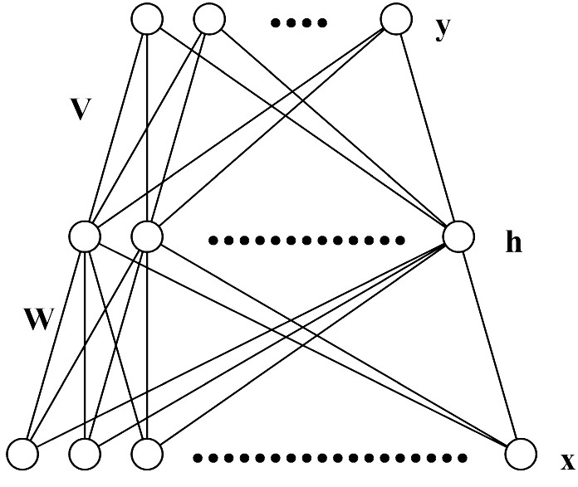
5.1. Multi-Layer Perceptron (MLP)
Each layer receives its inputs from the previous layer and forwards its outputs to the next – feed forward structure
Output layer: sigmoid activation function for classification, linear activation function for regression problem
Referred to as a two-layer network (two layer of weights)

Slide 4
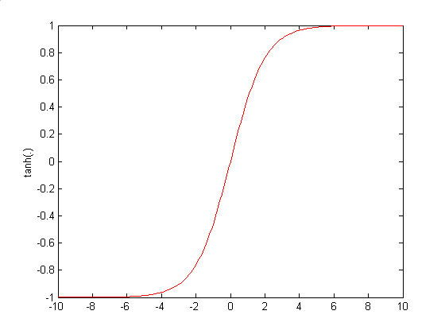
Architecture of MLP (N-H-M): Forward Propagation

Slide 5
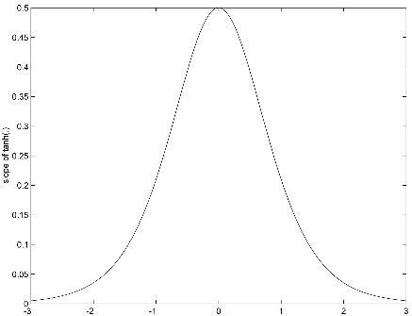
5.3. Training of MLP : Error Back-Propagation Algorithm

Slide 6
$$y_{1}$$
$$y_{k}$$
$$y_{M}$$
$$δ_{1}$$
$$δ_{k}$$
$$δ_{M}$$
$$v_{1j}$$
$$v_{kj}$$
$$v_{Mj}$$
$$\sum_{k=1}^{M}{v_{kj}δ_{k}}$$
$$h_{j}$$
$$f(.)$$
$$f^{′}(.)\sum_{k=1}^{M}{v_{kj}δ_{k}}$$
$$x_{0}$$
$$x_{1}$$
$$x_{i}$$
$$x_{N}$$

Slide 7
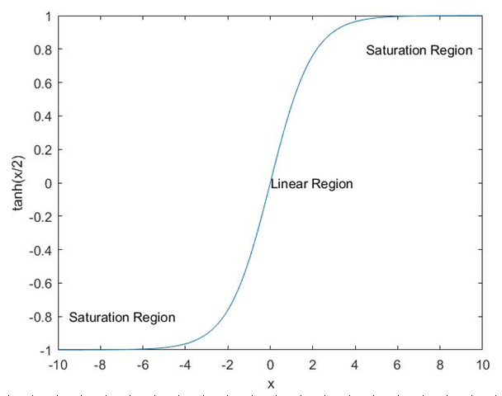
5.4. Incorrect Saturation of Output Nodes
Correct Saturation
$$y_{k}≈t_{k}, δ_{k}≈0$$
Incorrect Saturation
$${If y}_{k}≈±1 and t_{k}=∓1 , δ_{k}≈0 although \left|t_{k}−y_{k}\right|≈2$$
Incorrect Saturation of Output Nodes → Very Slow Convergence of Learning due to $δ_{k}≈0$

Slide 8
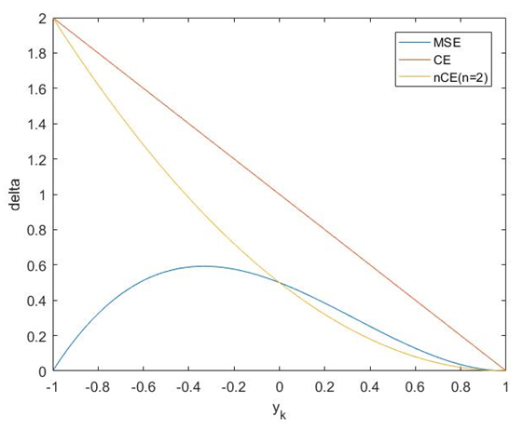
Training of MLP : Error Back-Propagation Algorithm

Slide 9
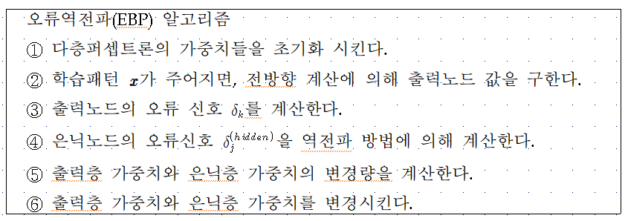
Error Back-Propagation Algorithm

Slide 10
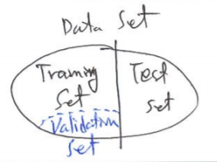
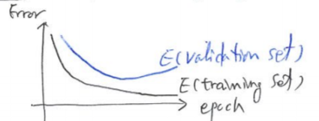
5.5. Remarks on Training
Convergence(?)… may oscillate or reach a local minima.
Many epochs (thousands) may be needed for adequate training
Termination criteria:
– Fixed number of training epochs
– Threshold on error of training samples
– Increasing of error on a validation samples
For better performance, run several trials starting from different initial random weights
– Take the result with the best training or validation performance.
– Build a committee of networks (ensemble technique)…Chapter 8

Slide 11
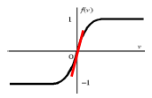
Initialization of Weights
Initialization of weights such that nodes are in the “linear” regions
To avoid the premature saturation problem
Keep all weights near zero, so that all sigmoid units are in their linear regions. Otherwise nodes can be initialized into flat regions of the sigmoid causing for very small gradients.⇒ Premature Saturation Problem
Break symmetry
– Each hidden node should have different input weights so that the hidden nodes move in different directions.

Slide 12
Online, Batch and Learning with Momentum
Online: Take a gradient descent step with each input
Batch: Sum the gradient for each example i. Then take a gradient descent step
Momentum factor: Make the t+1-th update dependent on the t-th update
- to keep weight moving in the same direction and improves convergence

Slide 13
Overtraining Prevention
Too many epochs → over-train the network
Use a validation set to test accuracy in some intervals of epochs
Stop the training when the performance on the validation set decreases
10-fold cross-validation
Error
Validation Set
Training Set
Epochs

Slide 14
Over-fitting Prevention
Too few hidden units prevent the system from adequately fitting the data and learning the concept.
Too many hidden units leads to over-fitting.
Trial and error
Another approach to preventing over-fitting is weight decay
Error
Validation Set
Training Set
#Hidden Nodes

Slide 15
5.6. Learning Time Series Data
Time-delay neural networks (TDNN)
$$y$$
$$h$$
$$x_{0}=1$$
$$x^{t−T}$$
$$x^{t−1}$$
$$x^{t}$$

Slide 16
5.7. Deep Neural Networks
$$y_{k}$$
$$h^{(L)}$$
$$h^{(2)}$$
$$h^{(1)}$$
$$x$$

Slide 17
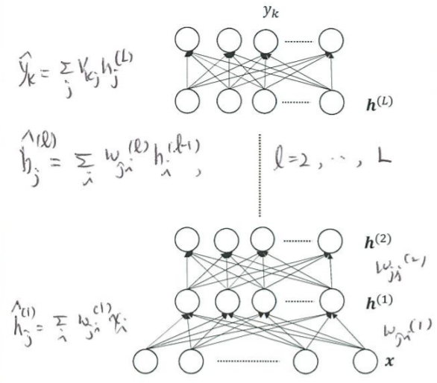
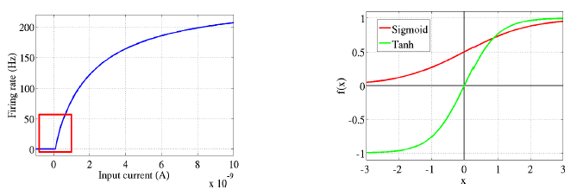
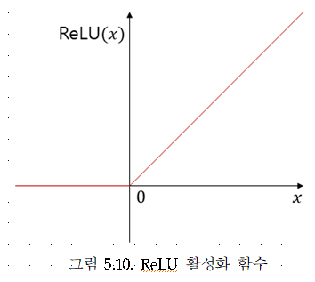
$$y_{k}$$
$$h^{(L)}$$
$$h^{(2)}$$
$$h^{(1)}$$
$$x$$

Slide 18
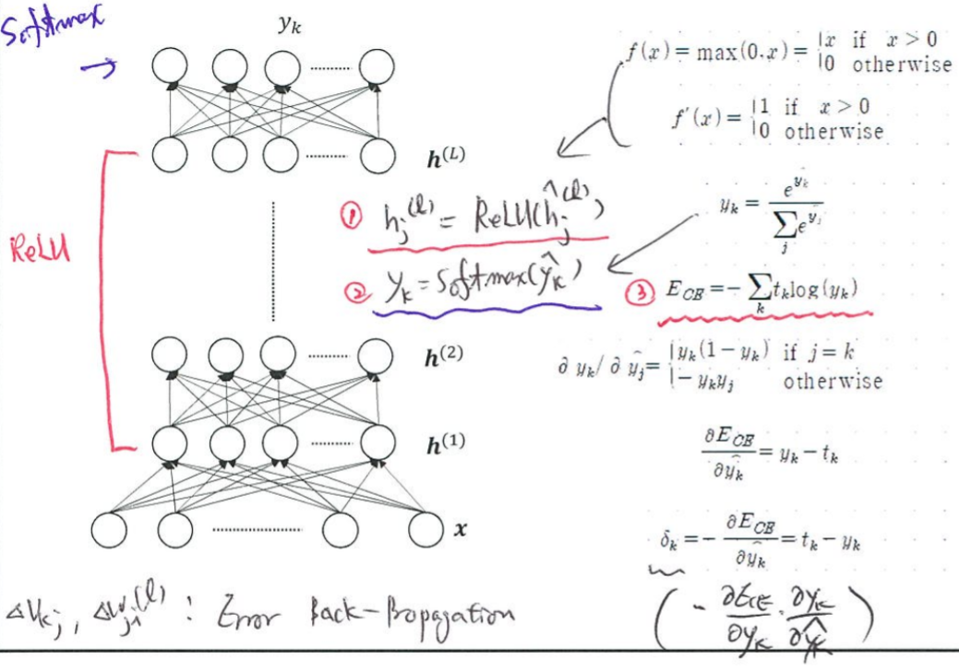
$$y_{k}$$
$$h^{(L)}$$
$$h^{(2)}$$
$$h^{(1)}$$
$$x$$

Slide 19
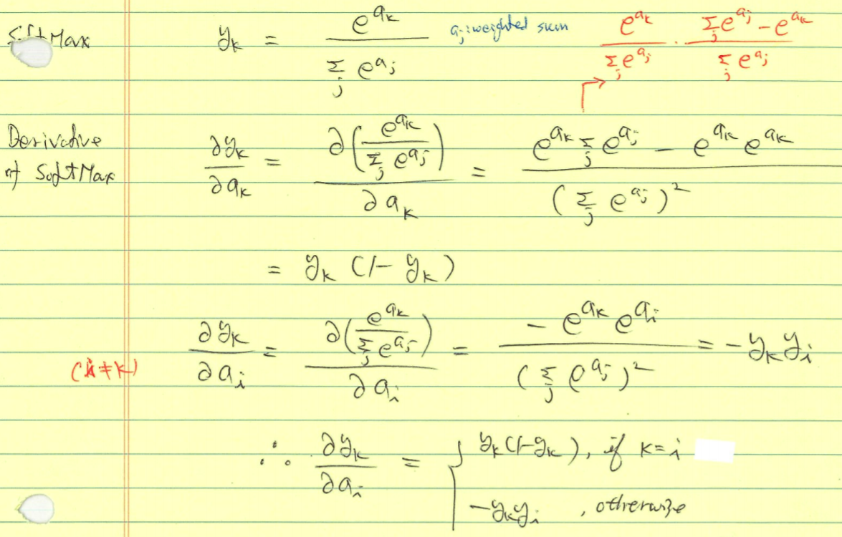

Slide 20
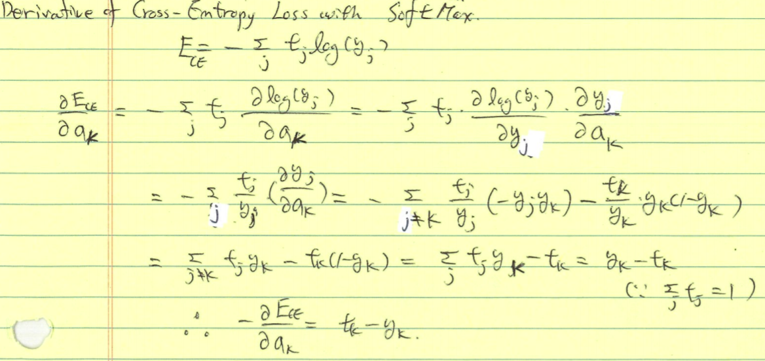

Slide 21
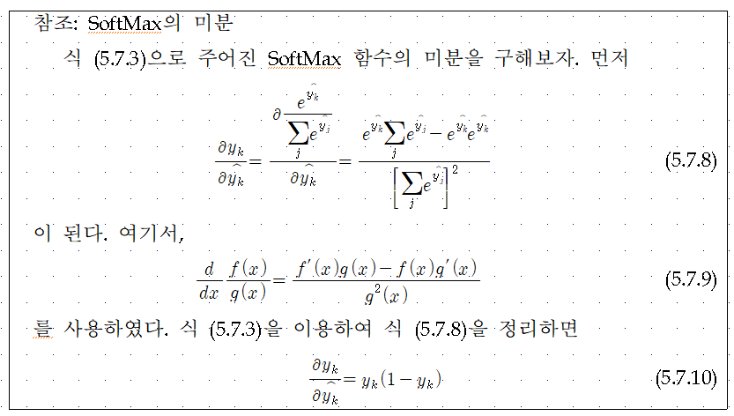
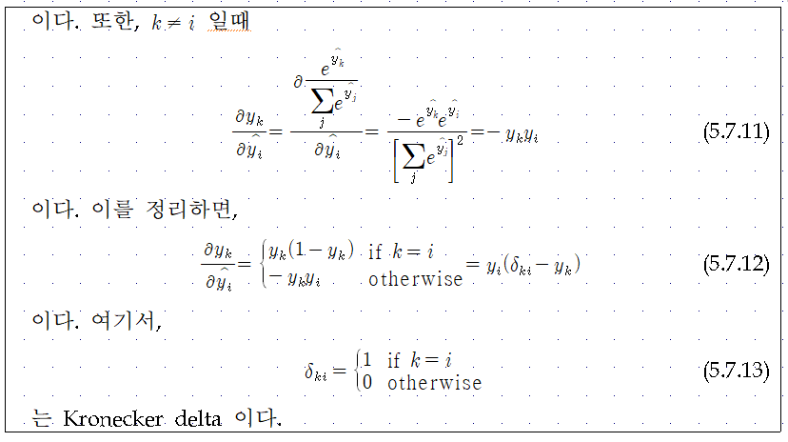

Slide 22
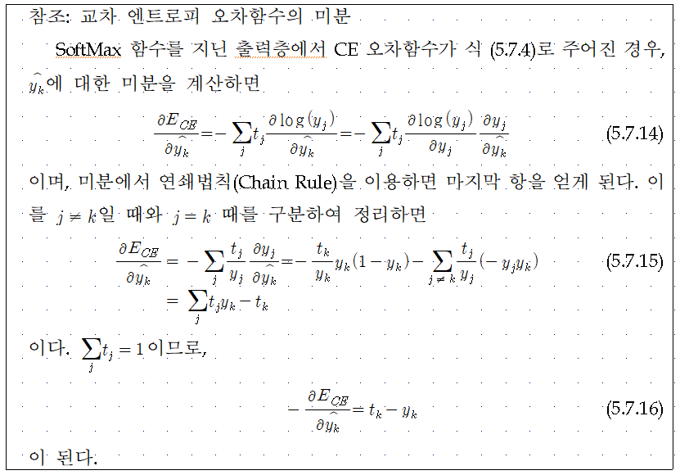

Slide 23
$$y_{k}$$
$$h^{(L)}$$
$$h^{(2)}$$
$$h^{(1)}$$
$$x$$

Slide 26
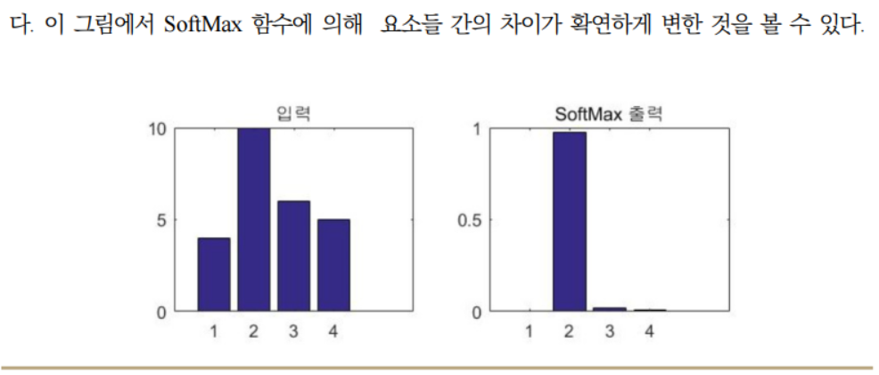

Slide 27
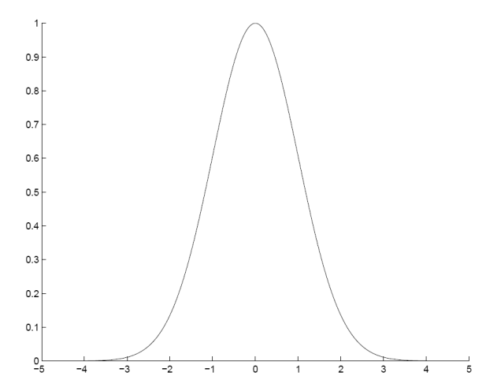
5.8. Radial Basis Function Networks
Locally-tuned units:
$$y_{k}$$
$$h$$
$$m_{j}$$
$$s_{j}$$
$$x$$

Slide 28
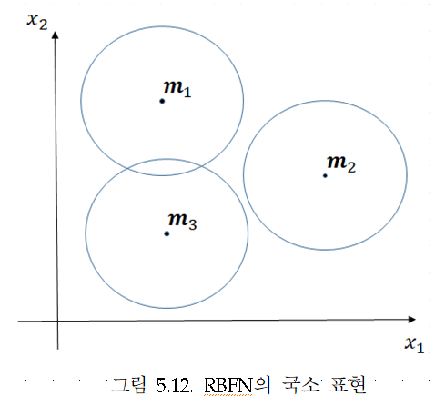
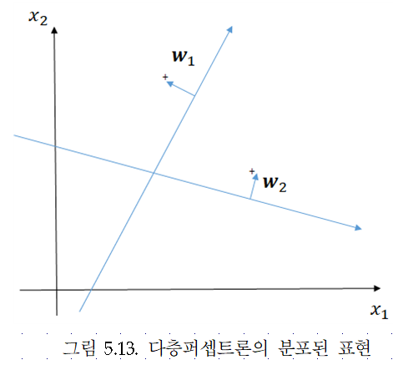
Local vs. Distributed Representation

Slide 29
Training RBF Network
Hybrid learning
• First layer centers and spreads (Unsupervised k-means)
• Second layer weights (Supervised gradient descent)
Fully supervised
•Similar to backpropagation in MLP, gradient descent for all parameters

Slide 30
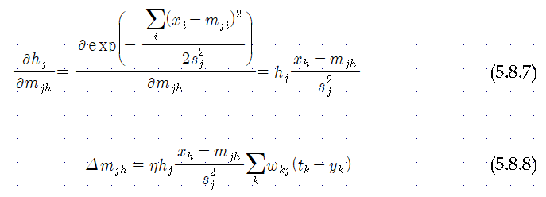
RBF Network: Fully Supervised Method
Similar to backpropagation in MLP

Slide 31
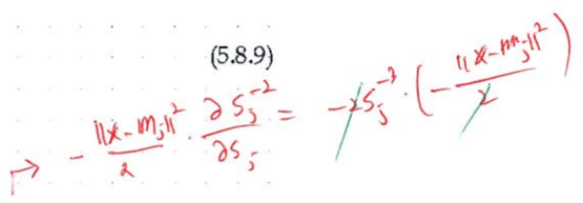
RBF Network: Fully Supervised Method
Similar to backpropagation in MLP

