Slide 1
Machine Learning

Slide 2
Contents
Introduction
K-Nearest Neighbor Algorithm
LDA(Linear Discriminant Analysis)
Perceptron
Feed-Forward Neural Networks
RNN(Recurrent Neural Networks)
SVM(Support Vector Machine)
Ensemble Learning
CNN(Convolutional Neural Network)
PCA(Principal Component Analysis)
ICA(Independent Component Analysis)
Clustering
GAN(Generative Adversarial Network)

Slide 3
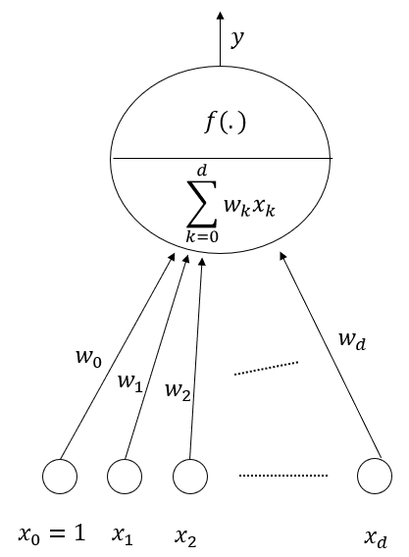
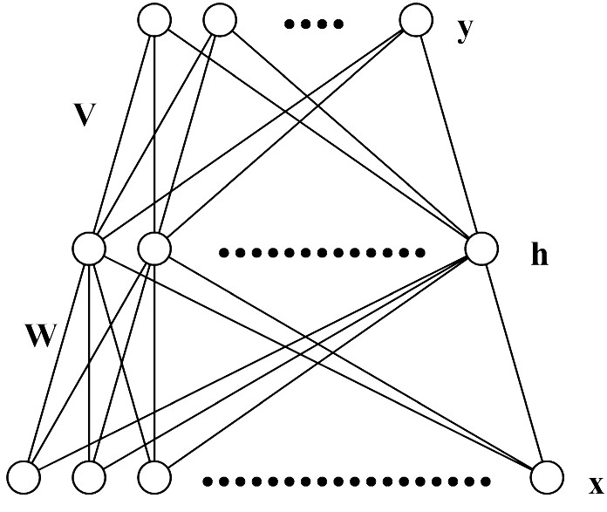
5.1. Multi-Layer Perceptron (MLP)
Each layer receives its inputs from the previous layer and forwards its outputs to the next – feed forward structure
Output layer: sigmoid activation function for classification, linear activation function for regression problem
Referred to as a two-layer network (two layer of weights)

Slide 4
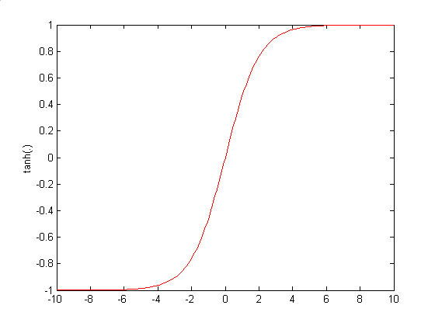
Architecture of MLP (N-H-M): Forward Propagation

Slide 5
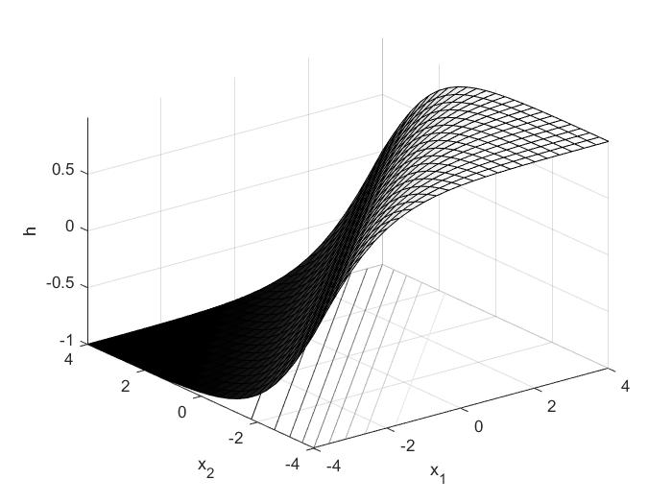
5.2. Representational Power of MLP
MLP with 3 layers can represent arbitrary function
Each hidden unit represents a soft threshold function in the input space
Combine two opposite-facing threshold functions to make a ridge
Combine two perpendicular ridges to make a bump
Add bumps of various sizes and locations to fit any surface
Universal approximator
A two layer (linear output) network can approximate any continuous function on a compact input domain to arbitrary accuracy given a sufficiently large number of hidden units

Slide 6
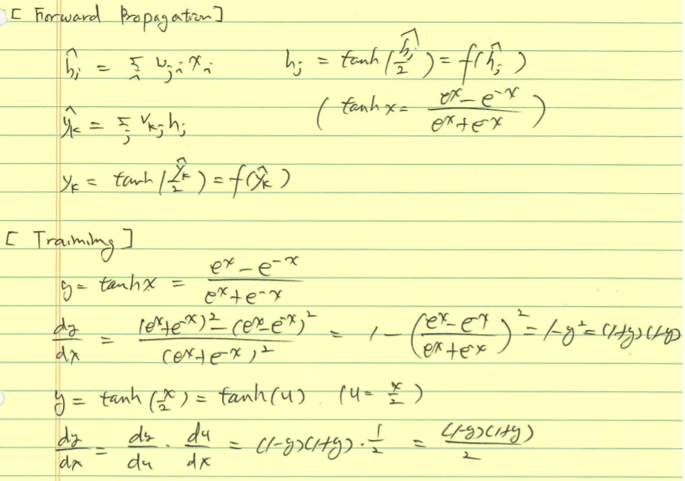
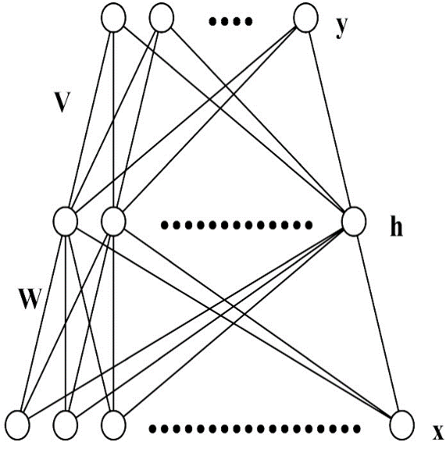

Slide 7
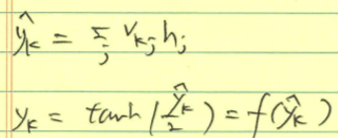
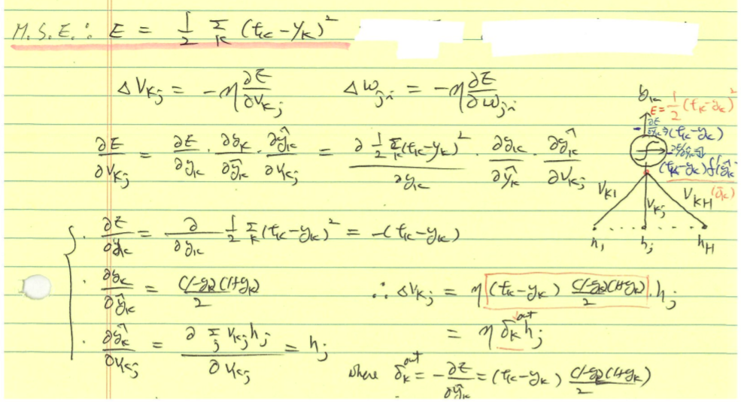
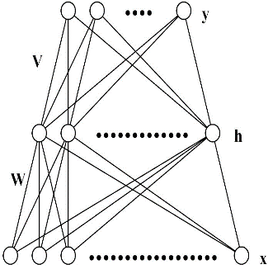

Slide 8
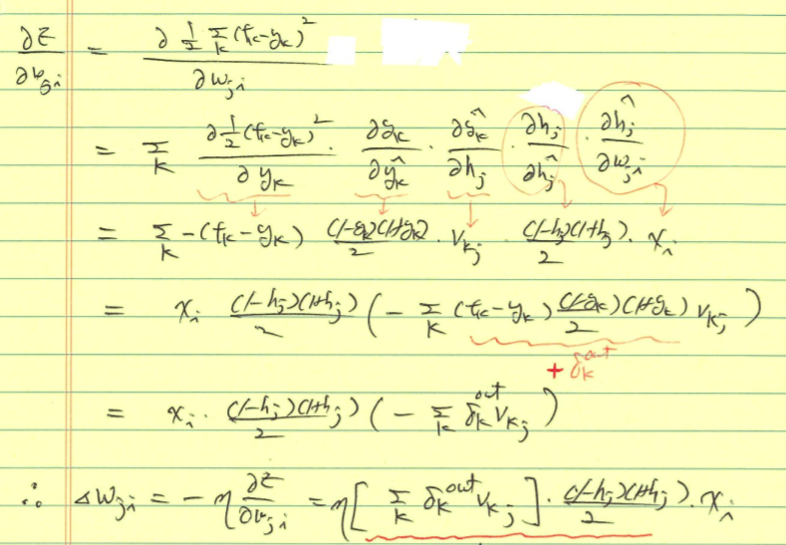

Slide 9
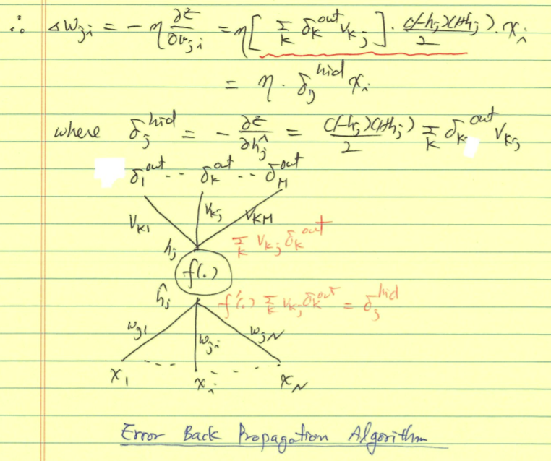

Slide 10
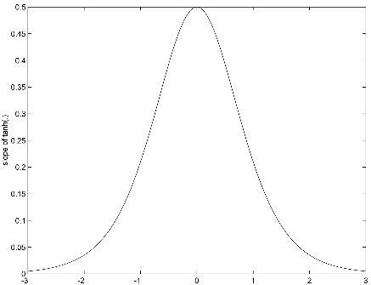
5.3. Training of MLP : Error Back-Propagation Algorithm

Slide 11
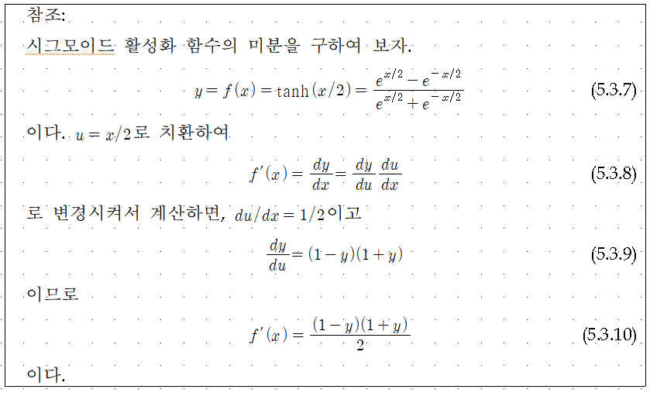

Slide 12
$$y_{1}$$
$$y_{k}$$
$$y_{M}$$
$$δ_{1}$$
$$δ_{k}$$
$$δ_{M}$$
$$v_{1j}$$
$$v_{kj}$$
$$v_{Mj}$$
$$\sum_{k=1}^{M}{v_{kj}δ_{k}}$$
$$h_{j}$$
$$f(.)$$
$$f^{′}(.)\sum_{k=1}^{M}{v_{kj}δ_{k}}$$
$$x_{0}$$
$$x_{1}$$
$$x_{i}$$
$$x_{N}$$

Slide 13
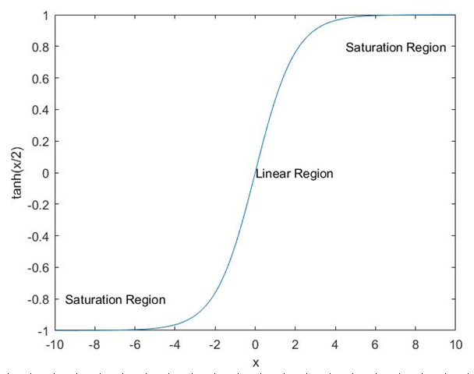
5.4. Incorrect Saturation of Output Nodes
Correct Saturation
$$y_{k}≈t_{k}, δ_{k}≈0$$
Incorrect Saturation
$${If y}_{k}≈±1 and t_{k}=∓1 , δ_{k}≈0 although \left|t_{k}−y_{k}\right|≈2$$
Incorrect Saturation of Output Nodes → Very Slow Convergence of Learning due to $δ_{k}≈0$

Slide 15
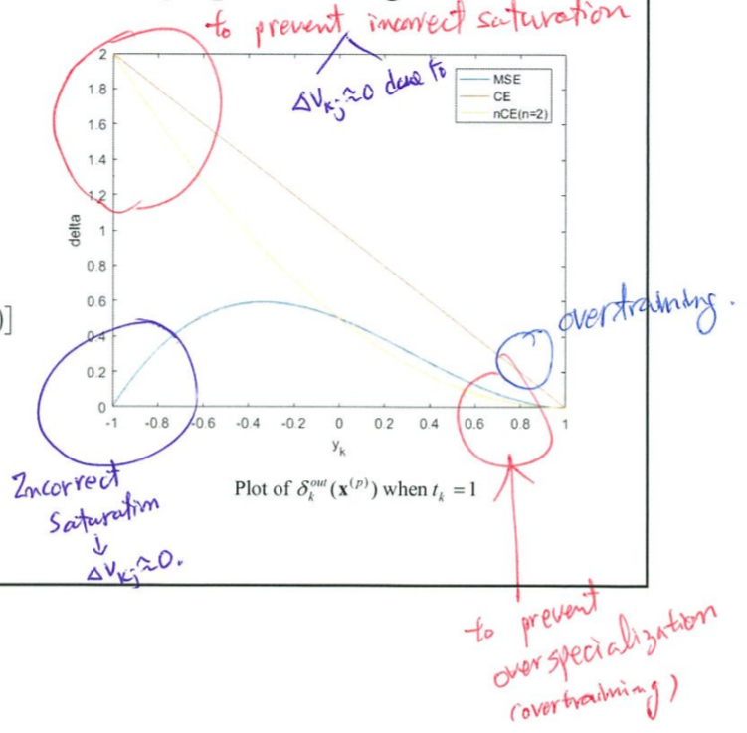
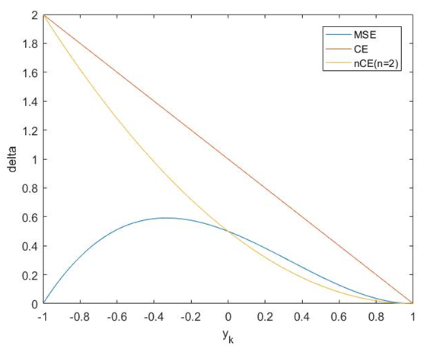
Training of MLP : Error Back-Propagation Algorithm

Slide 16
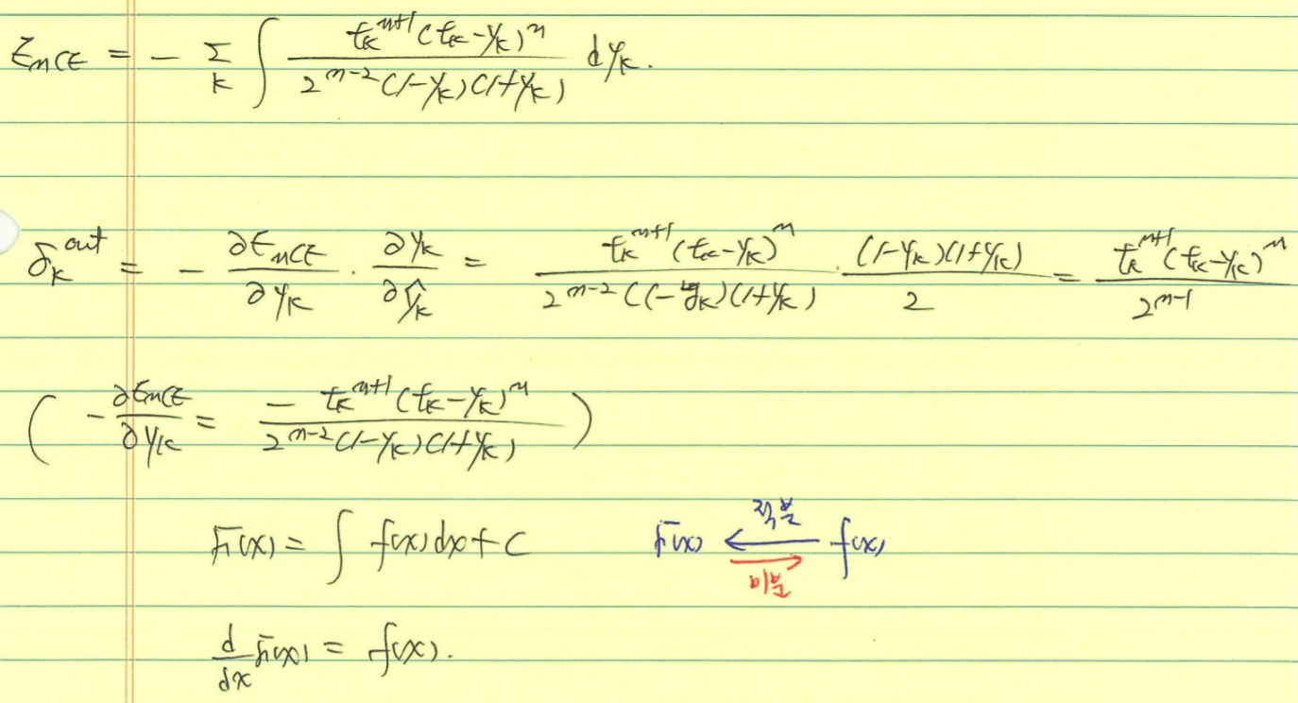

Slide 17
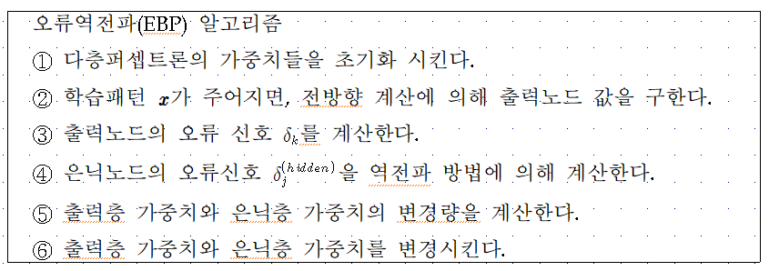
Error Back-Propagation Algorithm

Slide 18
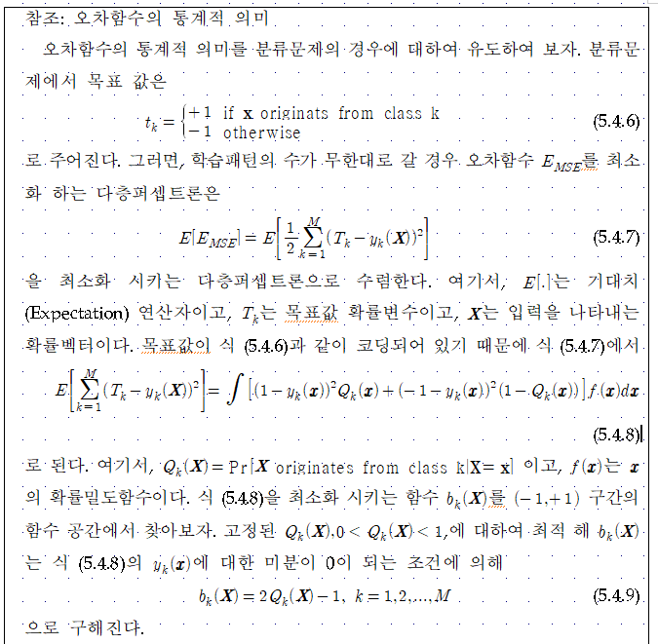
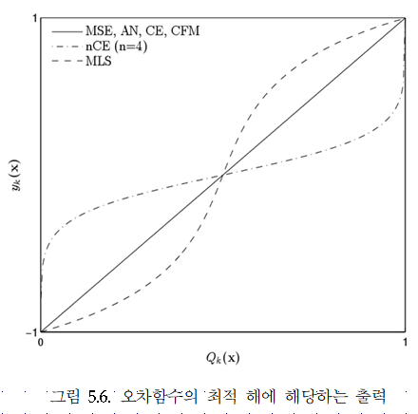

Slide 19
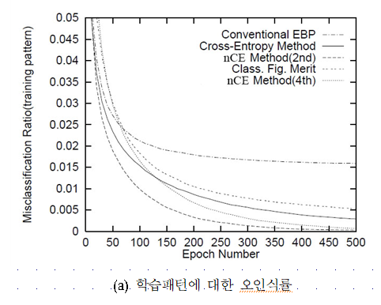
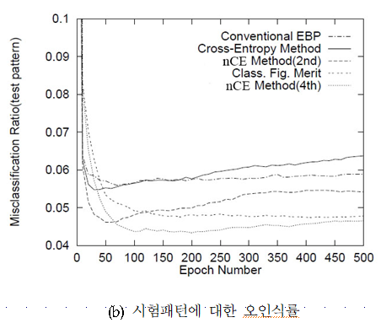

Slide 21
