Slide 1
Machine Learning

Slide 2
Contents
Introduction
K-Nearest Neighbor Algorithm
LDA(Linear Discriminant Analysis)
Perceptron
Feed-Forward Neural Networks
RNN(Recurrent Neural Networks)
SVM(Support Vector Machine)
Ensemble Learning
CNN(Convolutional Neural Network)
PCA(Principal Component Analysis)
ICA(Independent Component Analysis)
Clustering
GAN(Generative Adversarial Network)

Slide 3
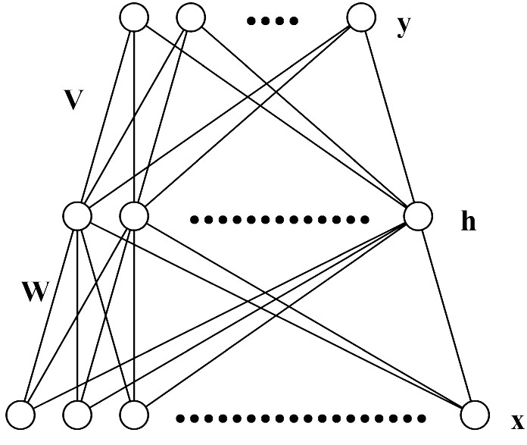

5.1. Multi-Layer Perceptron (MLP)
Feed-forward structure: inputs from the previous layer and outputs to the next layer
Output layer: sigmoid activation function for classification problems and linear activation function for regression problems
Figure: two-layer network (two layer of weights)

Slide 4
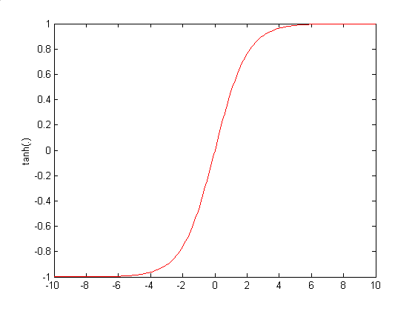
Architecture of MLP (N-H-M): Forward Propagation

Slide 5
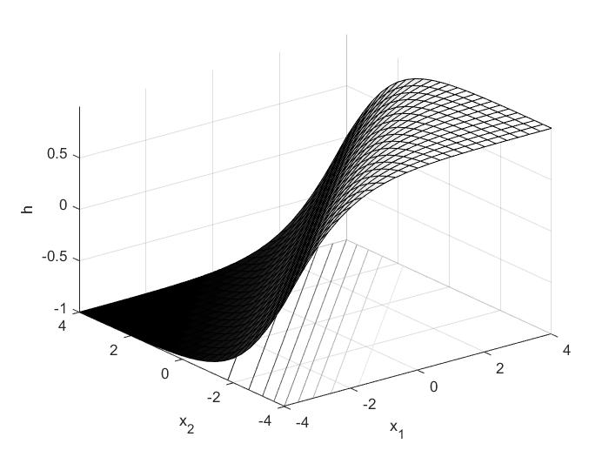
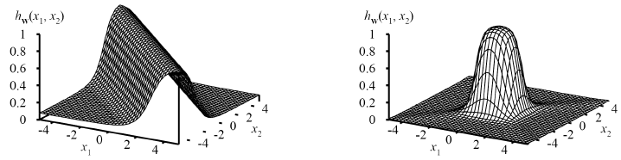
5.2. Representational Power of MLP
MLP with two layers can represent arbitrary function
  Each hidden unit represents a soft threshold function in the input space
  Combine two opposite-facing threshold functions to make a ridge
  Combine two perpendicular ridges to make a bump
  Add bumps of various sizes and locations to fit any surface
Universal approximator
  Given a sufficiently large number of hidden units , a two layer (linear output) network can approximate any continuous function on a compact input domain to arbitrary accuracy.

Slide 6
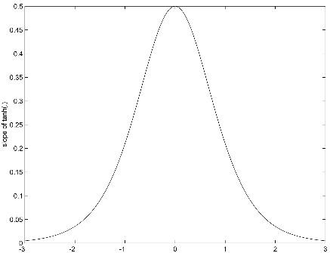
5.3. Training of MLP : Error Back-Propagation Algorithm

Slide 7
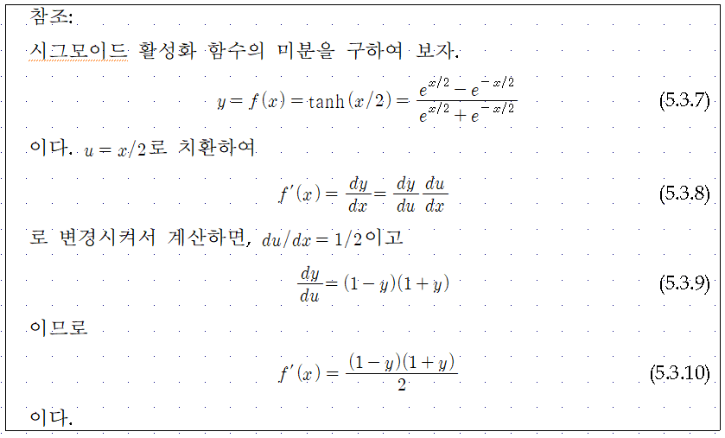

Slide 8








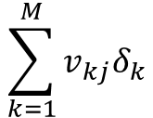








$$y_{1}$$
$$y_{k}$$
$$y_{M}$$
$$δ_{1}$$
$$δ_{k}$$
$$δ_{M}$$
$$v_{1j}$$
$$v_{kj}$$
$$v_{Mj}$$
$$\sum_{k=1}^{M}{v_{kj}δ_{k}}$$
$$h_{j}$$
$$f(.)$$
$$f^{′}(.)\sum_{k=1}^{M}{v_{kj}δ_{k}}$$
$$x_{0}$$
$$x_{1}$$
$$x_{i}$$
$$x_{N}$$

Slide 9
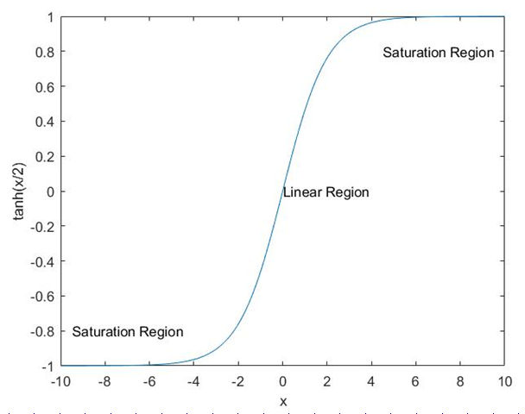

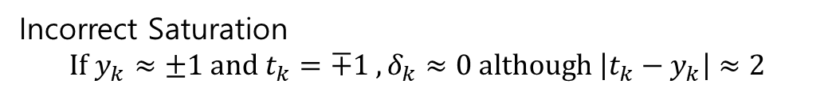
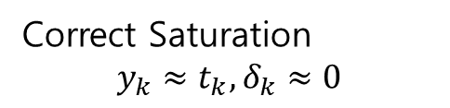
5.4. Incorrect Saturation of Output Nodes
Correct Saturation
$$y_{k}≈t_{k}, δ_{k}≈0$$
Incorrect Saturation
$${If y}_{k}≈±1 and t_{k}=∓1 , δ_{k}≈0 although \left|t_{k}−y_{k}\right|≈2$$
Incorrect Saturation of Output Nodes → Very Slow Convergence of Learning due to $δ_{k}≈0$

Slide 10
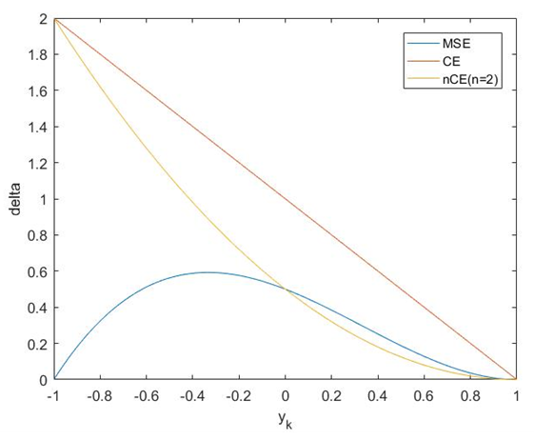
Training of MLP : Error Back-Propagation Algorithm

Slide 11
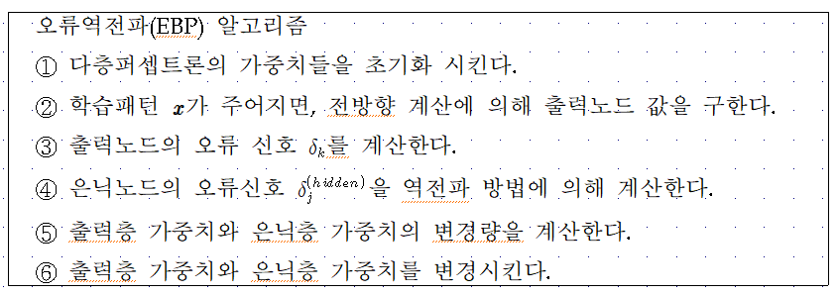
Error Back-Propagation Algorithm

Slide 12
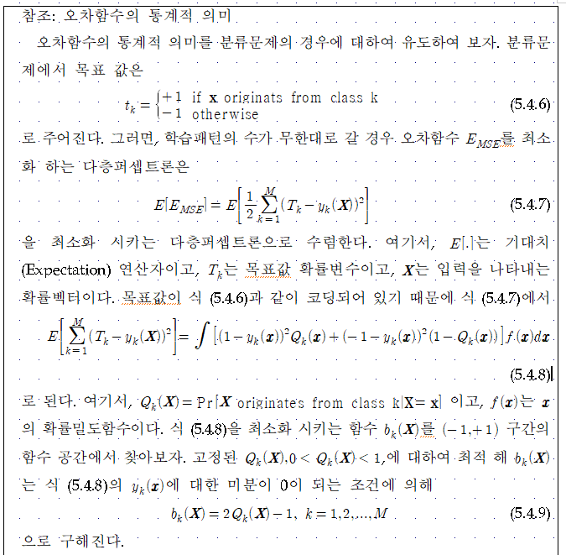
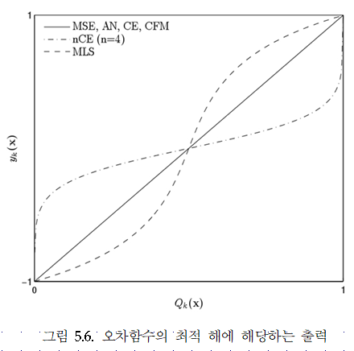

Slide 13
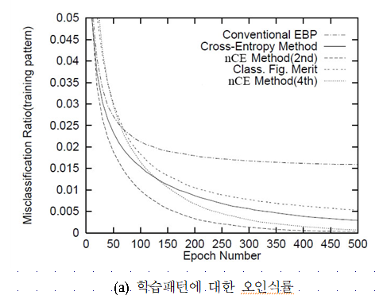
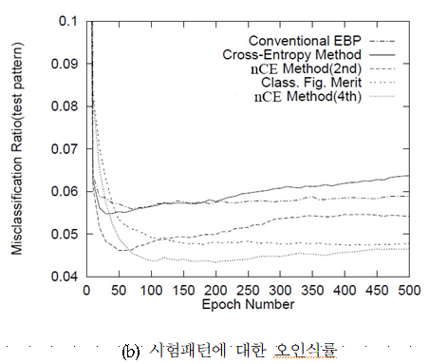

Slide 14
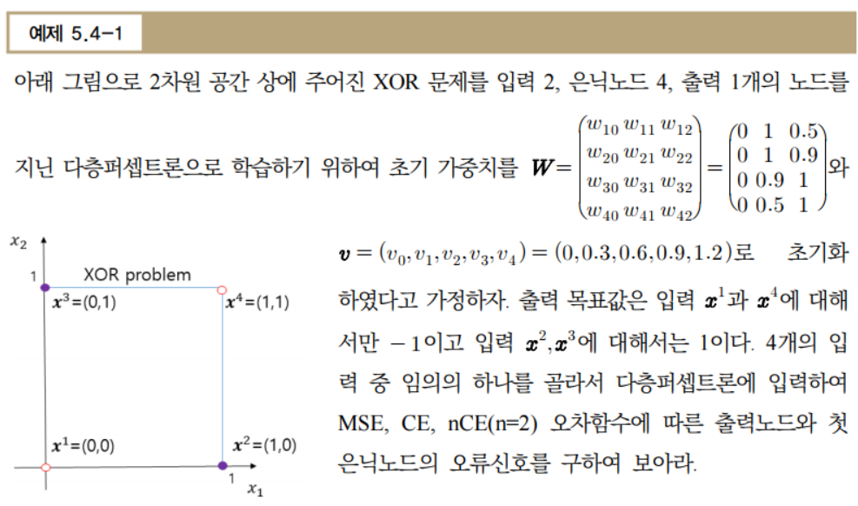

Slide 15
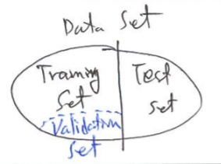
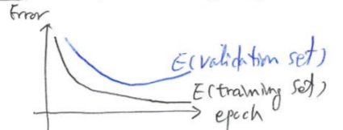
5.5. Remarks on Training
Convergence(?)… may oscillate or reach a local minima.
Many epochs (thousands) may be needed for adequate training
Termination criteria:
  – Fixed number of training epochs
  – Threshold on error of training samples
  – Increasing of error on a validation samples
For better performance, run several trials starting from different initial random weights
  – Take the result with the best training or validation performance.
  – Build a committee of networks (ensemble technique)…Chapter 8

Slide 16
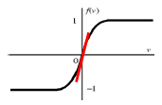
Initialization of Weights
Initialization of weights such that nodes are in the “linear” regions
  To avoid the premature saturation problem
  Keep all weights near zero, so that all sigmoid units are in their linear regions. Otherwise nodes can be initialized into flat regions of the sigmoid causing for very small gradients.⇒ Premature Saturation Problem
Break symmetry
  – Each hidden node should have different input weights so that the hidden nodes move in different directions.

Slide 17
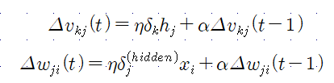
Online, Batch and Learning with Momentum
Online: Take a gradient descent step with each input
Batch: Sum the gradient for each example i. Then take a gradient descent step
Momentum factor: Make the t+1-th update dependent on the t-th update
- to keep weight moving in the same direction and improves convergence

Slide 18
Overtraining Prevention
Too many epochs → over-train the network
Use a validation set to test accuracy in some intervals of epochs
Stop the training when the performance on the validation set decreases
10-fold cross-validation
Error
Validation Set
Training Set
Epochs

Slide 19
Over-fitting Prevention
Too few hidden units prevent the system from adequately fitting the data and learning the concept.
Too many hidden units leads to over-fitting.
Trial and error
Another approach to preventing over-fitting is weight decay
Error
Validation Set
Training Set
#Hidden Nodes

Slide 20






5.6. Learning Time Series Data
Time-delay neural networks (TDNN)
$$y$$
$$h$$
$$x_{0}=1$$
$$x^{t−T}$$
$$x^{t−1}$$
$$x^{t}$$

Slide 21
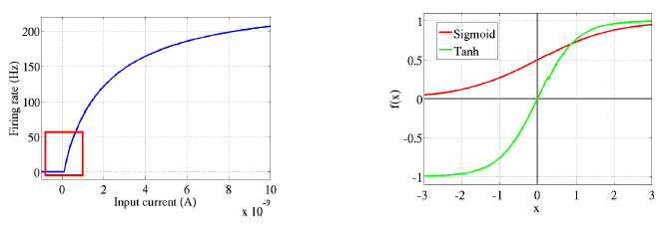
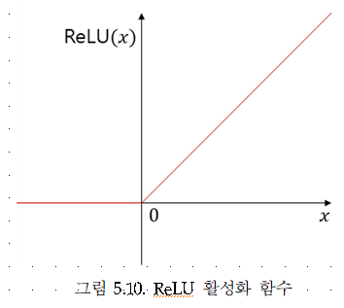





5.7. Deep Neural Networks
$$y_{k}$$
$$h^{(L)}$$
$$h^{(2)}$$
$$h^{(1)}$$
$$x$$

Slide 22


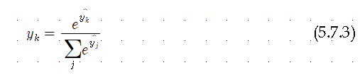




$$y_{k}$$
$$h^{(L)}$$
$$h^{(2)}$$
$$h^{(1)}$$
$$x$$

Slide 23
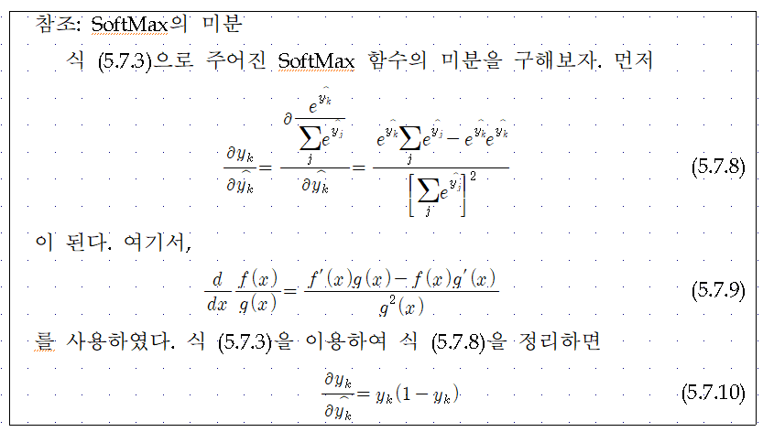
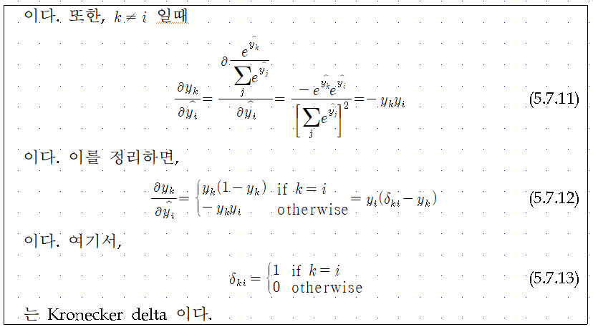

Slide 24
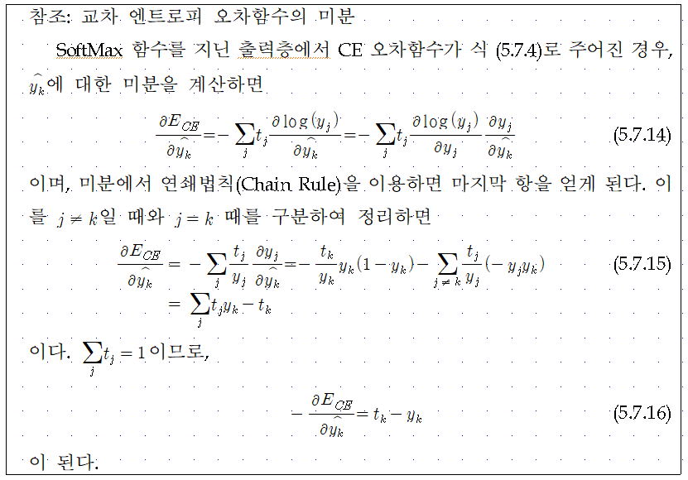

Slide 25
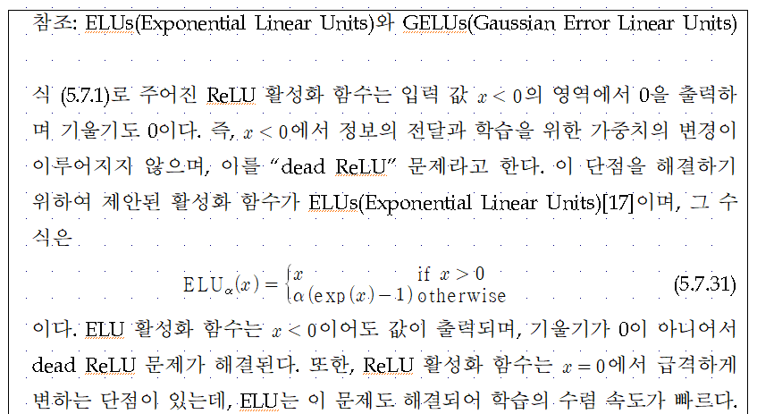

Slide 26
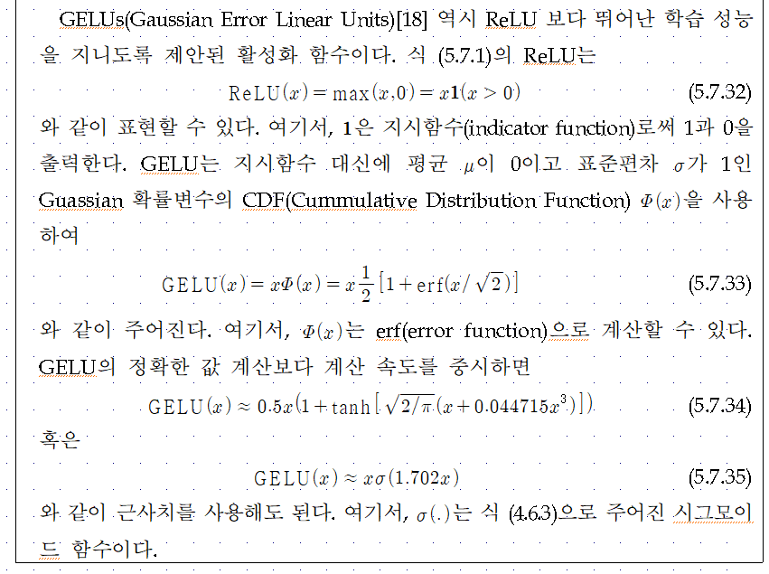
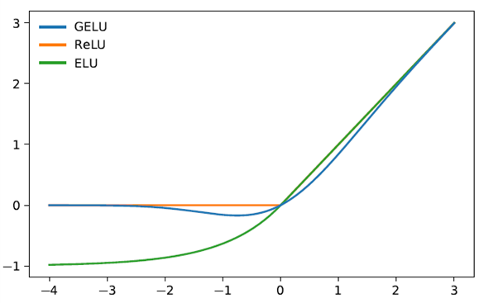
GELU는 ReLU를 매끄러운 모양으로 만들은 형태이다. GELU는 단조함수가 아니며 모든 지점에서 곡률을 지닌 것이 ReLU 및 ELU와 다른 특징이다.
이 특징이 GELU가 ReLU 및 ELU보다 더 뛰어난 학습 성능을 지니도록 해준다[18].

Slide 27
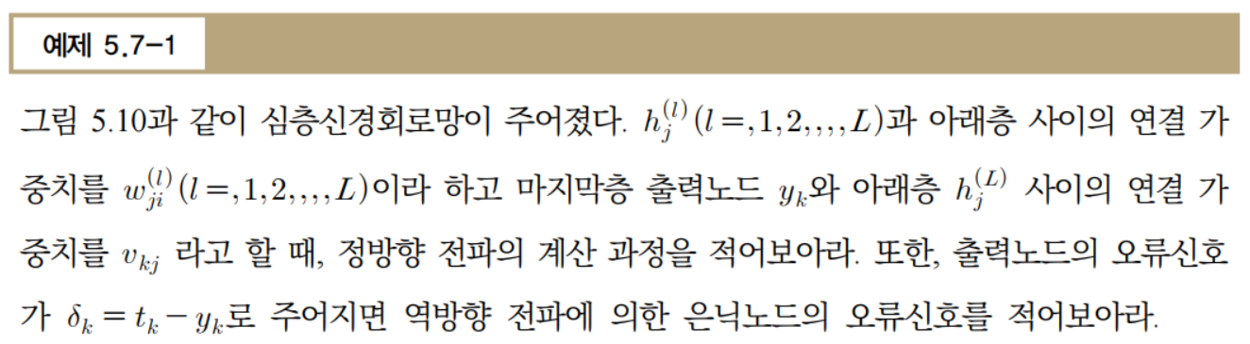

Slide 28
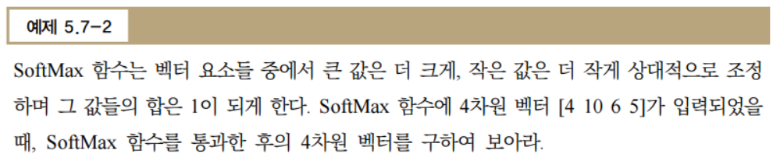

Slide 29

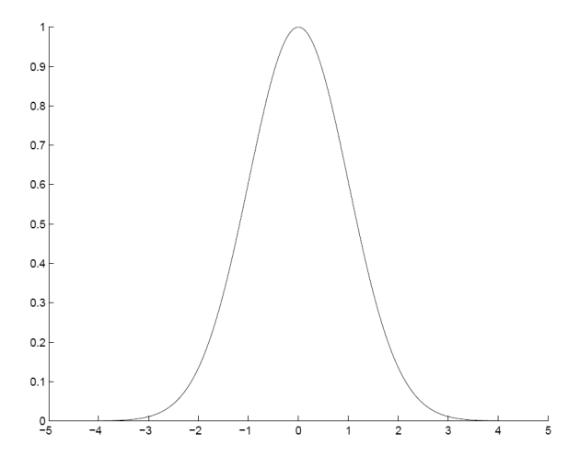





5.8. Radial Basis Function Networks
Locally-tuned units:
$$y_{k}$$
$$h$$
$$m_{j}$$
$$s_{j}$$
$$x$$

Slide 30
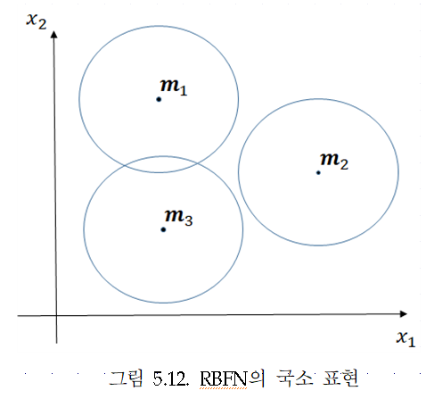
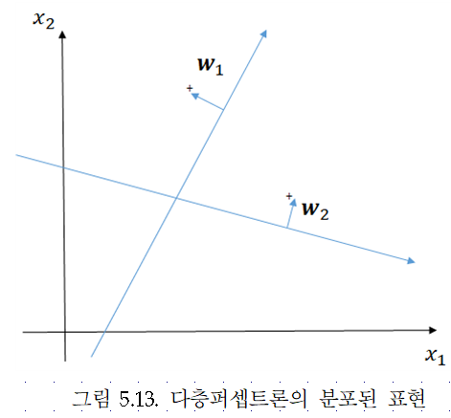
Local vs. Distributed Representation

Slide 31
Training RBF Network
Hybrid learning
• First layer centers and spreads (Unsupervised k-means)
• Second layer weights (Supervised gradient descent)
Fully supervised
•Similar to backpropagation in MLP, gradient descent for all parameters

Slide 32

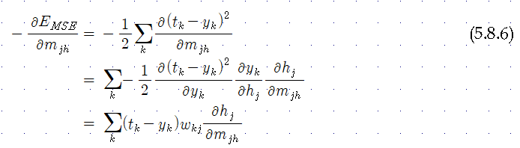



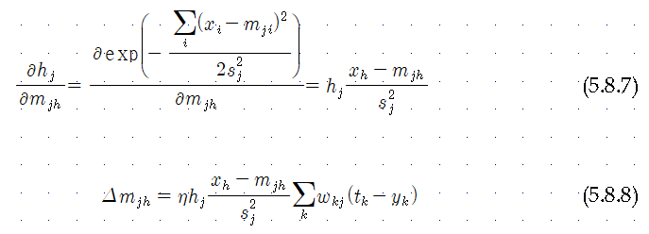
RBF Network: Fully Supervised Method
Similar to backpropagation in MLP

Slide 33
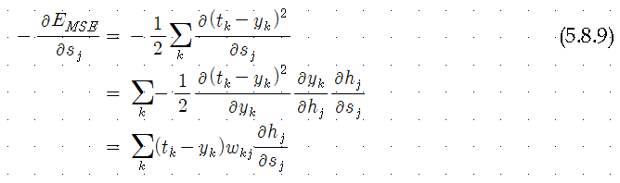
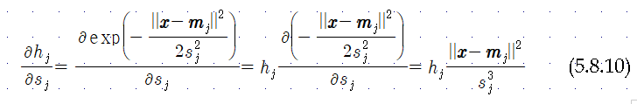

RBF Network: Fully Supervised Method
Similar to backpropagation in MLP

