Slide 1

Machine Learning

Slide 2
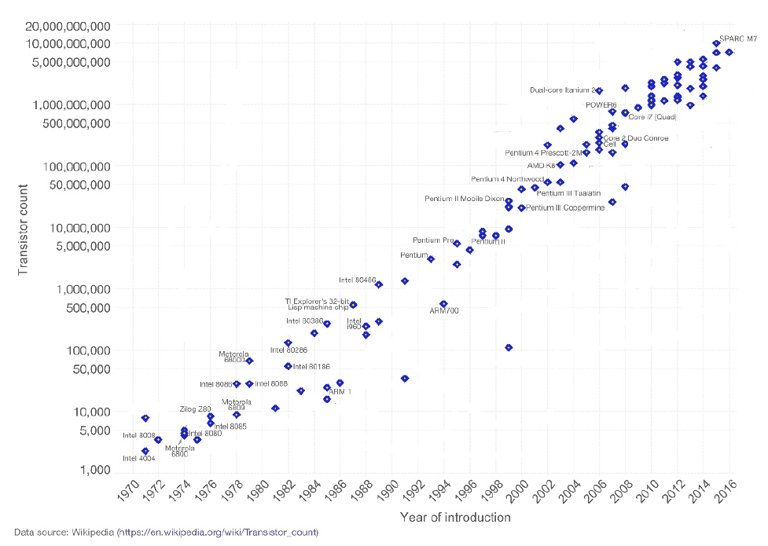
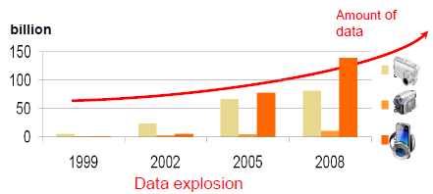
1.1. Machine Learning?
Motivation for Machine Learning
Advances in computer technology
(store/access/process) :
  predictions, understanding and control.
Very difficult to understand the details of the process that explains the generation of the data
Need a technique to make a good and useful approximation in detecting certain patterns and regularities Machine Learning!
Moore’s law
The number of transistors that can be inexpensively placed on an integrated circuit is increasing exponentially, doubling approximately every two years

Slide 3
1.3. Types of Machine Learning
Prediction
  Supervised Learning: Given $\{\left(x_{i},y_{i}\right)\}$ pairs, find a good understanding f: X→Y. Ex) Classification, Regression
  Active Learning : Find f: X→Y, but $y_{1},…,y_{N}$ are initially hidden and there is a charge for each label you want revealed. The hope is that by intelligent adaptive querying, you can get away with significantly fewer labels than you would need in a regular supervised learning framework
  Semi-supervised learning: Given both small number of labels and large number of unlabeled data, find f: X→Y.
Understanding
  Unsupervised Learning: Given $\{x_{i}\}$ find something interesting. Ex) Clustering, novelty-detection
Policy(Control)
  Reinforcement Learning: find f: P→A to max R
  (P: history of perception, A: action. R: long term reward)
Generative Model
  Generative Adversarial Network: The field of unsupervised learning which aims to study algorithms that learn the underlying structure of the given data, without specifying a target value.

Slide 4
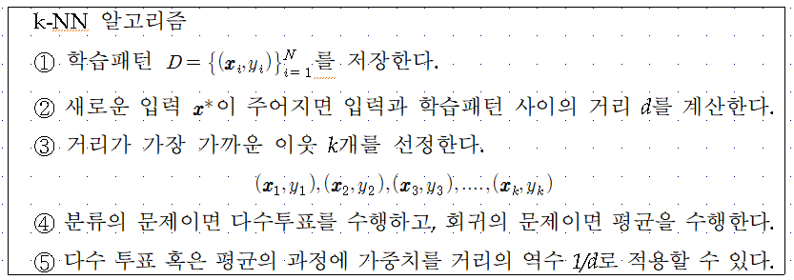
k-NN Algorithm

Slide 5












LDA
Fisher's idea: Fisher's linear discriminant
  Maximize a function that will give a large separation between the projected class means
  While also giving a small variance within each class, thereby minimizing the class overlap
$$x_{2}$$
$$m_{2}$$
$$m_{1}$$
Maximizing
$$m_{2}$$
$$s_{2}^{2}$$
From $\frac{∂J(w)}{∂w}=0,$
$$m_{1}$$
$$w$$
$$s_{1}^{2}$$
$$x_{1}$$

Slide 6
Contents
Introduction
K-Nearest Neighbor Algorithm
LDA(Linear Discriminant Analysis)
Perceptron
Feed-Forward Neural Networks
RNN(Recurrent Neural Networks)
SVM(Support Vector Machine)
Ensemble Learning
CNN(Convolutional Neural Network)
PCA(Principal Component Analysis)
ICA(Independent Component Analysis)
Clustering
GAN(Generative Adversarial Network)

Slide 7


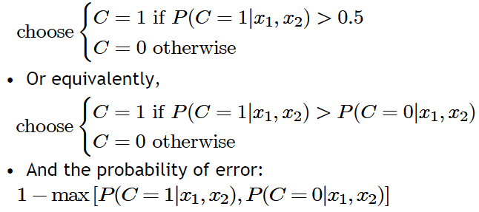
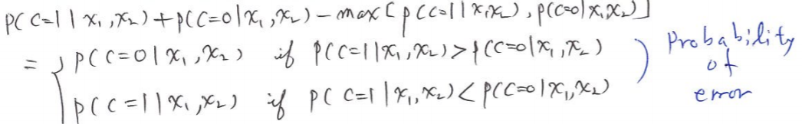
4.1. Classification
Savings
Low-risk
Credit scoring example:
  Inputs are income and savings
  Output is low-risk vs. high-risk
Formally speaking
Decision rule: if we know
High-risk
Income

Slide 8
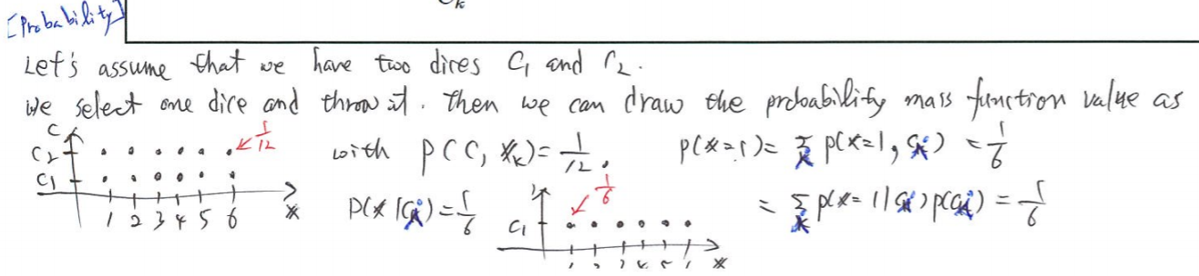
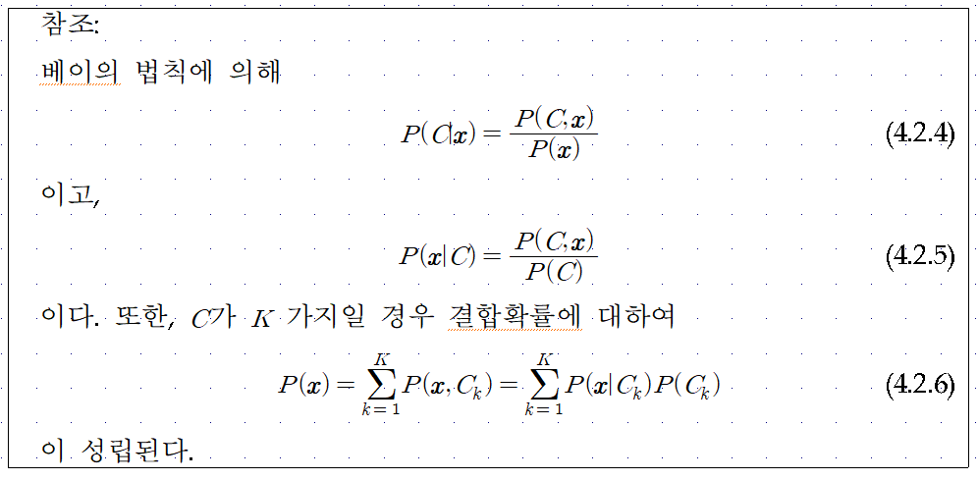

Slide 9
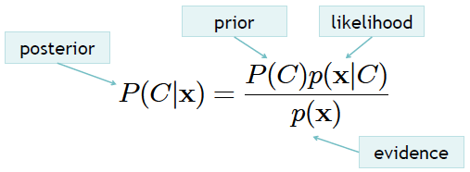
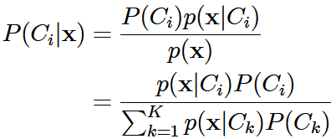

4.2. Bayes’ Optimal Classifier
Bayes rule for one concept
Bayes rule for K > 1 concepts
Decision rule using Bayes rule (Bayes optimal classifier):

Slide 10


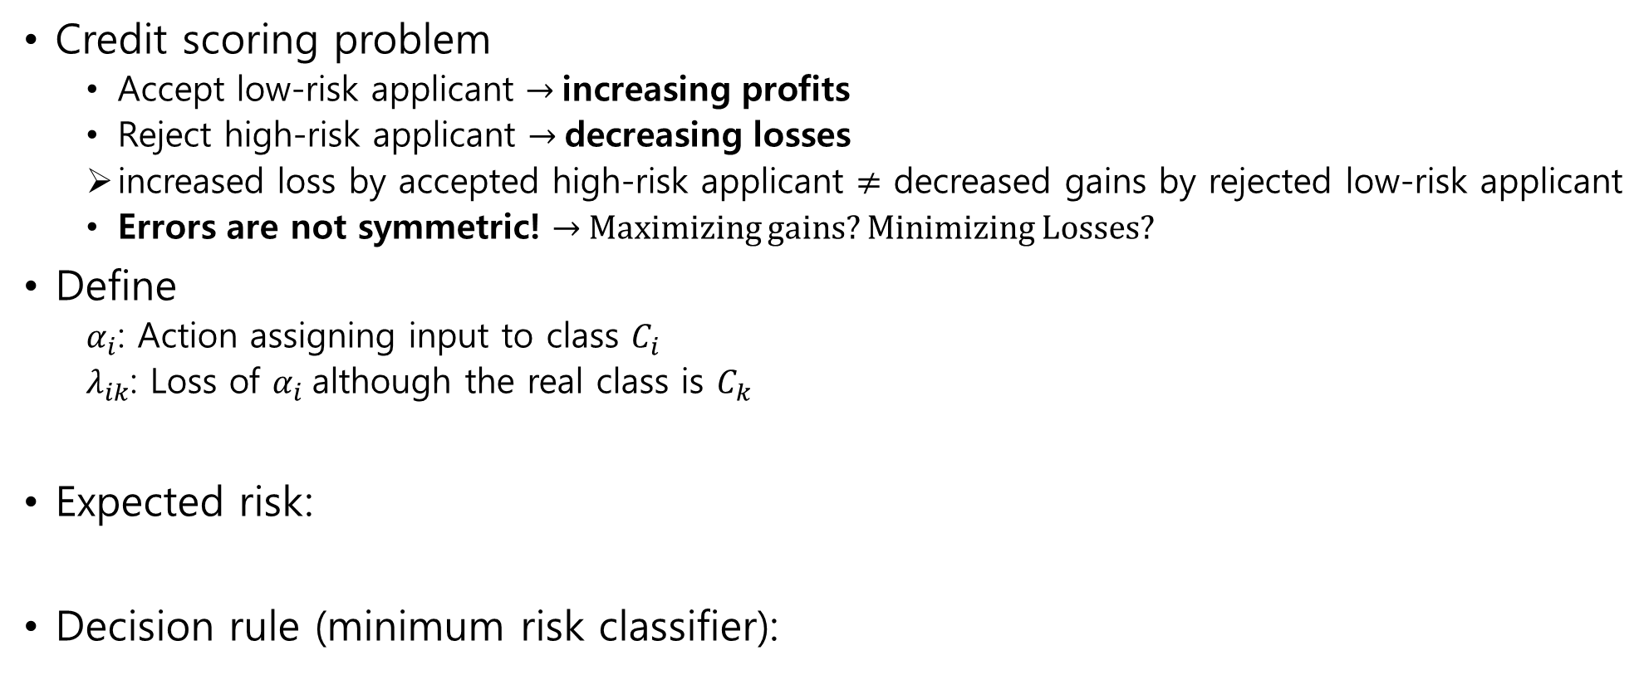
4.3. Losses and Risks
Credit scoring problem
  Accept low-risk applicant → increasing profits
  Reject high-risk applicant → decreasing losses
  increased loss by accepted high-risk applicant $≠$ decreased gains by rejected low-risk applicant
  Errors are not symmetric! → Maximizing gains? Minimizing Losses?
Define
  $α_{i}$: Action assigning input to class $C_{i}$
  $λ_{ik}$: Loss of $α_{i}$although the real class is $C_{k}$
Expected risk:
Decision rule (minimum risk classifier):

Slide 11
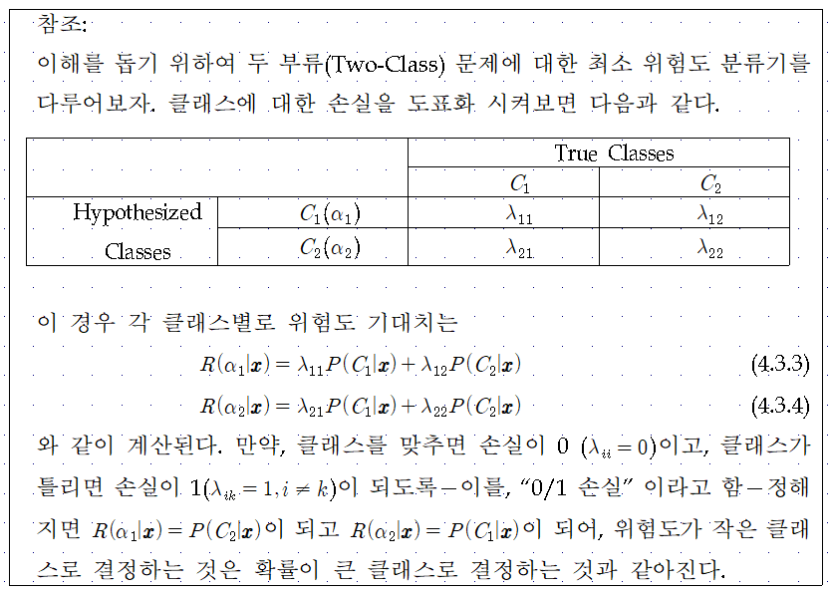

Slide 12
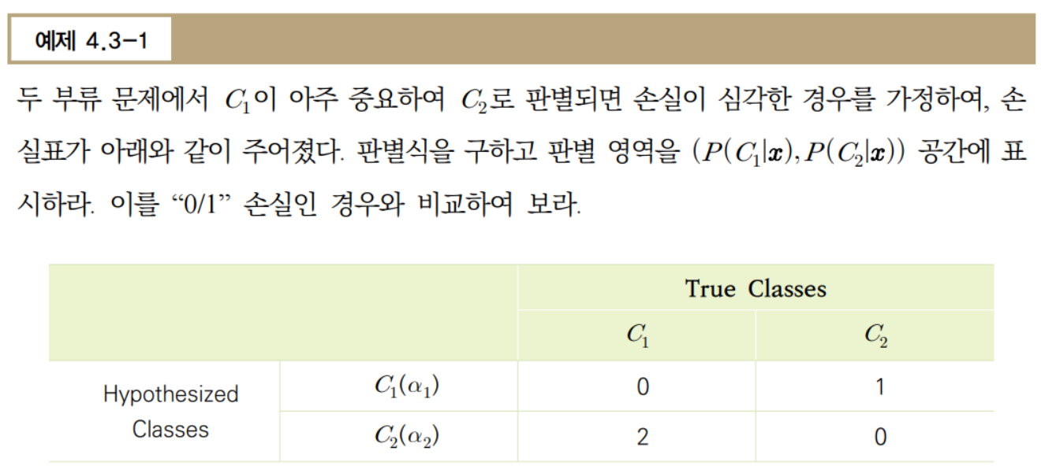

Slide 13
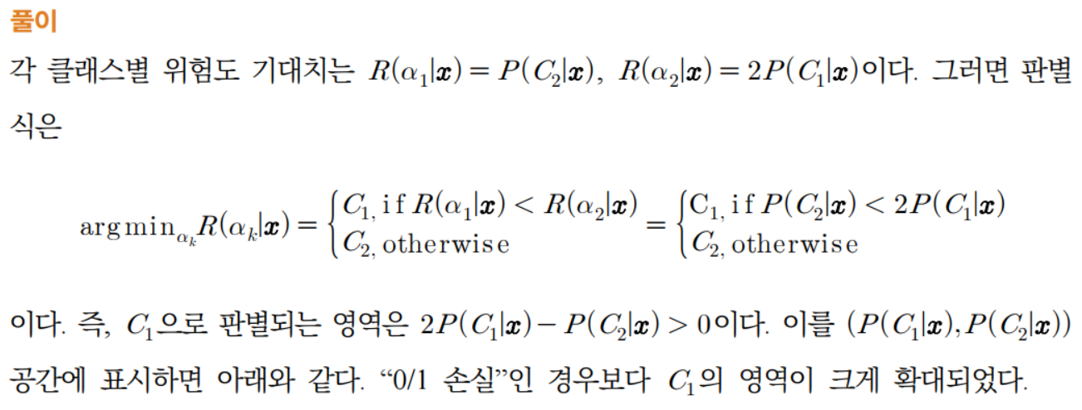
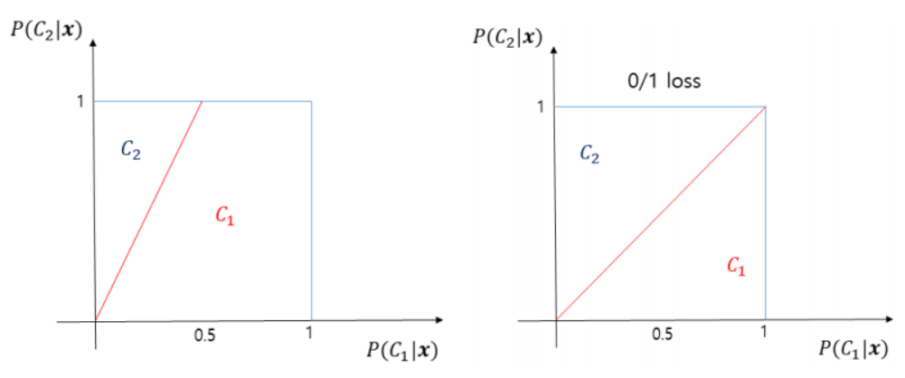

Slide 14




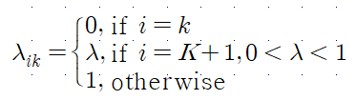



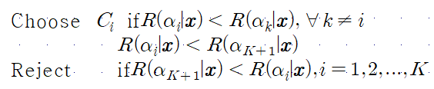
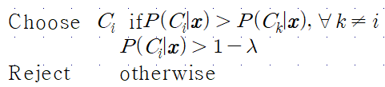
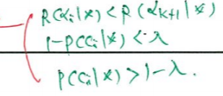
0/1 Loss and Rejection
0/1 loss
  Minimum risk classifier = Bayes optimal classifier
Rejection

Slide 15
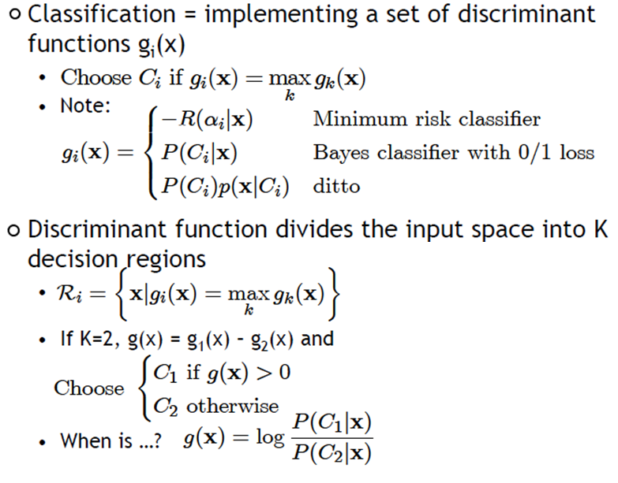
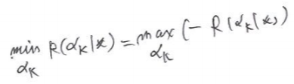
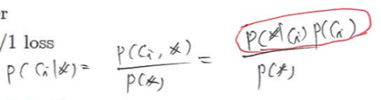
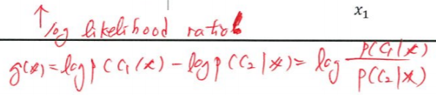



4.4. Discriminant Functions
$$x_{2}$$
$$C_{3}$$
$$C_{1}$$
Reject
$$C_{2}$$
$$x_{1}$$

Slide 16

Likelihood-based vs. Discriminant-based
Likelihood-based classification
Discriminant-based classification
Estimating the boundaries is enough; no need to accurately estimate the densities inside the boundaries!

Slide 17




4.5. Linear Discriminant Function
Linear discriminant
Advantages:
  Simple: O(d) space/computation
  Knowledge extraction: Weighted sum of attributes; positive/negative weights, magnitudes (credit scoring)
  Optimal when are Gaussian with shared covariance matrix; useful when classes are (almost) linearly separable

Slide 18
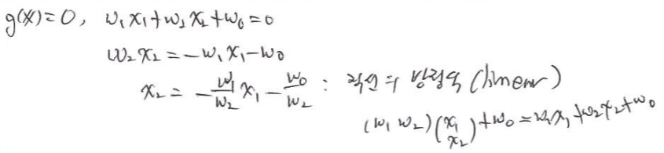
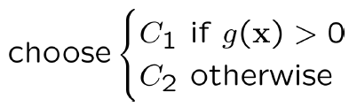







$$x_{2}$$
$$g\left(x\right)=w_{1}x_{1}+w_{2}x_{2}+w_{0}=0$$
$$g\left(x\right)<0$$
$$C_{1}$$
$$g\left(x\right)>0$$
$$C_{2}$$
$$x_{1}$$

Slide 19
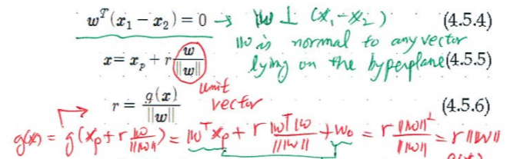
















$$x_{2}$$
${Two points x}_{1}$ ${and x}_{2} on the decison surface$
$$g\left(x\right)=0$$
$$g\left(x\right)<0$$
$$g\left(x\right)>0$$
$${|w}_{0}|/|\left|w\right||$$
$$w$$
$$x$$
$${Position from the origin }_{}$$
$$x_{p}$$
$$\left|g(x)\right|/|\left|w\right||$$
$$x_{1}$$

Slide 20
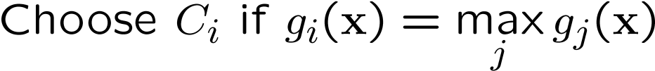



Multiple Classes (One-vs-All)
$$H_{3}$$
$$x_{2}$$
$$H_{1}$$
$$C_{3}$$
$$C_{1}$$
$$H_{2}$$
$$C_{2}$$
$$x_{1}$$

Slide 21
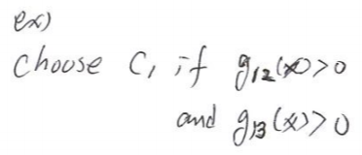








Pairwise Separation (One-vs-One)
$$x_{2}$$
$$H_{31}$$
$$H_{12}$$
$$C_{3}$$
$$C_{1}$$
$$H_{23}$$
$$C_{2}$$
$$x_{1}$$

Slide 22




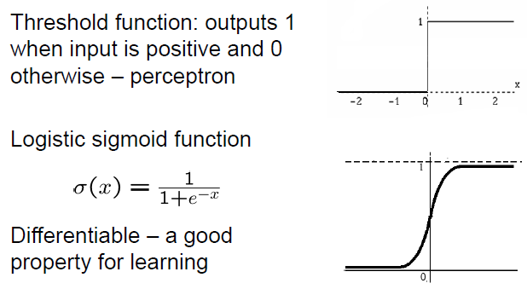

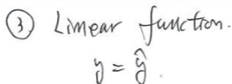











4.6. Single Layer Perceptron
$$y$$
$$f(.)$$
$$\sum_{k=0}^{d}{w_{k}x_{k}}$$
$$w_{d}$$
$$w_{0}$$
$$w_{1}$$
$$w_{2}$$
$$x_{0}=1$$
$$x_{1}$$
$$x_{2}$$
$$x_{d}$$

Slide 23
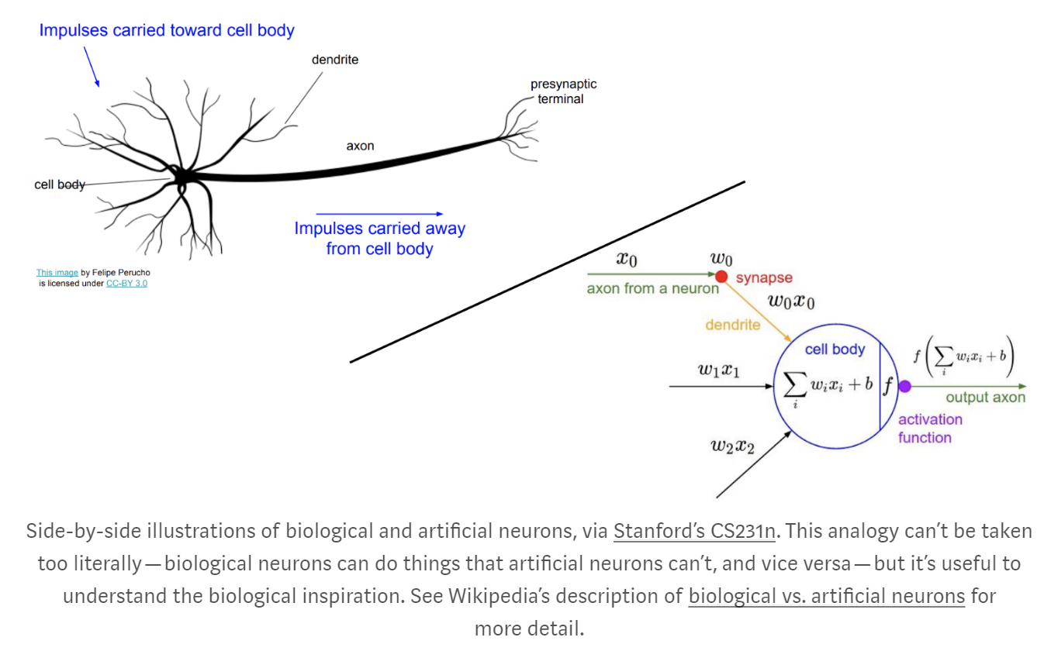


$$x_{i}$$
$$w_{i}$$

Slide 24



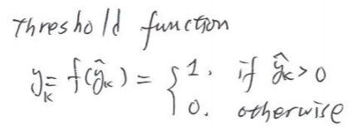








Single-Layer Perceptron with K Outputs
$$y_{1}$$
$$y_{2}$$
$$y_{3}$$
$$y_{K}$$
$$w_{1}$$
$$w_{2}$$
$$w_{3}$$
$$w_{k}$$
$$x_{0}=1$$
$$x_{1}$$
$$x_{2}$$
$$x_{d}$$

Slide 25
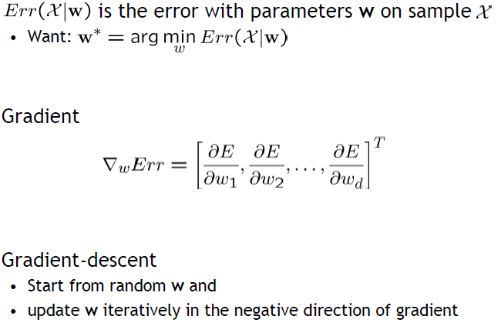





Gradient Descent
4.7. Training Perceptron
$${E(W}^{t})$$
$${E(W}^{t+1})$$
$$W^{t+1}$$
$$W^{t}$$

Slide 26
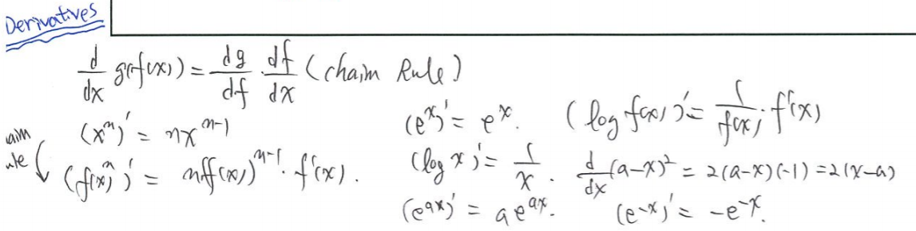
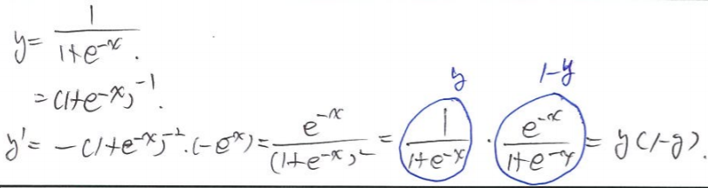
Chain rule

Slide 27









Gradient Descent
Training Sample
Perceptron Output $y^{t}$ Desired Output $r^{t}$
Regression (Linear Output)
$${E(W}^{t})$$
Mean-Squared Error(MSE)
$${E(W}^{t+1})$$
$$W^{t+1}$$
$$W^{t}$$
Learning rate

Slide 28
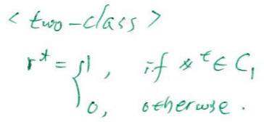
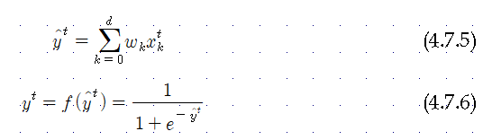



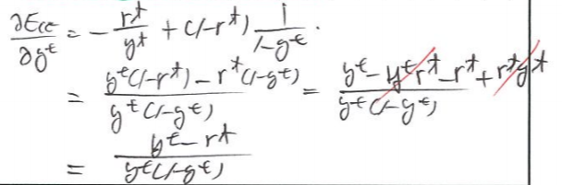

Gradient Descent
Training Sample
Perceptron Output $y^{t}$ Desired Output $r^{t}$
Classification (Sigmoid Output)
[Cross-Entropy Error]

Slide 29
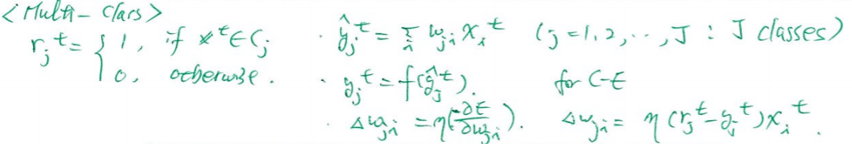
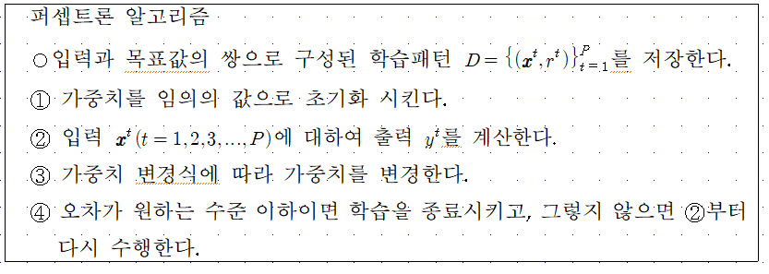
<Multi-Class>

Slide 30
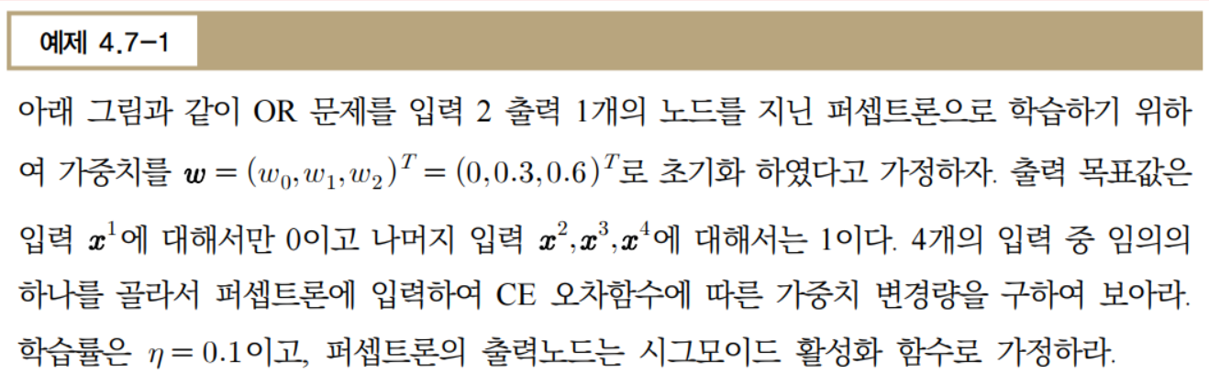
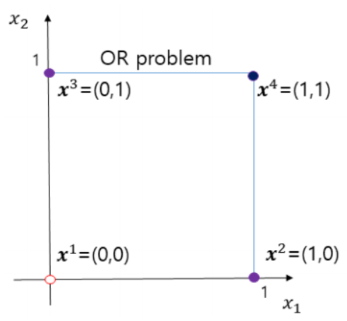

Slide 31
