Slide 1
Machine Learning

Slide 2
1.3. Types of Machine Learning
Prediction
Supervised Learning: Given $\{\left(x_{i},y_{i}\right)\}$ pairs, find a good understanding f: X→Y. Ex) Classification, Regression
Active Learning : Find f: X→Y, but $y_{1},…,y_{N}$ are initially hidden and there is a charge for each label you want revealed. The hope is that by intelligent adaptive querying, you can get away with significantly fewer labels than you would need in a regular supervised learning framework
Semi-supervised learning: Given both small number of labels and large number of unlabeled data, find f: X→Y.
Understanding
Unsupervised Learning: Given $\{x_{i}\}$ find something interesting. Ex) Clustering, novelty-detection
Policy(Control)
Reinforcement Learning: find f: P→A to max R
(P: history of perception, A: action. R: long term reward)
Generative Model
Generative Adversarial Network: The field of unsupervised learning which aims to study algorithms that learn the underlying structure of the given data, without specifying a target value.

Slide 3
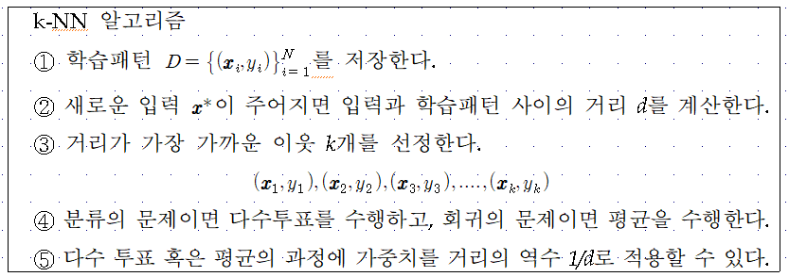
k-NN Algorithm

Slide 4
Contents
Introduction
K-Nearest Neighbor Algorithm
LDA(Linear Discriminant Analysis)
Perceptron
Feed-Forward Neural Networks
RNN(Recurrent Neural Networks)
SVM(Support Vector Machine)
Ensemble Learning
CNN(Convolutional Neural Network)
PCA(Principal Component Analysis)
ICA(Independent Component Analysis)
Clustering
GAN(Generative Adversarial Network)

Slide 5
3.1. Linear Discriminant Analysis (LDA)
Problem: Given a set of data points, each of which is labelled with a class, find the best set of basis vectors for projecting the data points such that classification is improved.
Idea: Form the projection such that the variability across the different classes is maximized, while the variability within each class is minimized.

Slide 6
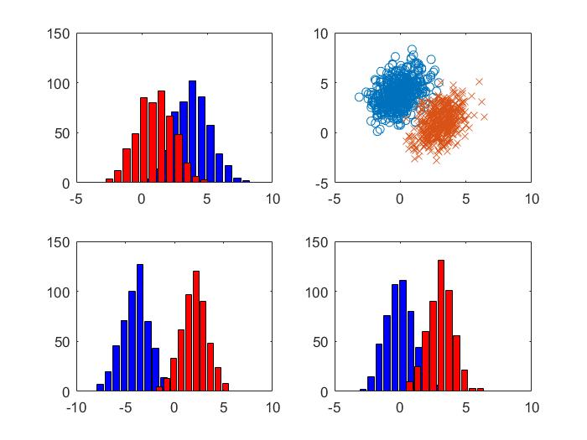
Which one is the best projection?

Slide 7
LDA: Maximize Difference of Means
Considering the simple problem of projecting onto one dimension
The two classes should be well separated in this single dimension
A simple idea is to maximize the difference of the means in the projected space
What is a problem with this solution?

Slide 8
LDA: A Better Idea
Fisher's idea: Fisher's linear discriminant
Maximize a function that will give a large separation between the projected class means
While also giving a small variance within each class, thereby minimizing the class overlap
$$x_{2}$$
$$m_{2}$$
$$m_{1}$$
$$m_{2}$$
$$s_{2}^{2}$$
$$m_{1}$$
$$w$$
$$s_{1}^{2}$$
$$x_{1}$$

Slide 9
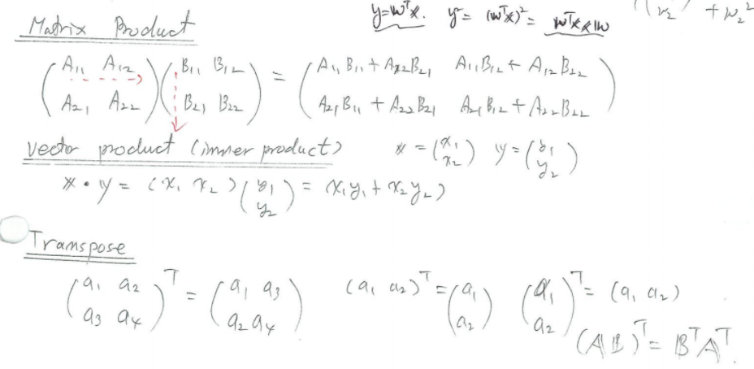

Slide 11
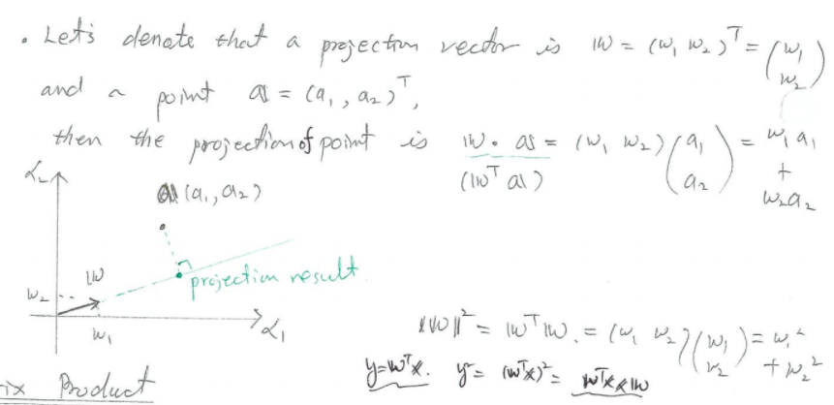

Slide 12
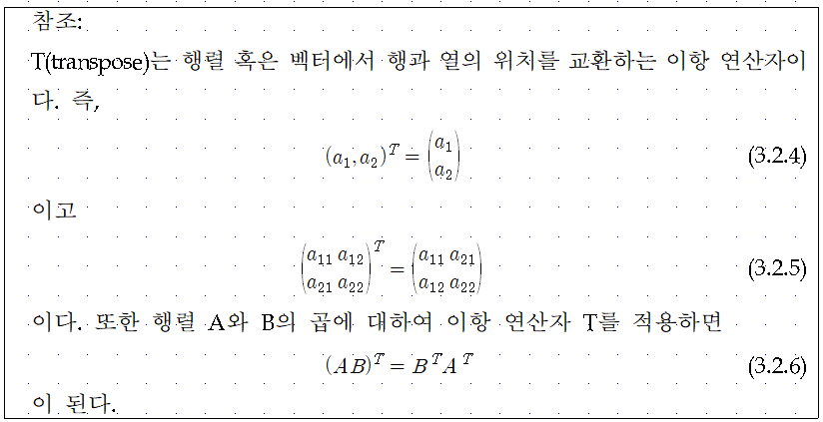
3.2. Projection with Basis Vectors
Point A = ${(a_{1},a_{2})}^{T}$
Basis Vector w = ${(w_{1},w_{2})}^{T}$
Projection $w^{T}A=$ $w_{1}$ $a_{1}$+ $w_{2}$ $a_{2}$

Slide 13
3.3. LDA Formulation
$$x_{2}$$
$$m_{2}$$
$$m_{1}$$
$$m_{2}$$
$$s_{2}^{2}$$
$$m_{1}$$
$$w$$
$$s_{1}^{2}$$
$$x_{1}$$

Slide 14
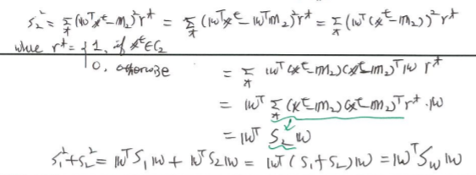
$$x_{2}$$
$$m_{2}$$
$$m_{1}$$
$$m_{2}$$
$$s_{2}^{2}$$
$$m_{1}$$
$$w$$
$$s_{1}^{2}$$
$$x_{1}$$

Slide 16
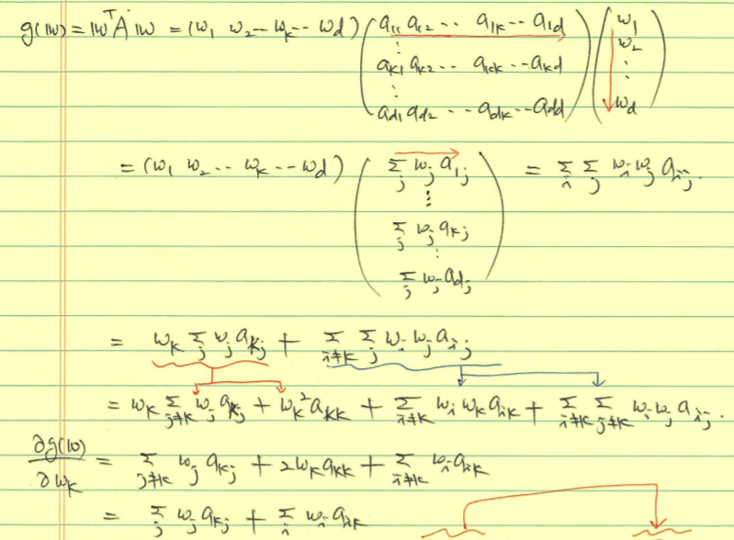

Slide 17
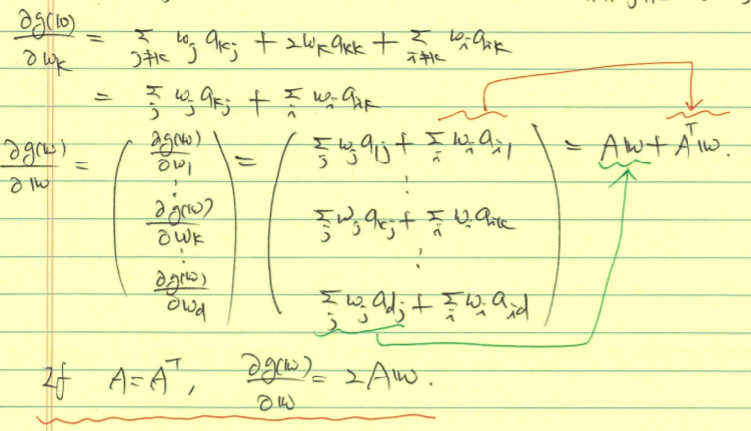
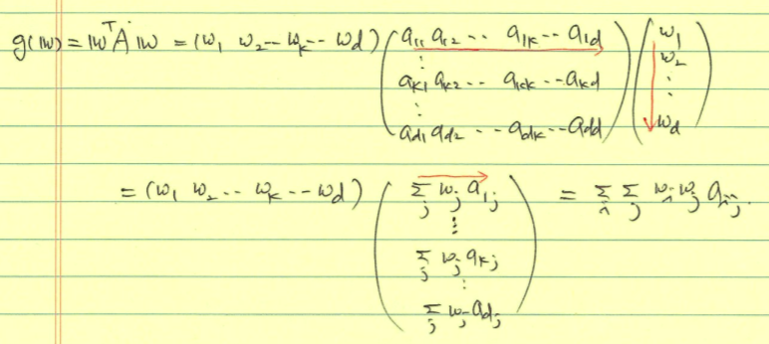

Slide 18
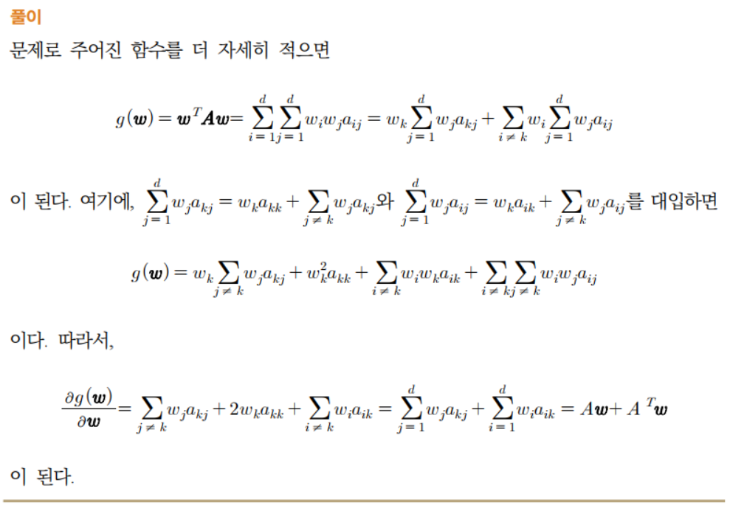

Slide 20
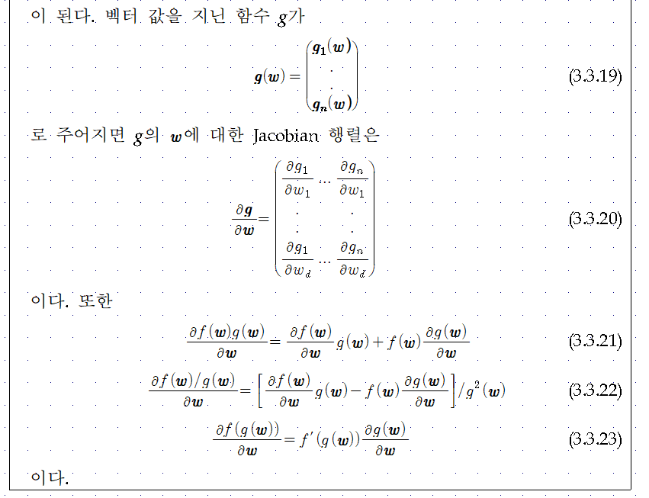

Slide 21
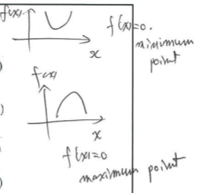
Maximizing
From $\frac{∂J(w)}{∂w}=0,$
scalar

Slide 22
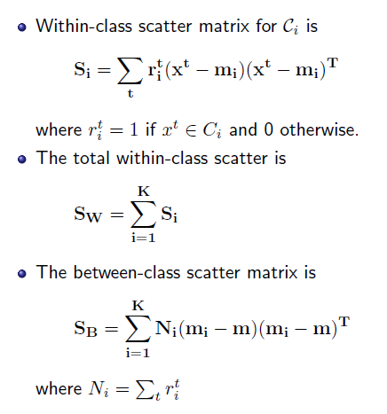
More than 2 Classes (K > 2)
Projection from d-dim space to (c-1)-dim space:

