Slide 1
Machine Learning

Slide 2
Contents
Introduction
K-Nearest Neighbor Algorithm
LDA(Linear Discriminant Analysis)
Perceptron
Feed-Forward Neural Networks
RNN(Recurrent Neural Networks)
SVM(Support Vector Machine)
Ensemble Learning
CNN(Convolutional Neural Network)
PCA(Principal Component Analysis)
ICA(Independent Component Analysis)
Clustering
GAN(Generative Adversarial Network)

Slide 3
3.1. Linear Discriminant Analysis (LDA)
Problem: Given a set of data points with class labels, find the best set of basis vectors for projecting the data points such that classification is improved.
Idea: Form the projection (maximizing the variability across the different classes, while minimizing the variability within each class)

Slide 4
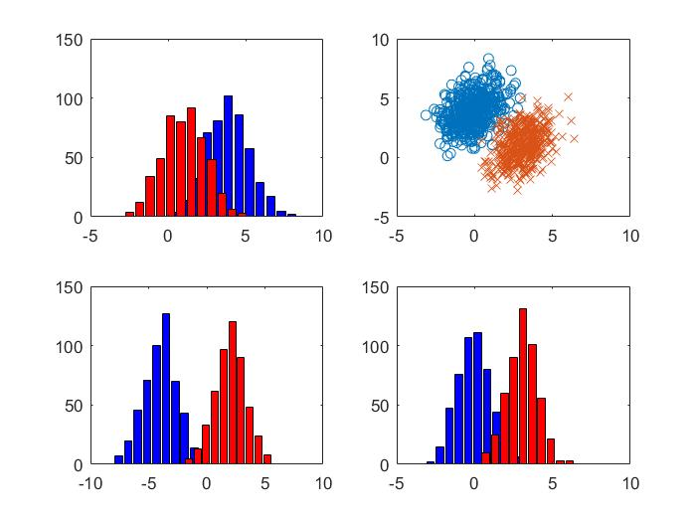
Which one is the best projection?

Slide 5
LDA: Maximize Difference of Means
Considering the simple problem of projecting onto one dimension
The two classes should be well separated in this single dimension
A simple idea is to maximize the difference of the means in the projected space
What is a problem with this solution?
...Overlap of classes after the projection

Slide 6
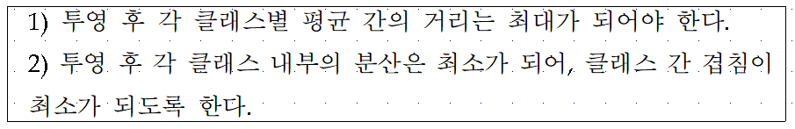









LDA: A Better Idea
Fisher's idea: Fisher's linear discriminant
$$x_{2}$$
$$m_{2}$$
$$m_{1}$$
$$m_{2}$$
$$s_{2}^{2}$$
$$m_{1}$$
$$w$$
$$s_{1}^{2}$$
$$x_{1}$$

Slide 7
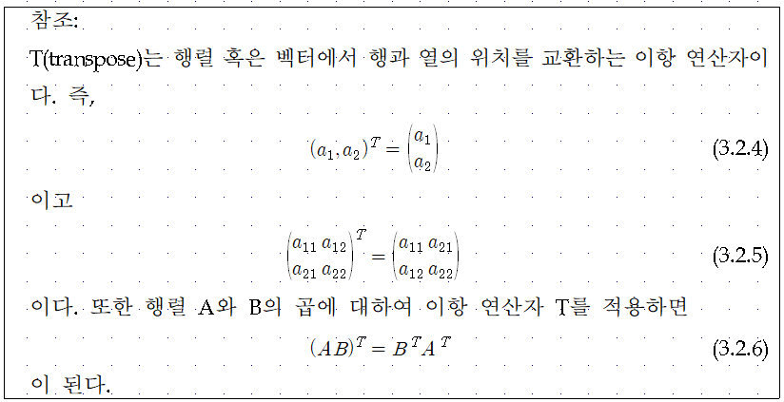

3.2. Projection with Basis Vectors
Point A = ${(a_{1},a_{2})}^{T}$
Basis Vector w = ${(w_{1},w_{2})}^{T}$
Projection $w^{T}A=$ $w_{1}$ $a_{1}$+ $w_{2}$ $a_{2}$

Slide 8

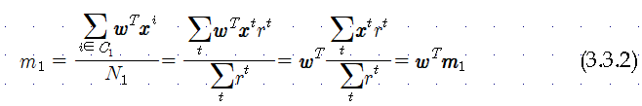


3.3. LDA Formulation
Maximizing
$$x_{2}$$
$$m_{2}$$
$$m_{1}$$
$$m_{2}$$
$$s_{2}^{2}$$
$$m_{1}$$
$$w$$
$$s_{1}^{2}$$
$$x_{1}$$
Between-Class Scatter (numerator)

Slide 9
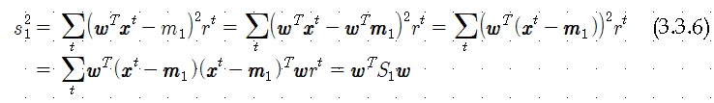

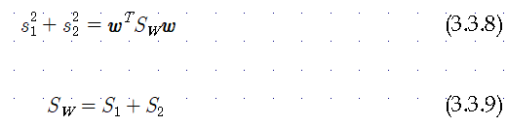

$$x_{2}$$
$$m_{2}$$
Within-Class Scatter (denominator)
$$m_{1}$$
$$m_{2}$$
$$s_{2}^{2}$$
$$m_{1}$$
$$w$$
$$s_{1}^{2}$$
$$x_{1}$$

Slide 10
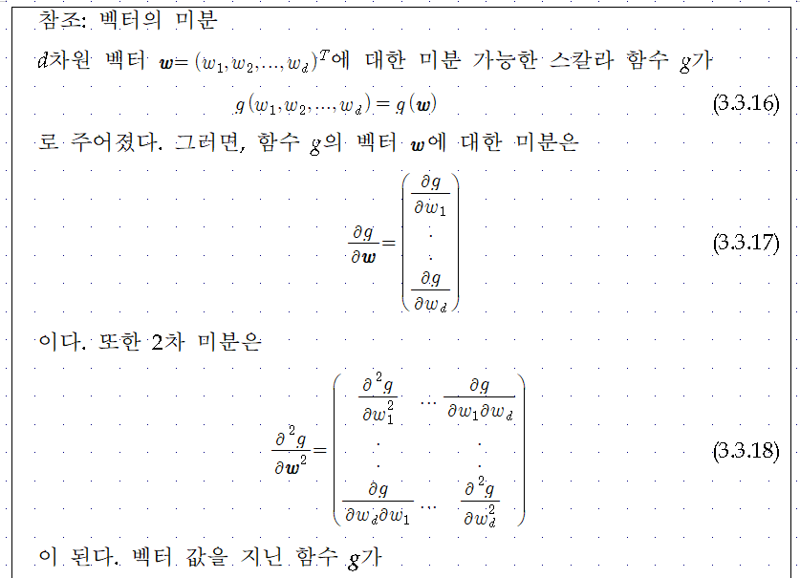

Slide 11
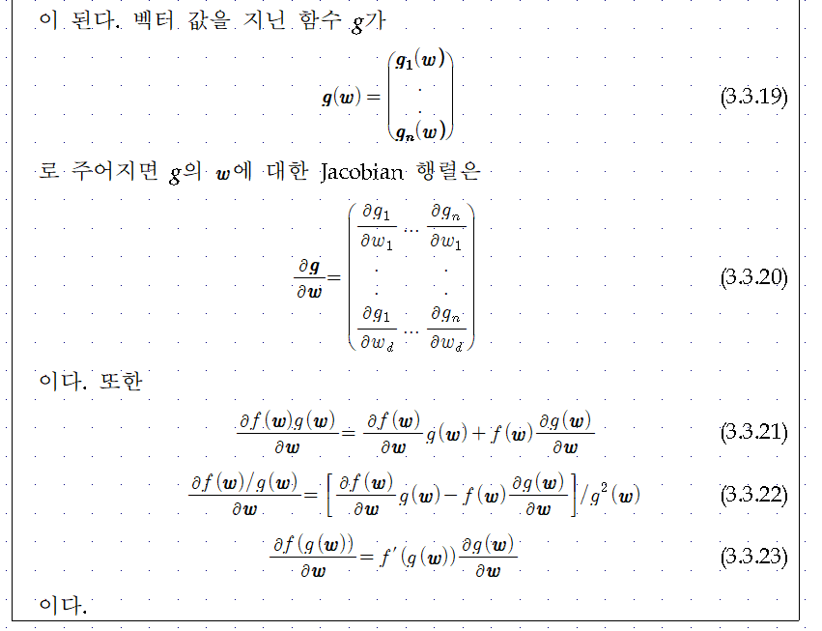

Slide 12
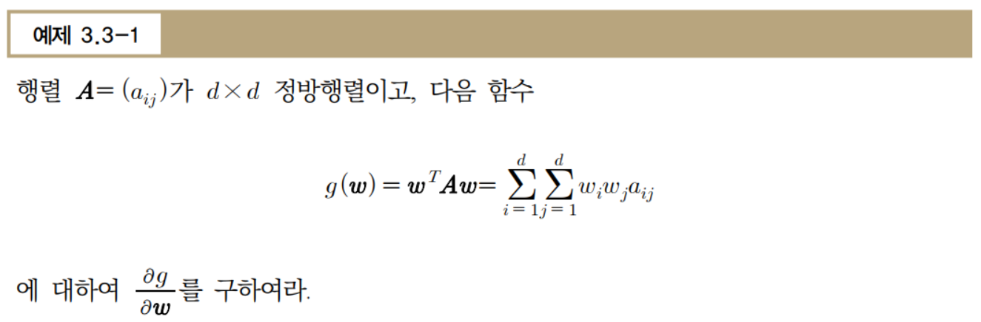

Slide 13


Maximizing
From $\frac{∂J(w)}{∂w}=0,$
scalar

Slide 14
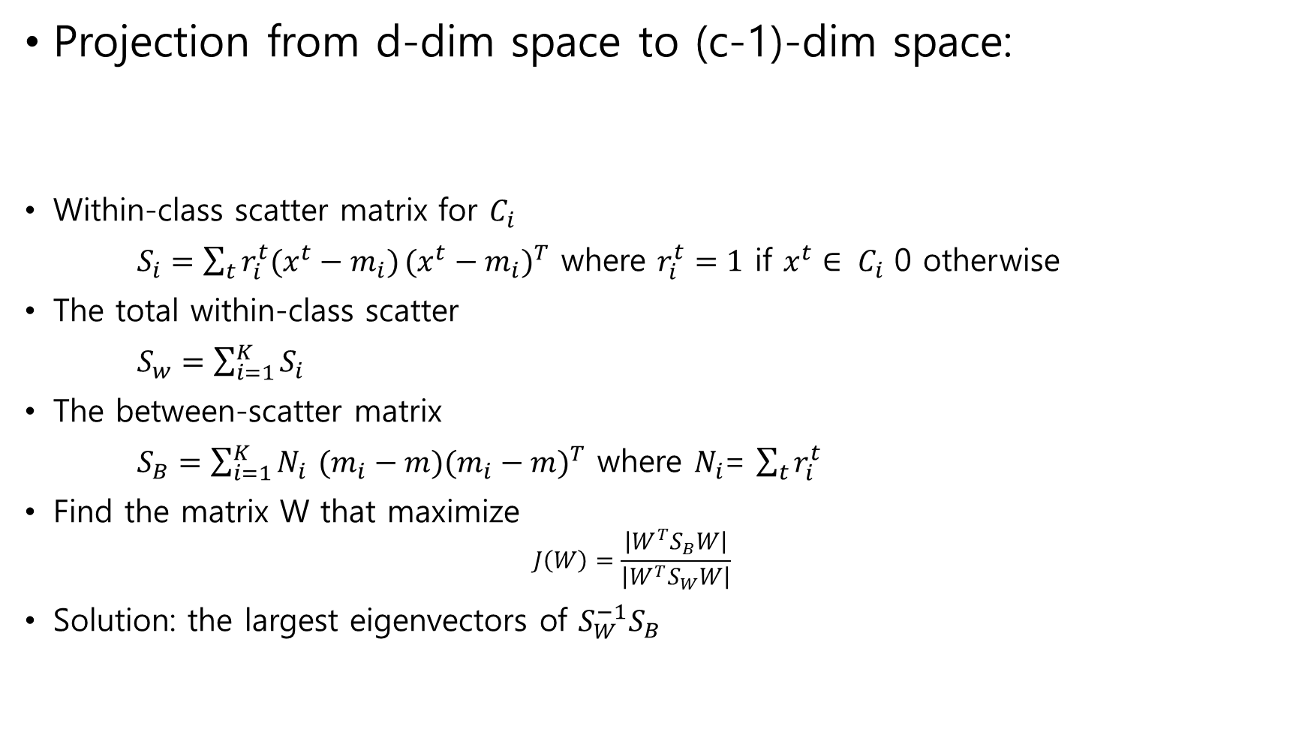
More than 2 Classes (K > 2)
Projection from d-dim space to (c-1)-dim space:
Within-class scatter matrix for $C_{i}$
$S_{i}=\sum_{t}{r_{i}^{t}(x^{t}−m_{i})}{(x^{t}−m_{i})}^{T}$ where $r_{i}^{t}=1$ if $x^{t}∈ C_{i}$ 0 otherwise
The total within-class scatter
$S_{w}=\sum_{i=1}^{K}{S_{i}}$
The between-scatter matrix
$S_{B}=\sum_{i=1}^{K}{N_{i}}$ $(m_{i}−m){(m_{i}−m)}^{T}$ where $N_{i}$= $\sum_{t}{r_{i}^{t}}$
Find the matrix W that maximize
  $$J\left(W\right)=\frac{\left|W^{T}S_{B}W\right|}{\left|W^{T}S_{W}W\right|}$$
Solution: the largest eigenvectors of $S_{W}^{−1}S_{B}$

