Slide 1
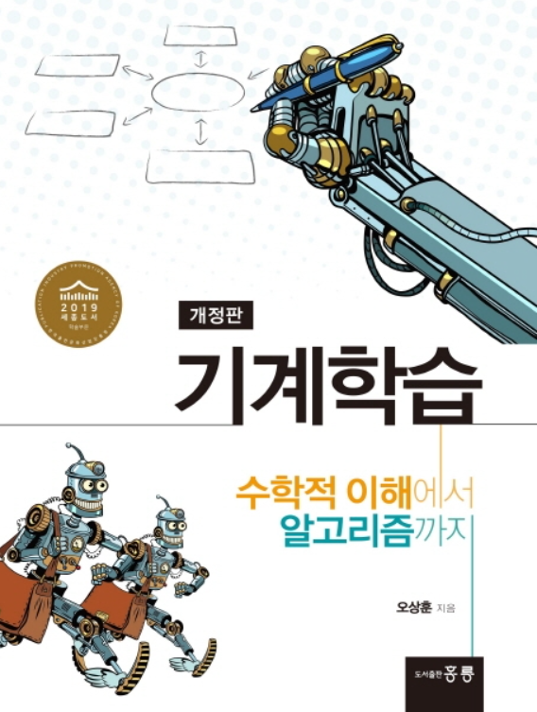
Machine Learning
Sang-Hoon Oh
Division of Information Communication Convergence Engineering
Mokwon University

Slide 2
Contents
Introduction
K-Nearest Neighbor Algorithm
LDA(Linear Discriminant Analysis)
Perceptron
Feed-Forward Neural Networks
RNN(Recurrent Neural Networks)
SVM(Support Vector Machine)
Ensemble Learning
CNN(Convolutional Neural Network)
PCA(Principal Component Analysis)
ICA(Independent Component Analysis)
Clustering
GAN(Generative Adversarial Network)

Slide 3
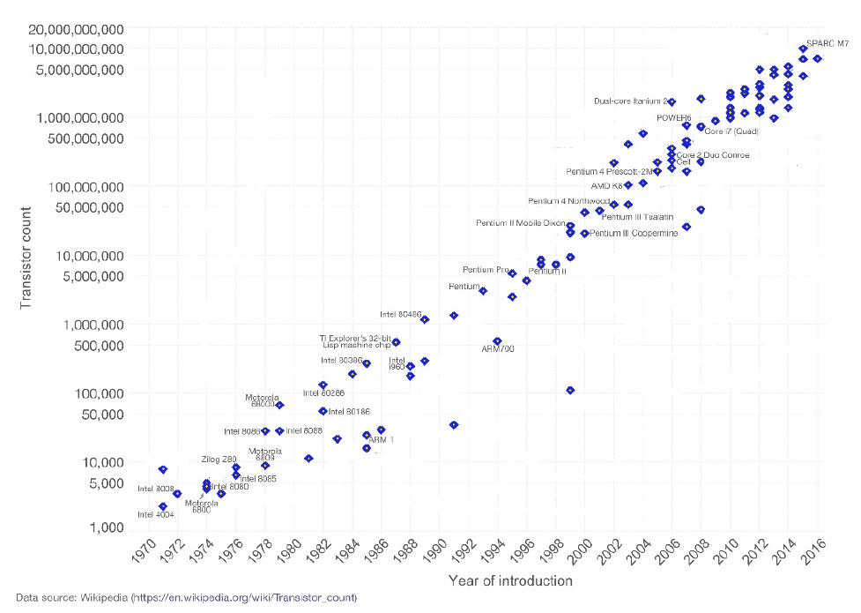
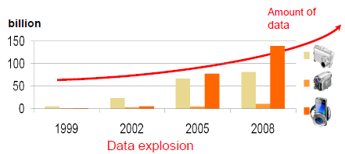
1.1. Machine Learning?
Motivation for Machine Learning
Advances in computer technology
(store/access/process) :
predictions, understanding and control.
Very difficult to understand the details of the process that explains the generation of the data
Need a technique to make a good and useful approximation in detecting certain patterns and regularities Machine Learning!
Moore’s law
The number of transistors that can be inexpensively placed on an integrated circuit is increasing exponentially, doubling approximately every two years

Slide 4
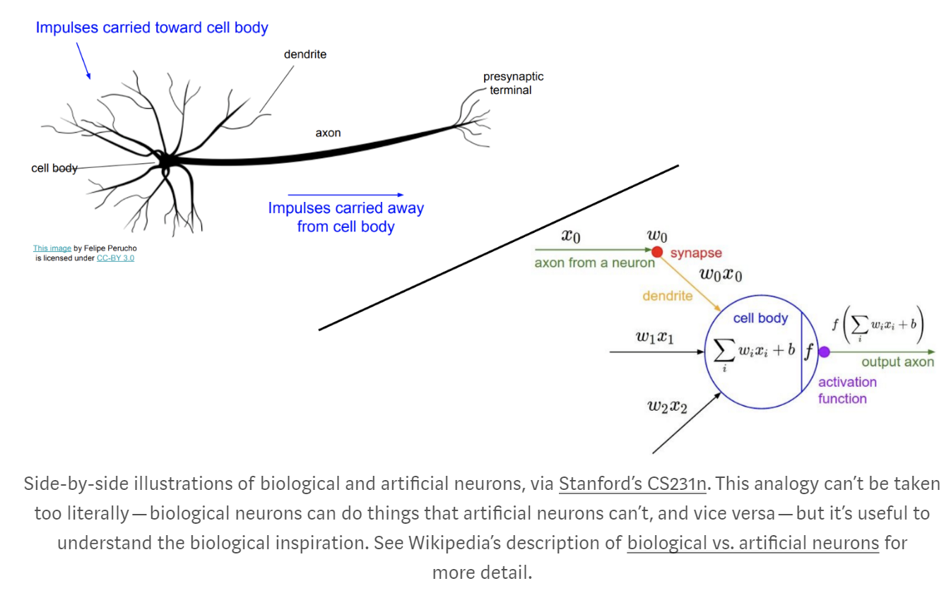
1.2. Historical Background of Machine Learning
Biological vs. Artificial Neuron
(1943) McCulloch and Pitts: Artificial neuron model
(1949) Hebbian learning
(1958) Perceptron (Rosenblatt)

Slide 5
1.2. Historical Background of Machine Learning
1. Latency Period(1940~1980)
2. Quickening Period(1980~1995)
Latency Period (1940~1980)
1943 | McClloch & Pitts Neuron Model
1949 | Hebbian Learning (Hebb)
1958 | Perceptron (Rosenblatt)
1960 | Delta Rule (Widrow & Hoff)
1967 | Outstar Learning (Grossberg)
1969 | Perceptron Book (Minsky & Papert)
1972 | Associative Memory Neural Nets (Kohonen)
1973 | Pattern Classification and Scene Analysis (Duda & Hart)
1977 | Associative Memory Nets (Anderson)
1980 | Neocognitron (Fukushima)
Quickening Period (1980~1995)
1981 | Parallel Models of Associative Memory (Hinton & Anderson)
1982 | Self-Organizing Maps (Kohonen)
1982 | Hopfield Neural Networks (Hopfield)
1983 | Boltzmann Machine (Hinton & Sejnowski)
1985 | Adaptive Resonance Theory (Carpenter & Grossberg)
1986 | Error Back-Propagation Algorithm (Rumelhart, Hinton, &Williams)
1988 | Bayesian Networks (Lauritzen, Spiegelhalter, & Pearl)
1992 | Support Vector Machines (Boser, Guyon, & Vapnik)
1995 | Statistical Learning Theory (Vapnik)

Slide 6
3. Growth Period(1995~2010)
4. Leaping Period(2010~Current)
Growth Period (1995~2010)
1997 | Independent Component Analysis (Bell & Sejnowski)
1998 | Natural Gradient (Amari)
1998 | Reinforcement Learning (Sutton & Barto)
1999 | Learning in Graphical Model (Jordan)
1999 | Kernel Machines (Schoelkopf & Smola)
2003 | Boosting Algorithms (Freund & Shapire)
2005 | DARPA Grand Challenge
2006 | Restricted Boltzmann Machine/Deep Learning (Hinton & Salakutdinov)
2009 | Probabilistic Graphical Models (Koller & Friedman)
Leaping Period (2010~Current)
2010 | Google Car
2011 | IBM Watson AI
2011 | Apple Siri Personal Assistant
2012 | AlexNet
2013 | Allen Institute for Artificial Intelligence
2013 | Facebook AI Research
2014 | Baidu Deep Learning Institute
2014 | Amazon Echo & Alexa
2014 | Generative Adversial Networks (Goodfellow et al.)
2015 | DARPA Robotics Challenge
2016 | Google DeepMind AlphaGo
2016 | Apple AI Lab
2016 | Google Home & Assistant

Slide 7
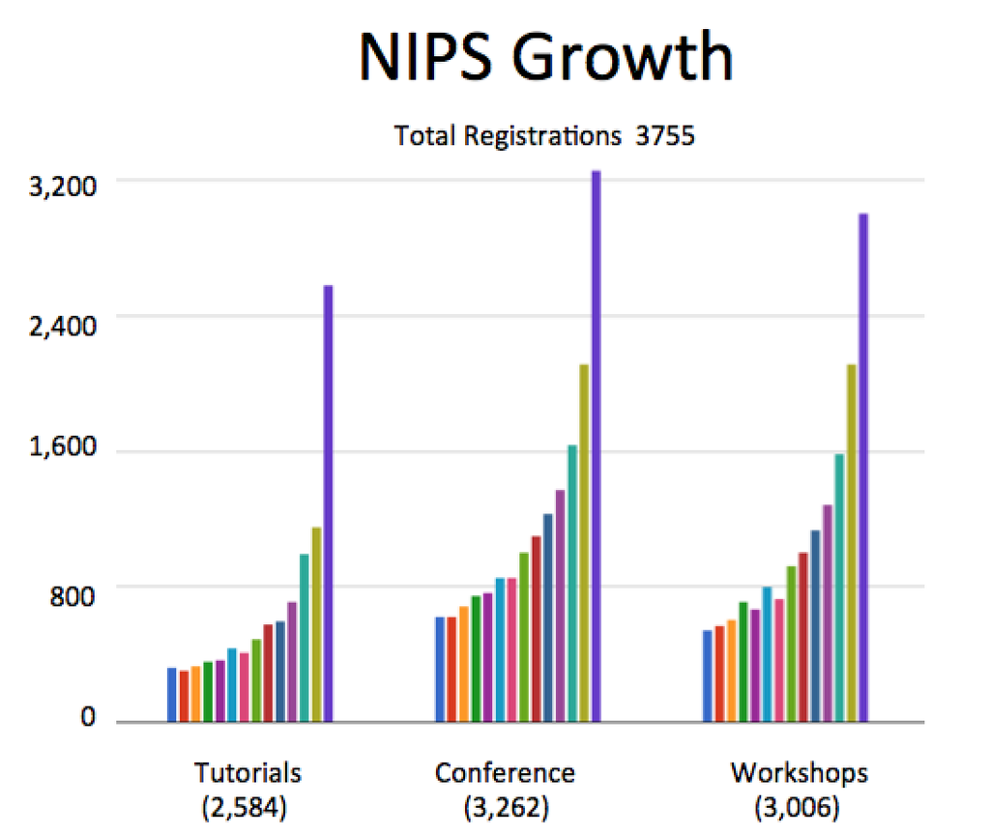
A Brief Review of NIPS 2015
FEBRUARY 2016
Zak Shafran
The twenty ninth Conference on Neural Information Processing Systems (NIPS), a single track machine learning and computational neuroscience conference, was held in Montreal, during a relatively balmy winter week, spanning December 7th to 12th. The conference saw a record number of attendees. As illustrated in the graph, during the last 14 years, there has been a steady increase in the number of attendees in all three categories -- tutorials, conference, and workshops; and biggest growth this year was in tutorials where the attendance doubled compared to the previous year!
A Brief Review of NIPS 2015
February 2016
Article Authors: Zak Shafran
The twenty ninth Conference on Neural Information Processing Systems (NIPS), a single track machine learning and computational neuroscience conference, was held in Montreal, during a relatively balmy winter week, spanning December 7th to 12th. The conference saw a record number of attendees. As illustrated in the graph, during the last 14 years, there has been a steady increase in the number of attendees in all three categories -- tutorials, conference, and workshops; and biggest growth this year was in tutorials where the attendance doubled compared to the previous year!
………………………

Slide 8
1.3. Types of Machine Learning
Prediction
Supervised Learning: Given $\{\left(x_{i},y_{i}\right)\}$ pairs, find a good understanding f: X→Y. Ex) Classification, Regression
Active Learning : Find f: X→Y, but $y_{1},…,y_{N}$ are initially hidden and there is a charge for each label you want revealed. By intelligent adaptive querying, you can get away with significantly fewer labels than those needed in a regular supervised learning framework
Semi-supervised learning: Given both small number of labels and large number of unlabeled data, find f: X→Y.
Understanding
Unsupervised Learning: Given $\{x_{i}\}$ find something interesting. Ex) Clustering, novelty-detection
Policy(Control)
Reinforcement Learning: find f: P→A to max R
(P: history of perception, A: action. R: long term reward)
Generative Model
Generative Adversarial Network: The field of unsupervised learning which aims to study algorithms that learn the underlying structure of the given data, without specifying a target value.

Slide 9
2.2. Classification by k-Nearest Neighbors Algorithm
Classification
Ex) Credit scoring
Low-risk and high-risk customers from their incomes and savings
Class membership
Other examples
Handwritten digit recognition
Speech Recognition
Fraud detection
Savings
Low-risk
High-risk
Income

Slide 10
2.3. Regression by k-Nearest Neighbors Algorithm
Regression
Ex) The price of a used car
Output values: continuous(regression) vs. discrete (classification)
Other examples
Stock price prediction
Oil price prediction
Water level prediction
Price
Milage

Slide 11
Applications
○Medicine/Biology
(Predict) Possibility of second attack (patient hospitalized due to heart attack)
(Predict) Glucose in the blood of diabetic person
(Predict) Predict cancer
Bioinformatics.
○Economy/finance
(Predict) Predict stock price
(Predict) Credit card fraud detection
○IT
(Predict) Handwritten ZIP code recognition
(Predict) Spam mail
(Predict) Speech Recognition
(Understanding) Call patterns for network optimization
○Astronomy/Physics
(Understanding) Discovering astronomical features
○Intelligence
(Policy) Flying helicopters upside down
(Policy) Game playing
(Policy) Robot navigation

