Slide 1
Machine Learning

Slide 2
Contents
Introduction
K-Nearest Neighbor Algorithm
LDA(Linear Discriminant Analysis)
Perceptron
Feed-Forward Neural Networks
RNN(Recurrent Neural Networks)
SVM(Support Vector Machine)
Ensemble Learning
CNN(Convolutional Neural Network)
PCA(Principal Component Analysis)
ICA(Independent Component Analysis)
Clustering
Generative Model

Slide 3








13.1. Discrimination and Generation
Supervised learning
  Training samples
  Objective
Unsupervised learning
  Training samples
  Objective
Classification
  Discriminator to perform
  Discriminant function (w/o p.d.f. information)

Slide 4




Machine learning : training from examples
Generator : generation of samples from or
Discriminator (supervised learning)
Generator (unsupervised learning)

Slide 5
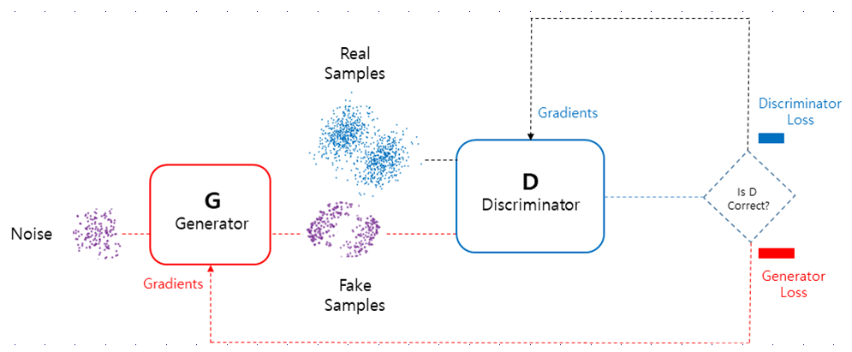
13.2. GAN(Generative Adversarial Network)

Slide 6
Generator
  It aims to generate new data similar to the expected one. The Generator could be asimilated to a human art forger, which creates fake works of art.
Discriminator
  This model’s goal is to recognize if an input data is ‘real’ — belongs to the original dataset — or if it is ‘fake’ — generated by a forger. In this scenario, a Discriminator is analogous to the police (or an art expert), which tries to detect artworks as truthful or fraud.
How do these models interact?
  It can be thought of the Generator as having an adversary, the Discriminator. The Generator (forger) needs to learn how to create data in such a way that the Discriminator isn’t able to distinguish it as fake anymore. The competition between these two teams is what improves their knowledge, until the Generator succeeds in creating realistic data.

Slide 7
13.3. Mathematical Modelling of GAN
Feed-forward neural network: Universal approximator
Discriminator
  It’s weights are updated as to maximize the probability that any real data input x is classified as belonging to the real dataset, while minimizing the probability that any fake image is classified as belonging to the real dataset. In more technical terms, the loss/error function used maximizes the function D(x), and it also minimizes D(G(z)).
Generator
  A neural network G(z, θ₁) is used to model the Generator mentioned above. It’s role is mapping input noise variables z to the desired data space x (say images). Conversely, a second neural network D(x, θ₂) models the discriminator and outputs the probability that the data came from the real dataset, in the range (0,1). In both cases, θᵢ represents the weights or parameters that define each neural network.
  The Generator’s weight’s are optimized to maximize the probability that any fake image is classified as belonging to the real datase. Formally this means that the loss/error function used for this network maximizes D(G(z)).

Slide 8
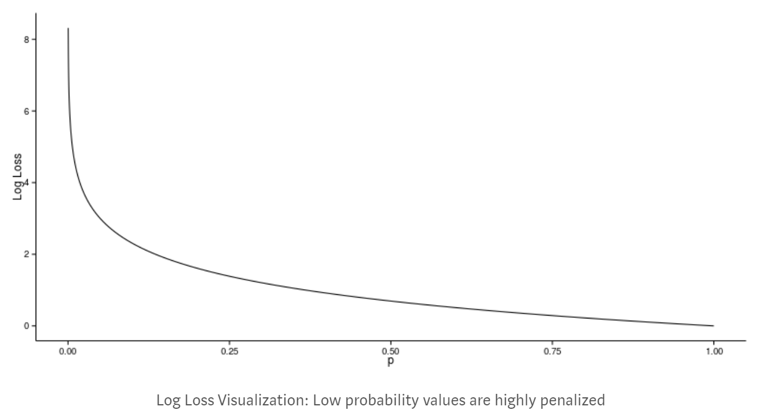

Slide 9
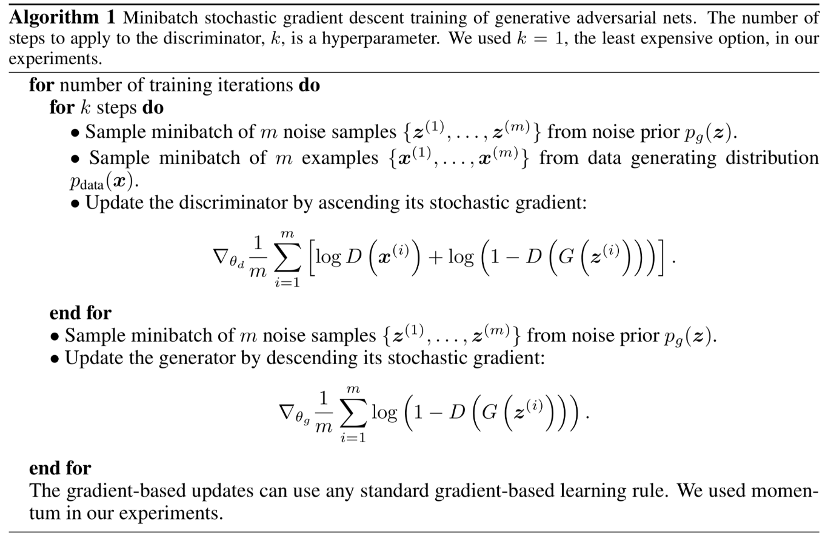

Slide 10
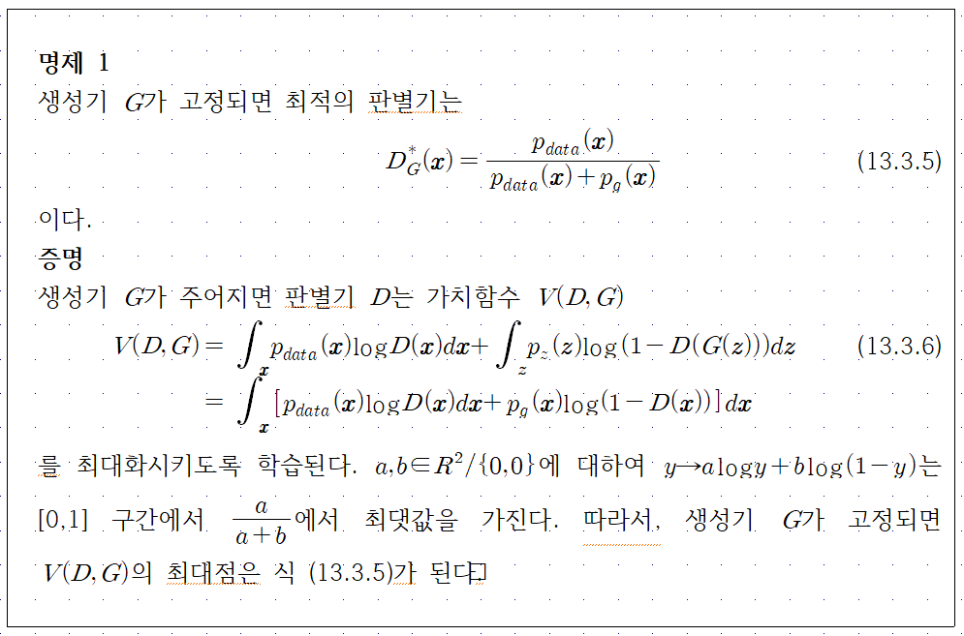

Slide 11
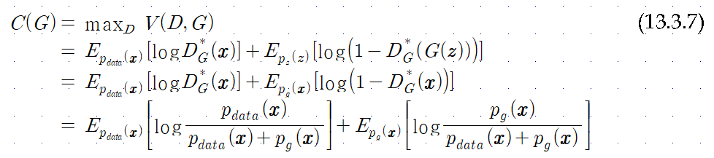

Slide 12
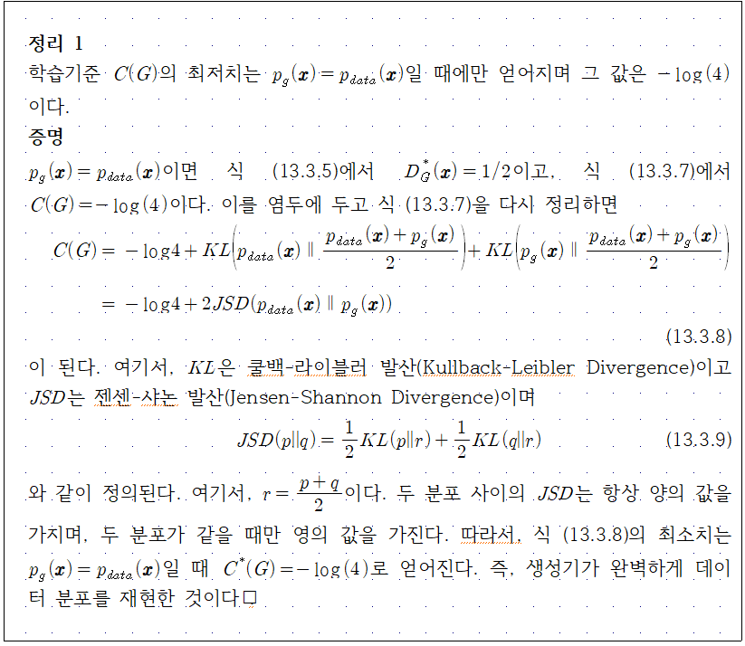

Slide 13
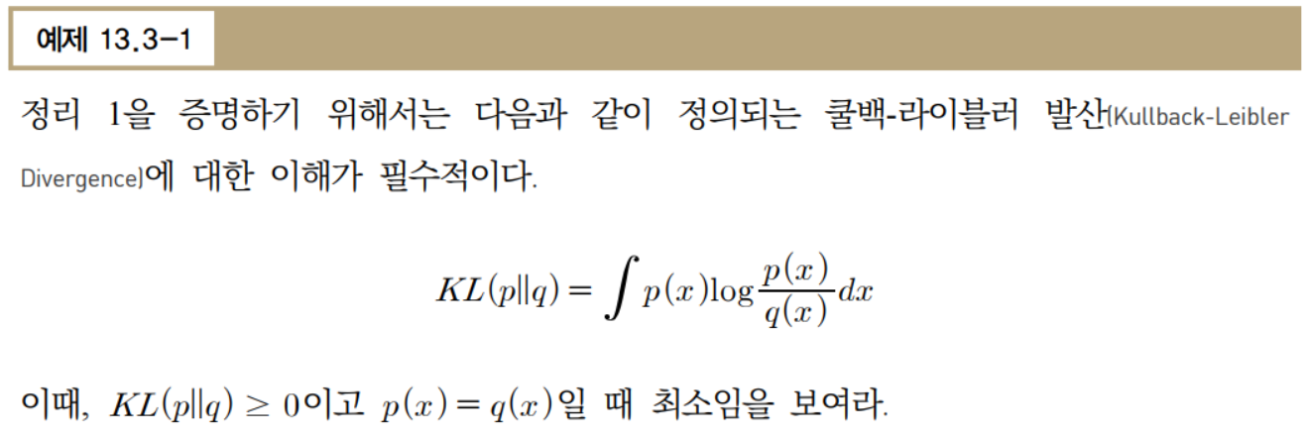
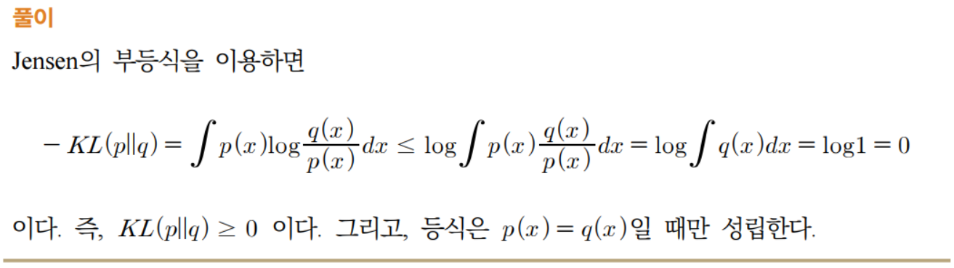

Slide 14


13.4. Coding a GAN
Leaky ReLU
Training Discriminator
  Maximizing
Training a Generator
  Minimizing

Slide 15
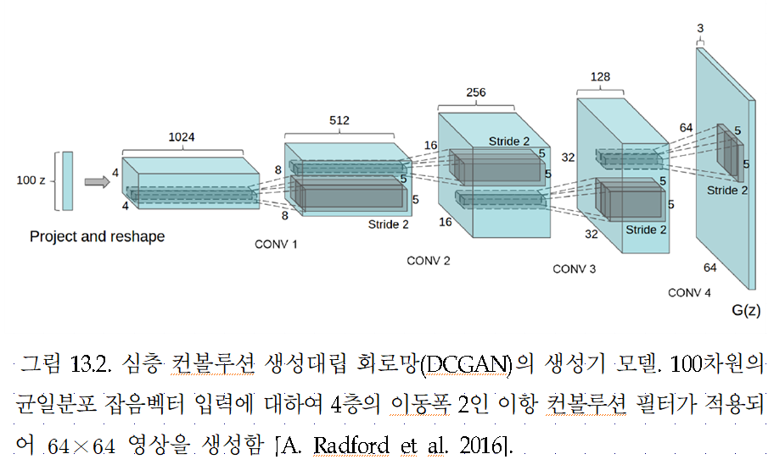
13.5. DCGAN

Slide 16
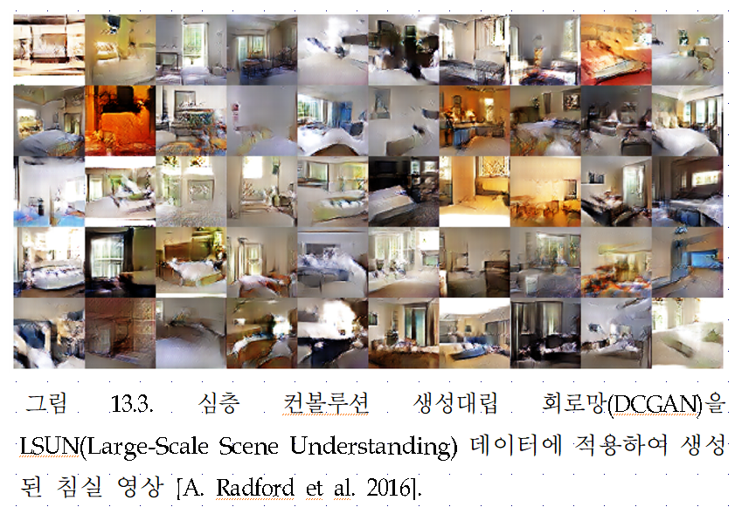

Slide 17
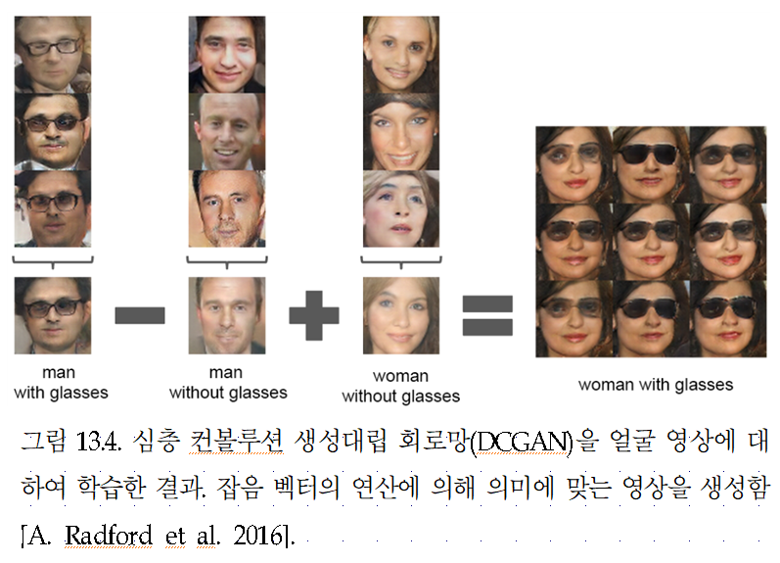

Slide 18
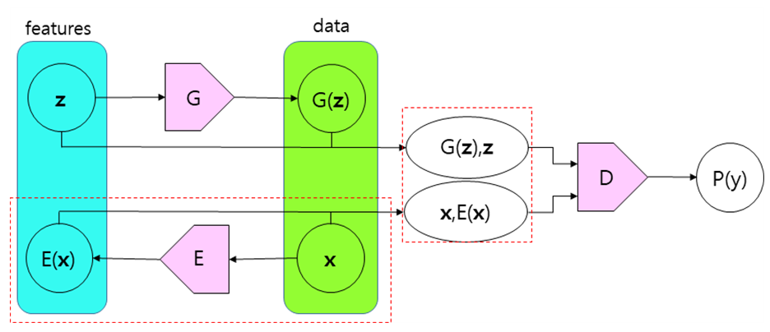
13.6. BiGAN

Slide 19
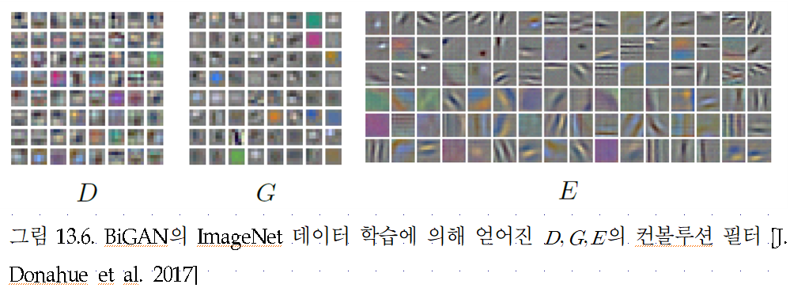

Slide 20
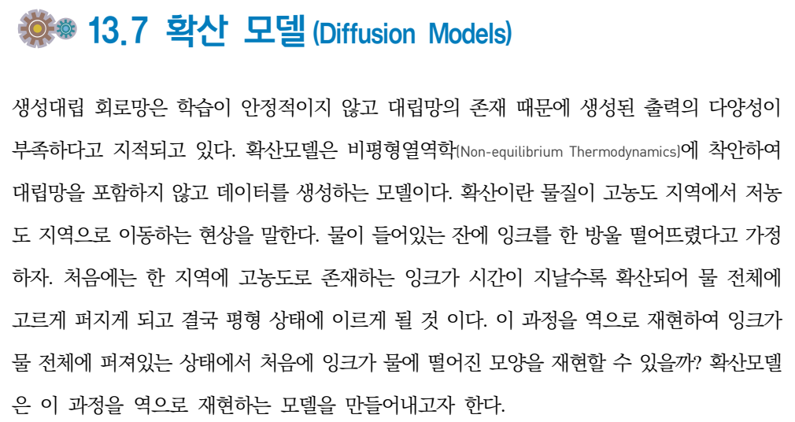

Slide 21
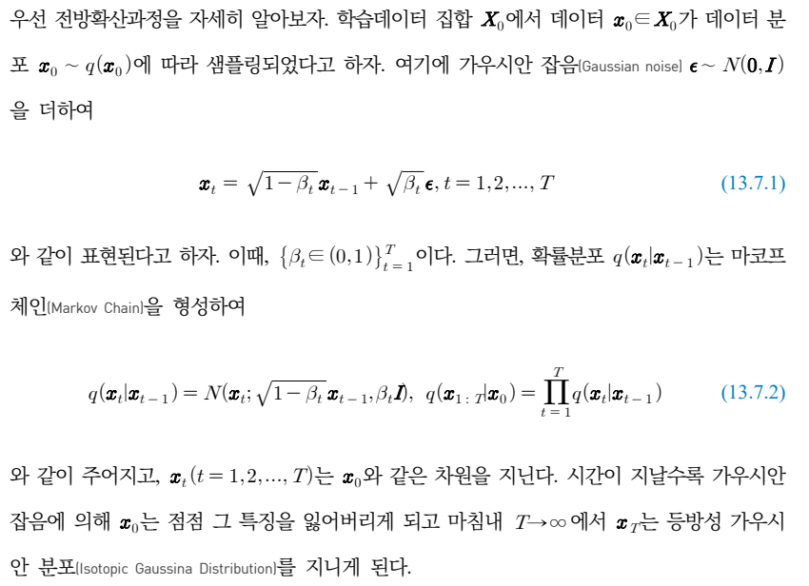

Slide 22
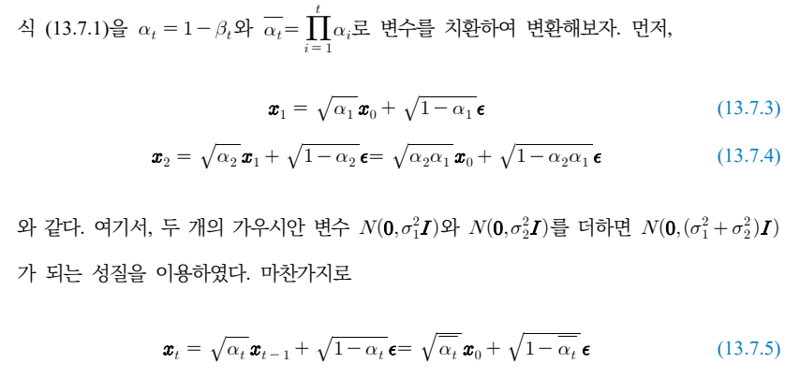


Slide 23
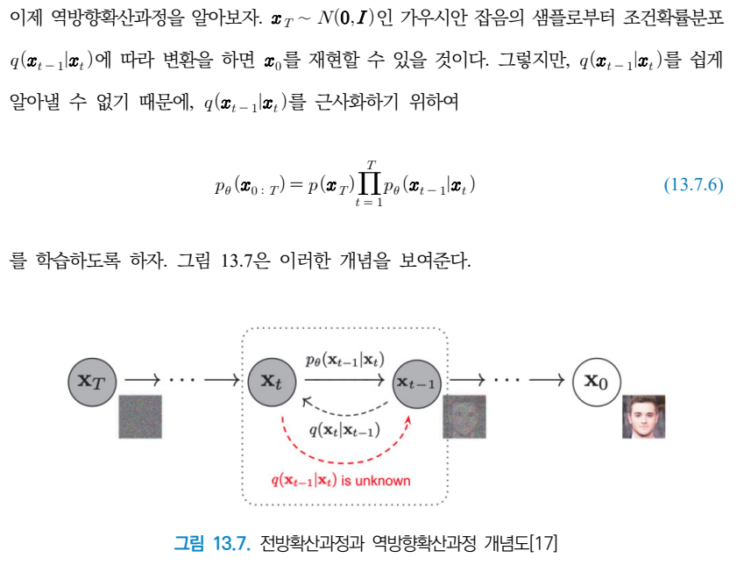

Slide 24
