Slide 1
Machine Learning

Slide 2
Contents
Introduction
K-Nearest Neighbor Algorithm
LDA(Linear Discriminant Analysis)
Perceptron
Feed-Forward Neural Networks
RNN(Recurrent Neural Networks)
SVM(Support Vector Machine)
Ensemble Learning
CNN(Convolutional Neural Network)
PCA(Principal Component Analysis)
ICA(Independent Component Analysis)
Clustering
GAN(Generative Adversarial Network)

Slide 3
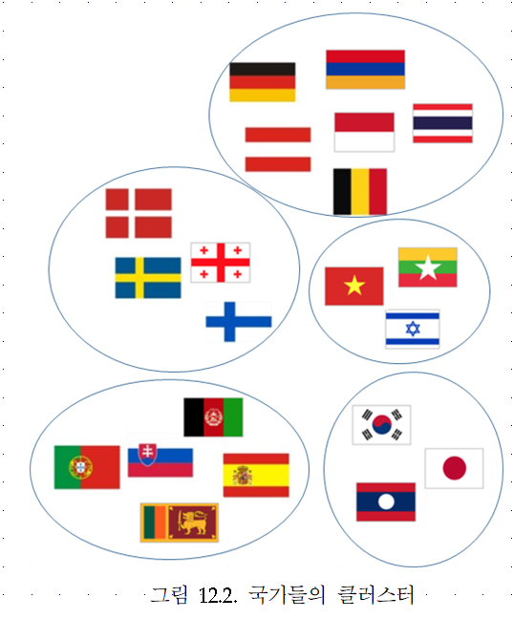
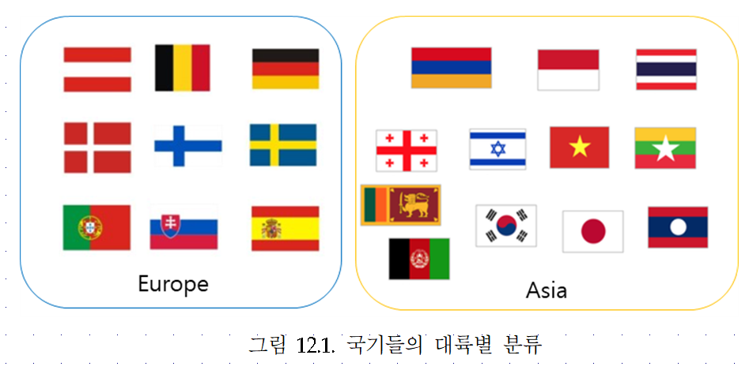
12.1. Clustering
Classification (known categories)
Clustering (creation of new categories)

Slide 4
Clustering
Clustering: grouping a set of objects into classes of similar objects
Subjective process
Unsupervised learning: learning from unlabelled data, as opposed to supervised data where a classification of examples is given
Many applications in science and engineering (data mining, statistical data analysis, pattern recognition, image analysis, information retrieval, bioinformatics, data compression, computer graphics
Characteristics
Dense in a certain area of space
high intra-class similarity
low inter-class similarity
It is the commonest form of unsupervised learning

Slide 5
12.2. Issues for clustering
“Groupness": What is a natural grouping among these objects?
“Similarity/Distance": What makes objects related?
“Representation": How do we represent objects? Vectors? Do we normalise?
“Parameters": How many clusters? Fixed a priori? Data-driven?
“Algorithms": Partitioning the data? Hierarchical algorithm?
Formal foundation and convergence

Slide 6
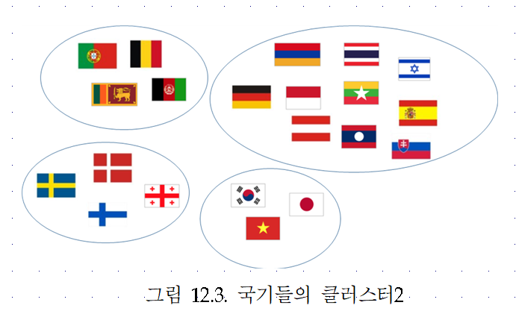
Groupness: What is a natural grouping among these objects?

Slide 7
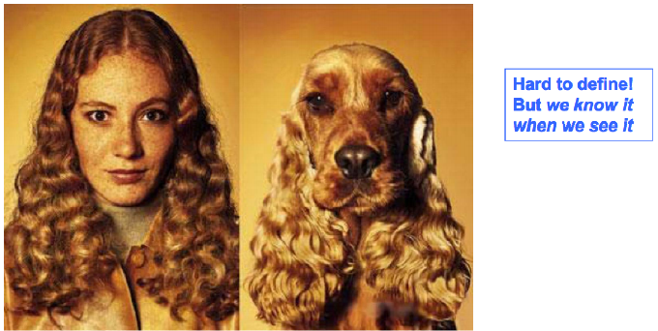
How do we define similarity?

Slide 8
A distance measure : properties?
Symmetry
Self-similarity
Triangular-Inequality

Slide 9
Distance measures
Two objects ( p features)
The Minkowski Distance Metric
Euclidean distance, Manhattan distance, supreme distance, infimum distance

Slide 10
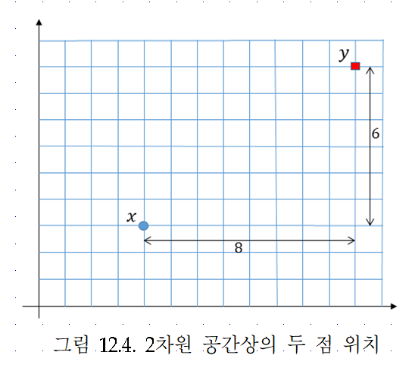
An example

Slide 11
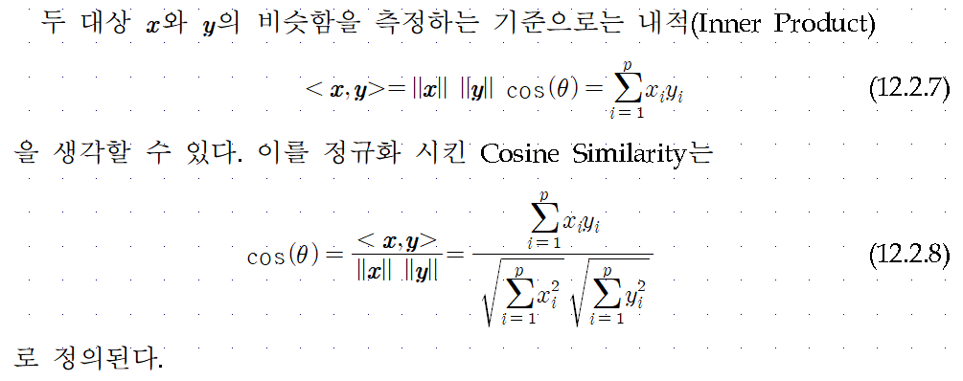

Slide 12
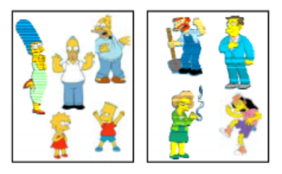
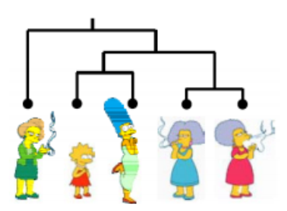
Clustering algorithms
Partitional Algorithm
Usually start with a random partitioning
K means clustering
Hierarchical Algorithm
Bottom-up
Top-down

Slide 13
Clustering algorithms

Slide 14
Distance between clusters
Single-link nearest neighbor: distance between their closest members
Complete-link farthest neighbor: distance between their farthest members
Centroid: distance between the centers of gravity of the two clusters
Average: distance between the average of all cross-cluster pairs

Slide 15
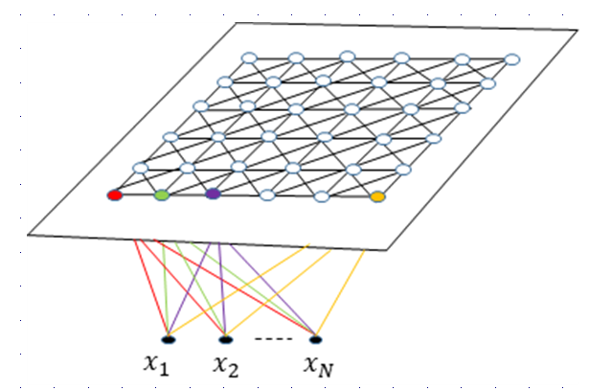
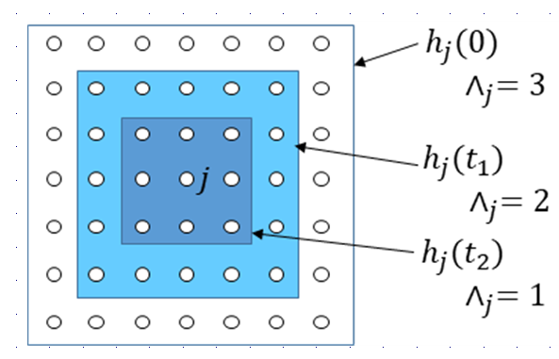
12.3. SOM(Self-Organizing Map)

Slide 17
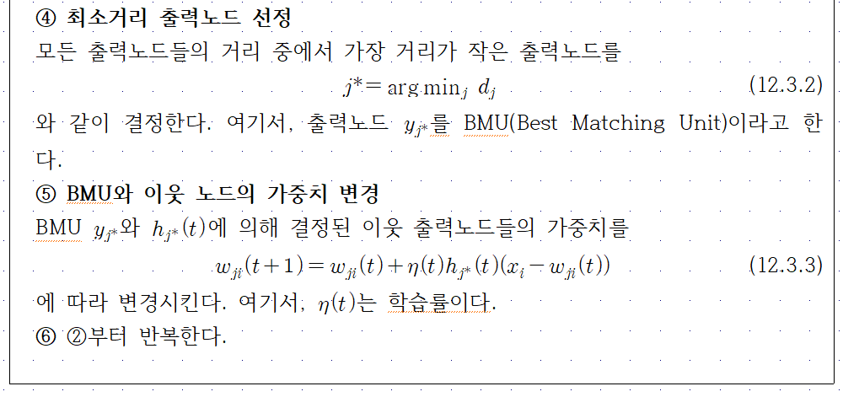

Slide 18
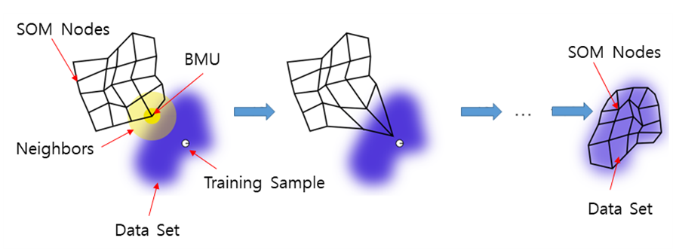

Slide 19
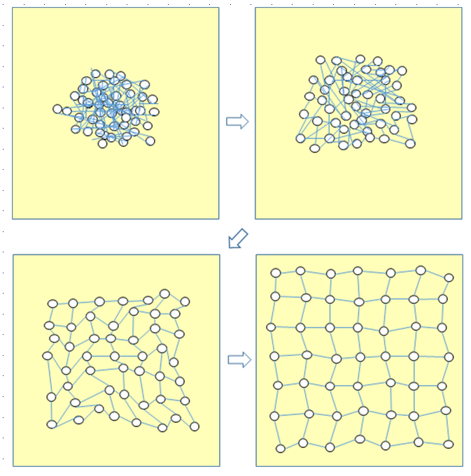

Slide 20
12.4. Conscience Learning

Slide 21
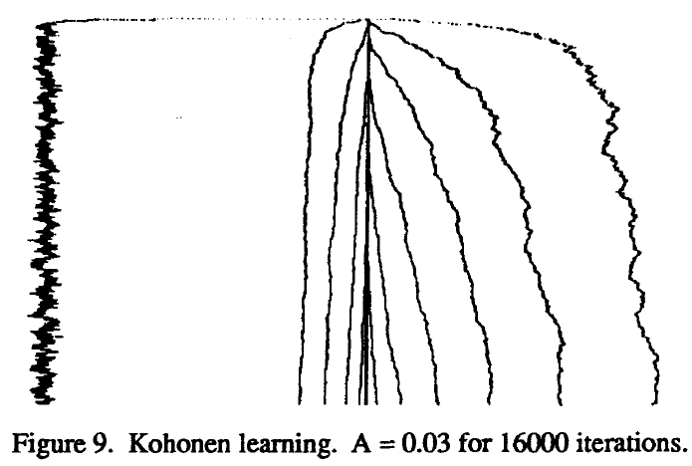
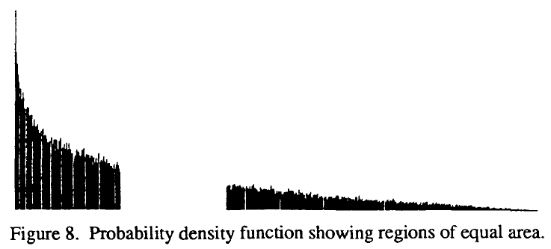
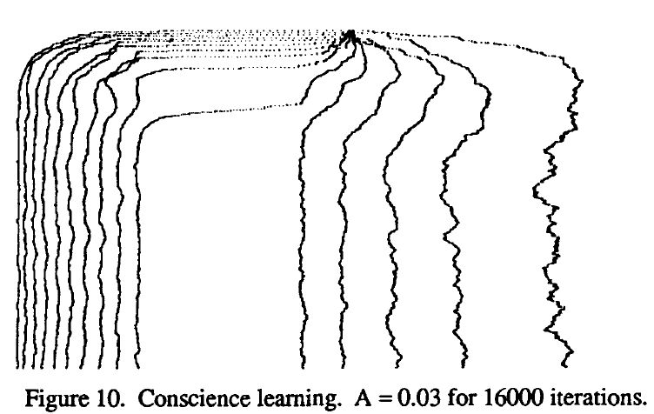

Slide 22
12.5. K-means Clustering
Vector Quantization
24bits/pixel (16M colors) ⇒ 8 bits/pixel (256 colors)
Uniform quantizing ( [0, 65535] → color 0 ) : wastes the color map
Find k reference vectors which best represent the data
Given $X=\left\{x^{t}\right\}$, find k reference vectors $m_{j}, j=1,2,…,k$

Slide 23
k means Clustering Algorithm
Assignment Step
Update Step

Slide 25
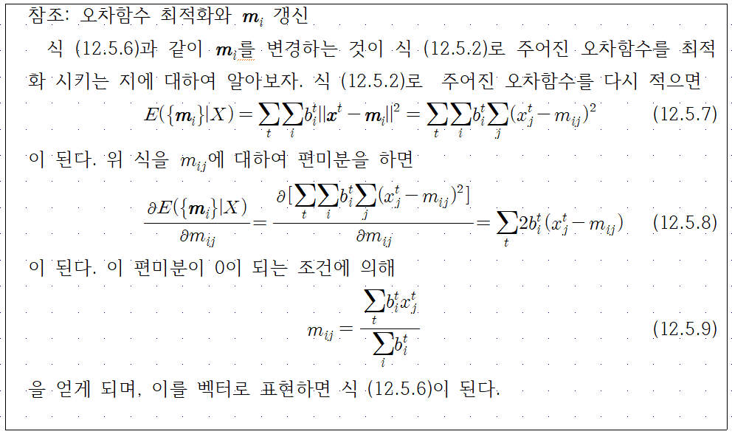

Slide 26
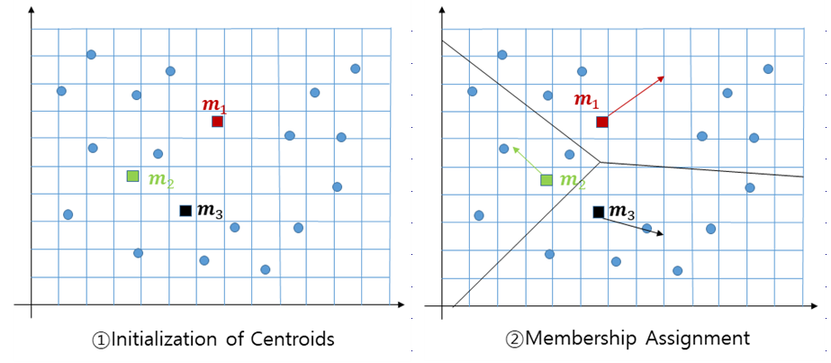

Slide 27
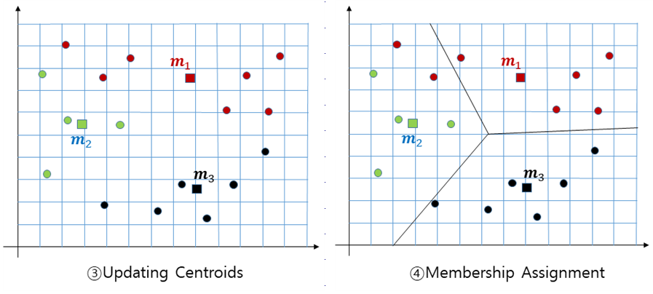

Slide 28
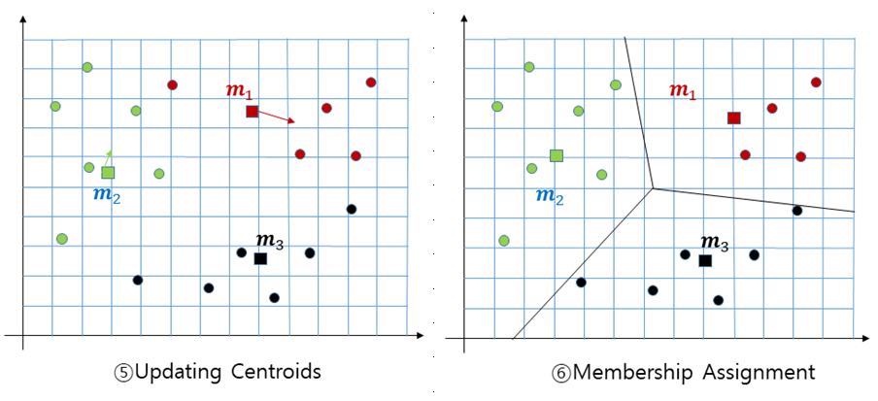

Slide 29
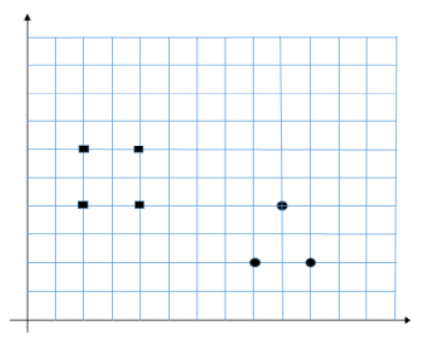

Slide 30
12.6. Evaluation
Evaluation (or "validation") of clustering results is as difficult as the clustering itself. Popular approaches involve "internal" evaluation, where the clustering is summarized to a single quality score, "external" evaluation, where the clustering is compared to an existing "ground truth" classification, "manual" evaluation by a human expert, and "indirect" evaluation by evaluating the utility of the clustering in its intended application.
Internal evaluation
Davies–Bouldin index
Dunn index

Slide 31
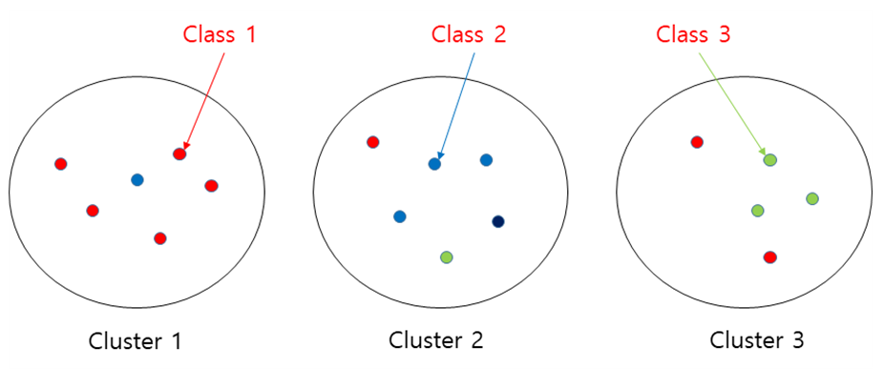
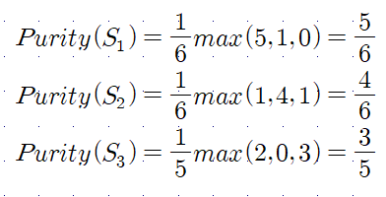
External evaluation
Purity

