Slide 1
Machine Learning

Slide 2
Contents
Introduction
K-Nearest Neighbor Algorithm
LDA(Linear Discriminant Analysis)
Perceptron
Feed-Forward Neural Networks
RNN(Recurrent Neural Networks)
SVM(Support Vector Machine)
Ensemble Learning
CNN(Convolutional Neural Network)
PCA(Principal Component Analysis)
ICA(Independent Component Analysis)
Clustering
GAN(Generative Adversarial Network)

Slide 3

11.1. Problem Statement
Cocktail Party Problem

Slide 4
Unknown mutually independent source signals with zero means
The model for sensor signals
Problem
  To recover the original signals except for a permutation of indices and scales
  Estimation of an unmixing matrix
u
W
x
A
s

Slide 5
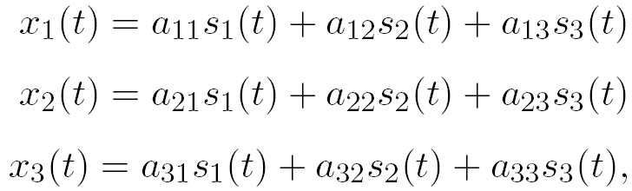








=
X

Slide 6
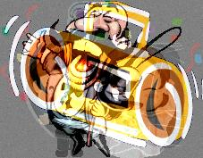
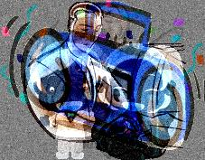

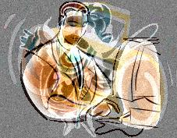


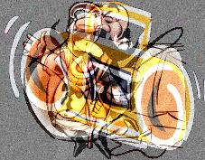

Blind Source Separation by ICA
?
mixing environment
initial system
Unknown sources and
the mixing environment

Slide 7
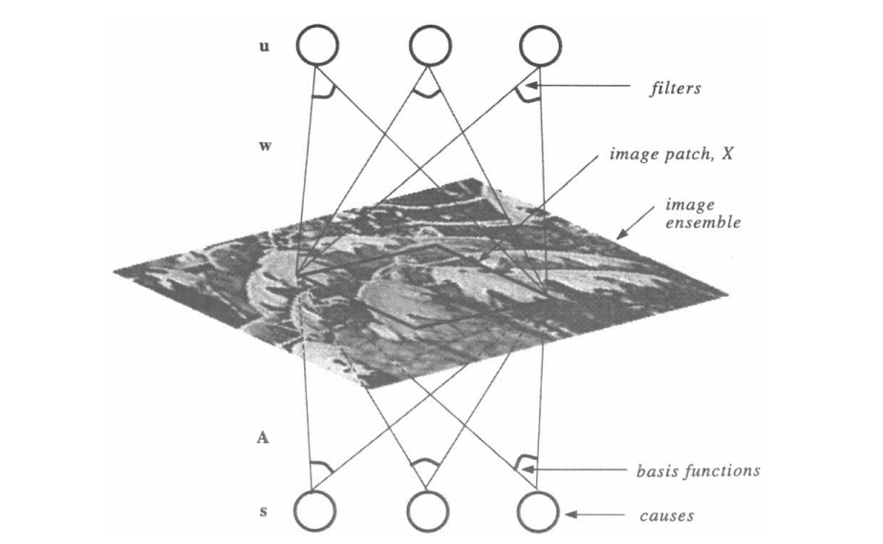
  Independent Components of Natural Scenes (Bell and Sejnowski, Vision Research 1996.[2])

Slide 8
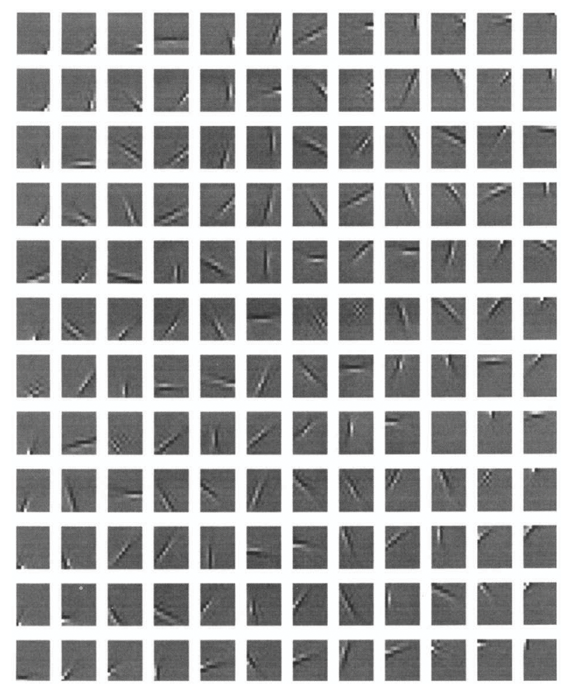
  Independent Components are Edge Filters

Slide 9
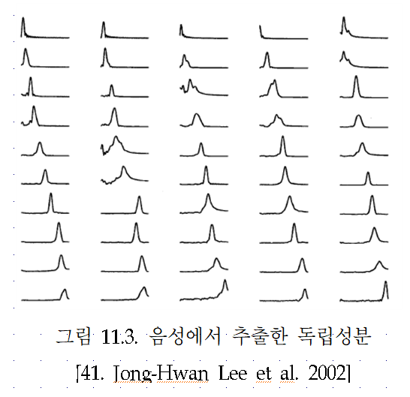

Slide 10
Assumptions and limitations on ICA
Basic assumptions:
  Individual source signals are statistically independent of the other source signals.
  # of sources ≤ # of observations
    x = As s=Wx
Limitations:
  Scale and sign indeterminacy
    We cannot determine the variance of sources
    x = As = (A/α) (αs)=A’s’
  Permutation indeterminacy
    We cannot determine the order of sources
  Sources should be non-Gaussian. At most one source can be Gaussian.

Slide 11

11.2. Information Theory
What is Entropy?
Definition: The average amount of information of the source.
Ex) Two Symbol Sources
1
0
1/2
1
p

Slide 12
Differential Entropy
  Bounded Case: Uniform Distribution
  Unbounded Case: Normal Distribution (Gaussian)
Joint Entropy
Mutual Information

Slide 13
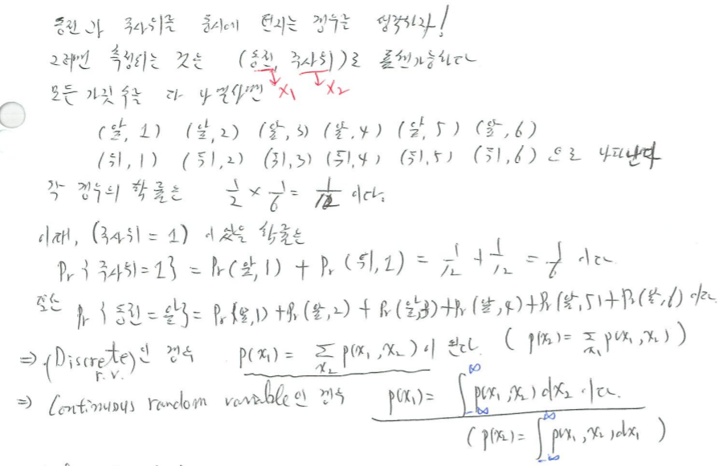

Slide 14
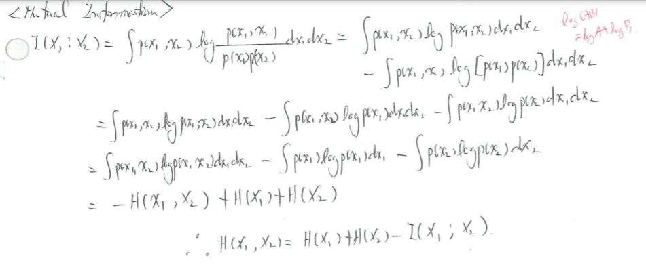
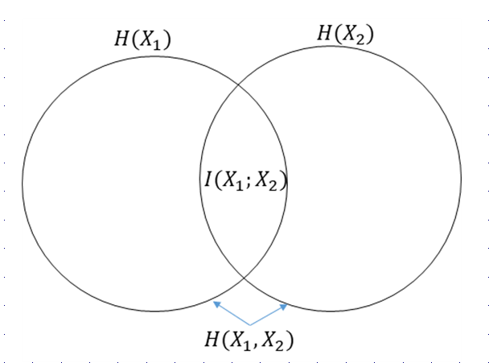
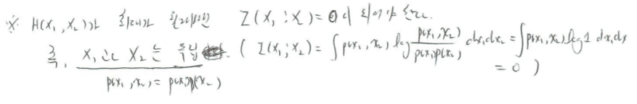

Slide 15
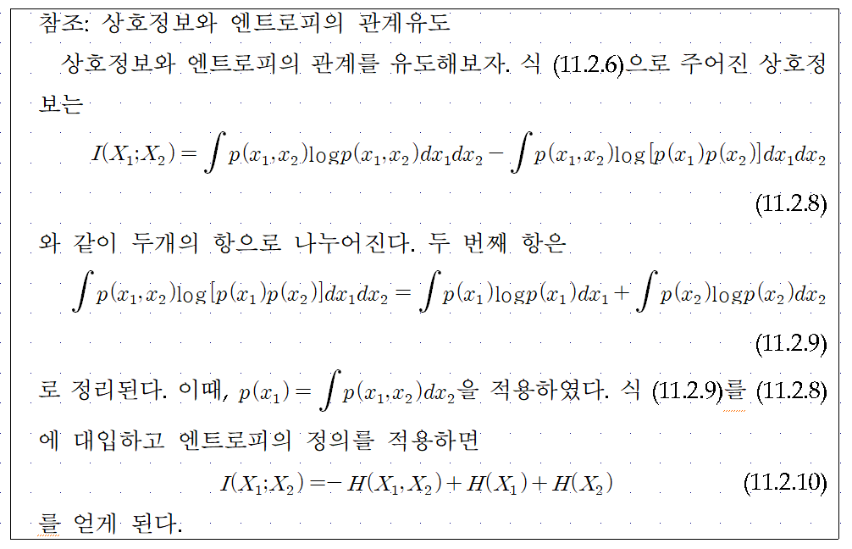

Slide 16
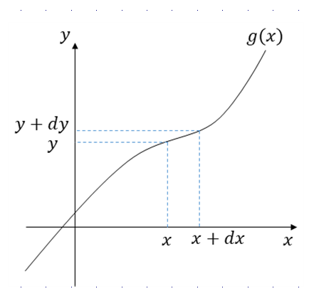
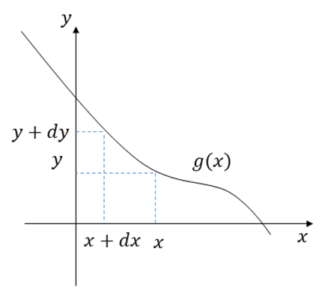
Probability Density Function
11.3. Probability

Slide 17
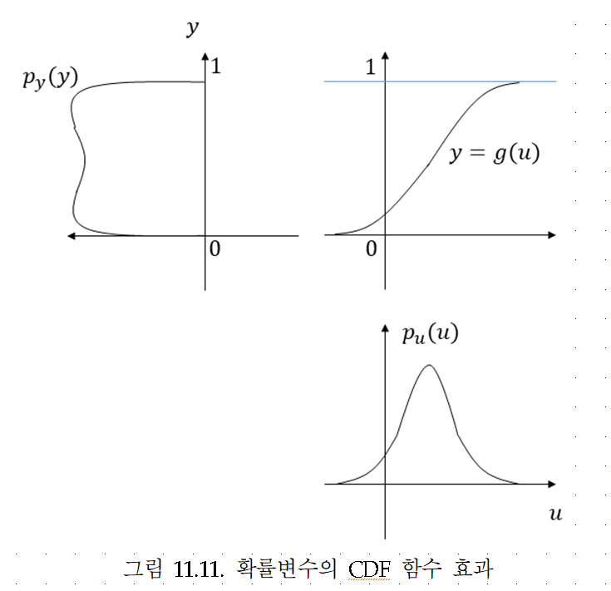

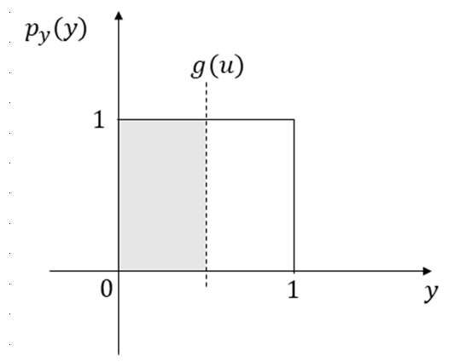


Slide 18
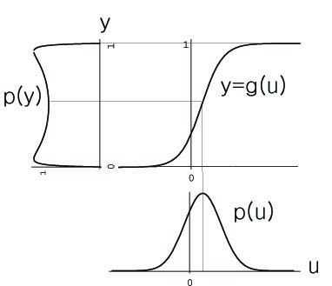
Objective Function of ICA
11.4. InfoMax Algorithm
Objective Function of ICA
Minimizing Mutual Information
Maximizing Entropy H(y)
u
W
x
A
s

Slide 19
Maximizing Output Entropy: InfoMax
Joint entropy at the outputs
Pdf of the outputs
Joint entropy at the outputs
where

Slide 20
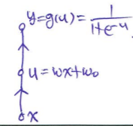
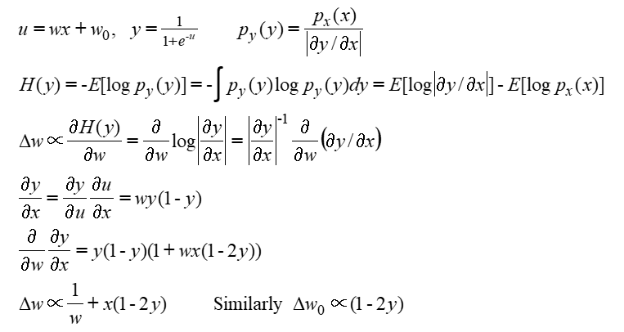

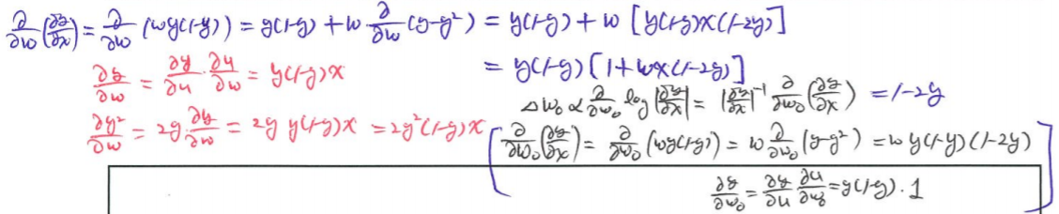
One Input One Output
Stochastic gradient ascent learning rule

Slide 21
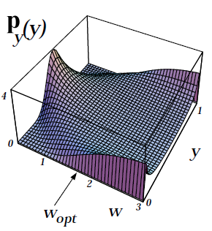
One Input One Output
Stochastic gradient ascent learning rule

Slide 22
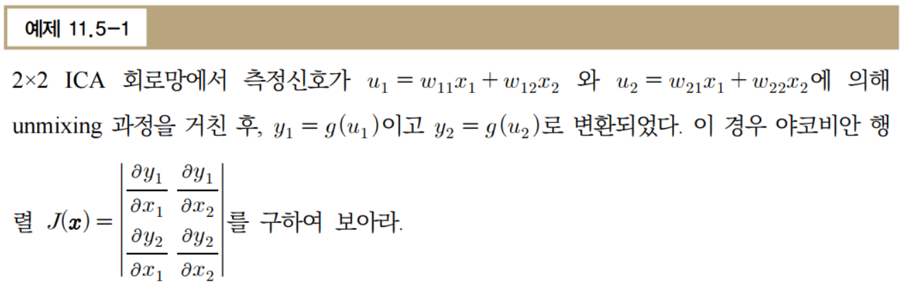
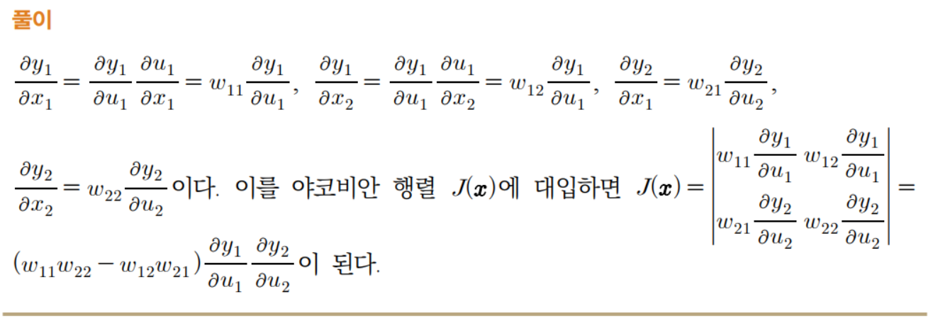

Slide 23

11.4. InfoMax Algorithm: N→ N Network
Stochastic gradient ascent learning rule
Jacobian of the transform

Slide 24
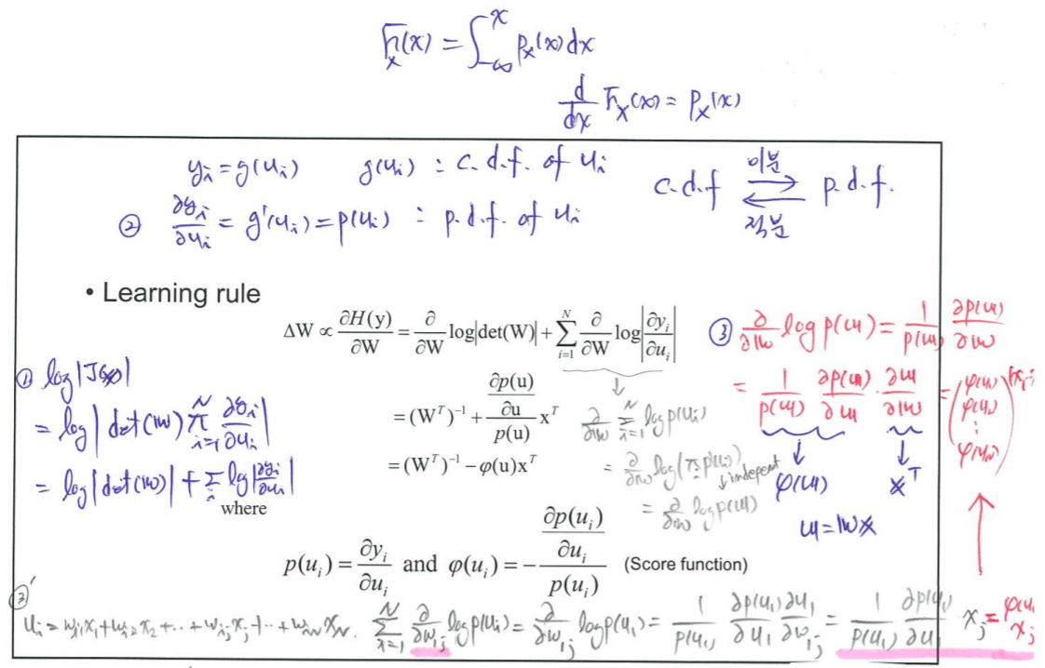

Slide 25
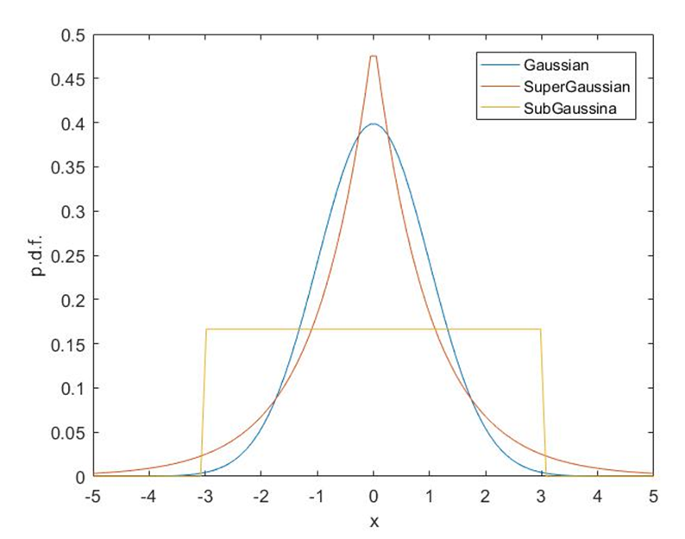
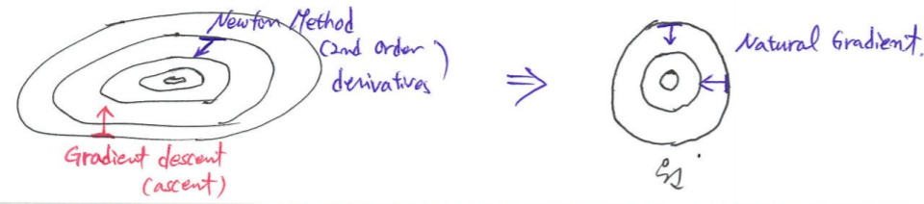

Natural Gradient (or Relative Gradient) (Amari, Neural Comuptation, 1998. [31])
How can we decide the score ft.:Ext. ICA (T.-W. Lee et al., 1999.[32])

Slide 26
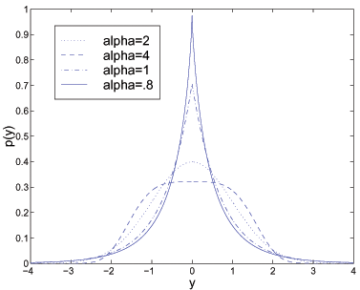
Flex. ICA: Generalized Gaussian
(S. Choi. 2000.[34])

Slide 27
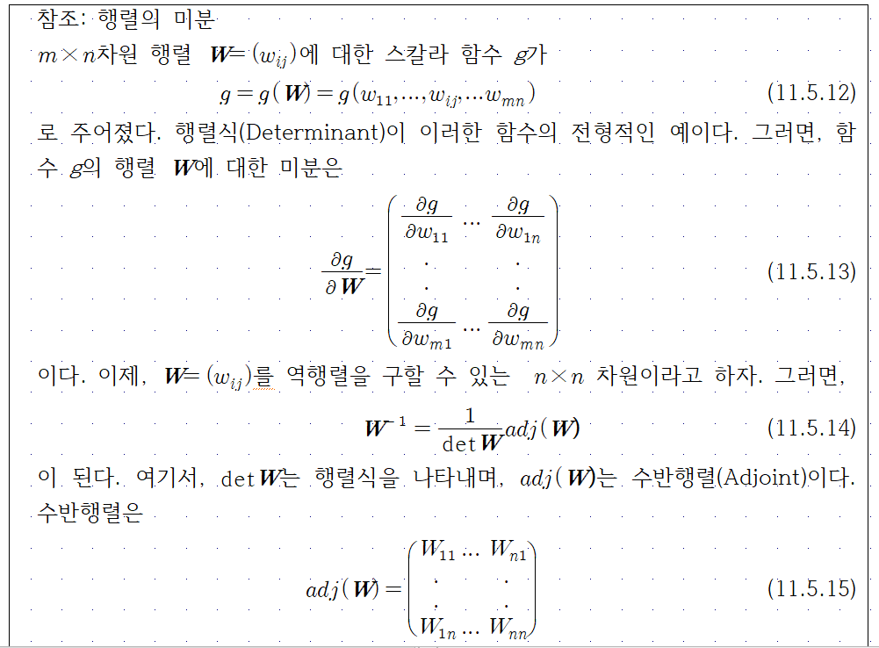
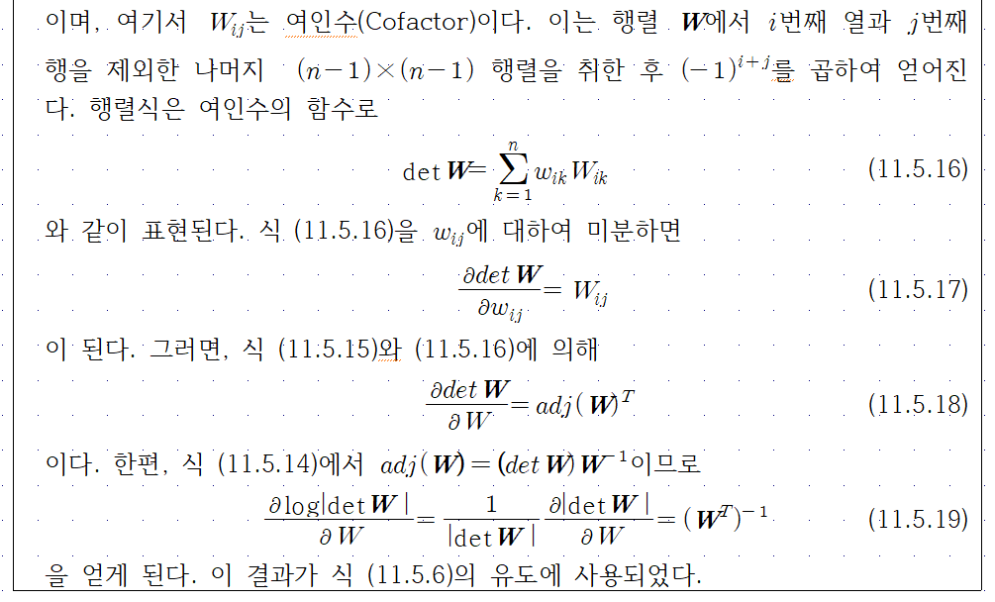

Slide 28
11.5. Comparison with PCA and Applications
PCA
Calculate covariance matrix
Using SVD, find M eigenvalues and eigenvectors.
Choose L eigen vectors corresponding to L largest eigen values.
L Largest eigen values
M-L small eigen values

Slide 29
Comparison of PCA and ICA
Independent = uncorrelated ?
Only for Gaussian data
dependence = correlation
ICA basis
PCA basis
Generally,
dependence ≠ correlation

Slide 30
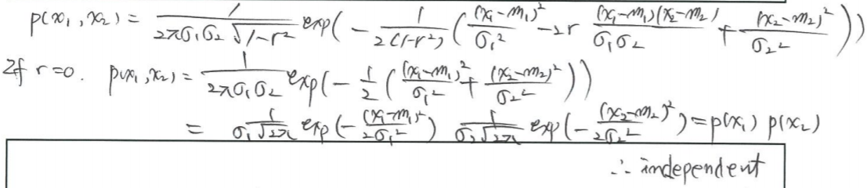
Comparison of PCA and ICA
Independent = uncorrelated ?
Only for Gaussian data
dependence = correlation
Generally,
dependence ≠ correlation

Slide 31
Whitened signal and independent signal
Observations
Whitened
Independent

Slide 32
Unifying Information-Theoretic Framework(1)
Max. H(y): InfoMax
Minimizing Mutual Information
Negentropy Maximization

Slide 33
Unifying Information-Theoretic Framework(2)
Maximum Likelihood Estimation

Slide 34
Unifying Information-Theoretic Framework(3)
High-Order Moments and Cumulants
Nonlinear PCA
Bussgang Algorithms
(Te-Won Lee et al., Computers and Mathematics with Applications, 2000. [1])

Slide 35
Applications of ICA
  Image processing
    e.g. denoising, feature extraction, etc
  Biomedical data analysis
    e.g. anaysis of EEG, MEG, ECG, etc…
  Speech and audio processing
    e.g. speech separation, feature extraction
  Telecommunication
    e.g. MIMO System, etc.
  Bioinformatics
    e.g. micro-array data analysis, etc
  Financial data analysis

Slide 36
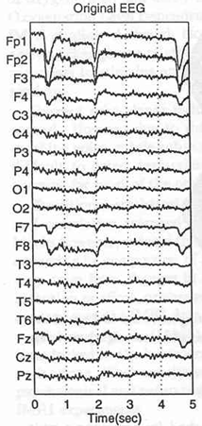
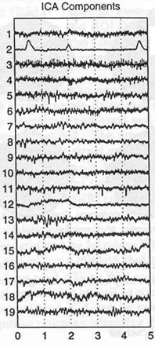
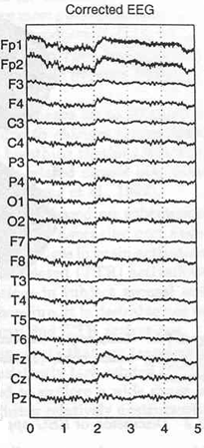
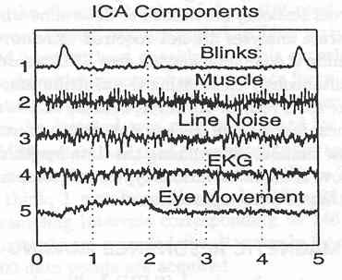

  Blind Source Separation of EEG Signals

Slide 37
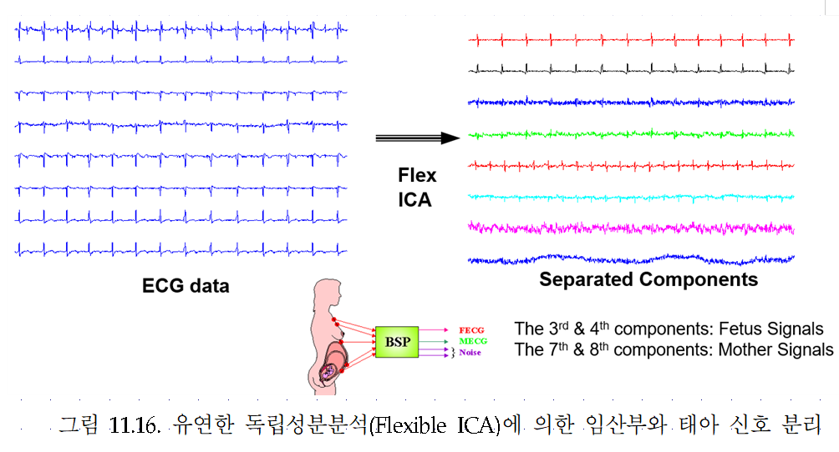

Slide 38
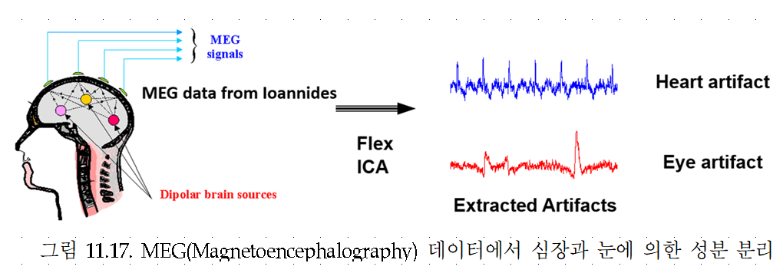

Slide 39





11.6. Projection Pursuit Learning for Latent Structure
Data Model
where
are independent sources.
Objective
where
If P=2, visualization!

Slide 40






Negentropy

Slide 41





Slide 42
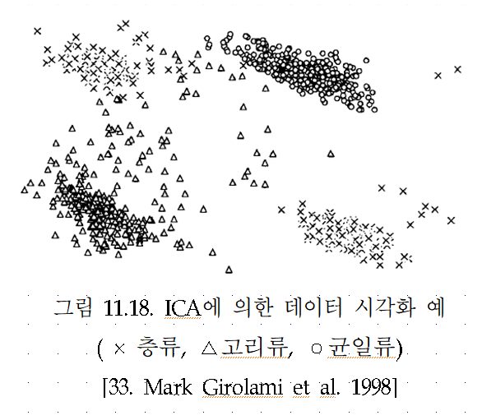

Slide 43
11.8 Convolved Mixtures: ANC vs. BSS
Signal
Source
x(n)
u₁(n)
Mixing
System
(?)
ANC
BSS
W(z)
Noise
Source
r₁(n)
Source 1
Mixing
System
(?)
x₁(n)
u₁(n)
W₂₁(z)
W₁₂(z)
Source 2
x₂(n)
u₂(n)

Slide 44
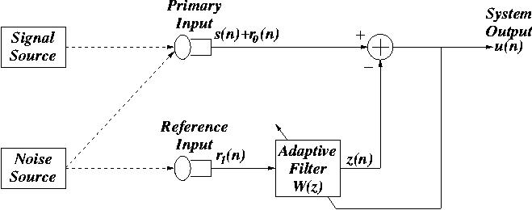
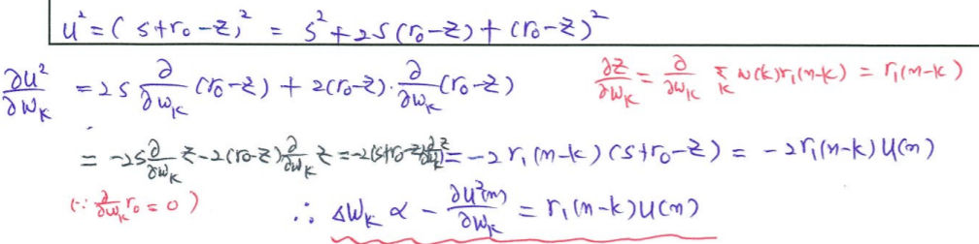
Adaptive Noise Canceling(ANC)
  System output
  Minimize the output power
  The LMS algorithm

Slide 45
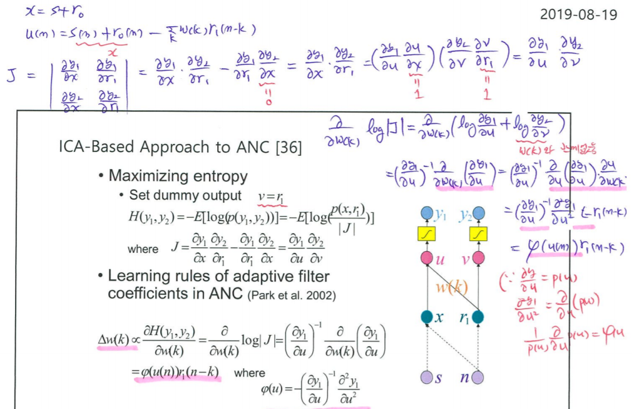

Slide 46
ICA-Based Approach to ANC [36]
Maximizing entropy
  Set dummy output
Learning rules of adaptive filter coefficients in ANC (Park et al. 2002)
y
y
1
2
where
u
v
w(k)
x
r
1
where
s
n

Slide 47
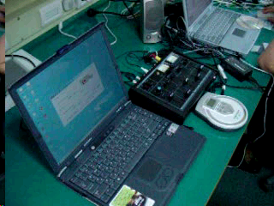
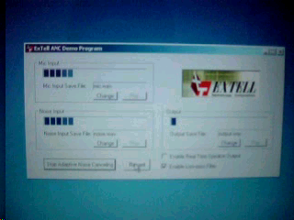
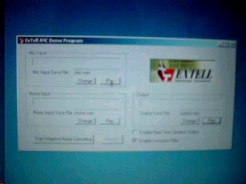

Known Noise Source
Input Signal with Noise
Output Signal after Process
Notes:
차례대로 자동으로 play 됩니다. (단 스피커 모양은 편집모드에서는 더블클릭/슬라이드쇼 환경에서는 원클릭에 재생됩니다)
실험을 위한 오디오환경
Adaptive 후 Speech Signal 입력
출력

Slide 48
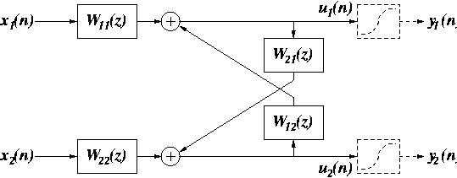
Time Domain Approach to BSS
Convolved mixtures
Feedback architecture
Learning rules

Slide 49
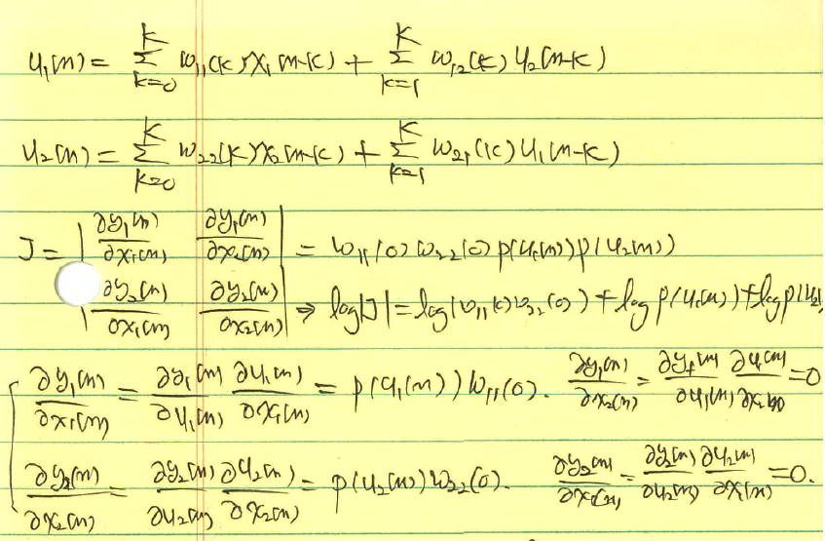

Slide 50
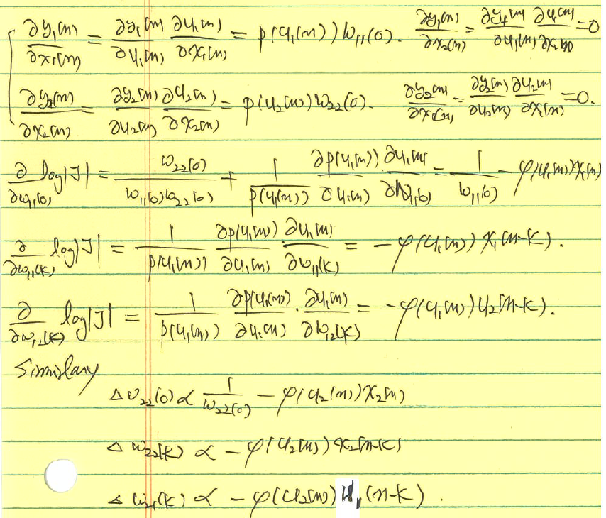

Slide 51
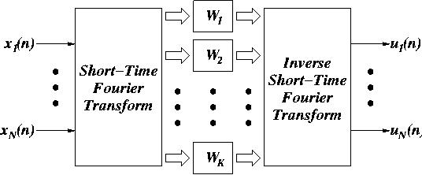
Frequency Domain Approach to BSS
In the frequency domain
Complex score function
Learning rule

Slide 52
