Slide 1
Machine Learning

Slide 2
Contents
Introduction
K-Nearest Neighbor Algorithm
LDA(Linear Discriminant Analysis)
Perceptron
Feed-Forward Neural Networks
RNN(Recurrent Neural Networks)
SVM(Support Vector Machine)
Ensemble Learning
CNN(Convolutional Neural Network)
PCA(Principal Component Analysis)
ICA(Independent Component Analysis)
Clustering
GAN(Generative Adversarial Network)

Slide 3
10.1. Dimensionality Reduction
High dimensional data - images, bag-of-words, protein-expressions etc.
Data will typically lie close to a much lower dimensional space, provided underlying structure of data.
What
Given d-dimensional data, reduce it to k-dimensional data, k < d, while preserving as much information as possible
Why?
Time complexity: Less computation
Space complexity: Less parameters
The cost of observing the feature
Simpler models: robust on small datasets
More interpretable; simpler explanation
Data visualization if plotted in 2 or 3 dimensions

Slide 4
Feature Selection vs. Extraction
Feature selection
Choose k<d important features, ignoring the remaining (d-k ) features
Subset selection algorithms
Feature extraction
Project the original d dimensions to new k<d dimensions
Principal component analysis (PCA)..chap. 10
Linear discriminant analysis (LDA)..chap. 3
Factor analysis (FA)

Slide 5
Feature Selection
$2^{d}$ possible subset selection from d features → cannot enumerate all of them
Forward Search (set of features F)
Initial set of features $∅$
Find the best new feature
Add $x_{j}$ to F if else stop
Backward Search
Start with all features
Remove one at each iteration, if possible
Floating Search
Add some features and remove other features at each iteration

Slide 6
10.2. Principal Components Analysis (PCA)
Idea:
Project d-dimensional data points onto lower dimensional space while preserving as much information as possible
In particular, choose projection that minimizes the squared error in reconstructing original data
Given d-dimensional data x, learns the top m-dimensions where
the dimensions are orthogonal
the reconstructed data as a linear combination of the top m-dimensions minimizes reconstruction error (sum of squared errors)

Slide 7
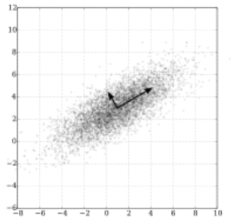
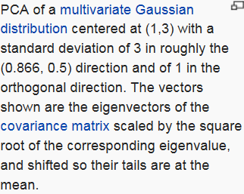
Maximum co-variance and orthogonality

Slide 8
10.3. Eigenstructure of Principal Component Analysis

Slide 13
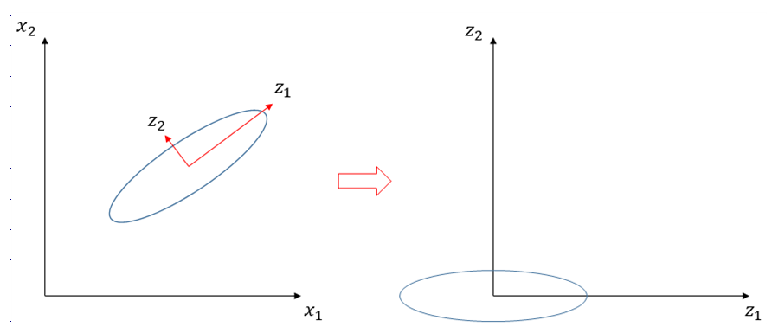
10.4. Understanding PCA

Slide 14
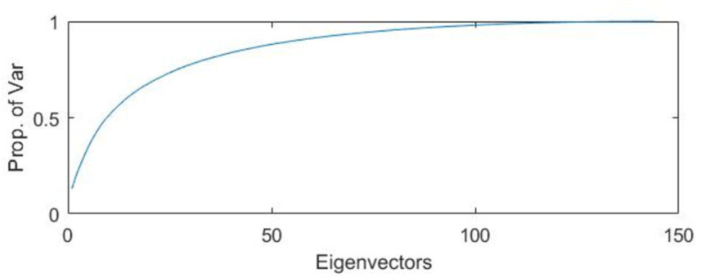
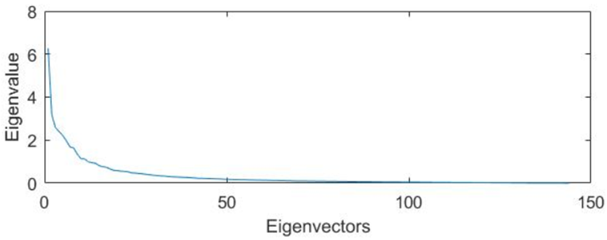
The Size of Reduced Dimension
Larger eigenvalues contribute more to variance of $z$
POV(Proportion of Variance)
Rule of thumb : POV>0.9
Stop at elbow of $λ_{k}$
Keep the eigenvectors whose eigenvalues are larger than average of eigenvalue

Slide 15
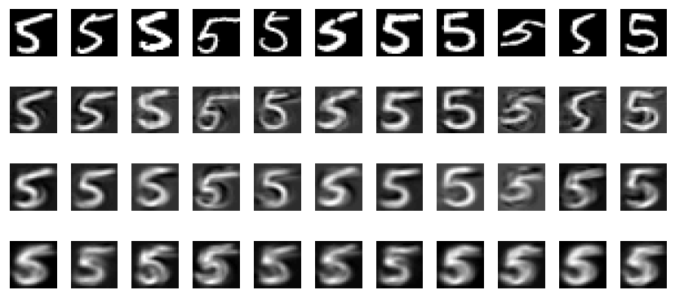
Reducing the dimension of digits
Top row : a selection of the digit 5 taken from the database of 892 examples.
Plotted beneath each digit is the reconstruction using 100, 30 and 5 eigenvectors
(from top to bottom). Note how the reconstructions for fewer eigenvectors express
less variability from each other, and resemble more a mean 5 digit.

Slide 16
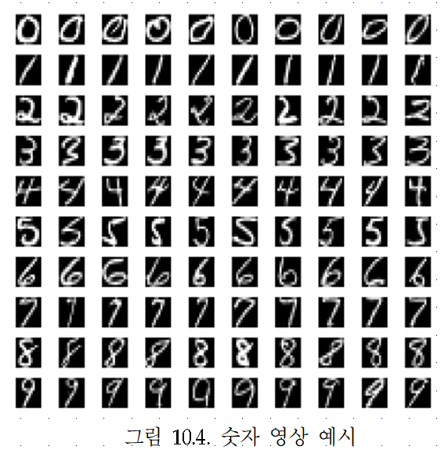
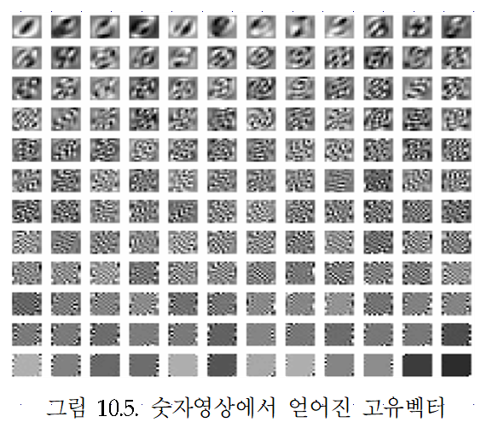

Slide 17
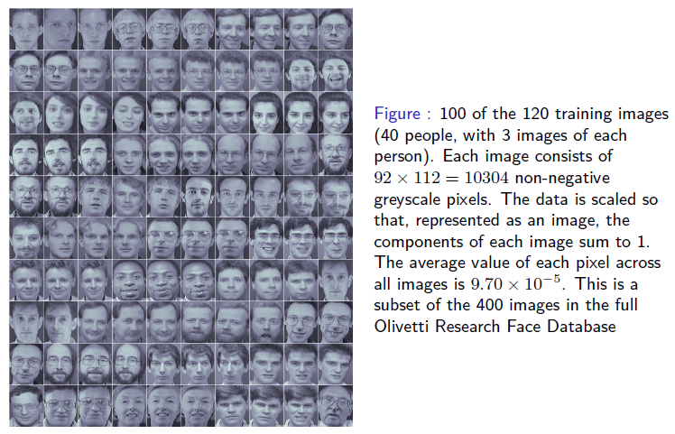
Reducing the dimension of faces

Slide 18
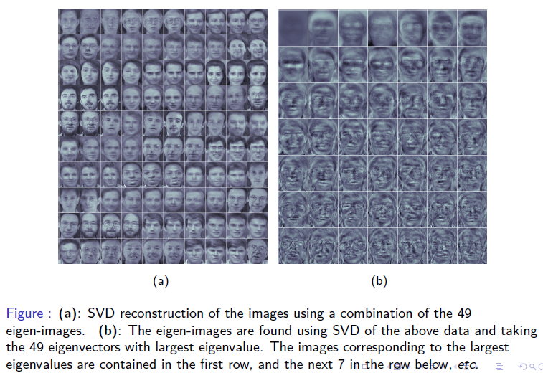
Reducing the dimension of faces

