Slide 1
2. K-Nearest Neighbor Algorithm
b
a
ㄴ
ㄱ
ㄷ

Slide 3
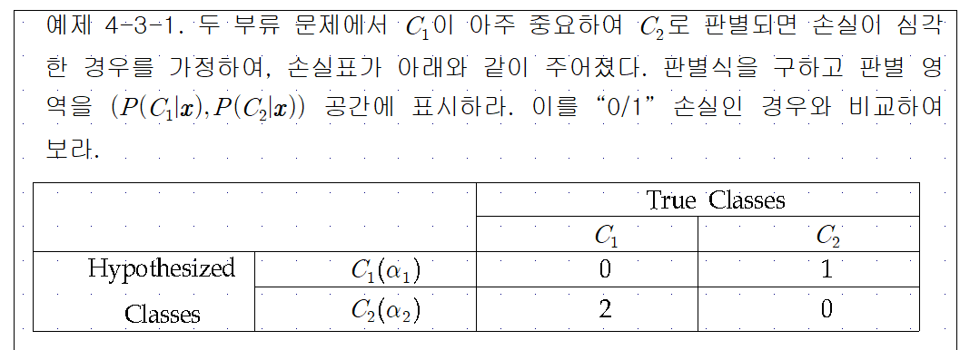
4. Perceptron

Slide 5
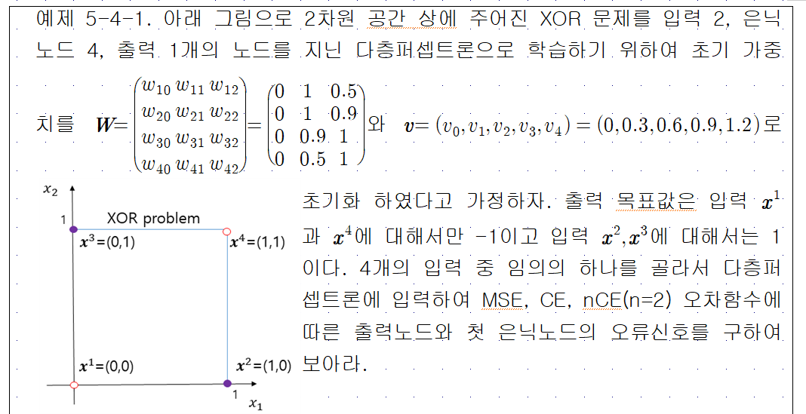

Slide 7
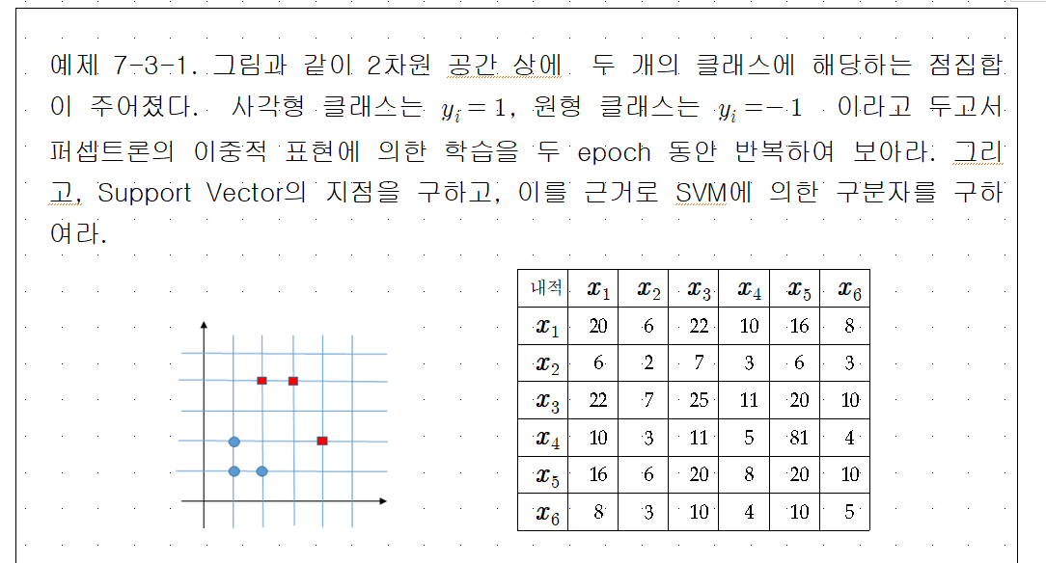

Slide 8
