Slide 1
Machine Learning
Sang-Hoon Oh
Division of Information Communication Convergence Engineering
Mokwon University

Slide 2
Contents
Introduction
K-Nearest Neighbor Algorithm
LDA(Linear Discriminant Analysis)
Perceptron
Feed-Forward Neural Networks
RNN(Recurrent Neural Networks)
SVM(Support Vector Machine)
Ensemble Learning
CNN(Convolutional Neural Network)
PCA(Principal Component Analysis)
ICA(Independent Component Analysis)
Clustering
GAN(Generative Adversarial Network)

Slide 3
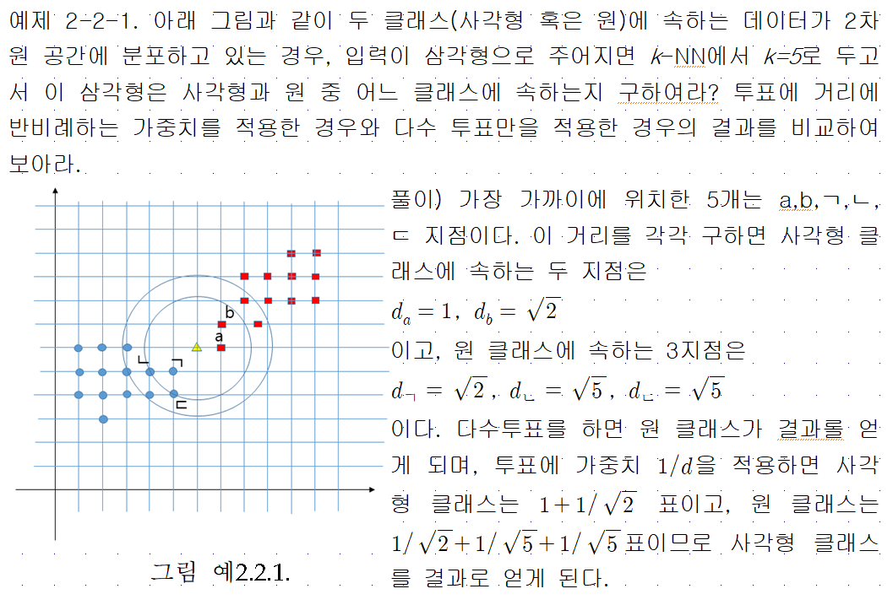

Slide 4
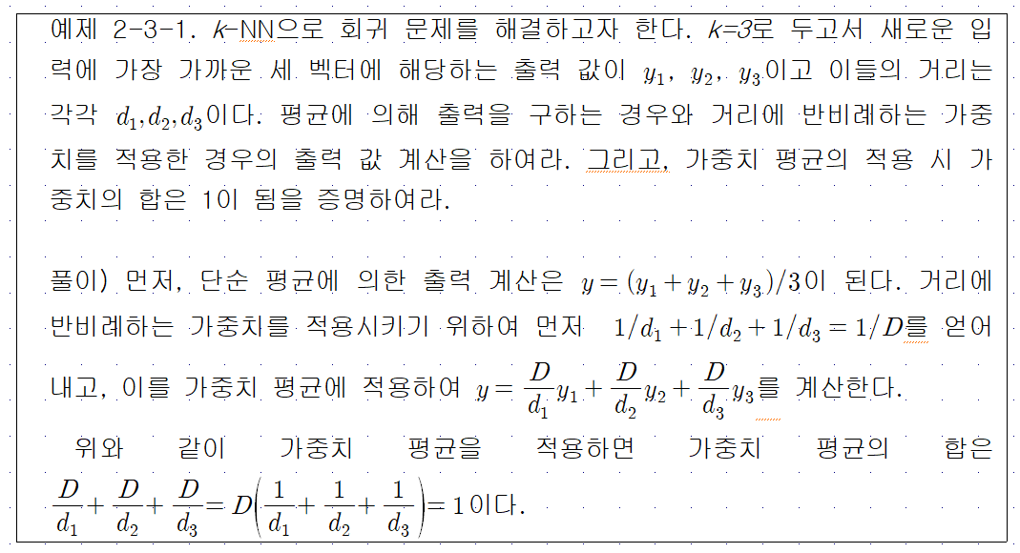

Slide 5
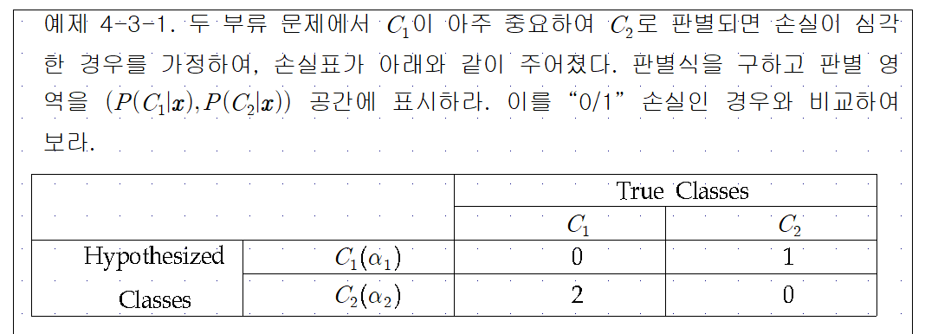
4. Perceptron

Slide 6
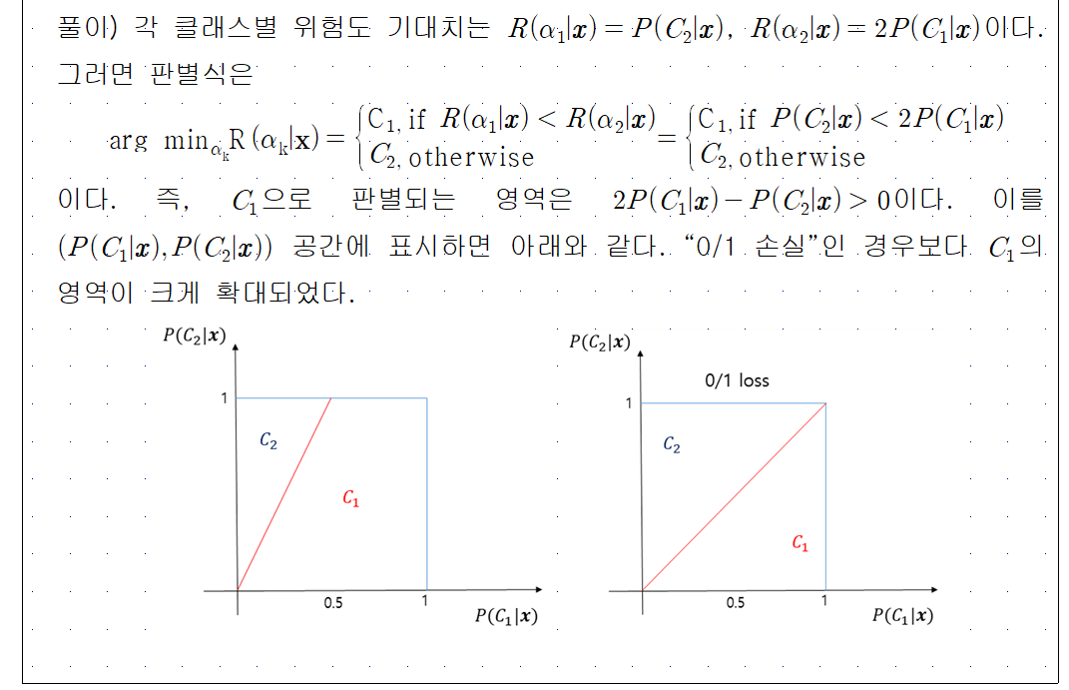

Slide 8
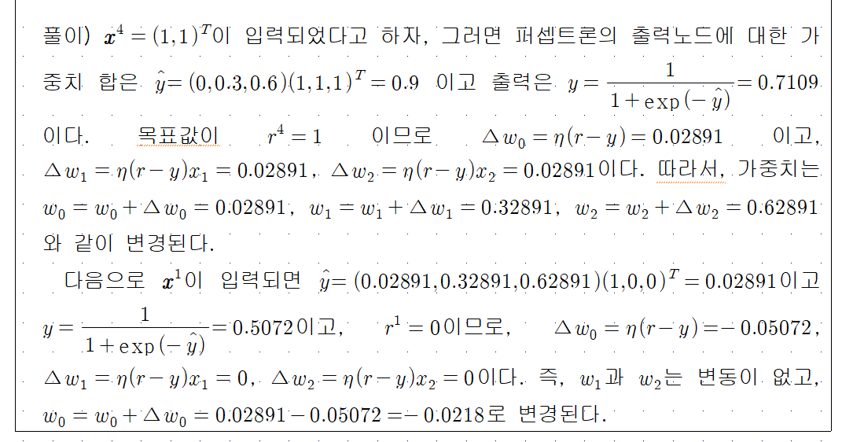

Slide 9
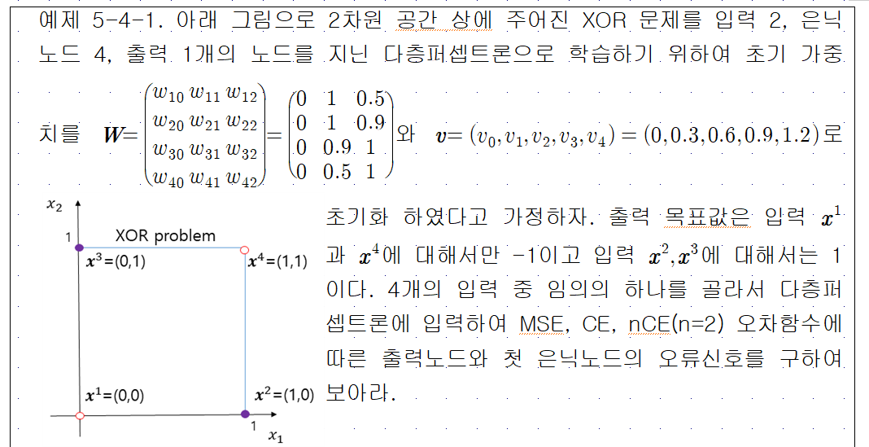

Slide 10
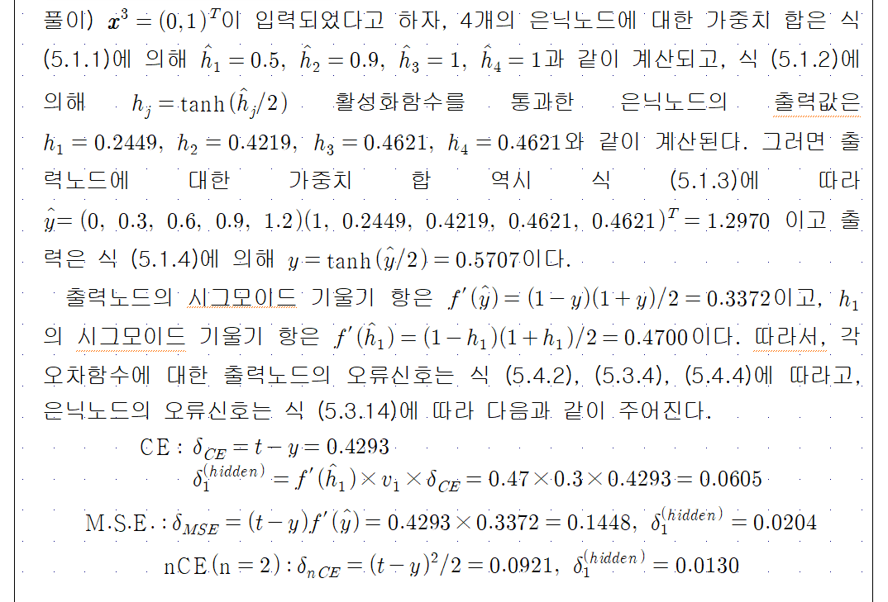

Slide 12
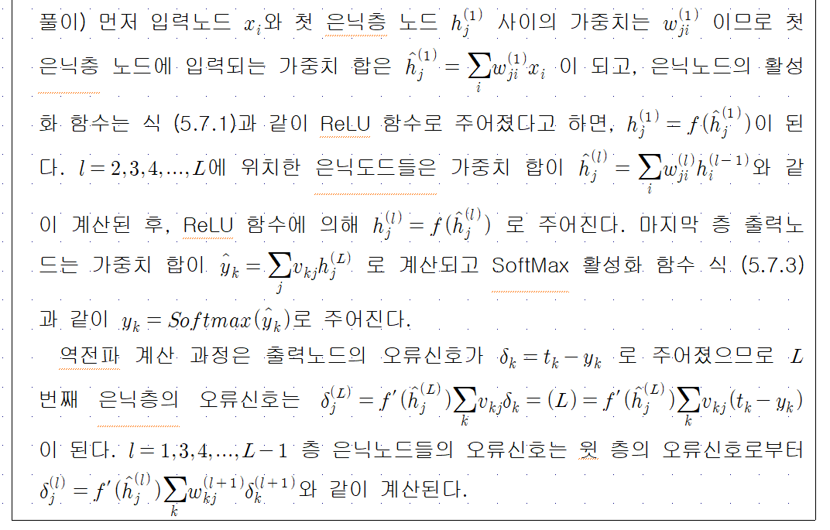

Slide 13
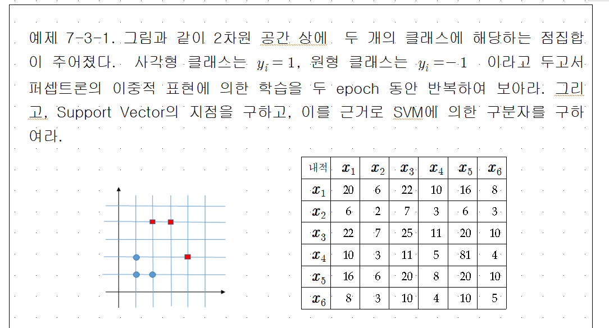

Slide 14
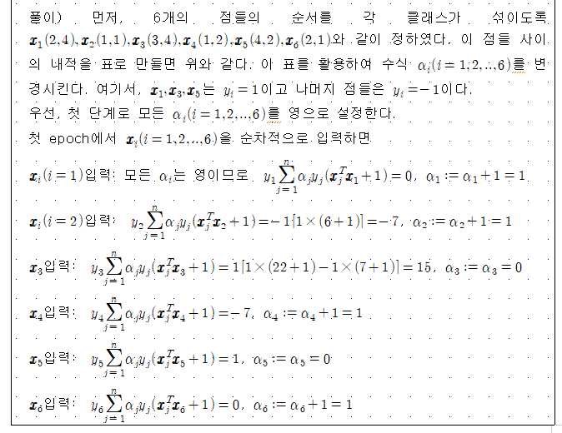

Slide 15
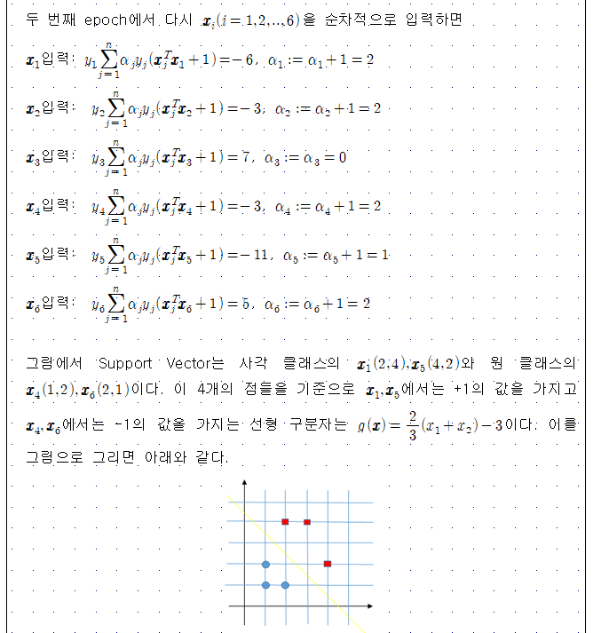

Slide 16
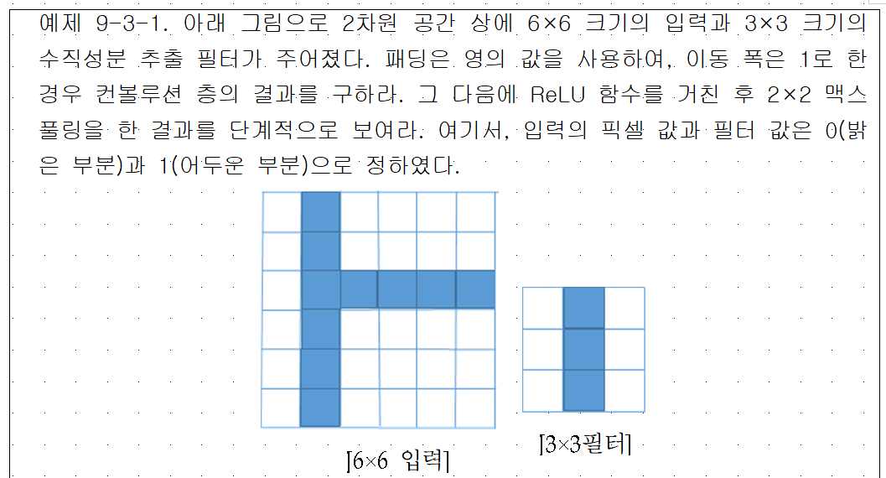

Slide 18
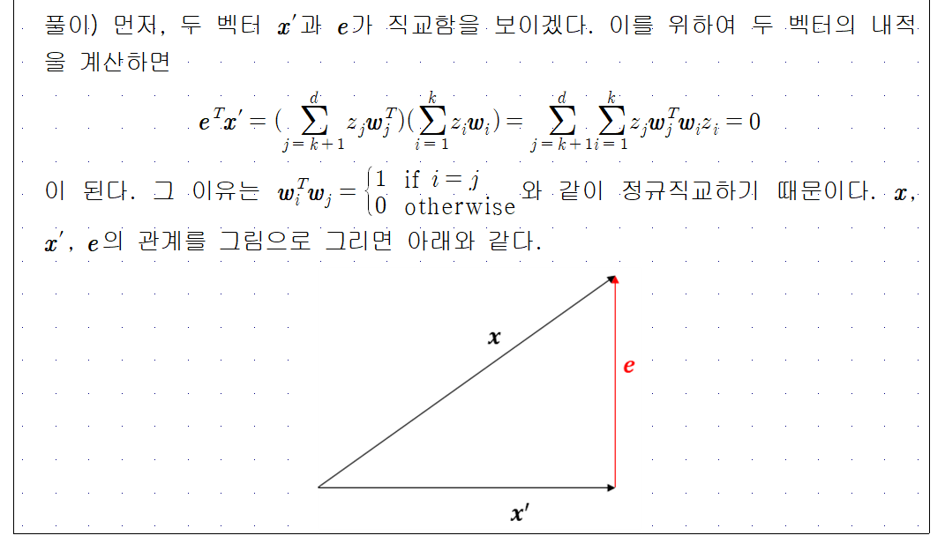

Slide 19
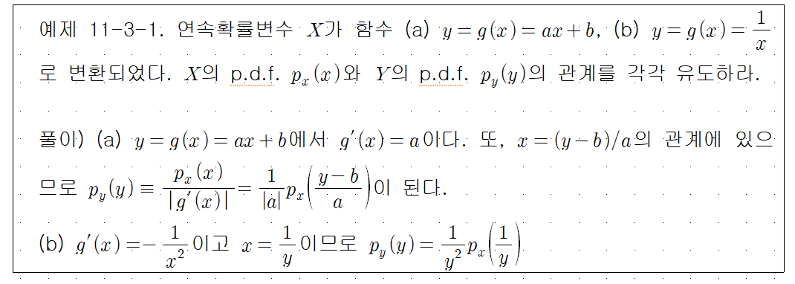

Slide 20
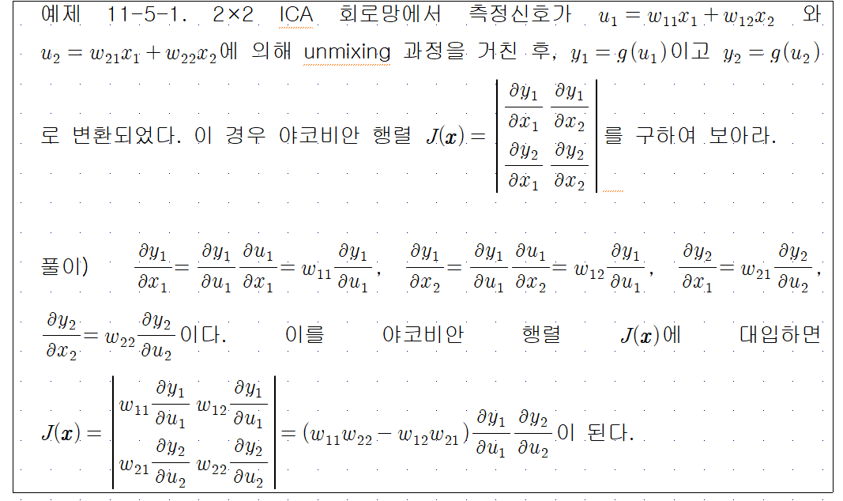

Slide 21
