Slide 1
Machine Learning

Slide 2
Contents
Introduction
K-Nearest Neighbor Algorithm
LDA(Linear Discriminant Analysis)
Perceptron
Feed-Forward Neural Networks
RNN(Recurrent Neural Networks)
SVM(Support Vector Machine)
Ensemble Learning
CNN(Convolutional Neural Network)
PCA(Principal Component Analysis)
ICA(Independent Component Analysis)
Clustering
GAN(Generative Adversarial Network)

Slide 3
8.1. Why?
Different learners use different
  Algorithms
  Hyper-parameters
  Representations (Modalities)
  Training sets
  Subproblems
No Free Lunch Theorem
  There is no single algorithm that is always the most accurate
  Each learners assumes a certain model (assumptions, inductive bias)
  Even if we fine tune the algorithm, there are instances the algorithm is not accurate – there may be another algorithm that is accurate on those
Generate a group of base learners which when combined has higher accuracy

Slide 4










8.2. Voting
Linear combination for output
Classification
  Simple voting: equal weight
  Plurality voting: class with max vote is the winner
  Majority voting (2 class problem)
$$y$$
+
$$w_{1}$$
$$w_{L}$$
$$w_{2}$$
$$w_{3}$$
$$d_{1}$$
$$d_{2}$$
$$d_{3}$$
$$d_{L}$$
$$x$$

Slide 5
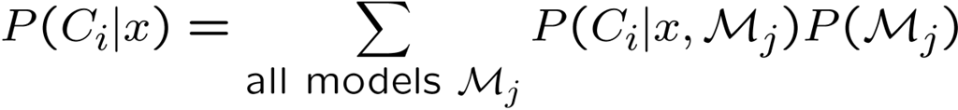

Bayesian perspective (Bayesian model combination):
If are i.i.d.(independent, identically distributed)
  Bias does not change, variance decrease by factor L
Suppose base learner = discriminant/regression function + random noise
  If noises are uncorrelated with 0 mean, we are averaging over noise

Slide 6


Given an input value x and L base learners, seek the weights such that
  Expectation done with regard to the true input distribution
  Note
Input distribution is not available in practice
  Use empirical distribution from training dataset

Slide 7
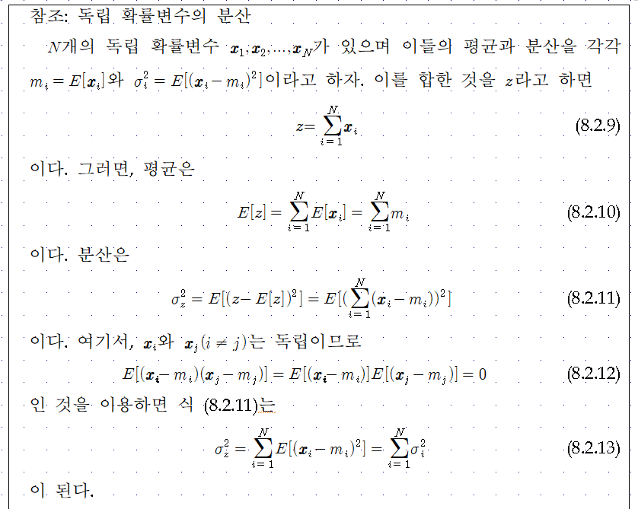

Slide 8
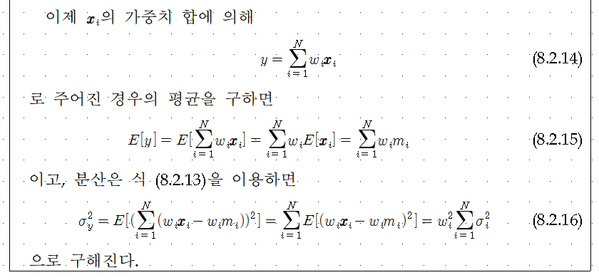

Slide 9
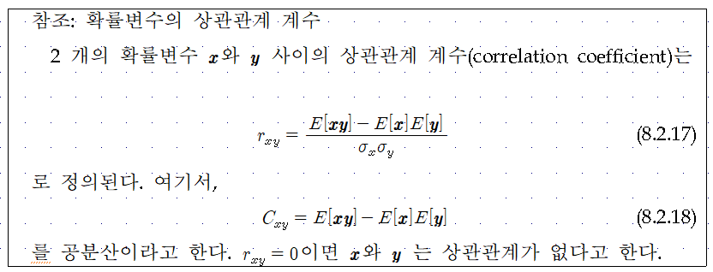

Slide 10
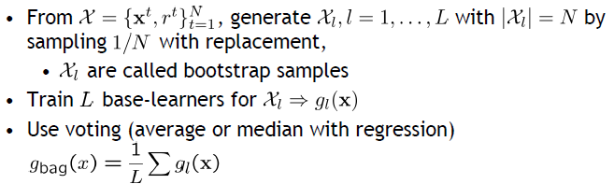
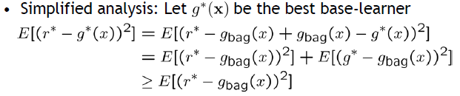
8.3. Bagging
Bootstrapping method: generate training sets, train one base-learner with each, and combine them
Why do we want to do this?
    Expectation done with regard to the input distribution
  Unstable algorithms profit from bagging

Slide 11
Boosting

Slide 12
AdaBoost: Algorithm

Slide 13
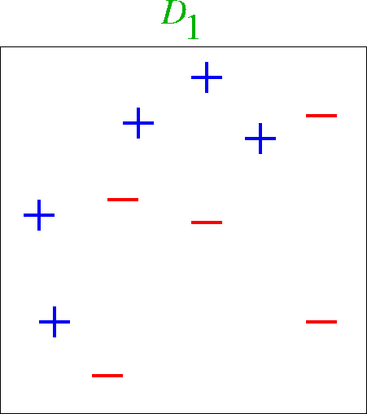
Toy Example

Slide 14
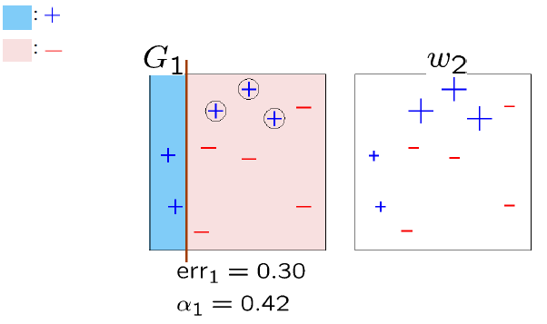
Round 1

Slide 15
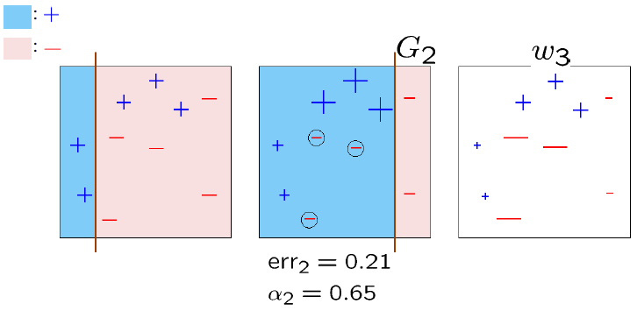
Round 2

Slide 16
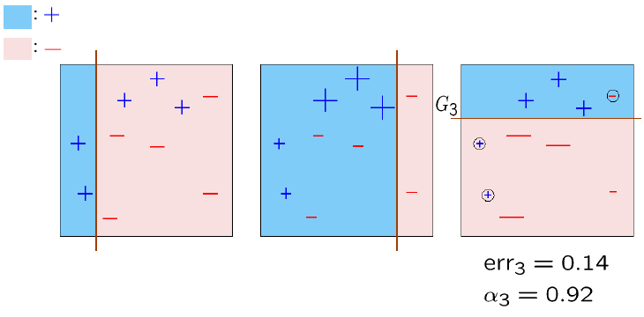
Round 3

Slide 17
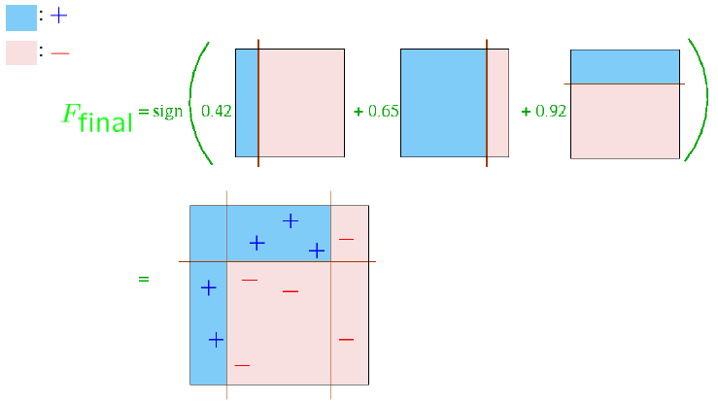
Final Classifier

Slide 18
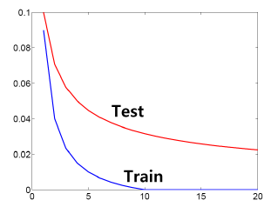
Test Error Behavior

Slide 19
Practical Advantages of AdaBoost
Fast
Simple and easy to program
No parameters to tune (except M)
Flexible – can combine with any learning algorithm
No prior knowledge needed about weak learner
Probably effective, provided can consistently find rough rules of thumb
  Shift in mind set – goal now is merely to find classifiers barely better than random guessing
Versatile
  Can use with data that is textual, numeric, discrete, etc.
  Has been extended to learning problems well beyond binary classification

Slide 20



8.4. Evaluation of Classifiers
“Accuracy” or “Recognition Ratio”
“Precision and Recall”
  TP : True Positive
  FP : False Positive
  TN : True Negative
  FN : False Negative Positive
True Class
p
n
Hypothesized Class
True Positive
False Positive
Precision
P
False Negative
True Negative
N
Recall
False Alarm
[Confusion Matrix]

Slide 21
A precision score of 1.0 for a class C means that every item labeled as belonging to class C does indeed belong to class C (but says nothing about the number of items from class C that were not labeled correctly).
A recall of 1.0 means that every item from class C was labeled as belonging to class C (but says nothing about how many other items were incorrectly also labeled as belonging to class C)
An inverse relationship between precision and recall, where it is possible to increase one at the cost of reducing the other.

Slide 22
Brain surgery provides an illustrative example of the tradeoff. Consider a brain surgeon tasked with removing a cancerous tumor from a patient’s brain. The surgeon needs to remove all of the tumor cells since any remaining cancer cells will regenerate the tumor. Conversely, the surgeon must not remove healthy brain cells since that would leave the patient with impaired brain function.
The surgeon may be more liberal in the area of the brain he removes to ensure he has extracted all the cancer cells. This decision increases recall but reduces precision. On the other hand, the surgeon may be more conservative in the brain he removes to ensure he extracts only cancer cells. This decision increases precision but reduces recall.
That is to say, greater recall increases the chances of removing healthy cells (negative outcome) and increases the chances of removing all cancer cells (positive outcome). Greater precision decreases the chances of removing healthy cells (positive outcome) but also decreases the chances of removing all cancer cells (negative outcome).

Slide 23
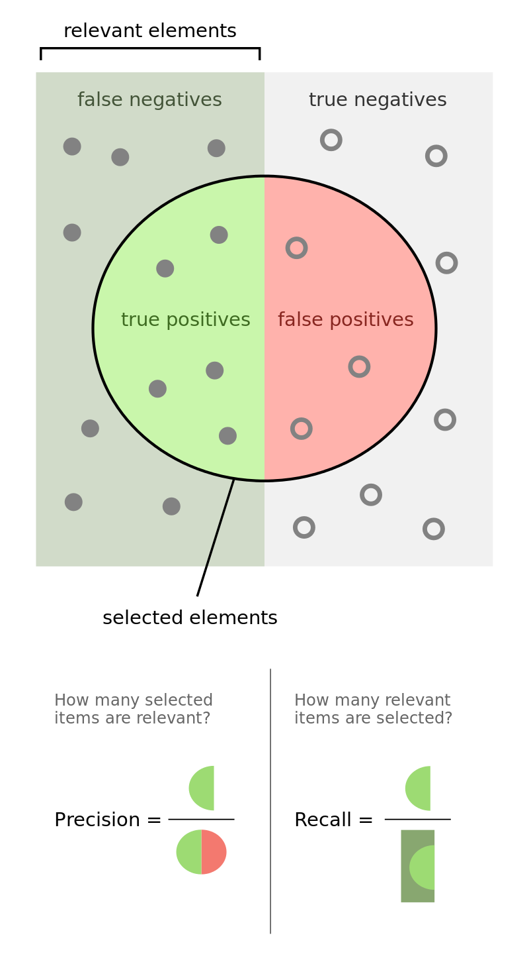
[from Wikipedia]

Slide 24


ROC(Receiver Operating Characteristic)
  a graphical plot that illustrates the diagnostic ability of a binary classifier system as its discrimination threshold is varied.
  plotting the true positive rate (TPR) against the false positive rate (FPR) at various threshold settings.
1
Perfect Classifier
A Classifier of Unconditionally Issuing Positive Class
True Class
p
n
Random Guess
Hypothesized Class
Better
0.5
True Positive
False Positive
True Positive Rate
P
Worse
False Negative
True Negative
A Classifier of Never Issuing a Positive Class
A Never-Guessing Classifier
N
0
0
0.5
1
Recall
False Alarm
False Positive Rate

Slide 25


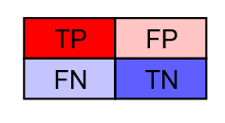
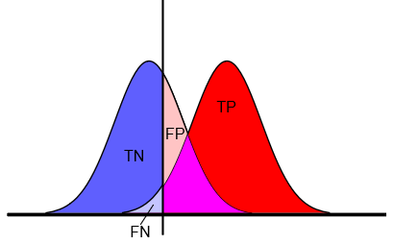




Curves in ROC Space : Useful for Imbalanced Data!
  Given a threshold T, the instance is classified as “positive” if X>T, and “negative” otherwise.
  X follows a probability density $f_{1}(x)$ if the instance actually belongs to class “positive”, and $f_{0}(x)$ if otherwise.
1
Threshold
T
0.5
True Positive Rate
$$f_{0}(x)$$
$$f_{1}(x)$$
0
0
0.5
1
$$x$$
False Positive Rate

Slide 26
