Slide 1
Machine Learning

Slide 2
Contents
Introduction
K-Nearest Neighbor Algorithm
LDA(Linear Discriminant Analysis)
Perceptron
Feed-Forward Neural Networks
RNN(Recurrent Neural Networks)
SVM(Support Vector Machine)
Ensemble Learning
CNN(Convolutional Neural Network)
PCA(Principal Component Analysis)
ICA(Independent Component Analysis)
Clustering
GAN(Generative Adversarial Network)

Slide 3
7.1. Characteristics of Support Vector Machine
Feed-forward Neural Network(Perceptron, MLP, RBF,..)
  Stochastic algorithm
  Generalizes well but need a lot of tuning
  Can be learned in incremental fashion
  To learn complex functions: use multiple hidden layers
SVM
  Deterministic algorithm
  Nice Generalization with few parameters to tune
  Hard to learn – Quadratic programming techniques
  Using kernel tricks to learn very complex functions

Slide 4
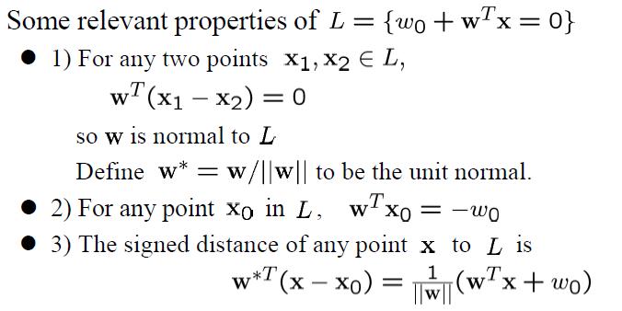
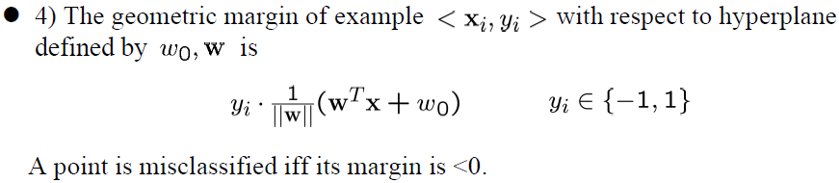










7.2. Linear Separator and Perceptron
$$x_{2}$$
$$L=\{g\left(x\right)=0\}$$
$${|w}_{0}|/|\left|w\right||$$
$$x_{0}$$
$${x−x}_{0}$$
$$x$$
$$w^{∗}$$
$$x_{p}$$
$$\left|g(x)\right|/|\left|w\right||$$
$$x_{1}$$

Slide 5
Perceptron Learning Algorithm

Slide 6
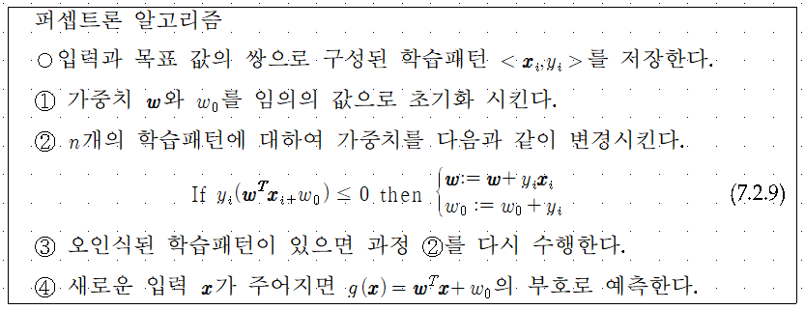

Slide 7
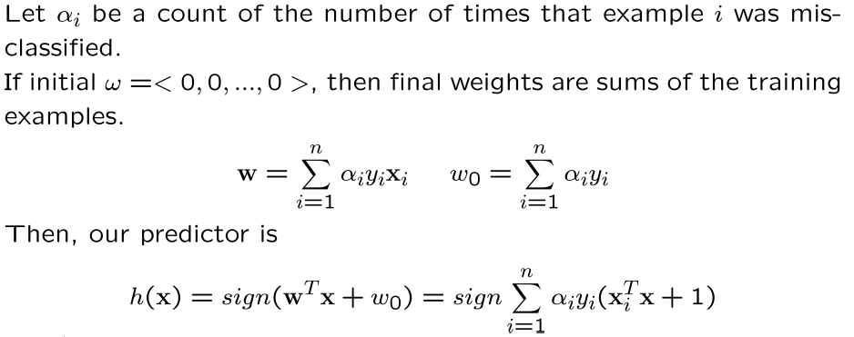
Perceptron Learning Alg.: Dual Representation

Slide 8
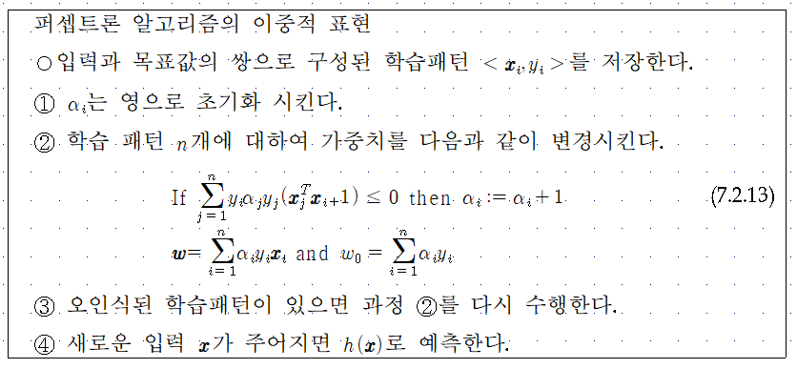

Slide 9











7.3. Support Vector Machine
Maximizing the margin leads to a particular choice of decision boundary. The location of the boundary is determined by a subset of the data points, known as support vectors, which are indicated by the circles.
$$x_{2}$$
d
$$x_{2}$$
b
c
$\{x|w^{T}x$+$w_{0}=+1\}$
$\{x|w^{T}x$+$w_{0}=−1\}$
a
$$C_{1}$$
$$C_{1}$$
$$\frac{1}{|\left|w\right||}$$
$$C_{2}$$
margin
$$w$$
$$C_{2}$$
$$x_{1}$$
$\{x|w^{T}x$+$w_{0}=0\}$
$$x_{1}$$

Slide 10
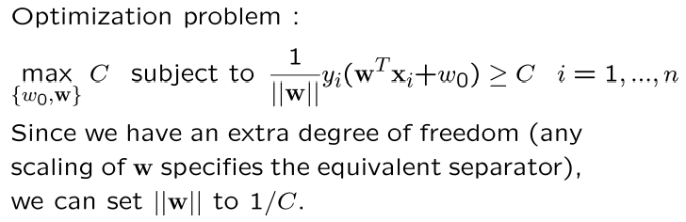
Support Vector Machine
Support vector machines
  Names a whole family of algorithms. We’ll start with the maximum margin separator. The idea is to find the separator with the maximum margin from all the data points. We’ll see, later, a theoretical argument that this might be a good idea. Seems a little less haphazard than a perceptron.

Slide 11
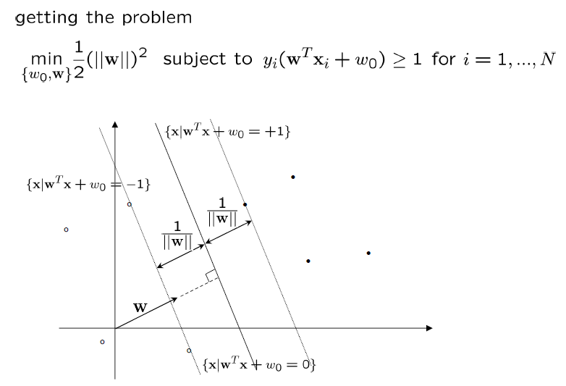
Support Vector Machine: Formulation

Slide 12
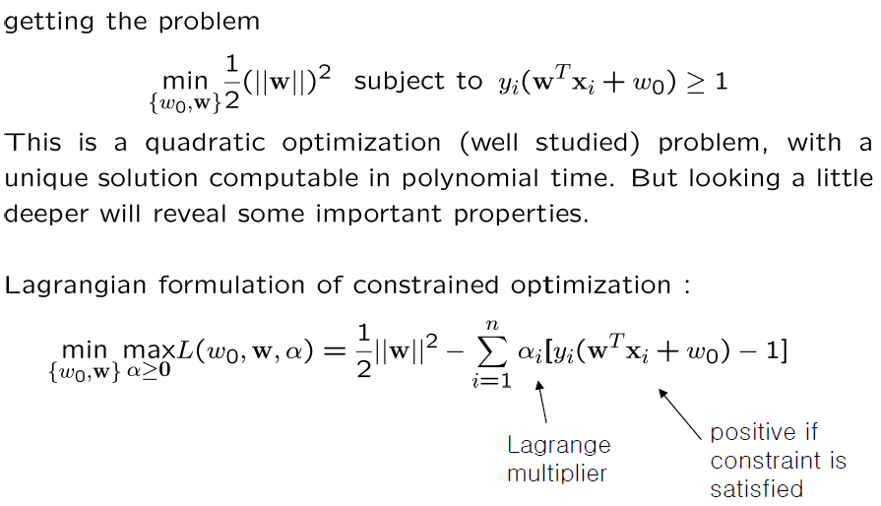
Support Vector Machine: Formulation

Slide 13
Support Vector Machine: Kuhn-Tucker Theorem

Slide 14
Support Vector Machine: Lagrange Formulation

Slide 15
Support Vector Machine: Solution

Slide 16
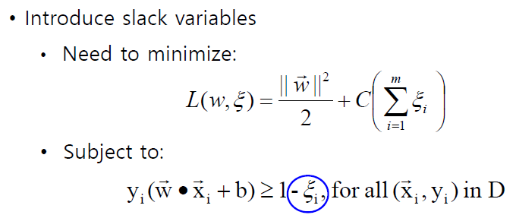
Support Vector Machines
What if the problem is not linearly separable?

Slide 17
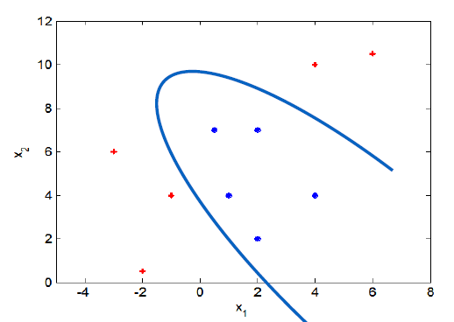
Support Vector Machines
What if decision boundary is not linear?

Slide 18
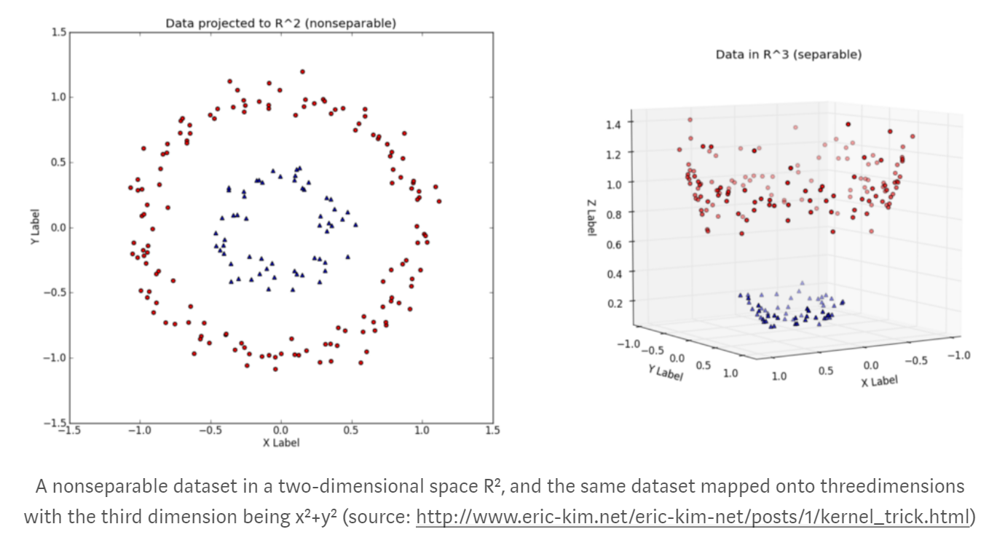

Slide 19
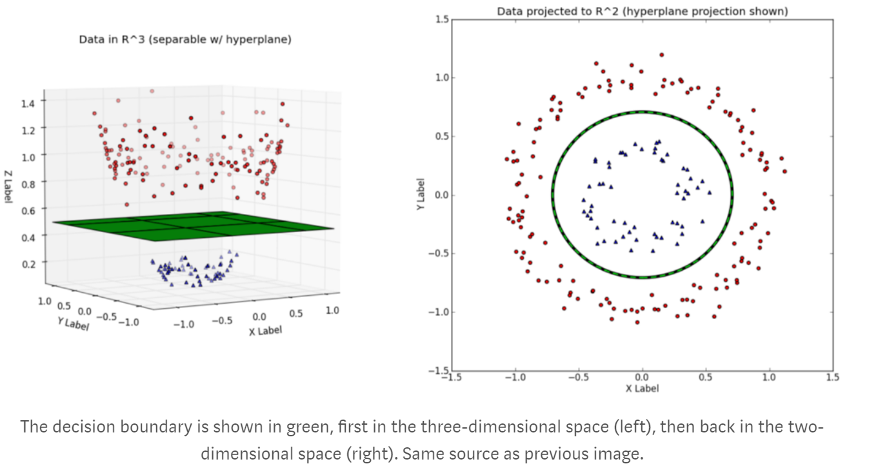

Slide 20
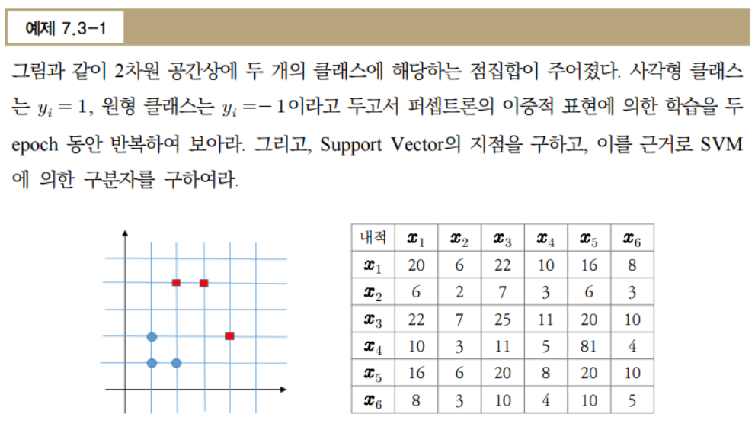

Slide 21

7.4. Application of SVM
Objective: Discriminate agreement and disagreement to the given self-relevant sentence in the single-trial level.
Stimuli: 74 Korean sentences from the Minnesota Multiphasic Personality inventory-II (MMPI-II). Sentence contents are related to personal experience.
Presentation: Considering the Subject-object-verb (SOV) typology of the Korean language, each sentence was separated into two parts: the verb (sentence ending) and the remainder of the sentence (contents).
(a) Positive ending | Contents | Sentence ending
Stimulus sentence (Korean) | 돈에 대해 걱정한 적이 | 있다
English translations in SOV form | The experience of worrying over money | Does exist
Original English MMPI-2 sentence | I worry a great deal over money.
(b) Negative ending | Contents | Sentence ending
Stimulus sentence (Korean) | 기절한 적이 | 없다
English translations in SOV form | The experience of having a fainting spell | Does not exist
Original English MMPI-2 sentence | I have never had a fainting spell.

Slide 22
Experiment Design
Objective: Discriminate agreement and disagreement to the given self-relevant sentence in the single-trial level.
The relationship between “yes/no” and “agree/disagree” in Korean.
예) 가족과 말다툼한 적이 있다/없다.
The experience of having quarrels with members of my family does/does not exist.
Example sentence |  | User response
 |  | User with experience | User without experience
The experience of having quarrels with members of my family (가족과 말다툼한 적이) | Does exist (있다) | Yes | No
 | Does not exist (없다) | No | Yes
Categorization for the classification |  | Agree | Disagree

Slide 23
Experiment Procedure
Experiment Design
fMRI Experiment
EEG Experiment
Related brain regions
Feature Selection
Single-trial Classification
Agreement or Disagreement?

Slide 24
Experiment Procedure
fMRI Experiment (19 subjects)
Image acquisition
3T MR scanner (Siemens Magnetom Vero, Germany)
MR-compatible goggle (NordicNeuroLab Visual systmes, Norway)
Gradient-echo echo-planar imaging (EPI) sequence (36 slices; thickness = 4 mm; no gap between slices; FOV = 220 × 220 mm; matrix = 64 × 64; TE = 28 ms; TR = 2.0 s; flip angle = 90 °; voxel size 3.4 mm × 3.4 mm × 4 mm)
Preprocessing
(SPM8) Realign, coregister, segmentation, normalize, and smooth
[11]
EEG Experiment (9 subjects)
Data acquisition
BrainAmp system (Brain Products GmbH, Germany)
32-channel EEG cap (BrainCap)
Eyetracker x120 (Tobii Technology, Sweden)
Preprocessing
60Hz notch filtering and 1Hz high-pass filtering
Offline re-referencing to average (except EOG and ECG)
Artifact Removal: EOG and ECG-related independent components
Trial rejection: Reject trials whose absolute amplitude is over 70 μV
[12]

Slide 25
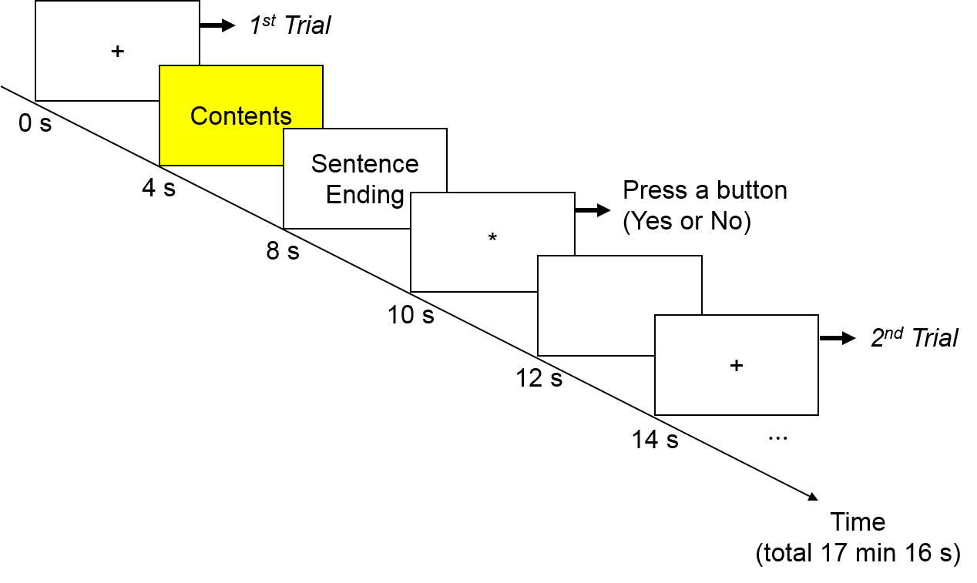
fMRI Data Analysis
Activation during reading ‘contents’
Activated regions and their functions
Agree>disagree: Dorsolateral prefrontal cortex (BA 9), anterior cingulate (BA32)
  -> decision-making
  -> self-descriptive trait judgment, and empathic judgments
Disagree>agree: Left fusiform gyrus
  -> written word recognition
  -> unfamiliar stimuli
[14]
[16][17]
[18]
Peak coordinate region | Number of voxels | Peak intensity | Peak MNI Coordinate
 |  |  | X | y | z
(A) Agree > Disagree
L Superior frontal gyrus | 43 | 4.2654 | -38 | 34 | 36
L Anterior cingulate | 105 | 4.1851 | -14 | 48 | -6
R Anterior cingulate | 30 | 3.8177 | 4 | 40 | 8
R Cingulate gyrus | 53 | 3.7786 | 12 | 4 | 30
R Paracentral lobule | 50 | 3.6175 | 8 | -38 | 76
R Supplementary motor area | 36 | 3.5777 | 2 | -20 | 68
L Postcentral gyrus | 35 | 3.3399 | -32 | -46 | 70
R Paracentral lobule | 24 | 3.2484 | 12 | -36 | 52
(B) Disagree > Agree
L Fusiform gyrus | 28 | 4.414 | -36 | -50 | -18
Notes. Contrasts were thresholded at an uncorrected p-value 0.005, corresponding to a t-statistic of 2.8784 and cluster size of 20 voxels. L = left. R = right

Slide 26

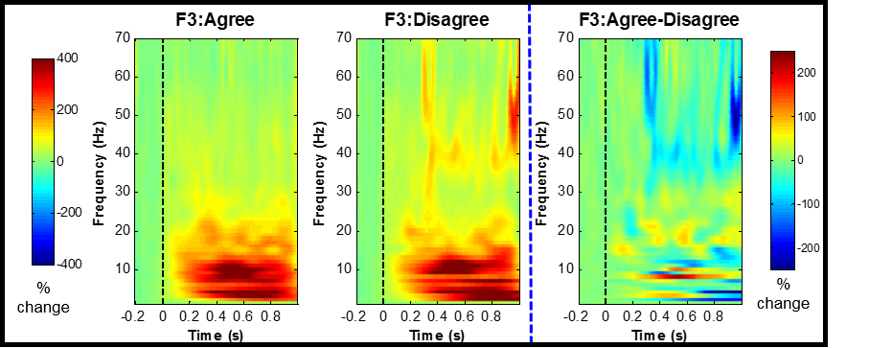
EEG Data Analysis
Referring to the fMRI results, responses at frontal channels are considered.
EEG patterns during reading ‘contents’
Oscillatory responses in sentence processing
  Grammatical or semantic violation affects EEG oscillatory responses. -> disagreement
  Gamma: increase at frontocentral
  Theta: increase at frontal midline and temporo-parietal
[3]-[7]
Time-frequency Representations (TFRs)
Event-related potential
Morlet-Wavelet Transformation

Slide 27
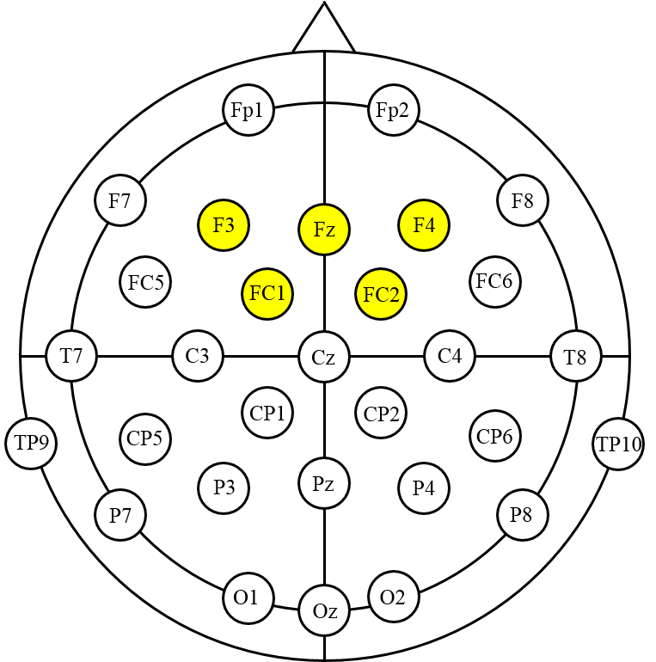
Feature Selection
Referring to the fMRI results, responses at frontal channels are considered.
Time-frequency Representations (TFRs)
Select 5 feature candidates
(a) gamma 35-45Hz 350-550ms
(b) beta2 20-26Hz 300-450ms
(c) beta1 14-17Hz 800-1,000ms
(d) alpha 9-12Hz 300-700ms
(e) theta 5-7Hz 400-1,000ms
Average TFR difference: Agree - Disagree
(a)
(a) Gamma 35-45Hz 350-550ms
(b)
(c)
(d)
(e)
(b) Beta2 20-26Hz 300-450ms
(c) Beta1 14-17Hz 800-1,000ms
(d) Alpha 9-12Hz 300-700ms
(e) Theta 5-7Hz 400-1,000ms

Slide 28
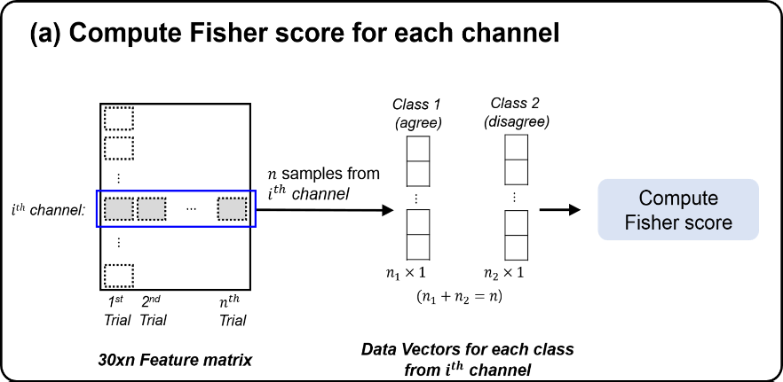
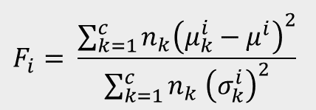
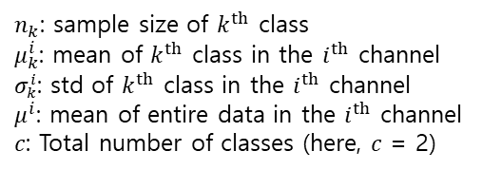

Channel Selection
Method & Analysis
Channel selection using the Fisher score
[19]
$n_{k}$: sample size of $k^{th}$ class
$μ_{k}^{i}$: mean of $k^{th}$ class in the $i^{th}$ channel
$σ_{k}^{i}$: std of $k^{th}$ class in the $i^{th}$ channel
$μ^{i}$: mean of entire data in the $i^{th}$ channel
$c$: Total number of classes (here, $c$ = 2)
The Fisher score for the $i^{th}$ channel:
$$F_{i}= \frac{\sum_{k=1}^{c}{n_{k}{\left(μ_{k}^{i}−μ^{i}\right)}^{2}}}{\sum_{k=1}^{c}{n_{k} {\left(σ_{k}^{i}\right)}^{2}}}$$
Rank | Theta |  | Alpha |  | Beta1 |  | Beta2 |  | Gamma
 | Channel | Fisher score | Channel | Fisher score | Channel | Fisher score | Channel | Fisher score | Channel | Fisher score
1 | C3 | 0.028 | C3 | 0.028 | P7 | 0.034 | C3 | 0.030 | F3 | 0.040
2 | CP5 | 0.027 | Fz | 0.027 | T8 | 0.026 | CP5 | 0.029 | T8 | 0.030
3 | CP2 | 0.025 | CP1 | 0.026 | F4 | 0.022 | FC1 | 0.026 | FC5 | 0.027
4 | P7 | 0.025 | FC1 | 0.025 | FC1 | 0.022 | Fp2 | 0.025 | FC2 | 0.024
5 | P3 | 0.023 | F4 | 0.025 | F3 | 0.020 | Fp1 | 0.025 | CP5 | 0.023

Slide 29
Classification
Subject-dependent classification with increasing the number of selected channels
Average accuracy using 5-fold cross validation
SVM classifier with linear and RBF kernels (LIBSVM)
Component | Classifier
 | Linear SVM | RBF SVM
Theta | 67.03% (30) | 70.89% (2)
Alpha | 66.39% (30) | 73.86% (4)
Beta1 | 62.88% (30) | 71.30% (4)
Beta2 | 65.07% (30) | 73.49% (3)
Gamma | 67.01% (20) | 75.54% (5)

