Slide 1
Machine Learning

Slide 2
Contents
Introduction
K-Nearest Neighbor Algorithm
LDA(Linear Discriminant Analysis)
Perceptron
Feed-Forward Neural Networks
RNN(Recurrent Neural Networks)
SVM(Support Vector Machine)
Ensemble Learning
CNN(Convolutional Neural Network)
PCA(Principal Component Analysis)
ICA(Independent Component Analysis)
Clustering
GAN(Generative Adversarial Network)

Slide 3







6.1. Recurrent Neural Networks
Universal approximation theorem for time series data
$$y$$
$$y_{k}$$
$$h_{j}$$
$$h$$
$$h$$
$$x$$
$$x$$
Recurrent connection for hidden nodes
Recurrent connection for output nodes

Slide 4



$$y_{k}$$
$$h_{j}$$
$$h$$
$$x$$
Recurrent connection from output to hidden nodes

Slide 5
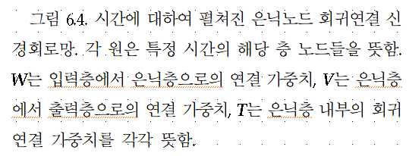











Output Layer
$$y$$
$$V$$
$$V$$
$$V$$
$$h_{j}$$
Hidden Layer
$$T$$
$$T$$
$$T$$
$$T$$
$$h$$
$$W$$
$$W$$
$$W$$
$$x$$
Input Layer

Slide 6







6.2. Long Short-Term Memory(LSTM)
Output Layer
$$V$$
$$V$$
$$V$$
$$V$$
$$V$$
Hidden Layer
$$T$$
$$T$$
$$T$$
$$T$$
$$W$$
$$W$$
$$W$$
$$W$$
$$W$$
Input Layer
Time
1
2
3
4
5

Slide 7



$$y_{k}$$
LSTM Block
LSTM Block
LSTM Block
LSTM Block
$$x$$

Slide 8
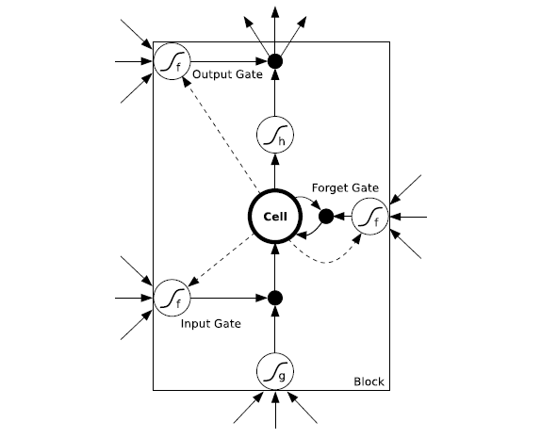
Long Short-term Memory (LSTM, Hochreiterand Schmidhuber, 1997)
Consists of a set of recurrently connected subnets, known as memory blocks
Each block contains one or more self-connected memory cells and three multiplicative units –the input, output, and forget gates.
The three gates control the activation of the cell via multiplications
𝑓: activation function of the gates
𝑔: cell input activation function
ℎ: cell output activation function

Slide 9
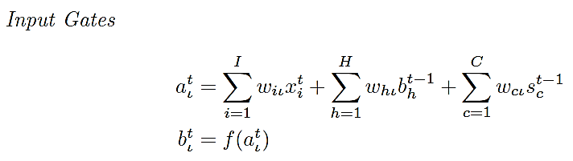
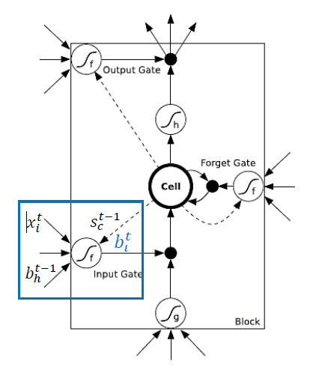

6.3. Forward Pass
I : # inputs
K : # outputs
H : # cells in the hidden layer
C : # cells per a memory
G : total # inputs to the hidden layer (= 4H)

Slide 10
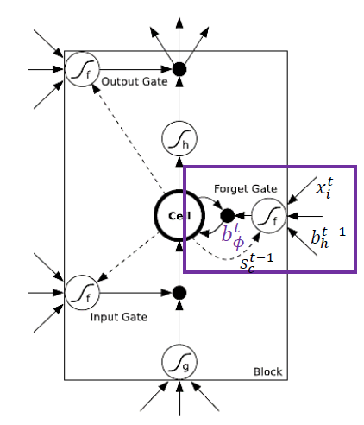

I : # inputs
K : # outputs
H : # cells in the hidden layer
C : # cells per a memory
G : total # inputs to the hidden layer (= 4H)

Slide 11
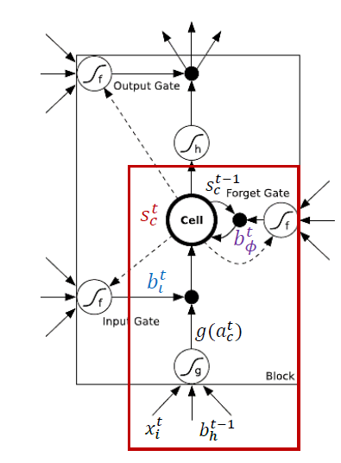


I : # inputs
K : # outputs
H : # cells in the hidden layer
C : # cells per a memory
G : total # inputs to the hidden layer (= 4H)

Slide 12
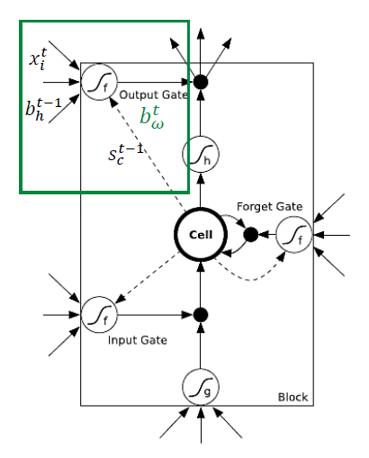

I : # inputs
K : # outputs
H : # cells in the hidden layer
C : # cells per a memory
G : total # inputs to the hidden layer (= 4H)

Slide 13
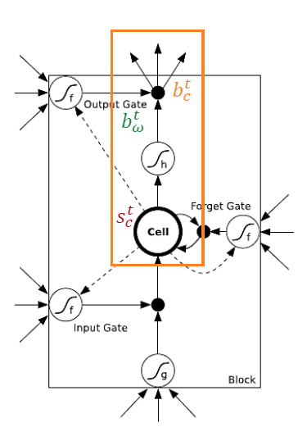
I : # inputs
K : # outputs
H : # cells in the hidden layer
C : # cells per a memory
G : total # inputs to the hidden layer (= 4H)

Slide 14
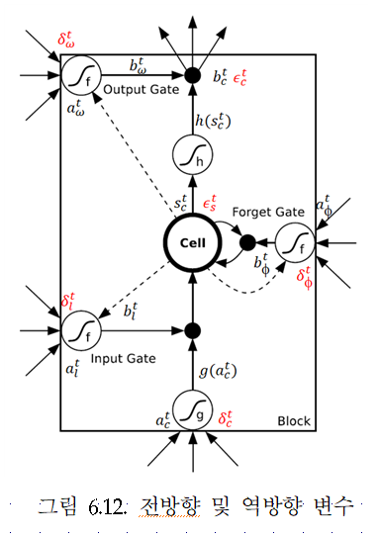





6.4. Backward Pass
Loss function: L
Cell Outputs

Slide 15



Output Gates
States

Slide 16



Cells
Forget Gates
Input Gates

