Slide 1
Machine Learning

Slide 2
Contents
Introduction
K-Nearest Neighbor Algorithm
LDA(Linear Discriminant Analysis)
Perceptron
Feed-Forward Neural Networks
RNN(Recurrent Neural Networks)
SVM(Support Vector Machine)
Ensemble Learning
CNN(Convolutional Neural Network)
PCA(Principal Component Analysis)
ICA(Independent Component Analysis)
Clustering
GAN(Generative Adversarial Network)

Slide 3
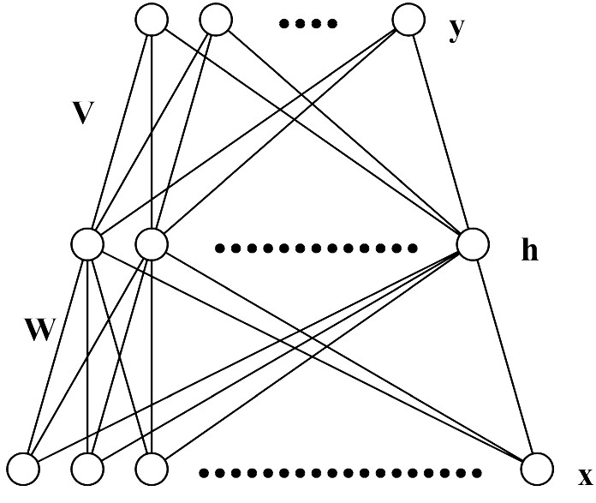
5.1. Multi-Layer Perceptron (MLP)
Each layer receives its inputs from the previous layer and forwards its outputs to the next – feed forward structure
Output layer: sigmoid activation function for classification, linear activation function for regression problem
Referred to as a two-layer network (two layer of weights)

Slide 4
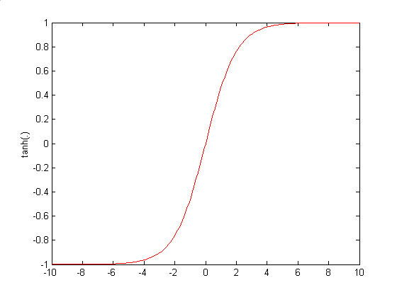
Architecture of MLP (N-H-M): Forward Propagation

Slide 5
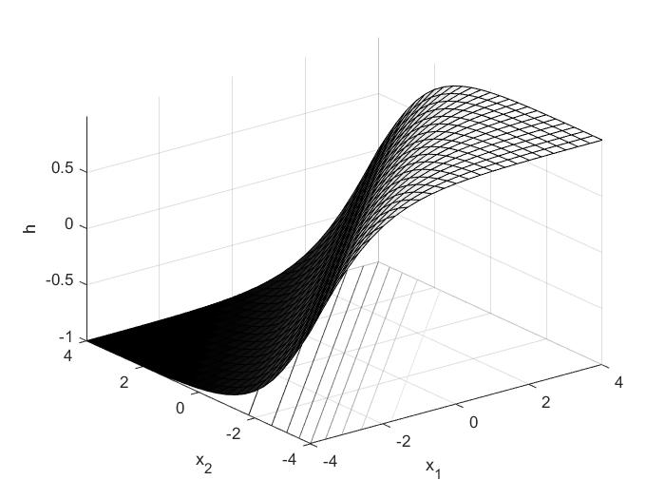
5.2. Representational Power of MLP
MLP with 3 layers can represent arbitrary function
Each hidden unit represents a soft threshold function in the input space
Combine two opposite-facing threshold functions to make a ridge
Combine two perpendicular ridges to make a bump
Add bumps of various sizes and locations to fit any surface
Universal approximator
A two layer (linear output) network can approximate any continuous function on a compact input domain to arbitrary accuracy given a sufficiently large number of hidden units

Slide 6
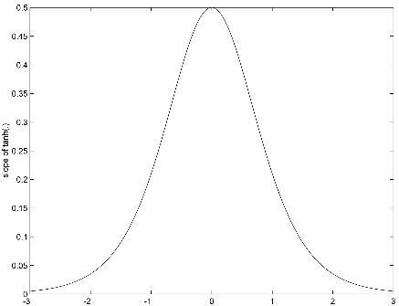
5.3. Training of MLP : Error Back-Propagation Algorithm

Slide 7
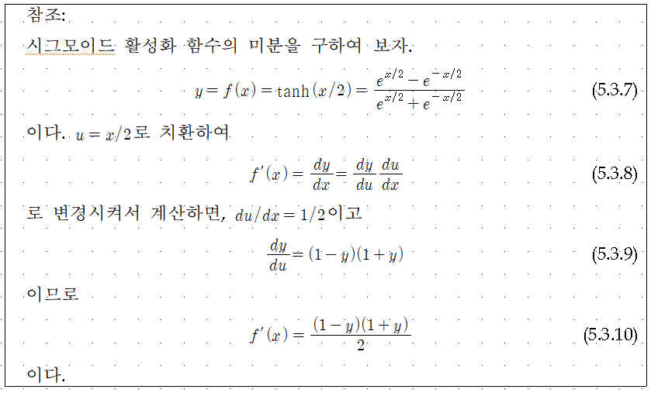

Slide 8
$$y_{1}$$
$$y_{k}$$
$$y_{M}$$
$$δ_{1}$$
$$δ_{k}$$
$$δ_{M}$$
$$v_{1j}$$
$$v_{kj}$$
$$v_{Mj}$$
$$\sum_{k=1}^{M}{v_{kj}δ_{k}}$$
$$h_{j}$$
$$f(.)$$
$$f^{′}(.)\sum_{k=1}^{M}{v_{kj}δ_{k}}$$
$$x_{0}$$
$$x_{1}$$
$$x_{i}$$
$$x_{N}$$

Slide 9
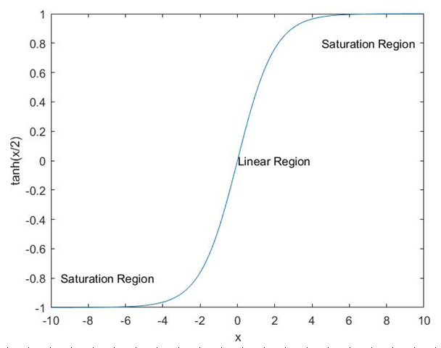
5.4. Incorrect Saturation of Output Nodes
Correct Saturation
$$y_{k}≈t_{k}, δ_{k}≈0$$
Incorrect Saturation
$${If y}_{k}≈±1 and t_{k}=∓1 , δ_{k}≈0 although \left|t_{k}−y_{k}\right|≈2$$
Incorrect Saturation of Output Nodes → Very Slow Convergence of Learning due to $δ_{k}≈0$

Slide 10
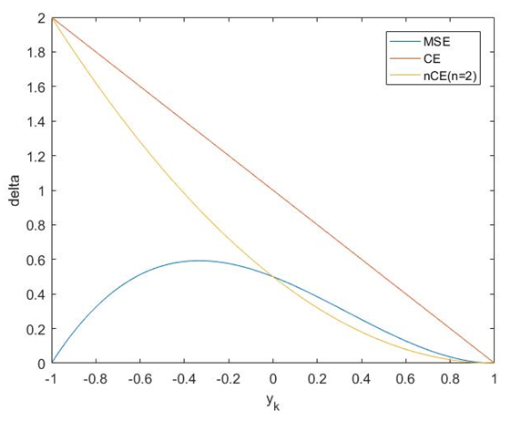
Training of MLP : Error Back-Propagation Algorithm

Slide 11
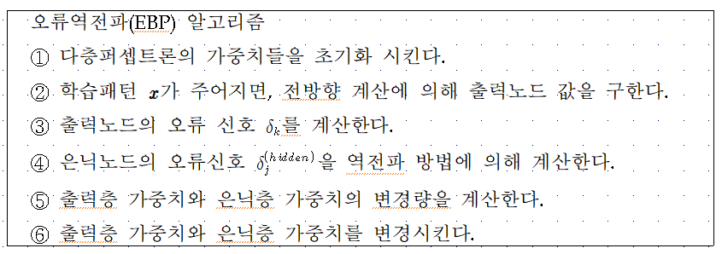
Error Back-Propagation Algorithm

Slide 12
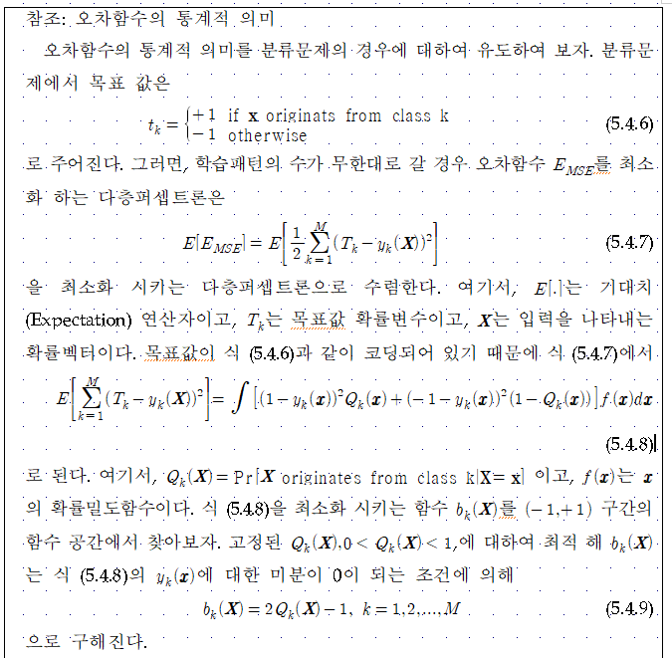
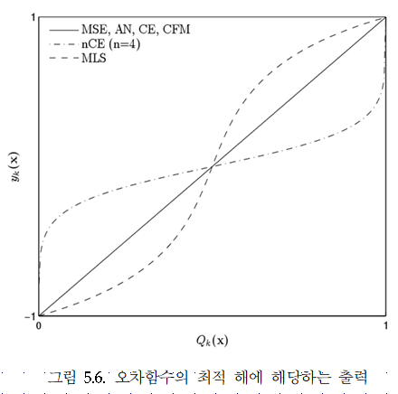

Slide 13
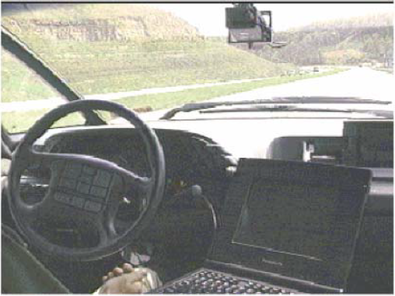
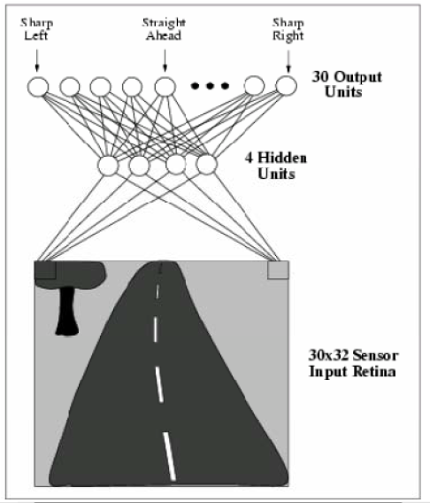
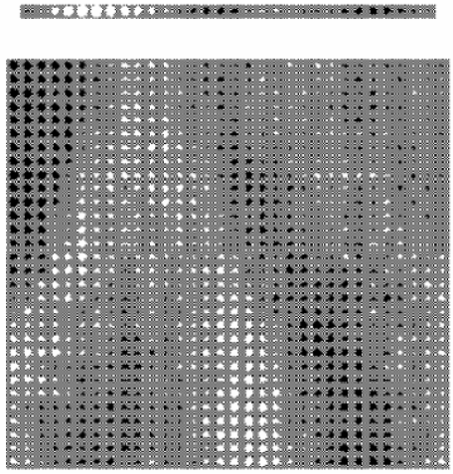
Example

Slide 14
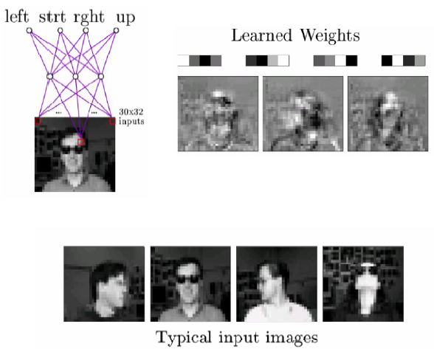
Example

Slide 15
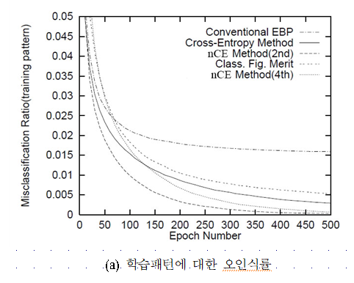
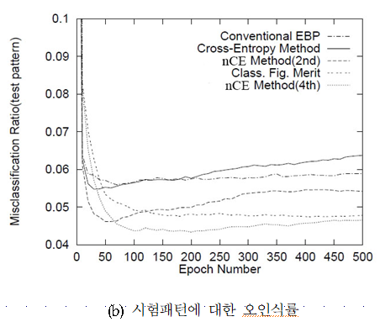

Slide 17
5.5. Remarks on Training
No guarantee of convergence, may oscillate or reach a local minima.
However, in practice many large networks can be adequately trained on large amounts of data for realistic problems, e.g.
– Driving a car
– Recognizing handwritten zip codes
– Play world championship level Backgammon
Many epochs (thousands) may be needed for adequate training, large data sets may require hours or days of CPU time.
Termination criteria can be:
– Fixed number of epochs
– Threshold on training set error
– Increased error on a validation set
To avoid local minima problems, can run several trials starting from different initial random weights and:
– Take the result with the best training or validation performance.
– Build a committee of networks that vote during testing, possibly weighting vote by training or validation accuracy

Slide 18
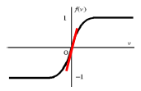
Notes on Proper Initialization
Start in the “linear” regions
keep all weights near zero, so that all sigmoid units are in their linear regions. Otherwise nodes can be initialized into flat regions of the sigmoid causing for very small gradients
Break symmetry
– If we start with the weights all equal, what will happen?
– Ensure that each hidden unit has different input weights so that the hidden units move in different directions.
Set each weight to a random number in the range
where “fan-in” is the number of inputs to the unit.

Slide 19
Batch, Online, and Online with Momentum
Batch: Sum the gradient for each example i. Then take a gradient descent step.
Online: Take a gradient descent step with each input as it is computed (this is the algorithm we described)
Momentum factor: Make the t+1-th update dependent on the t-th update
α is called the momentum factor, and typically take values in the range [0.7, 0.95]. This tends to keep weight moving in the same direction and improves convergence..

Slide 20
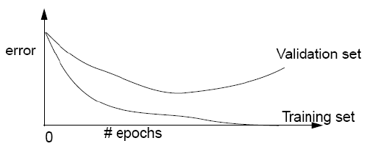
Overtraining Prevention
Running too many epochs may overtrain the network and result in overfitting. Tries too hard to exactly match the training data.
Keep a validation set and test accuracy after every epoch. Maintain weights for best performing network on the validation set and return it when performance decreases significantly beyond this.
To avoid losing training data to validation:
– Use 10-fold cross-validation to determine the average number of epochs that optimizes validation performance.
We will discuss cross-validation later in the course
– Train on the full data set using this many epochs to produce the final result.

Slide 21
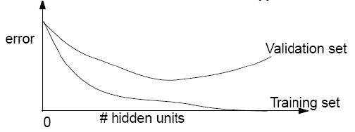
Over-fitting Prevention
Too few hidden units prevent the system from adequately fitting the data and learning the concept.
Too many hidden units leads to over-fitting.
Can also use a validation set or cross-validation to decide an appropriate number of hidden units.
Another approach to preventing over-fitting is weight decay, in which we multiply all weights by some fraction between 0 and 1 after each epoch.
- Encourages smaller weights and less complex hypotheses.
- Equivalent to including an additive penalty in the error function proportional to the sum of the squares of the weights of the network.

Slide 22
5.6. Learning Time Series Data
Time-delay neural networks (TDNN)
$$y$$
$$h$$
$$x_{0}=1$$
$$x^{t−T}$$
$$x^{t−1}$$
$$x^{t}$$

Slide 23
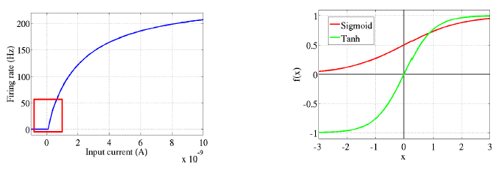
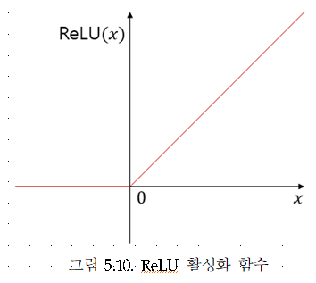
5.7. Deep Neural Networks
$$y_{k}$$
$$h^{(L)}$$
$$h^{(2)}$$
$$h^{(1)}$$
$$x$$

Slide 24
$$y_{k}$$
$$h^{(L)}$$
$$h^{(2)}$$
$$h^{(1)}$$
$$x$$

Slide 25
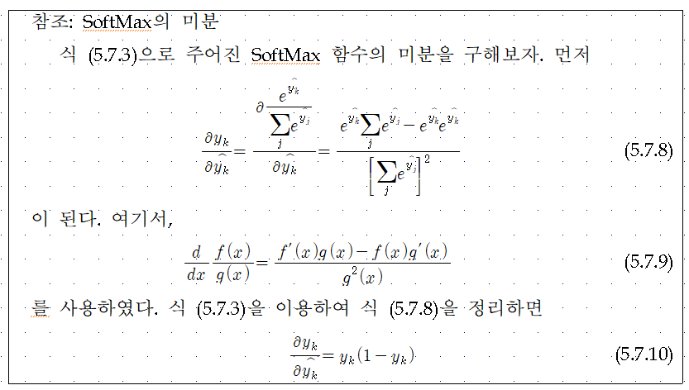
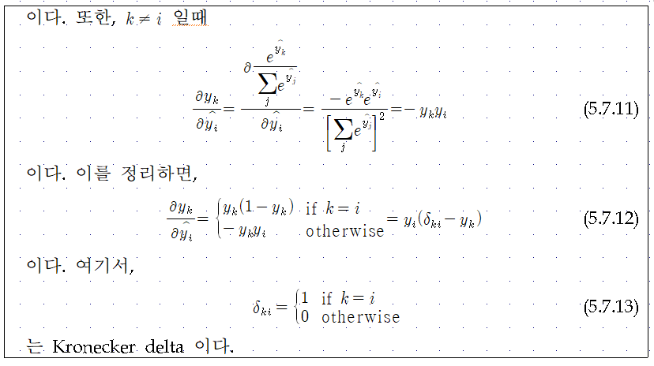

Slide 26
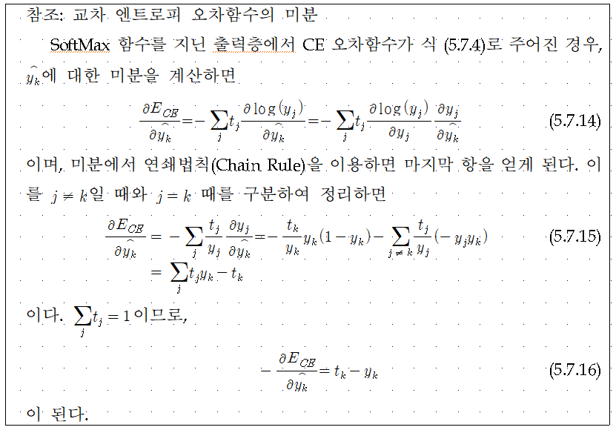

Slide 29
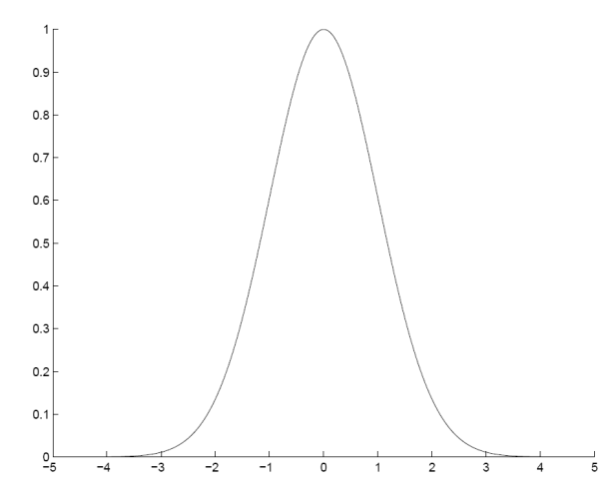
5.8. Radial Basis Function Networks
Locally-tuned units:
$$y_{k}$$
$$h$$
$$m_{j}$$
$$s_{j}$$
$$x$$

Slide 30
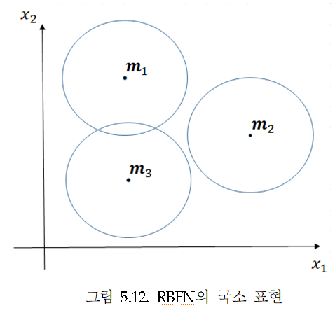
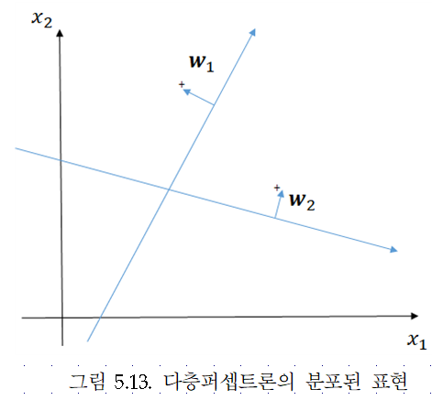
Local vs. Distributed Representation

Slide 31
Training RBF Network
Hybrid learning
• First layer centers and spreads (Unsupervised k-means)
• Second layer weights (Supervised gradient descent)
Fully supervised
•Similar to backpropagation in MLP, gradient descent for all parameters

Slide 32
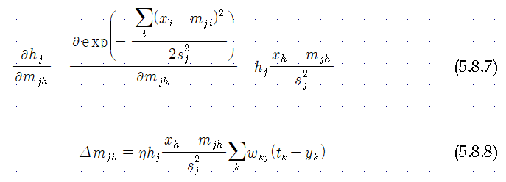
RBF Network: Fully Supervised Method
Similar to backpropagation in MLP

Slide 33
RBF Network: Fully Supervised Method
Similar to backpropagation in MLP

