Slide 1
Machine Learning

Slide 2
Contents
Introduction
K-Nearest Neighbor Algorithm
LDA(Linear Discriminant Analysis)
Perceptron
Feed-Forward Neural Networks
RNN(Recurrent Neural Networks)
SVM(Support Vector Machine)
Ensemble Learning
CNN(Convolutional Neural Network)
PCA(Principal Component Analysis)
ICA(Independent Component Analysis)
Clustering
GAN(Generative Adversarial Network)

Slide 3


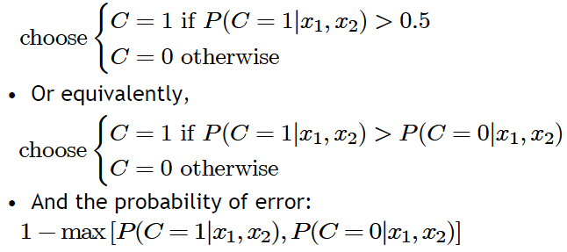
4.1. Classification
Credit scoring example:
  Inputs are income and savings
  Output is low-risk vs. high-risk
Formally speaking
Decision rule: if we know
Savings
Low-risk
High-risk
Income

Slide 4
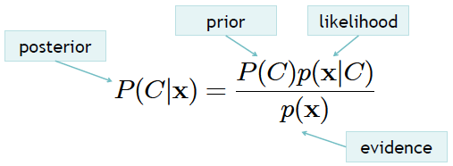
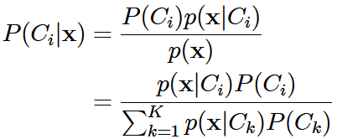

4.2. Bayes’ Optimal Classifier
Bayes rule for one concept
Bayes rule for K > 1 concepts
Decision rule using Bayes rule (Bayes optimal classifier):

Slide 5
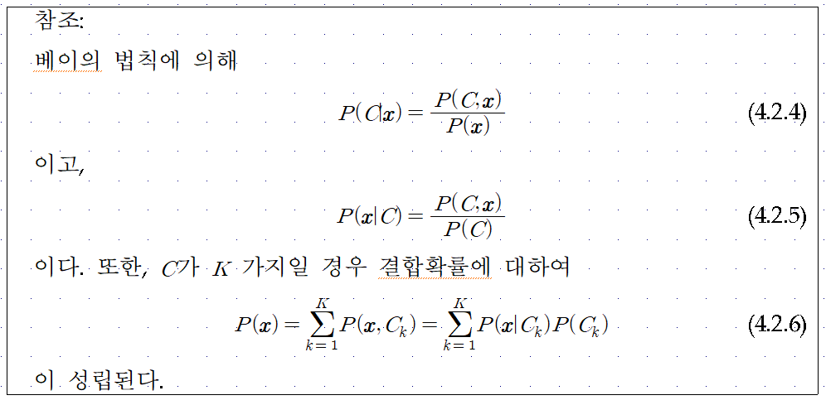

Slide 6



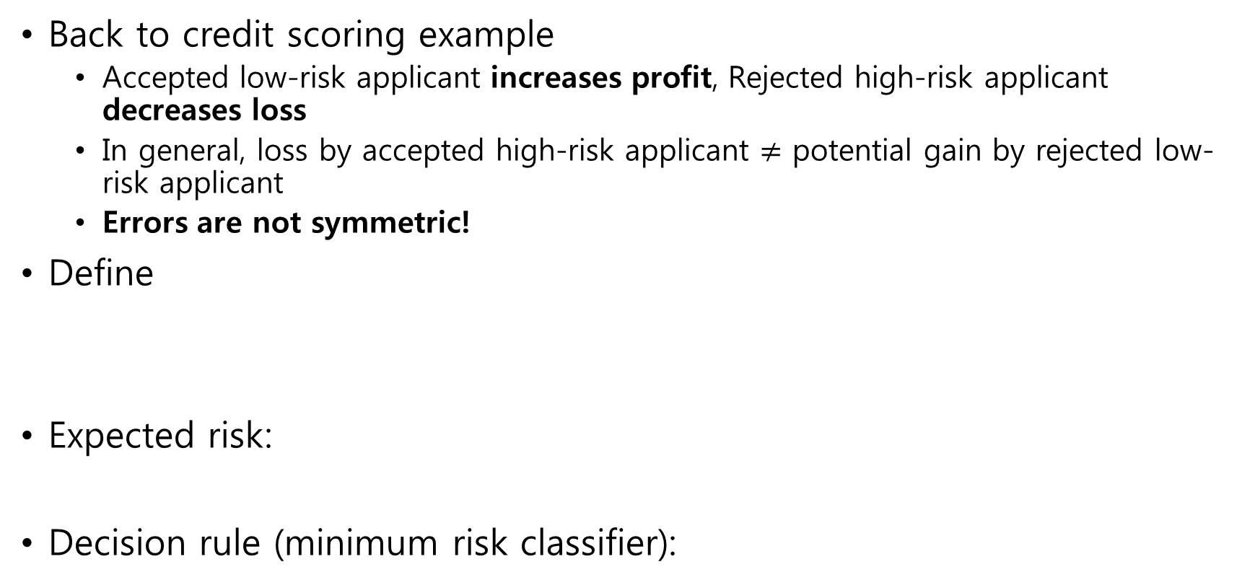
4.3. Losses and Risks
Back to credit scoring example
  Accepted low-risk applicant increases profit, Rejected high-risk applicant decreases loss
  In general, loss by accepted high-risk applicant $≠$ potential gain by rejected low-risk applicant
  Errors are not symmetric!
Define
Expected risk:
Decision rule (minimum risk classifier):

Slide 7
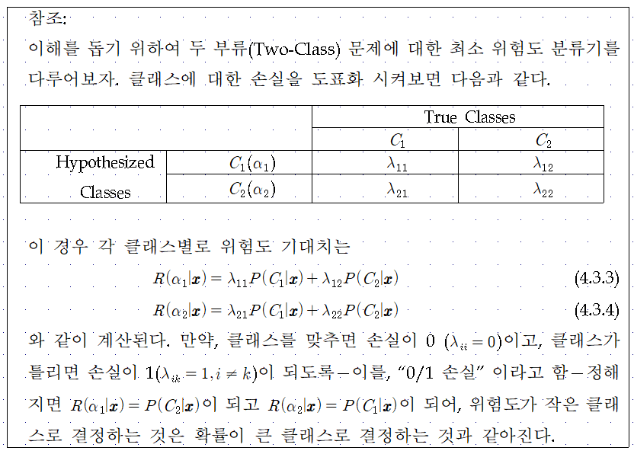

Slide 8
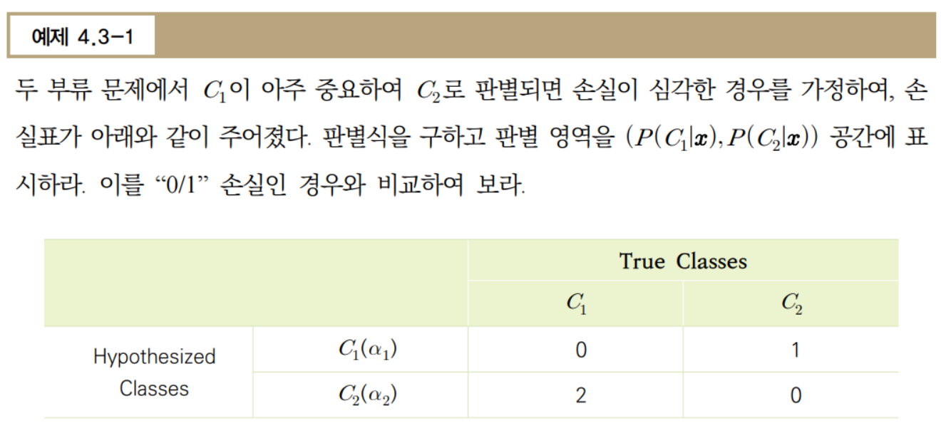

Slide 9
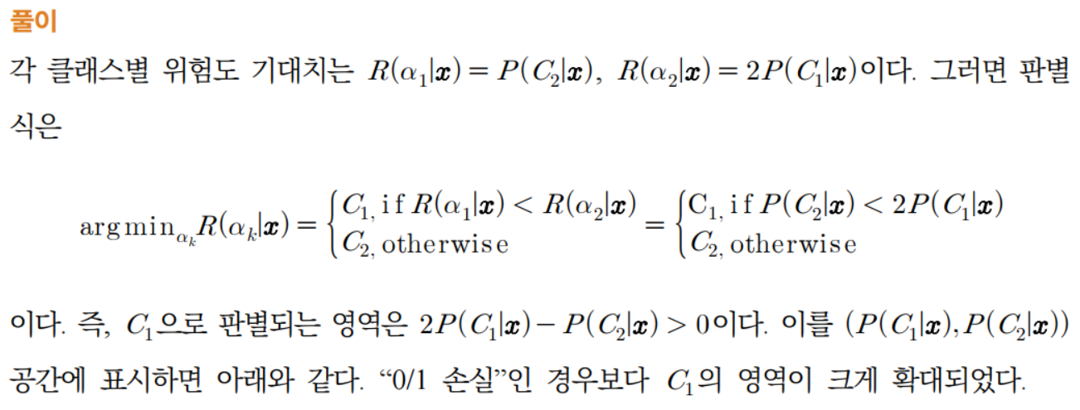
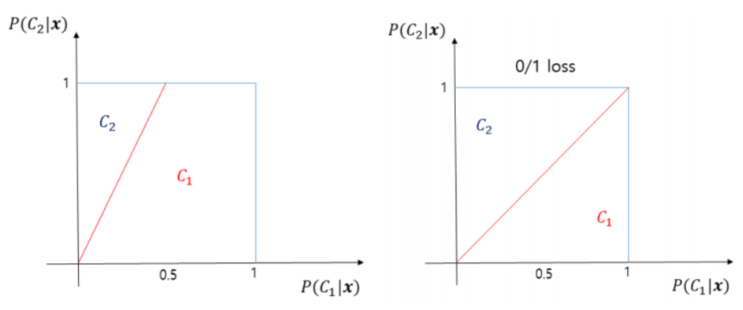

Slide 10
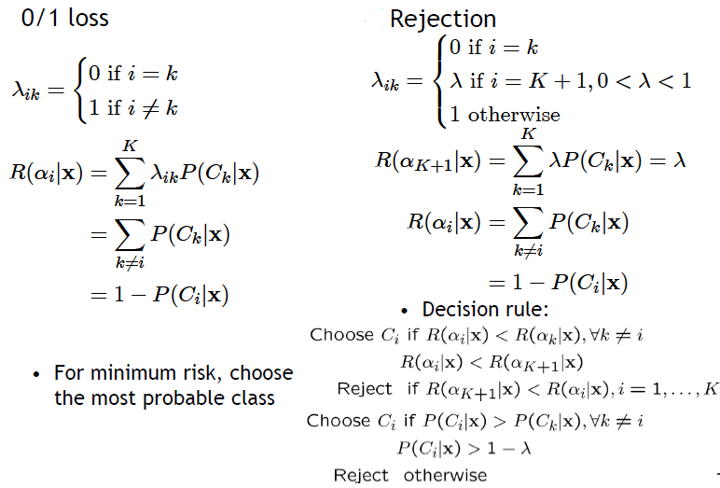
More on Losses and Risks

Slide 11
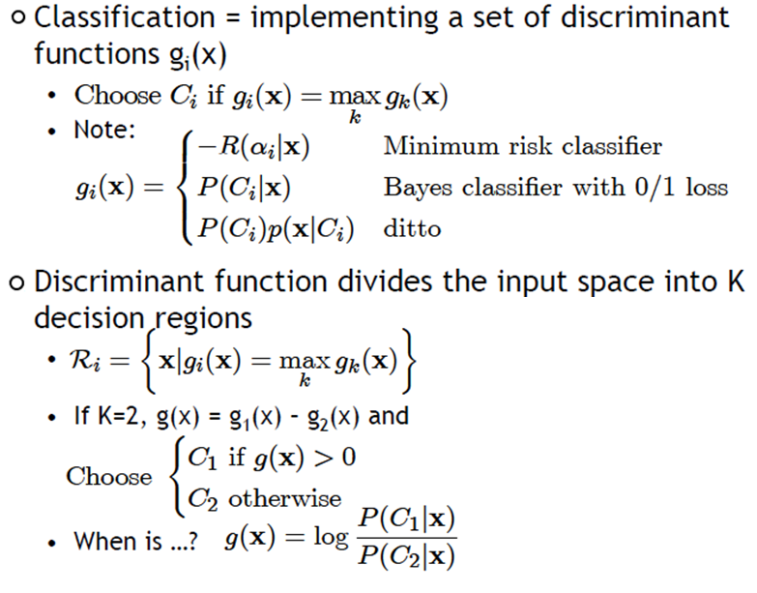





4.4. Discriminant Functions
$$x_{2}$$
$$C_{3}$$
$$C_{1}$$
Reject
$$C_{2}$$
$$x_{1}$$

Slide 12

Likelihood-based vs. Discriminant-based
Likelihood-based classification
Discriminant-based classification
Estimating the boundaries is enough; no need to accurately estimate the densities inside the boundaries!

Slide 13


4.5. Linear Discriminant Function
Linear discriminant
Advantages:
  Simple: O(d) space/computation
  Knowledge extraction: Weighted sum of attributes; positive/negative weights, magnitudes (credit scoring)
  Optimal when are Gaussian with shared covariance matrix; useful when classes are (almost) linearly separable

Slide 14
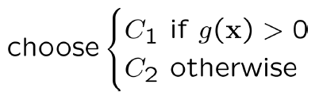







$$x_{2}$$
$$g\left(x\right)=w_{1}x_{1}+w_{2}x_{2}+w_{0}=0$$
$$g\left(x\right)<0$$
$$C_{1}$$
$$g\left(x\right)>0$$
$$C_{2}$$
$$x_{1}$$

Slide 15













$$x_{2}$$
${Two points x}_{1}$ ${and x}_{2} on the decison surface$
$$g\left(x\right)=0$$
$$g\left(x\right)<0$$
$$g\left(x\right)>0$$
$${|w}_{0}|/|\left|w\right||$$
$$w$$
$$x$$
$${Position from the origin }_{}$$
$$x_{p}$$
$$\left|g(x)\right|/|\left|w\right||$$
$$x_{1}$$

Slide 16
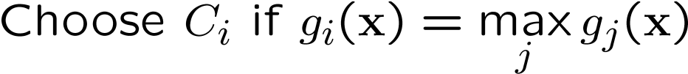



Multiple Classes (One-vs-All)
$$H_{3}$$
$$x_{2}$$
$$H_{1}$$
$$C_{3}$$
$$C_{1}$$
$$H_{2}$$
$$C_{2}$$
$$x_{1}$$

Slide 17








Pairwise Separation (One-vs-One)
$$x_{2}$$
$$H_{31}$$
$$H_{12}$$
$$C_{3}$$
$$C_{1}$$
$$H_{23}$$
$$C_{2}$$
$$x_{1}$$

Slide 18


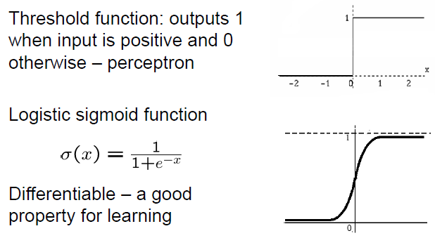












4.6. Single Layer Perceptron
$$y$$
$$f(.)$$
$$\sum_{k=0}^{d}{w_{k}x_{k}}$$
$$w_{d}$$
$$w_{0}$$
$$w_{1}$$
$$w_{2}$$
$$x_{0}=1$$
$$x_{1}$$
$$x_{2}$$
$$x_{d}$$

Slide 19
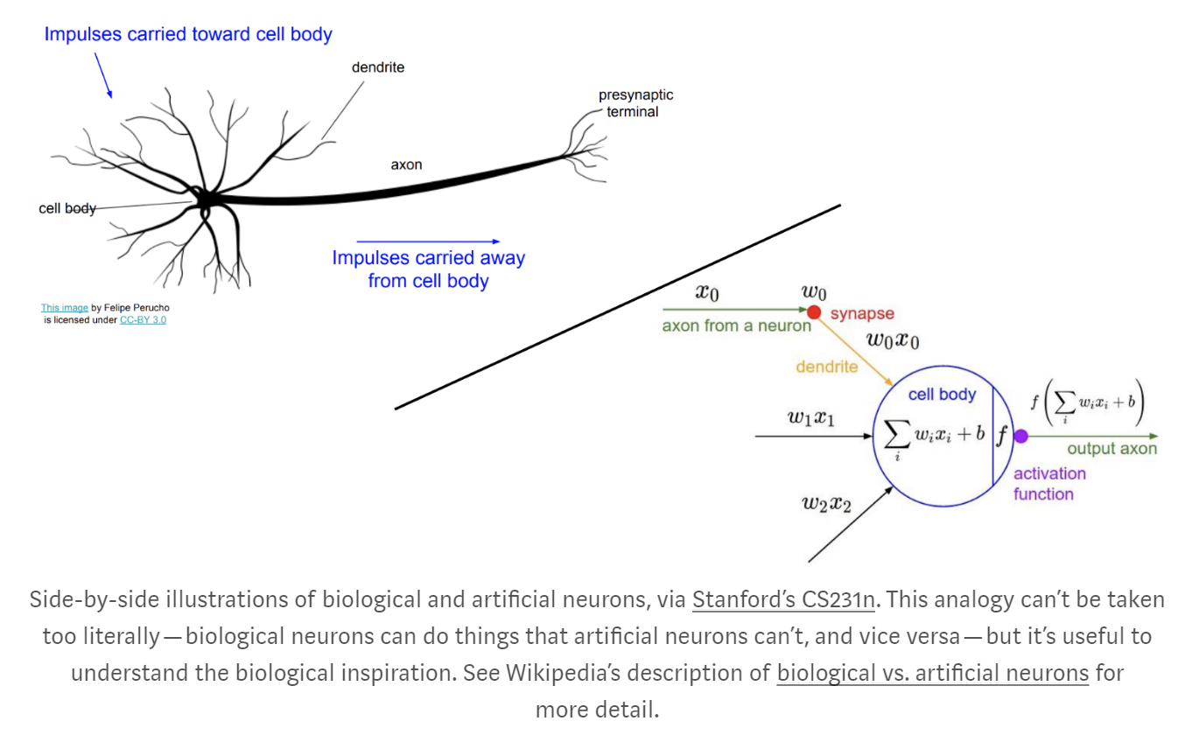

Slide 20










Single-Layer Perceptron with K Outputs
$$y_{1}$$
$$y_{2}$$
$$y_{3}$$
$$y_{K}$$
$$w_{1}$$
$$w_{2}$$
$$w_{3}$$
$$w_{k}$$
$$x_{0}=1$$
$$x_{1}$$
$$x_{2}$$
$$x_{d}$$

Slide 21
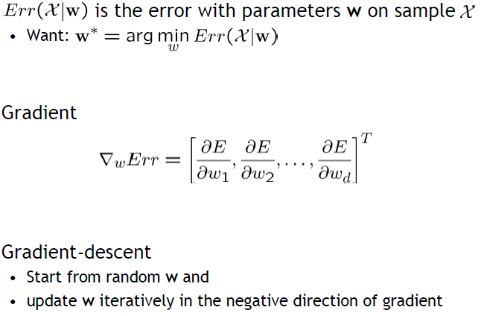
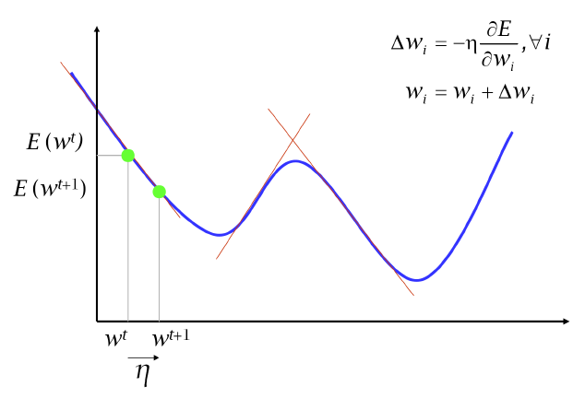
Gradient Descent
4.7. Training Perceptron

Slide 22





Gradient Descent
Training Sample
Perceptron Output $y^{t}$ Desired Output $r^{t}$
Regression (Linear Output)

Slide 23
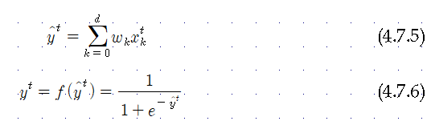




Gradient Descent
Training Sample
Perceptron Output $y^{t}$ Desired Output $r^{t}$
Classification (Sigmoid Output)

Slide 24
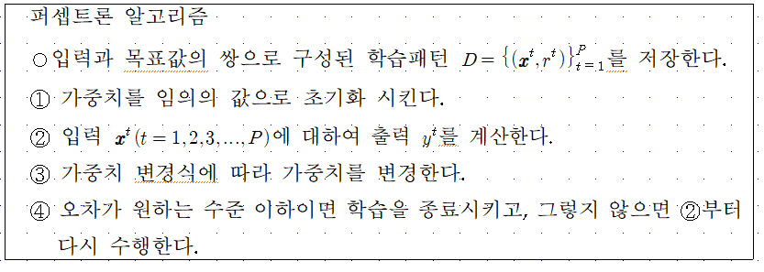

Slide 25
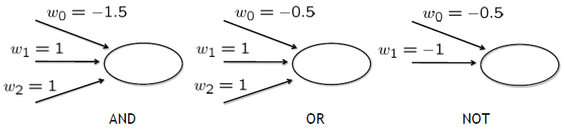
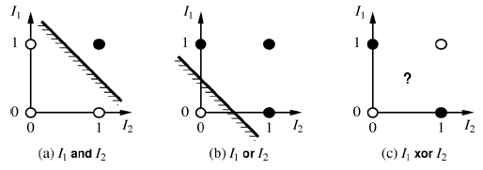

Expressiveness of Perceptrons
Consider perceptron with a = step function
  Can represent AND, OR, NOT, majority, etc., but not XOR
  Represents a linear separator in input space:

Slide 26
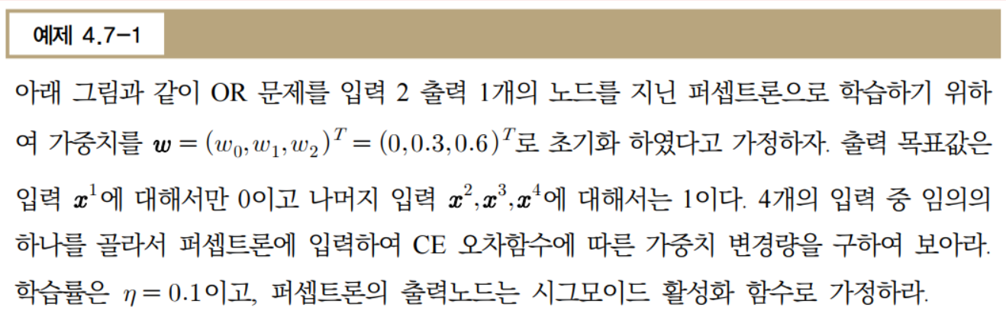
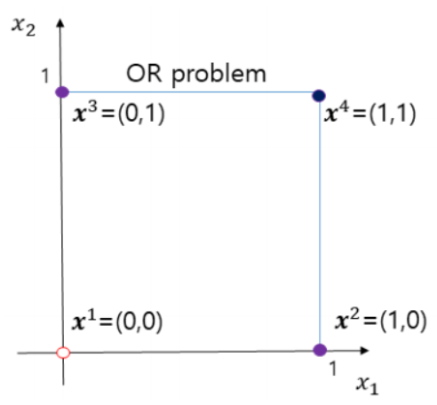

Slide 27
