Slide 1
Machine Learning

Slide 2
Contents
Introduction
K-Nearest Neighbor Algorithm
LDA(Linear Discriminant Analysis)
Perceptron
Feed-Forward Neural Networks
RNN(Recurrent Neural Networks)
SVM(Support Vector Machine)
Ensemble Learning
CNN(Convolutional Neural Network)
PCA(Principal Component Analysis)
ICA(Independent Component Analysis)
Clustering
GAN(Generative Adversarial Network)

Slide 3
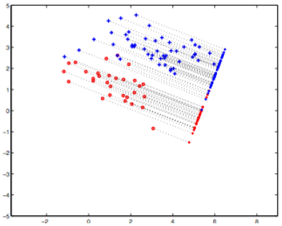
3.1. Linear Discriminant Analysis (LDA)
Problem: Given a set of data points, each of which is labelled with a class, find the best set of basis vectors for projecting the data points such that classification is improved.
Idea: Form the projection such that the variability across the different classes is maximized, while the variability within each class is minimized.

Slide 4
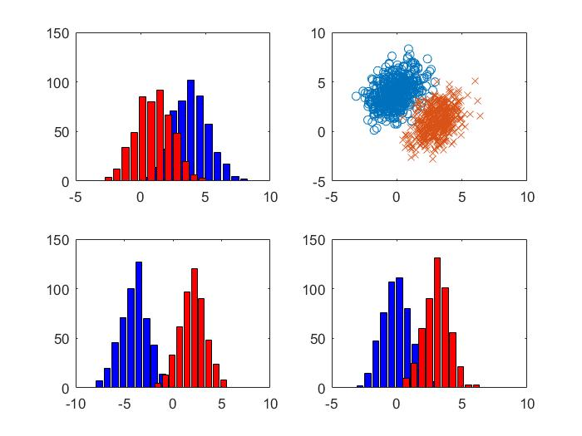
Which one is the best projection?

Slide 5
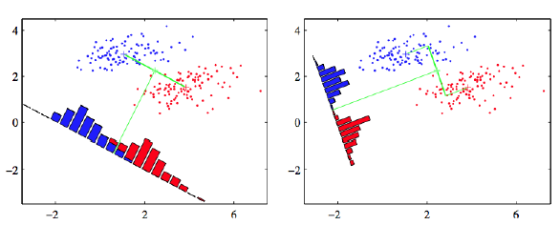
LDA: Maximize Difference of Means
Considering the simple problem of projecting onto one dimension
The two classes should be well separated in this single dimension
A simple idea is to maximize the difference of the means in the projected space
What is a problem with this solution?

Slide 6
LDA: A Better Idea
Fisher's idea: Fisher's linear discriminant
Maximize a function that will give a large separation between the projected class means
While also giving a small variance within each class, thereby minimizing the class overlap
$$x_{2}$$
$$m_{2}$$
$$m_{1}$$
$$m_{2}$$
$$s_{2}^{2}$$
$$m_{1}$$
$$w$$
$$s_{1}^{2}$$
$$x_{1}$$

Slide 7
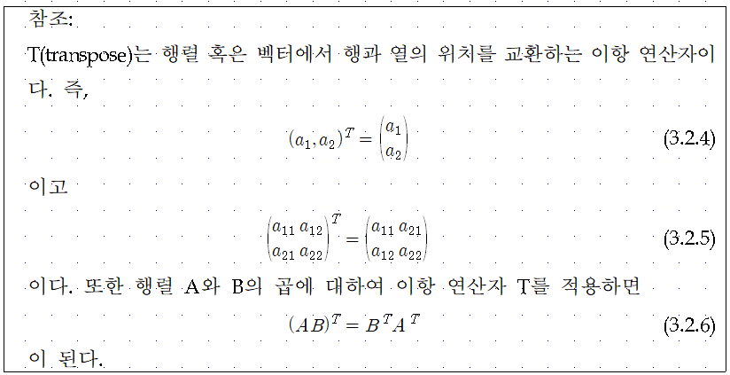
3.2. Projection with Basis Vectors
Point A = ${(a_{1},a_{2})}^{T}$
Basis Vector w = ${(w_{1},w_{2})}^{T}$
Projection $w^{T}A=$ $w_{1}$ $a_{1}$+ $w_{2}$ $a_{2}$

Slide 8
3.3. LDA Formulation
$$x_{2}$$
$$m_{2}$$
$$m_{1}$$
$$m_{2}$$
$$s_{2}^{2}$$
$$m_{1}$$
$$w$$
$$s_{1}^{2}$$
$$x_{1}$$

Slide 9
$$x_{2}$$
$$m_{2}$$
$$m_{1}$$
$$m_{2}$$
$$s_{2}^{2}$$
$$m_{1}$$
$$w$$
$$s_{1}^{2}$$
$$x_{1}$$

Slide 11
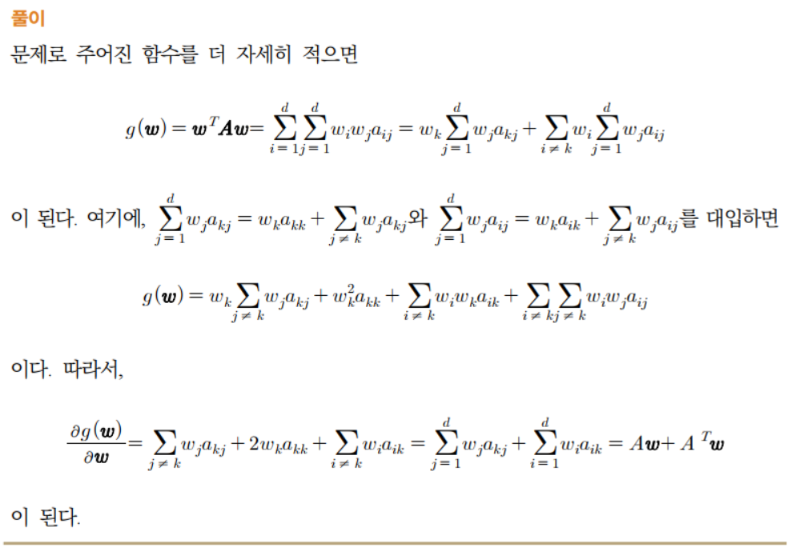

Slide 12
Maximizing
From $\frac{∂J(w)}{∂w}=0,$
scalar

Slide 14
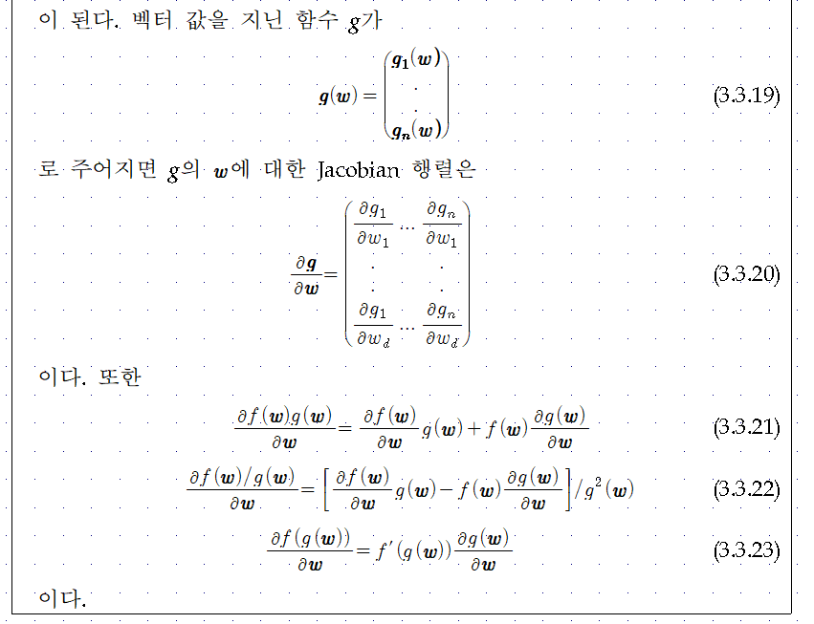

Slide 15
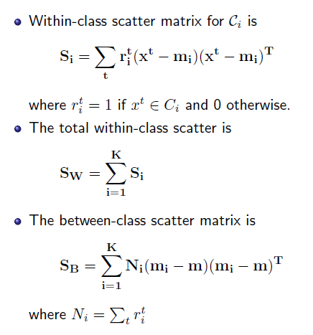
More than 2 Classes (K > 2)
Projection from d-dim space to (c-1)-dim space:

Slide 16
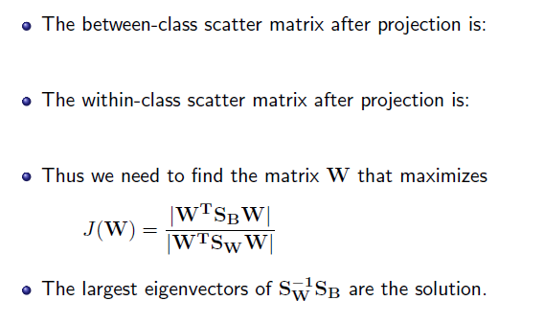
More than 2 Classes (K > 2)

Slide 17
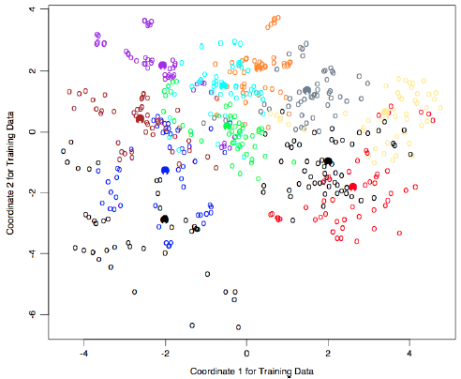
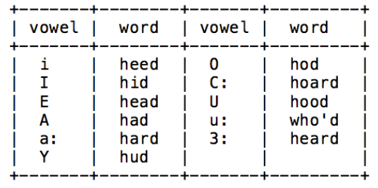
LDA on Vowels Data
11 vowels from words spoken by fteen speakers. (Source: David Deterding, Mahesan Niranjan, Tony Robinson, see Hastie book website for data)

Slide 18
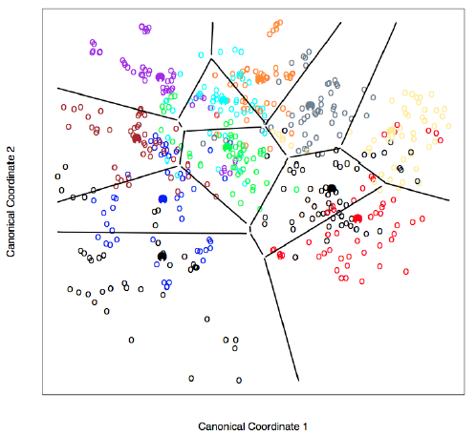
LDA on Vowels Data: Decision Boundaries

