Slide 1
Machine Learning
Sang-Hoon Oh
Division of Information Communication Convergence Engineering
Mokwon University

Slide 2


Slide 3
Contents
Introduction
K-Nearest Neighbor Algorithm
LDA(Linear Discriminant Analysis)
Perceptron
Feed-Forward Neural Networks
RNN(Recurrent Neural Networks)
SVM(Support Vector Machine)
Ensemble Learning
CNN(Convolutional Neural Network)
PCA(Principal Component Analysis)
ICA(Independent Component Analysis)
Clustering
GAN(Generative Adversarial Network)

Slide 4
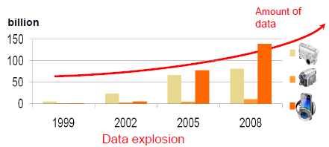
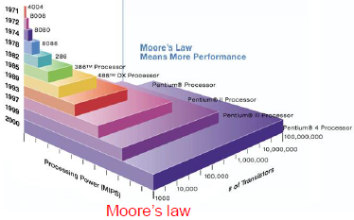
1.1. Machine Learning?
Motivation for Machine Learning
Advances in computer technology (store/access/process) can be used to analyze data (1) to make predictions, (2) for understanding and (3) control.
  Moore’s law : Describes a trend in the history of computer hardware. The number of transistors that can be inexpensively placed on an integrated circuit is increasing exponentially, doubling approximately every two years. The law is named after Intel co-founder Gordon E. Moore, who described the trend in his 195 paper. The term “Moore’s law” was coined around 1970 by the Caltech professor, Carver Mead.
  Data explosion : amount of data generated and stored grows at astounding rate (currently approximately 45GB/person x 7 billion = 315 Exabyte).
May not understand the details of the process that explains the generation of the data (consumer behavior- buy beer with chips, ice cream in summer…), however, need a technique to make a good and useful approximation in detecting certain patterns and regularities. Machine Learning!

Slide 5
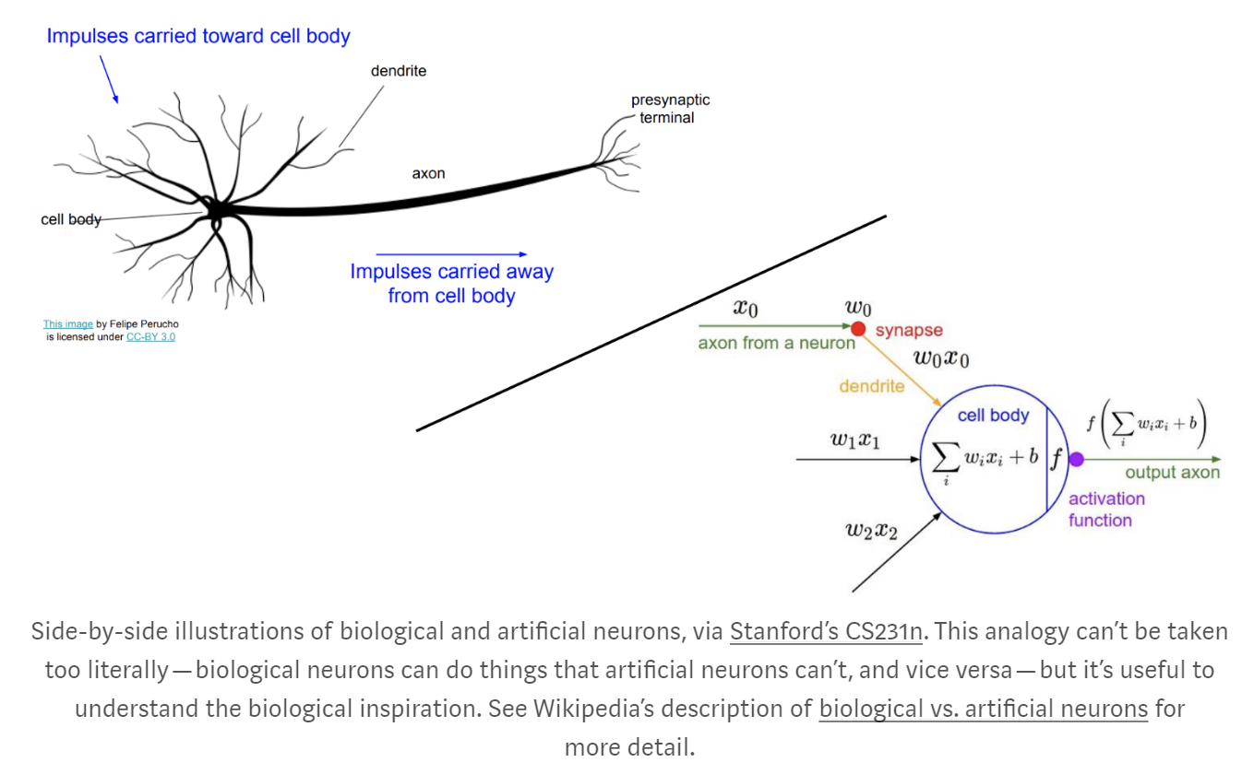
1.2. Historical Background of Machine Learning
Biological vs. Artificial Neuron
  (1943) McCulloch and Pitts: Artificial neuron model
  (1949) Hebbian learning
  (1958) Perceptron (Rosenblatt)

Slide 6
1.2. Historical Background of Machine Learning
1. Latency Period(1940~1980)
2. Quickening Period(1980~1995)
Latency Period (1940~1980)
1943 | McClloch & Pitts Neuron Model
1949 | Hebbian Learning (Hebb)
1958 | Perceptron (Rosenblatt)
1960 | Delta Rule (Widrow & Hoff)
1967 | Outstar Learning (Grossberg)
1969 | Perceptron Book (Minsky & Papert)
1972 | Associative Memory Neural Nets (Kohonen)
1973 | Pattern Classification and Scene Analysis (Duda & Hart)
1977 | Associative Memory Nets (Anderson)
1980 | Neocognitron (Fukushima)
Quickening Period (1980~1995)
1981 | Parallel Models of Associative Memory (Hinton & Anderson)
1982 | Self-Organizing Maps (Kohonen)
1982 | Hopfield Neural Networks (Hopfield)
1983 | Boltzmann Machine (Hinton & Sejnowski)
1985 | Adaptive Resonance Theory (Carpenter & Grossberg)
1986 | Error Back-Propagation Algorithm (Rumelhart, Hinton, &Williams)
1988 | Bayesian Networks (Lauritzen, Spiegelhalter, & Pearl)
1992 | Support Vector Machines (Boser, Guyon, & Vapnik)
1995 | Statistical Learning Theory (Vapnik)

Slide 7
3. Growth Period(1995~2010)
4. Leaping Period(2010~Current)
Growth Period (1995~2010)
1997 | Independent Component Analysis (Bell & Sejnowski)
1998 | Natural Gradient (Amari)
1998 | Reinforcement Learning (Sutton & Barto)
1999 | Learning in Graphical Model (Jordan)
1999 | Kernel Machines (Schoelkopf & Smola)
2003 | Boosting Algorithms (Freund & Shapire)
2005 | DARPA Grand Challenge
2006 | Restricted Boltzmann Machine/Deep Learning (Hinton & Salakutdinov)
2009 | Probabilistic Graphical Models (Koller & Friedman)
Leaping Period (2010~Current)
2010 | Google Car
2011 | IBM Watson AI
2011 | Apple Siri Personal Assistant
2012 | AlexNet
2013 | Allen Institute for Artificial Intelligence
2013 | Facebook AI Research
2014 | Baidu Deep Learning Institute
2014 | Amazon Echo & Alexa
2014 | Generative Adversial Networks (Goodfellow et al.)
2015 | DARPA Robotics Challenge
2016 | Google DeepMind AlphaGo
2016 | Apple AI Lab
2016 | Google Home & Assistant

Slide 8
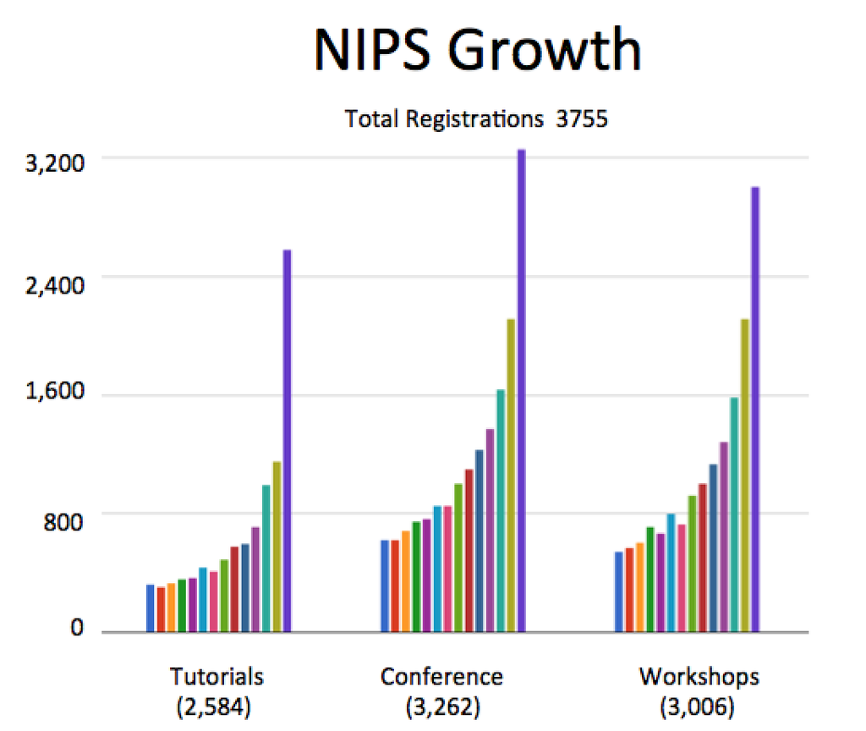
A Brief Review of NIPS 2015
FEBRUARY 2016
Zak Shafran
The twenty ninth Conference on Neural Information Processing Systems (NIPS), a single track machine learning and computational neuroscience conference, was held in Montreal, during a relatively balmy winter week, spanning December 7th to 12th. The conference saw a record number of attendees. As illustrated in the graph, during the last 14 years, there has been a steady increase in the number of attendees in all three categories -- tutorials, conference, and workshops; and biggest growth this year was in tutorials where the attendance doubled compared to the previous year!
A Brief Review of NIPS 2015
February 2016
Article Authors: Zak Shafran
The twenty ninth Conference on Neural Information Processing Systems (NIPS), a single track machine learning and computational neuroscience conference, was held in Montreal, during a relatively balmy winter week, spanning December 7th to 12th. The conference saw a record number of attendees. As illustrated in the graph, during the last 14 years, there has been a steady increase in the number of attendees in all three categories -- tutorials, conference, and workshops; and biggest growth this year was in tutorials where the attendance doubled compared to the previous year!
………………………

Slide 9
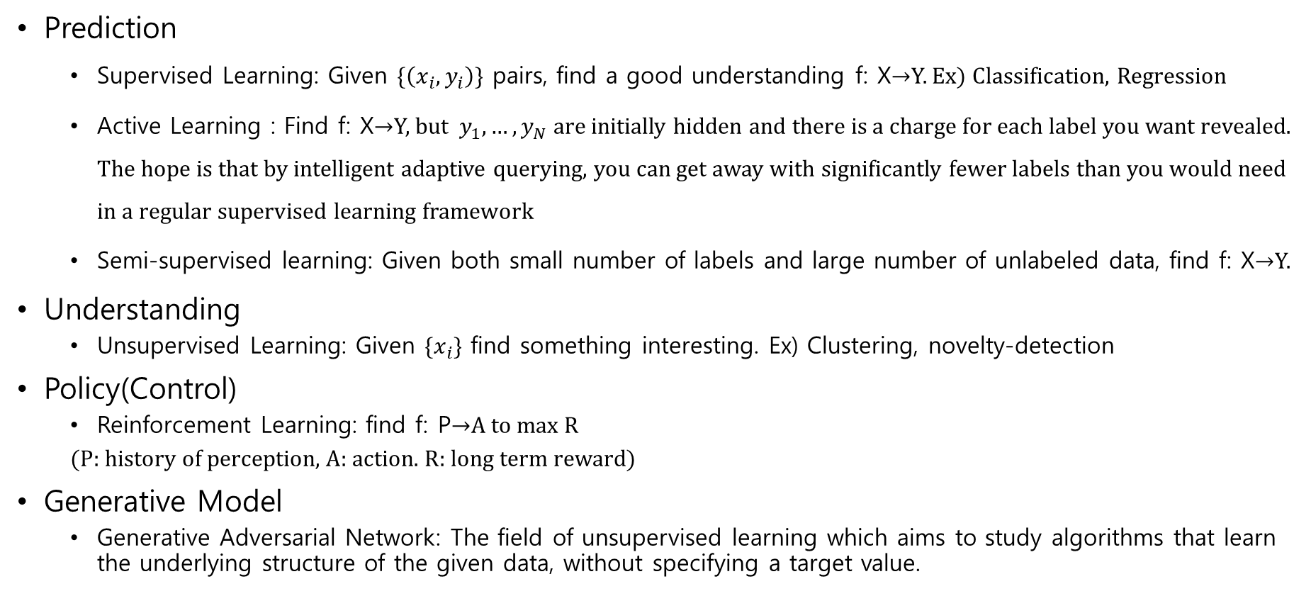
1.3. Types of Machine Learning
Prediction
  Supervised Learning: Given $\{\left(x_{i},y_{i}\right)\}$ pairs, find a good understanding f: X→Y. Ex) Classification, Regression
  Active Learning : Find f: X→Y, but $y_{1},…,y_{N}$ are initially hidden and there is a charge for each label you want revealed. The hope is that by intelligent adaptive querying, you can get away with significantly fewer labels than you would need in a regular supervised learning framework
  Semi-supervised learning: Given both small number of labels and large number of unlabeled data, find f: X→Y.
Understanding
  Unsupervised Learning: Given $\{x_{i}\}$ find something interesting. Ex) Clustering, novelty-detection
Policy(Control)
  Reinforcement Learning: find f: P→A to max R
  (P: history of perception, A: action. R: long term reward)
Generative Model
  Generative Adversarial Network: The field of unsupervised learning which aims to study algorithms that learn the underlying structure of the given data, without specifying a target value.

Slide 10
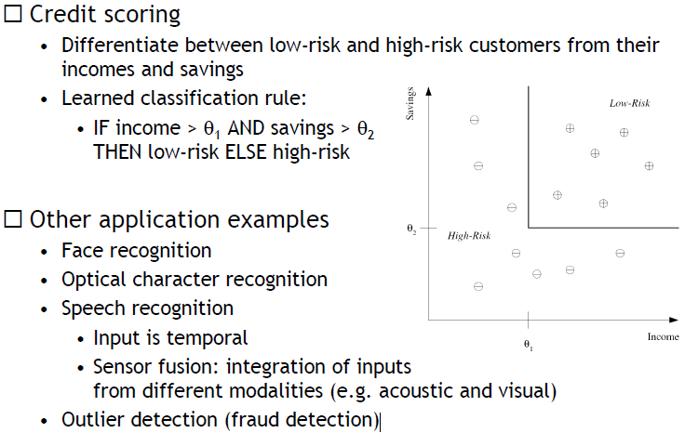
Machine learning: Classification

Slide 11
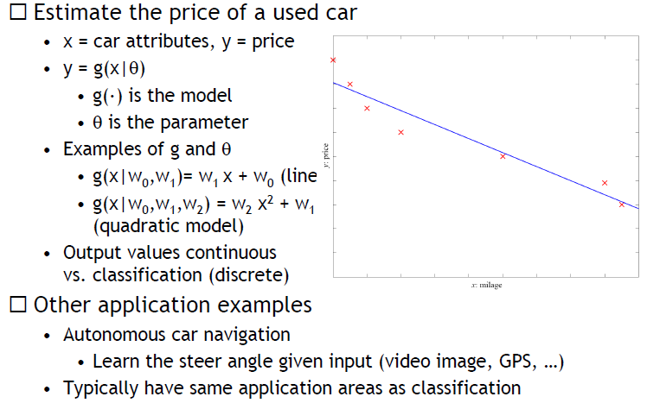
Machine learning: Regression

Slide 12
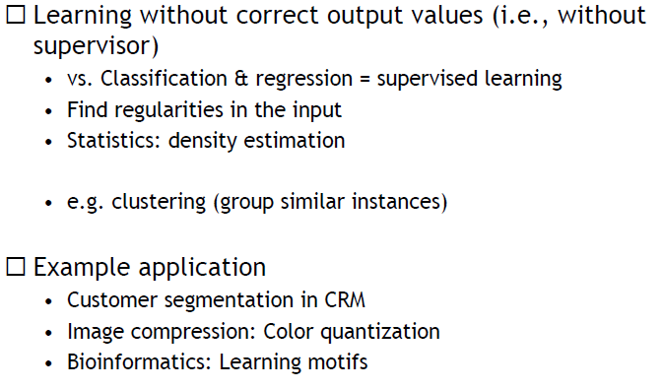
Machine learning: Unsupervised Learning

Slide 13
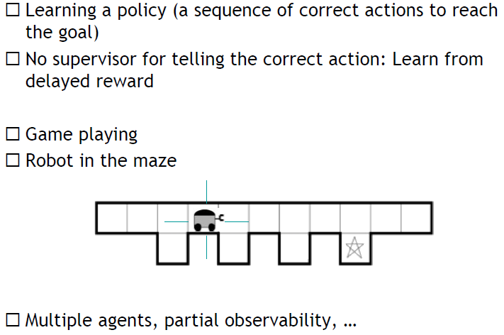
Machine learning: Reinforcement Learning

Slide 14
Applications
○Medicine/Biology
(Predict) Patient hospitalized due to heart attack will have second attack based on demographic, diet and clinical measurements.
(Predict) Glucose in the blood of diabetic person based on infrared absorption spectrum of person’s blood.
(Predict) Risk factor prostate cancer based on clinical and demographic variables).
Bioinformatics.
○Economy/finance
(Predict) Price of stock in 6 months based on company performance, economic data.
(Predict) Credit card fraud based on gender, demographic, credit history
○IT
(Predict) Numbers in a handwritten ZIP code based on digitized image of ZIP code
(Predict) Spam mail based on text in mail
(Predict) Text based on speech (Speech Recognition)
(Understanding) Call patterns are analyzed for network optimization.
○Astronomy/Physics
(Understanding) Discovering astronomical features
○Intelligence
(Policy) Flying helicopters upside down based on altitude, wind factor …
○http://mmp.kaist.ac.kr/~ee531/invertedFlight.wmv
(Policy) Playing game based on move by opponent.
(Policy) Robot navigation based on sensor input.

Slide 15
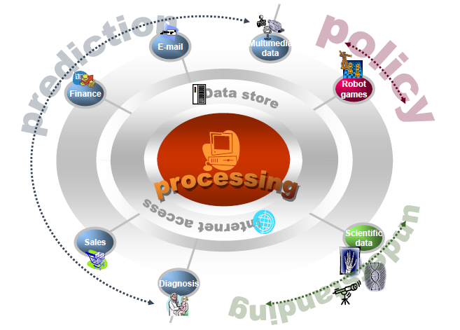
Applications: Summary

