Slide 1
Machine Learning

Slide 2
Contents
Introduction
K-Nearest Neighbor Algorithm
LDA(Linear Discriminant Analysis)
Perceptron
Feed-Forward Neural Networks
RNN(Recurrent Neural Networks)
SVM(Support Vector Machine)
Ensemble Learning
CNN(Convolutional Neural Network)
PCA(Principal Component Analysis)
ICA(Independent Component Analysis)
Clustering
GAN(Generative Adversarial Network)

Slide 3
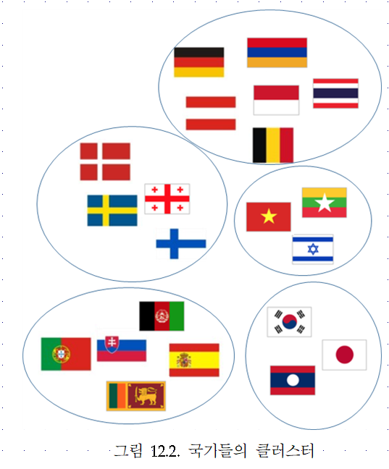
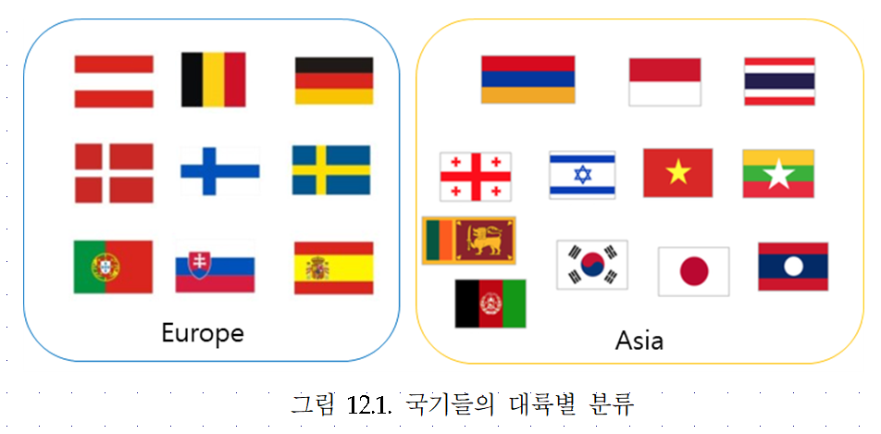
12.1. Clustering
Classification (known categories)
Clustering (creation of new categories)

Slide 4
Clustering
Clustering: the process of grouping a set of objects into classes of similar objects
  high intra-class similarity
  low inter-class similarity
  It is the commonest form of unsupervised learning
Unsupervised learning: learning from unlabelled data, as opposed to supervised data where a classification of examples is given
A common and important task that finds many applications in science and engineering
  Group genes that perform the same function
  Group individuals that have similar political view
  Categorize documents of similar topics
  Identify similar objects from photos

Slide 5
12.2. Issues for clustering
“Groupness": What is a natural grouping among these objects?
“Similarity/Distance": What makes objects related?
“Representation": How do we represent objects? Vectors? Do we normalise?
“Parameters": How many clusters? Fixed a priori? Data-driven?
“Algorithms": Partitioning the data? Hierarchical algorithm?
Formal foundation and convergence

Slide 6
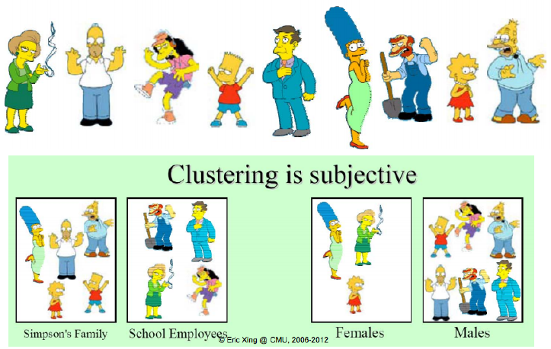
Groupness: What is a natural grouping among these objects?

Slide 7
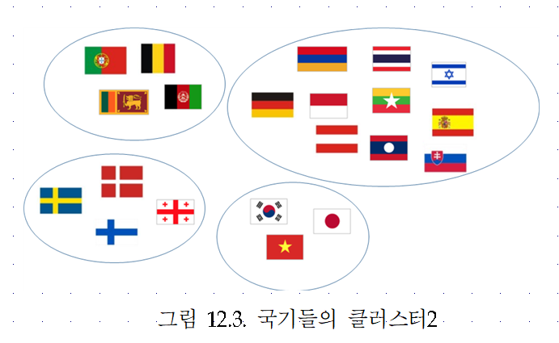
Groupness: What is a natural grouping among these objects?

Slide 8
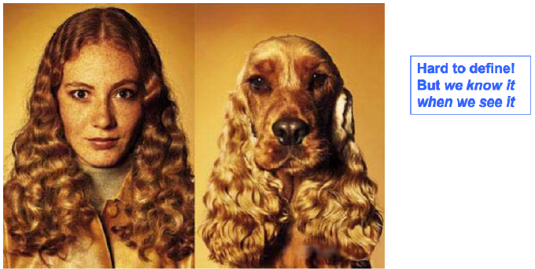
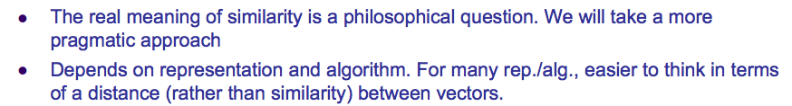
How do we define similarity?

Slide 9
What properties should a distance measure have?
Symmetry
Self-similarity
Separation
Triangular inequality

Slide 10
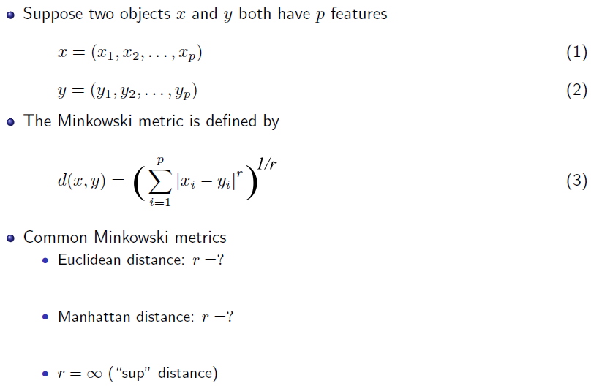
Distance measures

Slide 11
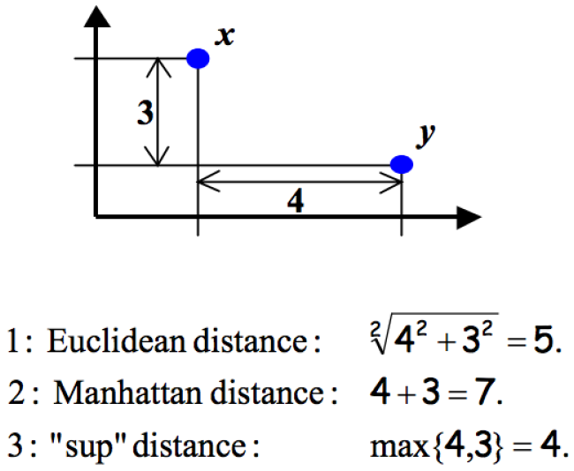
An example

Slide 12
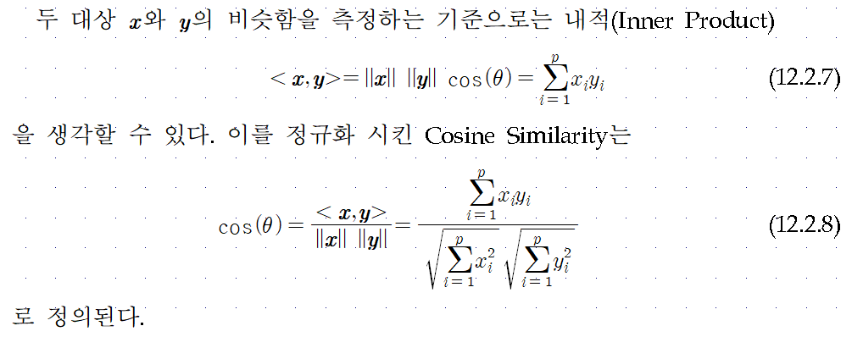

Slide 13
Clustering algorithms

Slide 14
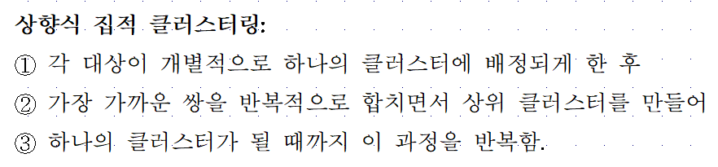
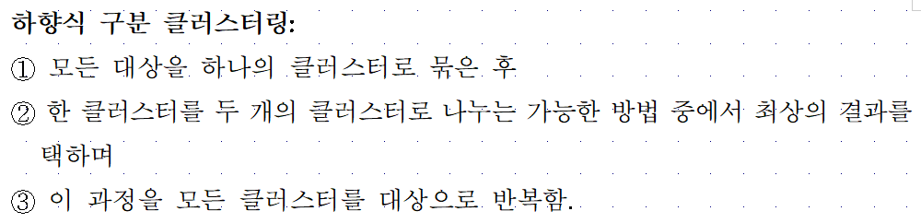
Clustering algorithms

Slide 15
Distance between clusters
We can define the distance between two clusters as
  Single-link nearest neighbor: their closest members
  Complete-link farthest neighbor: their farthest members
  Centroid: the centrois (centers of gravity) of the two clusters
  Average: the average of all cross-cluster pairs

Slide 16
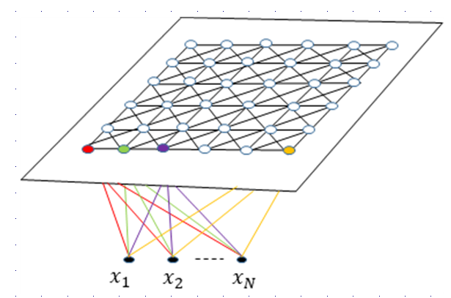
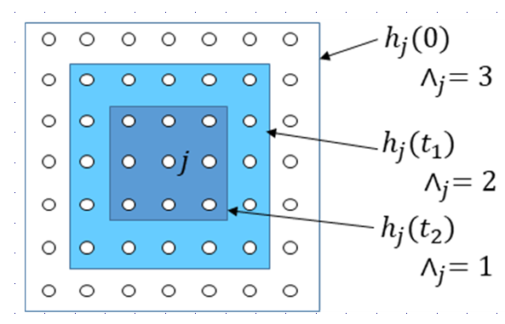
12.3. SOM(Self-Organizing Map)

Slide 17
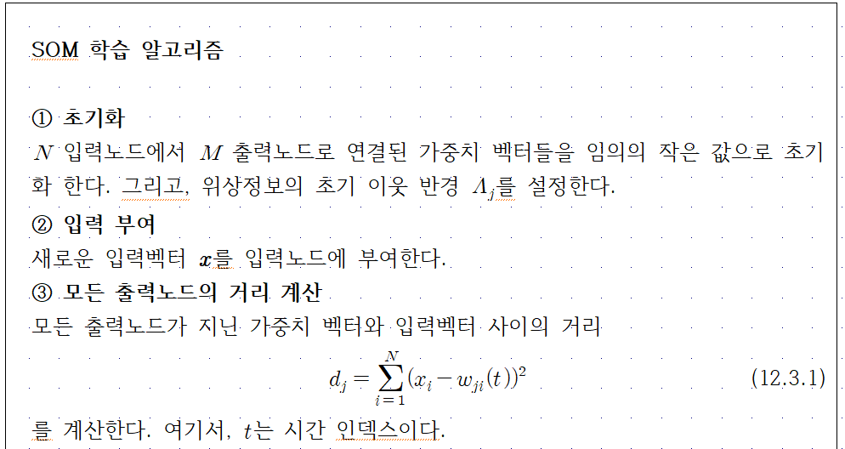

Slide 18
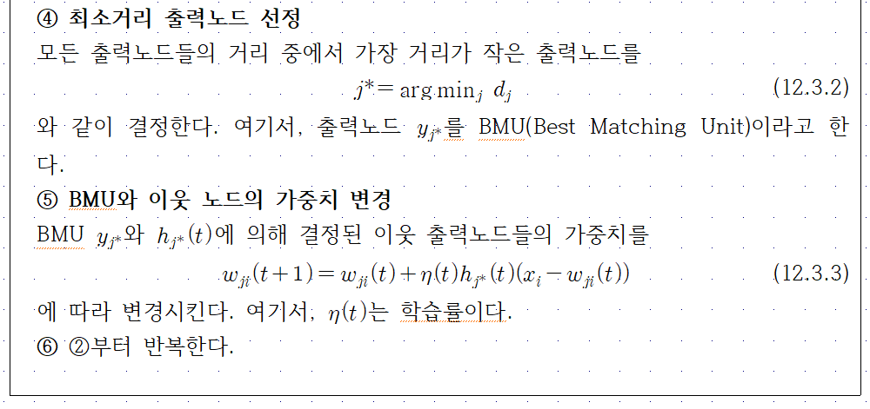

Slide 19
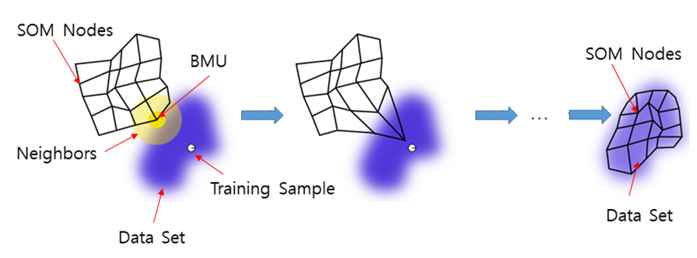

Slide 20
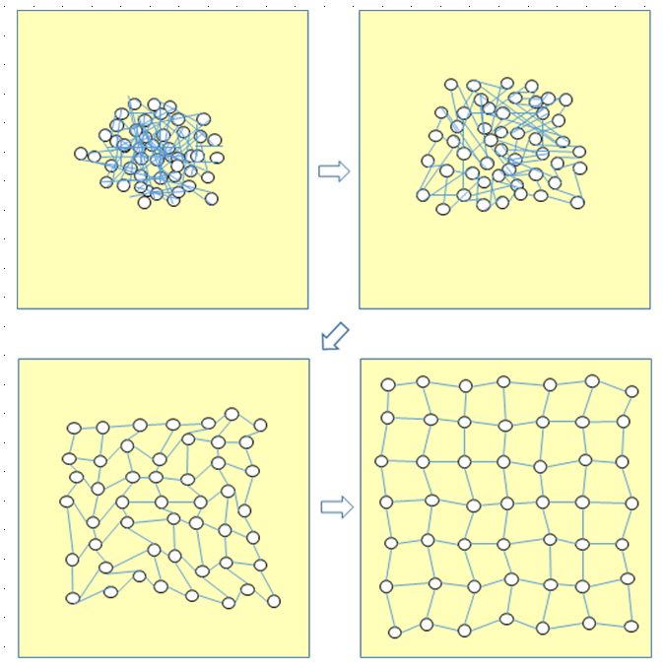

Slide 21

12.4. Conscience Learning

Slide 22
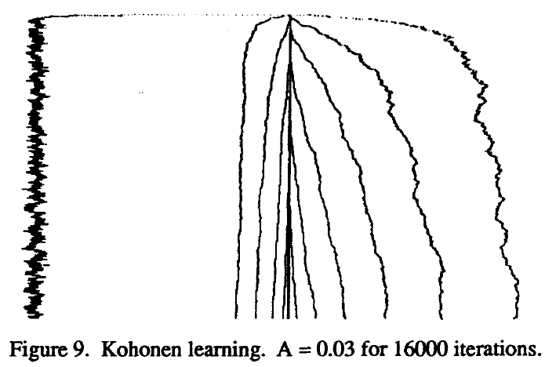
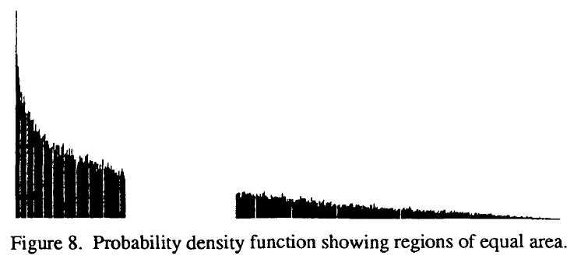
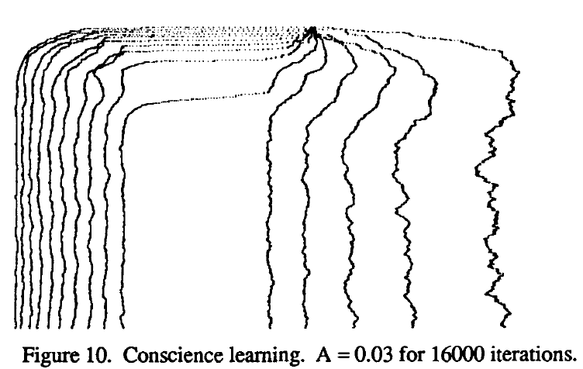

Slide 23
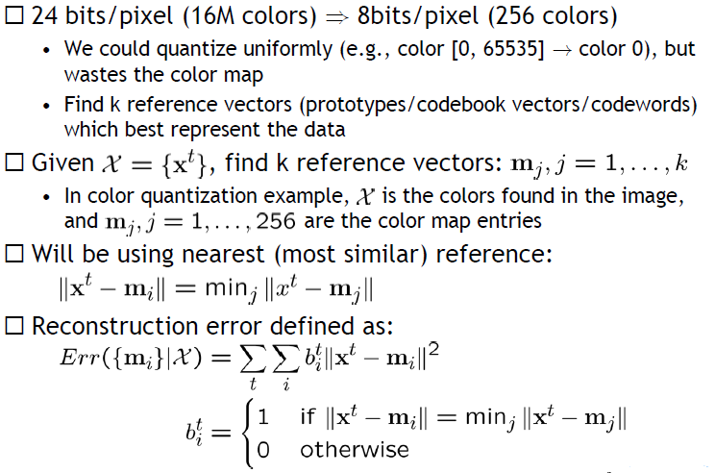
12.5. K-means Clustering

Slide 24
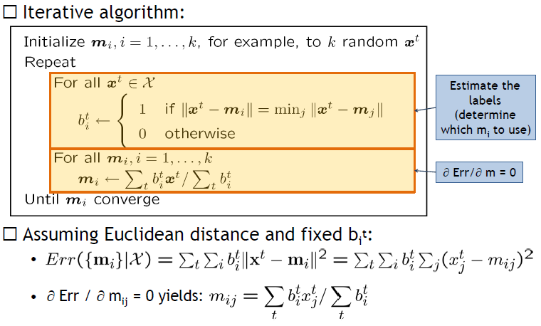

Slide 25

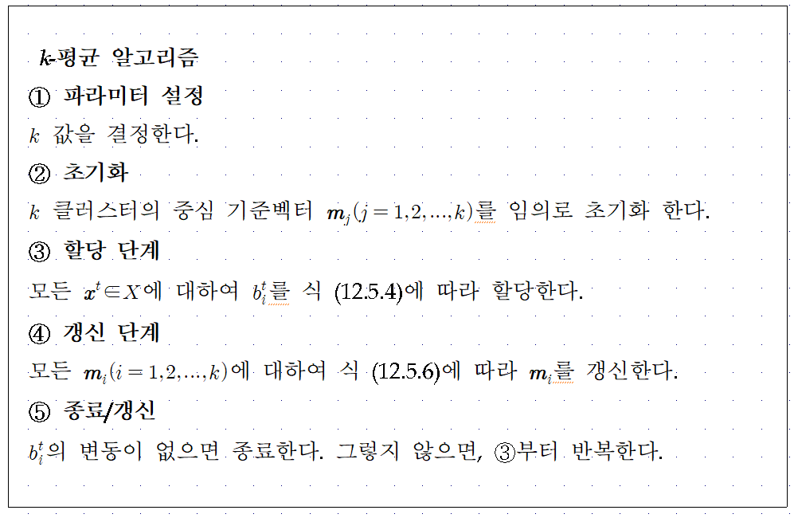
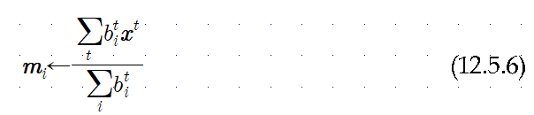

Slide 26
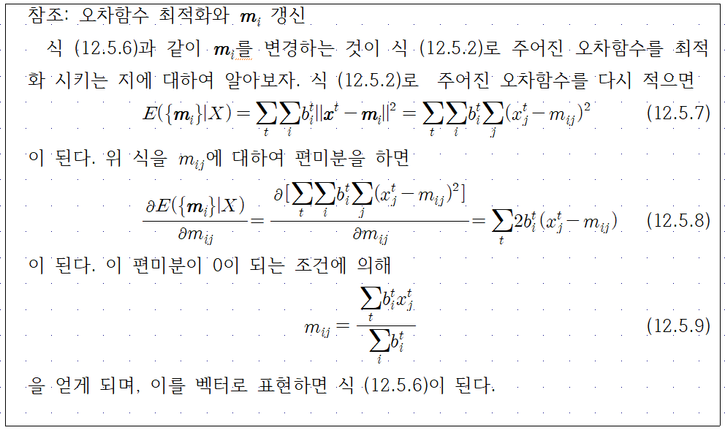

Slide 27
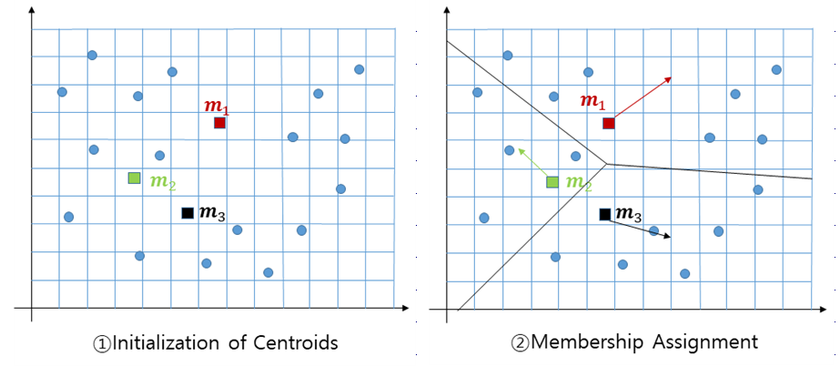

Slide 28
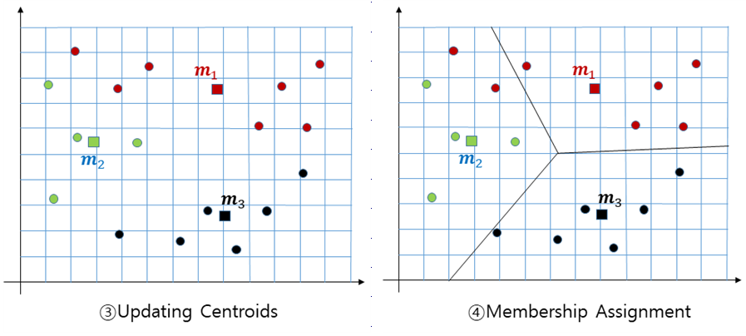

Slide 29
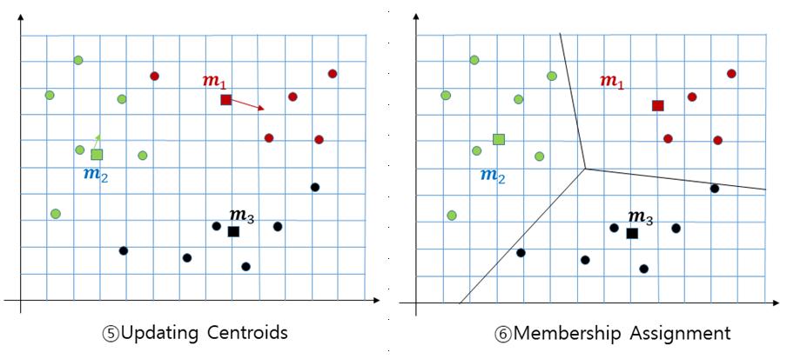

Slide 30


12.6. Evaluation
Evaluation (or "validation") of clustering results is as difficult as the clustering itself. Popular approaches involve "internal" evaluation, where the clustering is summarized to a single quality score, "external" evaluation, where the clustering is compared to an existing "ground truth" classification, "manual" evaluation by a human expert, and "indirect" evaluation by evaluating the utility of the clustering in its intended application.
Internal evaluation
Davies–Bouldin index
Dunn index

Slide 31

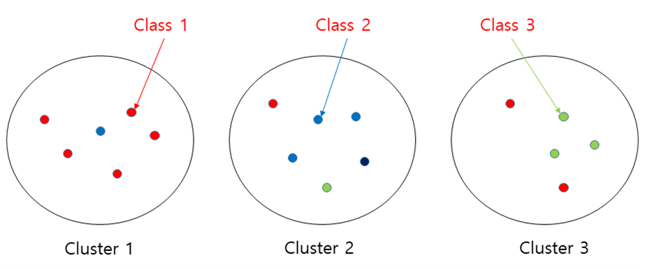
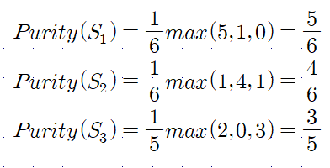
External evaluation
Purity

