Slide 1
Machine Learning

Slide 2
Contents
Introduction
K-Nearest Neighbor Algorithm
LDA(Linear Discriminant Analysis)
Perceptron
Feed-Forward Neural Networks
RNN(Recurrent Neural Networks)
SVM(Support Vector Machine)
Ensemble Learning
CNN(Convolutional Neural Network)
PCA(Principal Component Analysis)
ICA(Independent Component Analysis)
Clustering
GAN(Generative Adversarial Network)

Slide 3
10.1. Dimensionality Reduction
Data is often high dimensional - images, bag-of-word descriptions, gene-expressions etc. Provided there is some `structure', data will typically lie close to a much lower dimensional `manifold’.
What
Given d input variables (d-dimensional data), reduce it to k input variables (k-dimensional data), k < d, without loss of information
Why
Reduces time complexity: Less computation
Reduces space complexity: Less parameters
Saves the cost of observing the feature
Simpler models are more robust on small datasets
More interpretable; simpler explanation
Data visualization (structure, groups, outliers, etc.) easy if plotted in 2 or 3 dimensions

Slide 4
Feature Selection vs. Extraction
Feature selection
Choose k<d important features, ignoring the remaining (d-k) features
Subset selection algorithms
Feature extraction
Project the original xi, i=1,…,d dimensions to new k<d dimensions, zj, j=1,…,k
Principal component analysis (PCA), linear discriminant analysis (LDA), factor analysis (FA)

Slide 5
Subset Selection

Slide 6
10.2. Principal Components Analysis (PCA)
Idea:
Given data points in d-dimensional space, project onto lower dimensional space while preserving as much information as possible
E.g., find best planar approximation to 3D data
E.g., find best planar approximation to 104D data
In particular, choose projection that minimizes the squared error in reconstructing original data
Learned encoding is a linear combination of inputs
Given d-dimensional data x, learns the top m-dimensions where
the dimensions are orthogonal
the re-representational as a linear combination of the top m-dimensions minimizes reconstruction error (sum of squared errors)

Slide 7
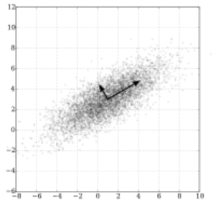
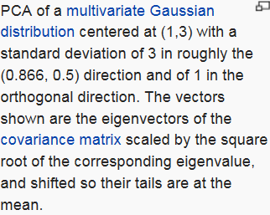
Maximum co-variance and orthogonality
Select a direction in m-dimensional space along which the variance in x is maximized.
Find another direction along which variance is maximised, but restrict the search to all directions orthonormal to all previous selected directions.
Repeat this until m vectors are selected.

Slide 8
10.3. Eigenstructure of Principal Component Analysis

Slide 12
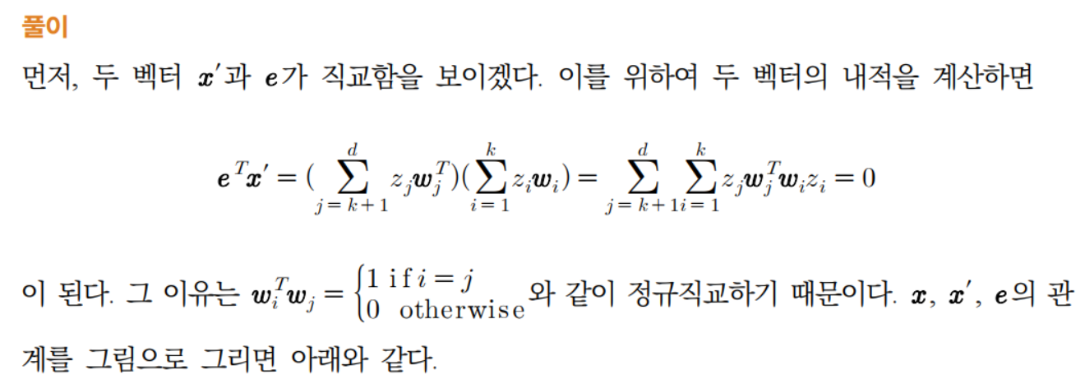
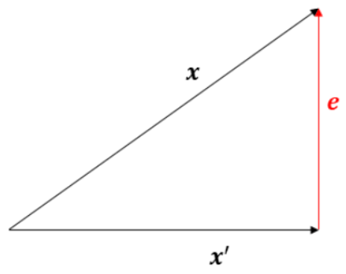

Slide 13
PCA Algorithm

Slide 14
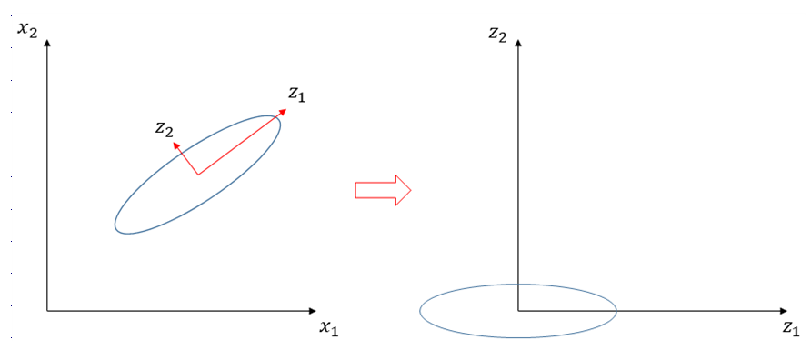
10.4. Understanding PCA

Slide 15
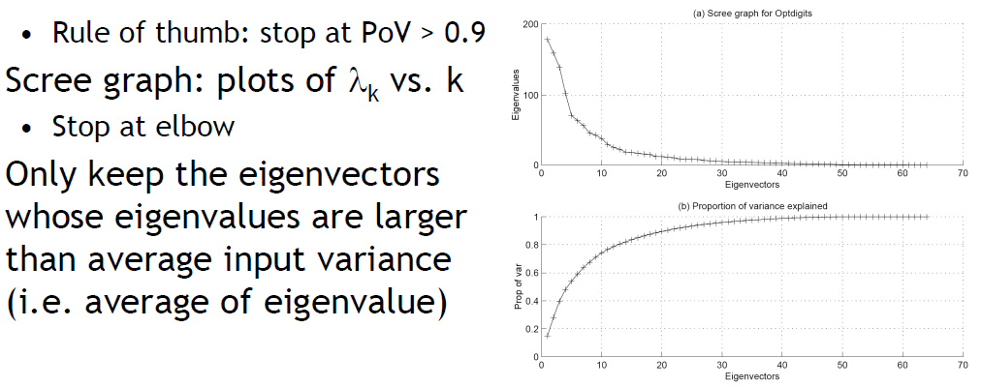
Choosing the Size of Reduced Dimension

Slide 16
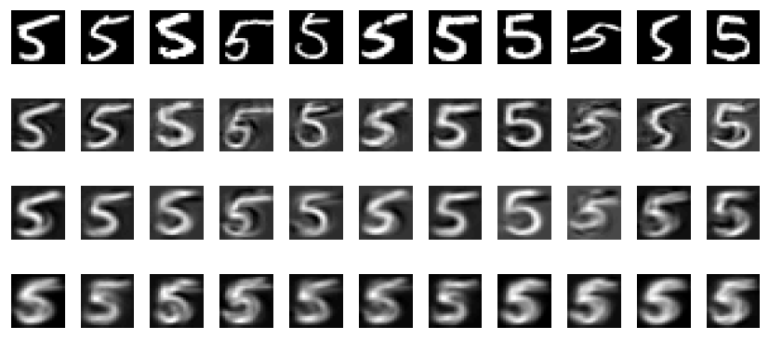
Reducing the dimension of digits
Top row : a selection of the digit 5 taken from the database of 892 examples.
Plotted beneath each digit is the reconstruction using 100, 30 and 5 eigenvectors
(from top to bottom). Note how the reconstructions for fewer eigenvectors express
less variability from each other, and resemble more a mean 5 digit.

Slide 17
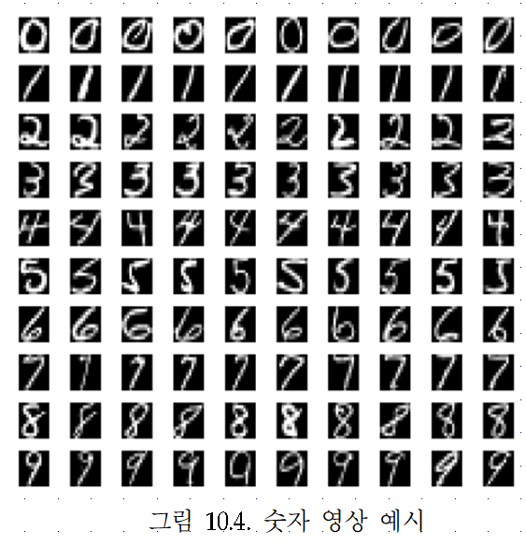
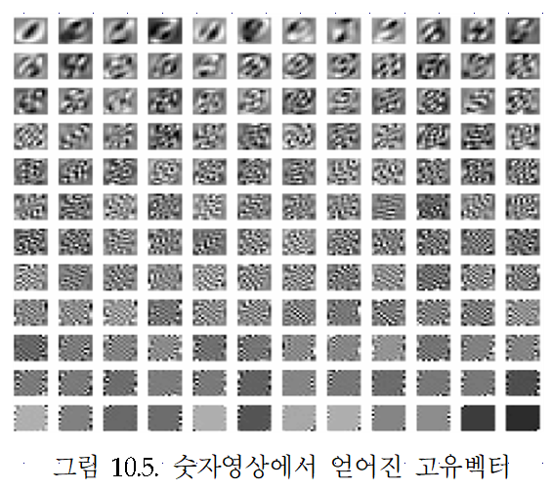

Slide 18
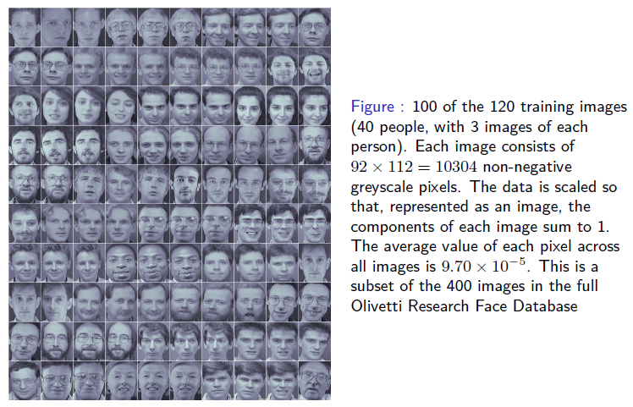
Reducing the dimension of faces

Slide 19
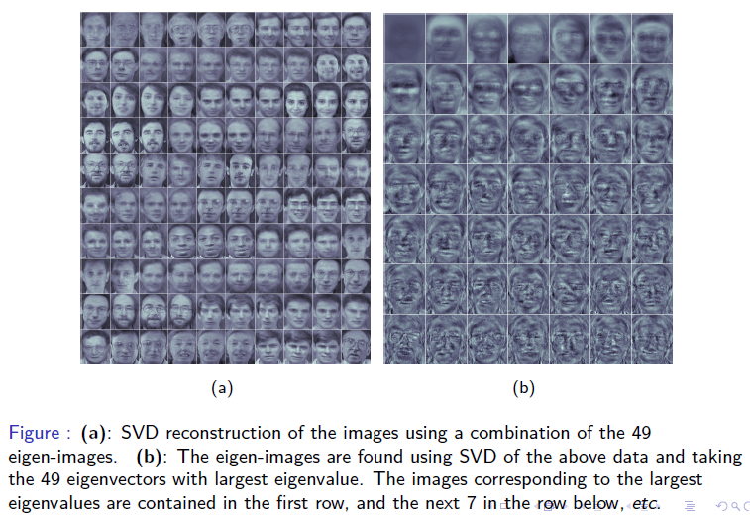
Reducing the dimension of faces

