Slide 1
Machine Learning
Supervised Learning
Classification and Regression
K-Nearest Neighbor Classification
Fisher’s Criteria & Linear Discriminant Analysis
Perceptron: Linearly Separable
Multilayer Perceptron & EBP & Deep Learning, RBF Network
Support Vector Machine
Ensemble Learning: Voting, Boosting(Adaboost)
Unsupervised Learning
Dimensionality Reduction: Principle Component Analysis
Independent Component Analysis
Clustering: K-means
Semi-supervised Learning & Reinforcement Learning

Slide 2
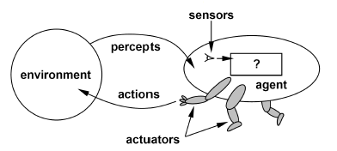
Reinforcement Learning
An approach to Artificial Intelligence
Learning from interaction
Learning about, from, and while interacting with an external environment
Goal-oriented learning
Learning what to do (i.e. how to map situations to actions) so as to maximize a numerical reward signal

Slide 3
Comparison to Supervised Learning
Supervised learning: “learning with teacher”
Target function to be learned:
Input-output pairs from the function to be learned is required:
Compute function that approximates the target function
Consider
Robot learning to dock on battery charger
Learning to choose actions to optimize factory output
Learning to play game (chess, poker, blackjack, poker, etc.)
Reinforcement learning: “learning with critic”
Doesn’t tell us what to do – how well we have been doing in the past
Feedback is scarce, and it comes late

Slide 4
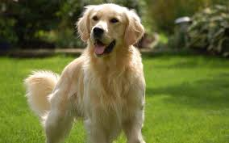
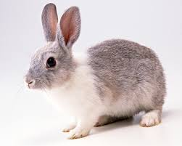
Supervised learning
Unsupervised learning
Reinforcement learning
Dog
Cat
Rabbit
?

Slide 5
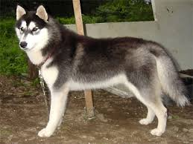
Supervised learning
Unsupervised learning
Reinforcement learning

Slide 6
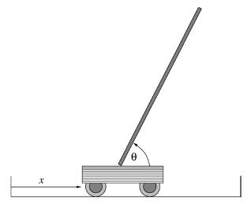
Example: Cart-Pole
State:
Reward:
-1 when the pole falls down or cart reaches the end of the rail
0 otherwise
Action: jerk-left, jerk-right

Slide 7
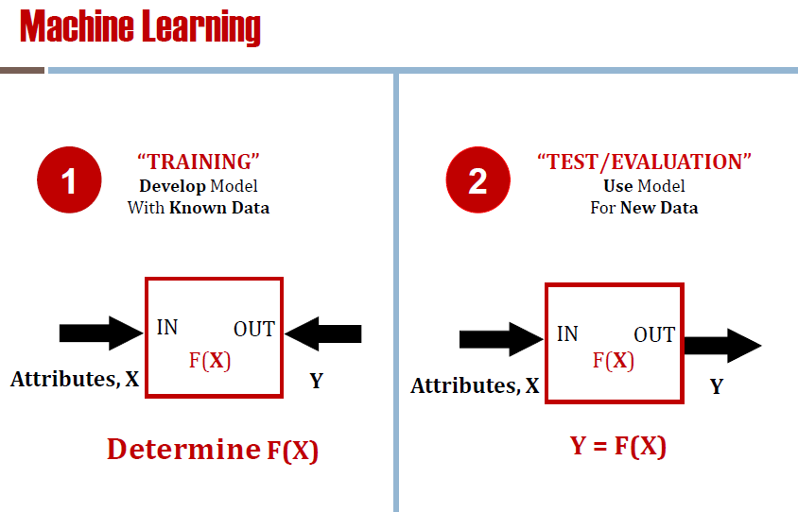
Semi-Supervised Learning

Slide 14
