Slide 1
Machine Learning
Supervised Learning
  Classification and Regression
  K-Nearest Neighbor Classification
  Fisher’s Criteria & Linear Discriminant Analysis
  Perceptron: Linearly Separable
  Multilayer Perceptron & EBP & Deep Learning, RBF Network
  Support Vector Machine
  Ensemble Learning: Voting, Boosting(Adaboost)
Unsupervised Learning
  Dimensionality Reduction: Principle Component Analysis
  Independent Component Analysis
  Clustering: K-means
Semi-supervised Learning & Reinforcement Learning

Slide 2
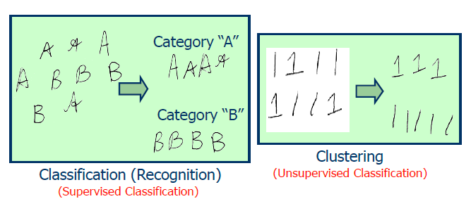
Classification vs. Clustering
Classification (known categories)
Clustering (creation of new categories)

Slide 3
Clustering
Clustering: the process of grouping a set of objects into classes of similar objects
  high intra-class similarity
  low inter-class similarity
  It is the commonest form of unsupervised learning
Unsupervised learning: learning from unlabelled data, as opposed to supervised data where a classification of examples is given
A common and important task that finds many applications in science and engineering
  Group genes that perform the same function
  Group individuals that have similar political view
  Categorize documents of similar topics
  Identify similar objects from photos

Slide 4
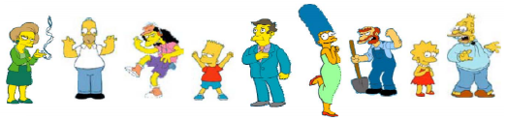

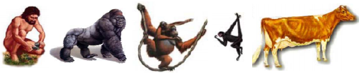
Clustering examples
People
Images
Language
Species

Slide 5
Issues for clustering
“Groupness": What is a natural grouping among these objects?
“Similarity/Distance": What makes objects related?
“Representation": How do we represent objects? Vectors? Do we normalise?
“Parameters": How many clusters? Fixed a priori? Data-driven?
“Algorithms": Partitioning the data? Hierarchical algorithm?
Formal foundation and convergence

Slide 6
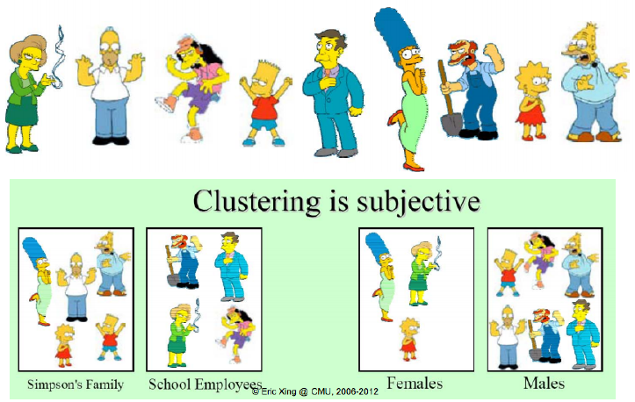
Groupness: What is a natural grouping among these objects?

Slide 7
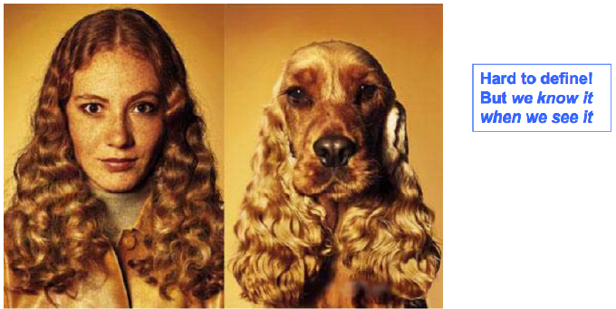
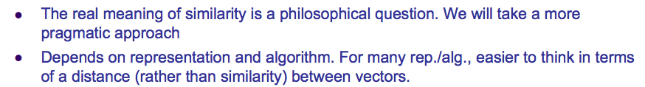
How do we define similarity?

Slide 8
What properties should a distance measure have?
Symmetry
Self-similarity
Separation
Triangular inequality

Slide 9
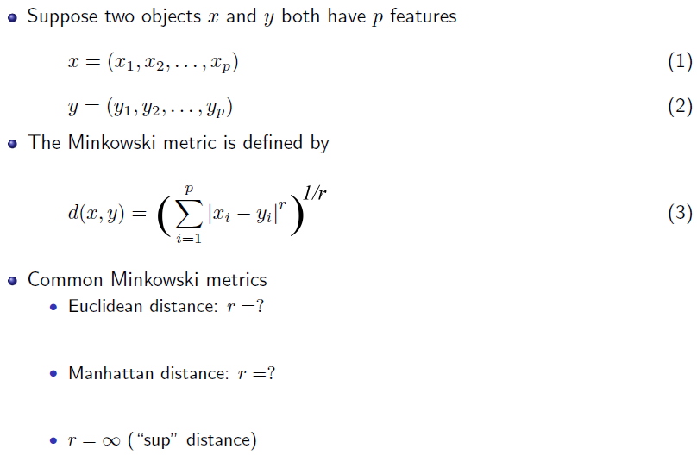
Distance measures

Slide 10
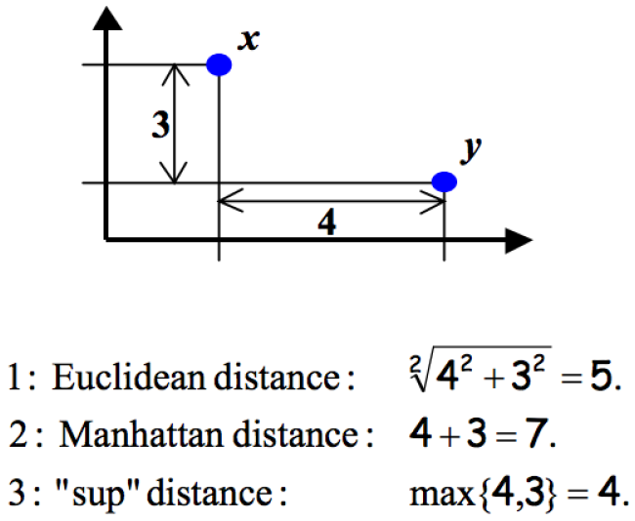
An example

Slide 11
Hamming distance
Manhattan distance is called Hamming distance when all features are binary
E.g. Gene expression levels under 17 conditions (1-High, 0-Low)

Slide 12
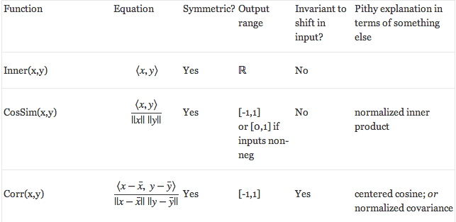
Similarity measures: Correlation coefficient

Slide 13
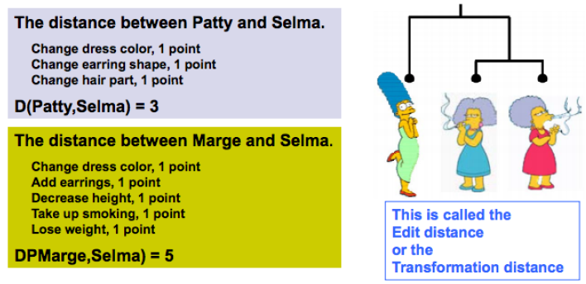
Edit distance: a generic technique for measuring similarity
To measure the similarity between two objects, transform one of the objects into the other, and measure how much effort it took. The measure of effort becomes the distance measure.

Slide 14
Clustering algorithms

Slide 15
Hierarchical Clustering algorithms

Slide 16
Hierarchical Clustering
Bottom-up agglomerative clustering
  Starts with each object in a separate cluster
  Then repeatedly joins the closest pair of clusters
  Until there is only one cluster
Top-down divisive clustering
  Starts with all data in a single cluster
  Considers every possible way to divide the cluster into two and chooses the best division
  Recurse on both sides

Slide 17
Distance between clusters
We can define the distance between two clusters as
  Single-link nearest neighbor: their closest members
  Complete-link farthest neighbor: their farthest members
  Centroid: the centrois (centers of gravity) of the two clusters
  Average: the average of all cross-cluster pairs

Slide 18
Single-link

Slide 19
Complete-link

Slide 20

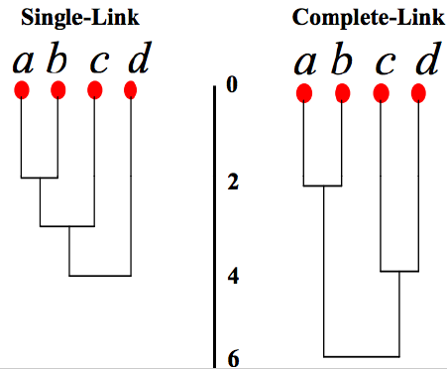
Dendograms

Slide 21
Partitioning Algorithms
Partitioning method: construct a partition of n objects into a set of K clusters
Given: a set of objects and the number K
Find: a partition of K clusters that optimizes the chosen partitioning criterion
  Globally optimal: exhaustively enumerate all partitions
  Effective heuristic methods: K-means algorithm

Slide 22
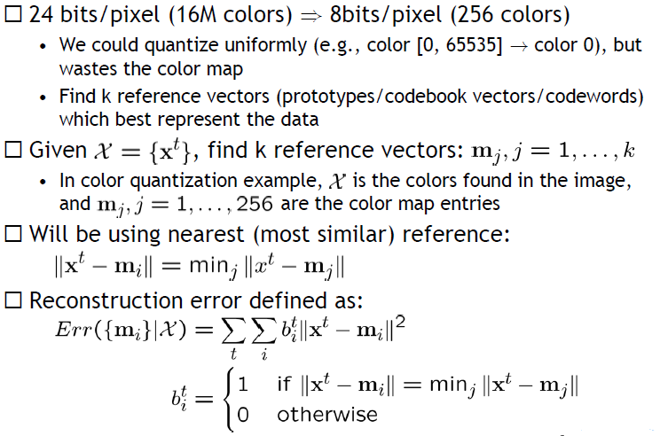
K-means Clustering

Slide 23
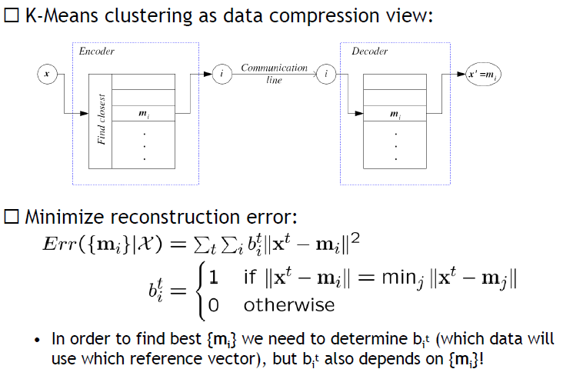
K-means Clustering

Slide 24
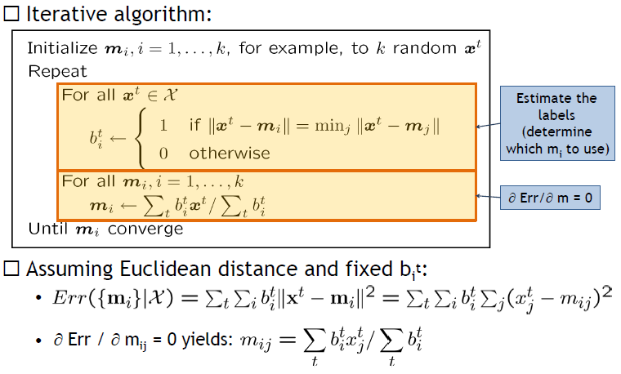
K-means Clustering Algorithm

Slide 25
K-means
Algorithm
Decide on a value for k
Initialize the k cluster centers randomly
Decide the class memberships of the N objects by assigning them to the nearest cluster centroids (aka the center of gravity or mean)
Re-estimate the k cluster centers, by assuming the memberships found above are correct
If none of the N objects changed membership in the last iteration, exit.
Otherwise go back to 3.

Slide 26
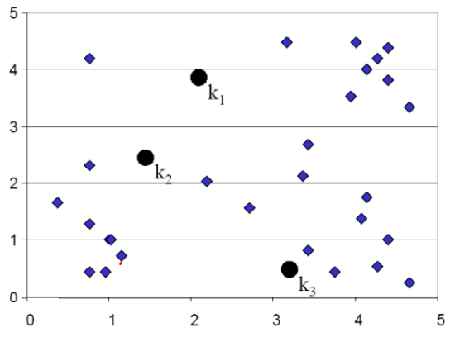
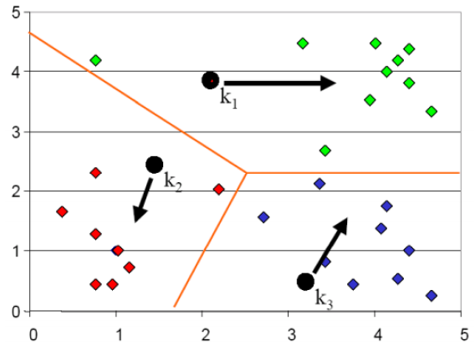
K-means

Slide 27
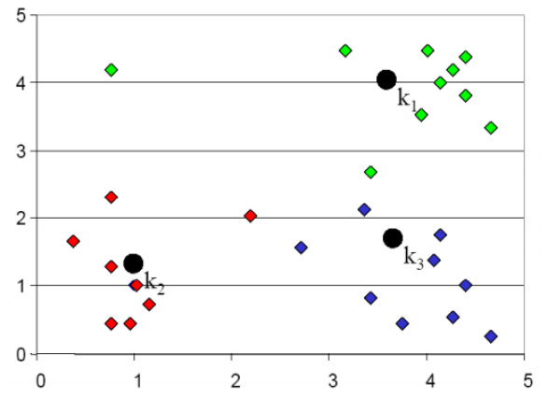
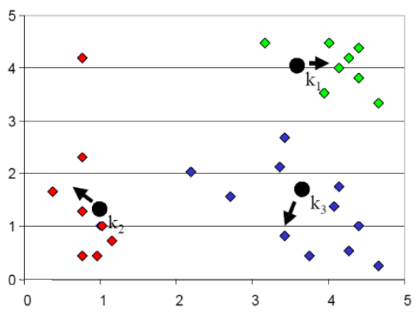
K-means

Slide 28
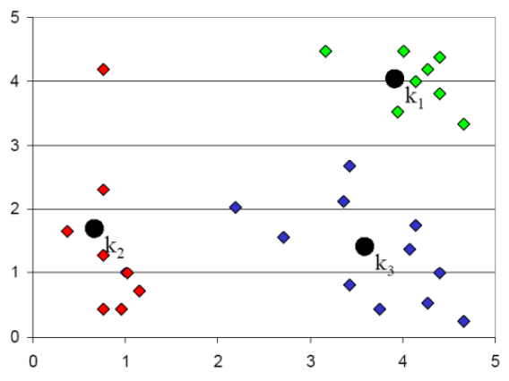
K-means

Slide 29
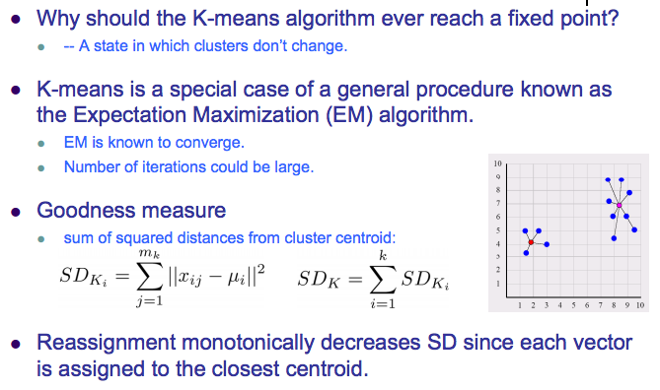
K-means

Slide 30
K-means: seed selection

Slide 31
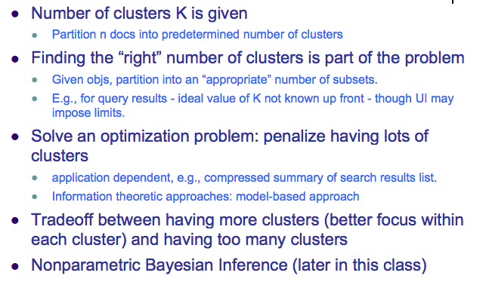
K-means: number of clusters

Slide 32
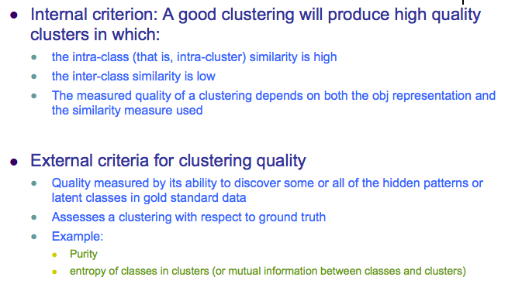
K-means: criteria for cluster quality

Slide 33
K-means: purity

