Slide 1
Machine Learning
Supervised Learning
Classification and Regression
K-Nearest Neighbor Classification
Fisher’s Criteria & Linear Discriminant Analysis
Perceptron: Linearly Separable
Multilayer Perceptron & EBP & Deep Learning, RBF Network
Support Vector Machine
Ensemble Learning: Voting, Boosting(Adaboost)
Unsupervised Learning
Dimensionality Reduction: Principle Component Analysis
Independent Component Analysis
Clustering: K-means
Semi-supervised Learning & Reinforcement Learning

Slide 2
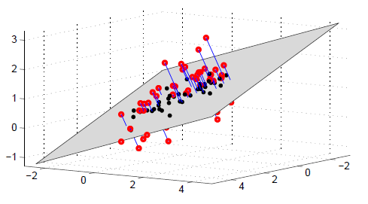
High-Dimensional Spaces - Low Dimensional Manifolds
Data is often high dimensional - images, bag-of-word descriptions, gene-expressions etc. Provided there is some `structure', data will typically lie close to a much lower dimensional `manifold'. Here we concentrate on computationally efficient linear dimension reduction techniques.

Slide 3
Dimensionality Reduction
What
Given d input variables (d-dimensional input), reduce it to k input variables (k-dimensional input), k < d, without loss of information
Why
Reduces time complexity: Less computation
Reduces space complexity: Less parameters
Saves the cost of observing the feature
Simpler models are more robust on small datasets
More interpretable; simpler explanation
Data visualization (structure, groups, outliers, etc.) easy if plotted in 2 or 3 dimensions

Slide 4
Feature Selection vs. Extraction
Feature selection
Choose k<d important features, ignoring the remaining (d-k) features
Subset selection algorithms
Feature extraction
Project the original xi, i=1,…,d dimensions to new k<d dimensions, zj, j=1,…,k
Principal component analysis (PCA), linear discriminant analysis (LDA), factor analysis (FA)

Slide 5
Subset Selection

Slide 6
Principal Components Analysis (PCA)
Idea:
Given data points in d-dimensional space, project onto lower dimensional space while preserving as much information as possible
E.g., find best planar approximation to 3D data
E.g., find best planar approximation to 104D data
In particular, choose projection that minimises the squared error in reconstructing original data
Learned encoding is a linear combination of inputs
Given d-dimensional data x, learns the top m-dimensions where
the dimensions are orthogonal
the re-representational as a linear combination of the top m-dimensions minimizes reconstruction error (sum of squared errors)

Slide 7
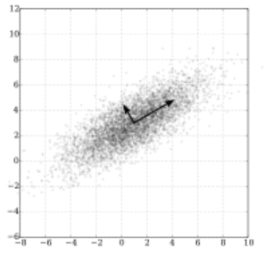
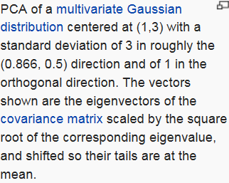
Maximum co-variance and orthogonality
Select a direction in m-dimensional space along which the variance in x is maximized.
Find another direction along which variance is maximised, but restrict the search to all directions orthonormal to all previous selected directions.
Repeat this until m vectors are selected.

Slide 8
Eigenstructure of Principal Component Analysis

Slide 11
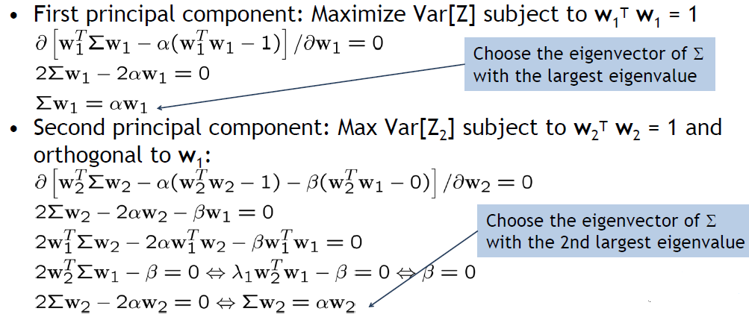
Principal Component Analysis (PCA)

Slide 12
PCA Algorithm

Slide 13
Understanding PCA

Slide 14
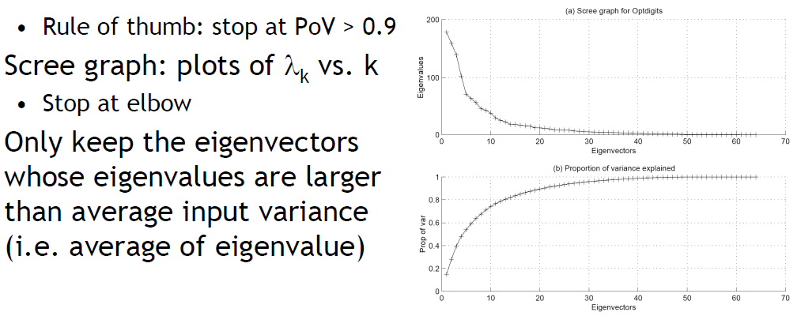
Choosing the Size of Reduced Dimension

Slide 15
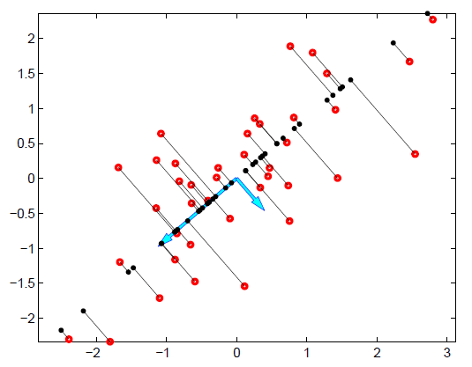
PCA
The original datapoints x (larger rings) and their reconstructions ~x (small dots) using 1 dimensional PCA. The lines represent the orthogonal projection of the original datapoint onto the first eigenvector. The arrows are the two eigenvectors scaled by the square root of their corresponding eigenvalues. The data has been centred to have zero mean. For each `high dimensional' datapoint x, the `low dimensional' representation y is given in this case by the distance (possibly negative) from the origin along the rst eigenvector direction to the corresponding orthogonal projection point.

Slide 16
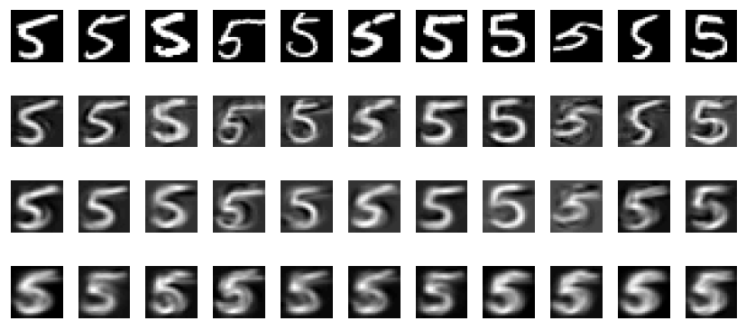
Reducing the dimension of digits
Top row : a selection of the digit 5 taken from the database of 892 examples.
Plotted beneath each digit is the reconstruction using 100, 30 and 5 eigenvectors
(from top to bottom). Note how the reconstructions for fewer eigenvectors express
less variability from each other, and resemble more a mean 5 digit.

Slide 17
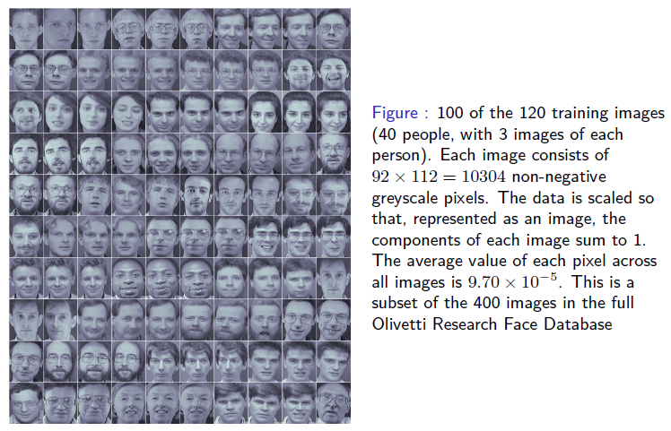
Reducing the dimension of faces

Slide 18
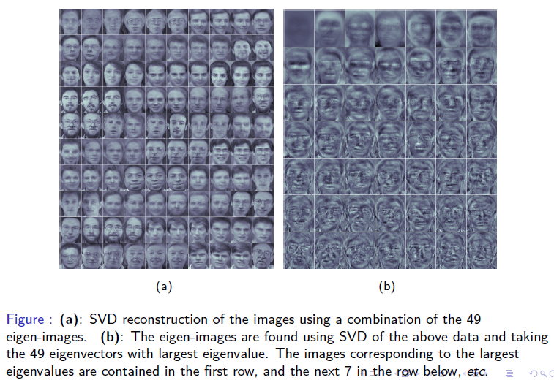
Reducing the dimension of faces

