Slide 1
Machine Learning
Supervised Learning
  Classification and Regression
  K-Nearest Neighbor Classification
  Fisher’s Criteria & Linear Discriminant Analysis
  Perceptron: Linearly Separable
  Multilayer Perceptron & EBP & Deep Learning, RBF Network
  Support Vector Machine
  Ensemble Learning: Voting, Boosting(Adaboost)
Unsupervised Learning
  Principle Component Analysis
  Independent Component Analysis
  Clustering: K-means
Semi-supervised Learning & Reinforcement Learning

Slide 2
Rationale
Different learners use different
  Algorithms
  Hyper-parameters
  Representations (Modalities)
  Training sets
  Subproblems
No Free Lunch Theorem
  There is no single algorithm that is always the most accurate
  Each learners assumes a certain model (assumptions, inductive bias)
  Even if we fine tune the algorithm, there are instances the algorithm is not accurate – there may be another algorithm that is accurate on those
Generate a group of base learners which when combined has higher accuracy

Slide 3
Voting
Linear combination for output
Classification
  Simple voting: equal weight
  Plurality voting: class with max vote is the winner
  Majority voting (2 class problem)

Slide 4
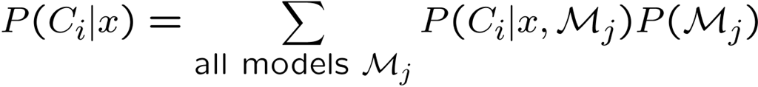

Voting
Bayesian perspective (Bayesian model combination):
If are i.i.d.(independent, identically distributed)
  Bias does not change, variance decrease by factor L
Suppose base learner = discriminant/regression function + random noise
  If noises are uncorrelated with 0 mean, we are averaging over noise

Slide 5
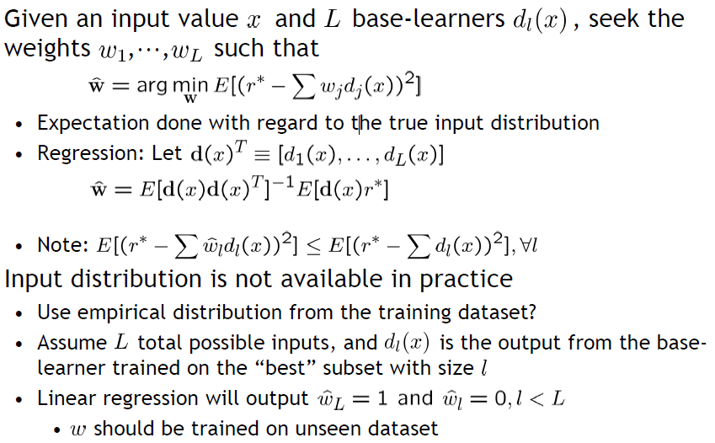
Stacking

Slide 6
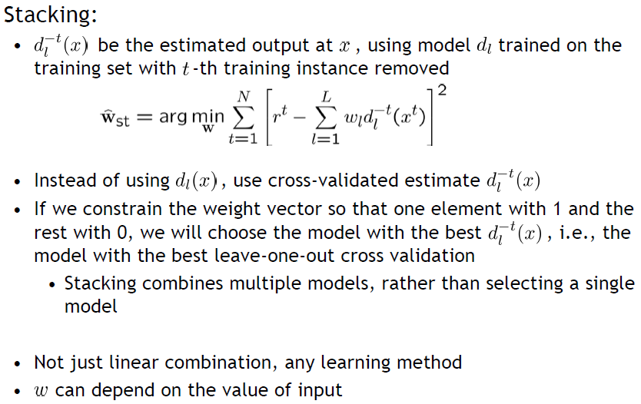
Stacking

Slide 7
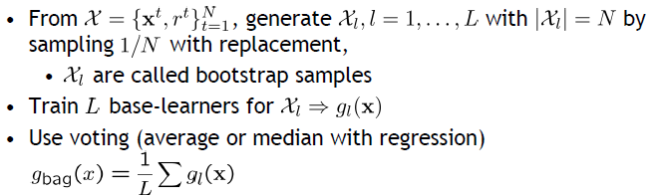
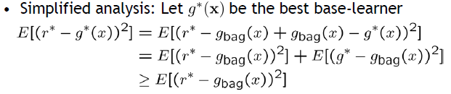
Bagging
Bootstrapping method: generate training sets, train one base-learner with each, and combine them
Why do we want to do this?
    Expectation done with regard to the input distribution
  Unstable algorithms profit from bagging

Slide 8
Boosting

Slide 9
AdaBoost: Algorithm

Slide 10
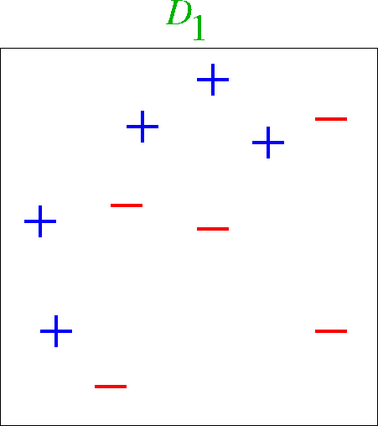
Toy Example

Slide 11
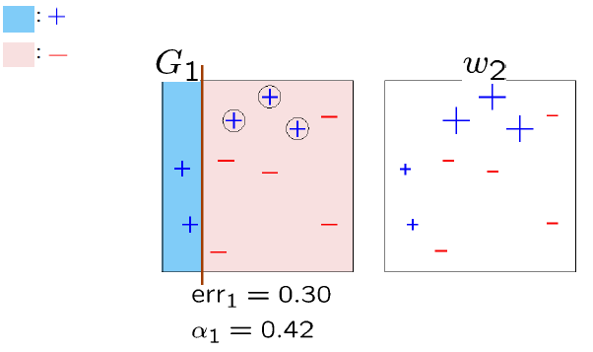
Round 1

Slide 12
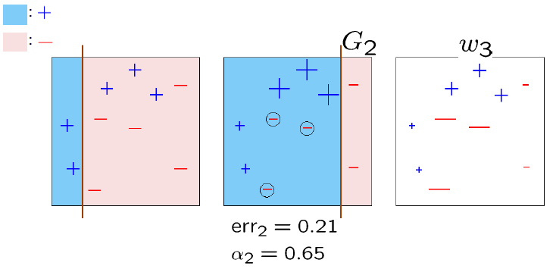
Round 2

Slide 13
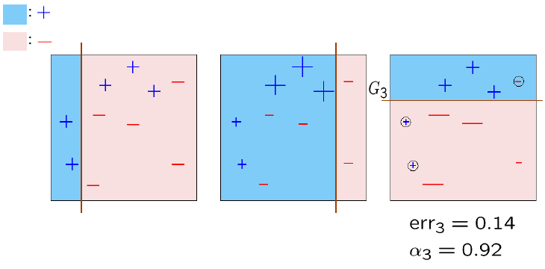
Round 3

Slide 14
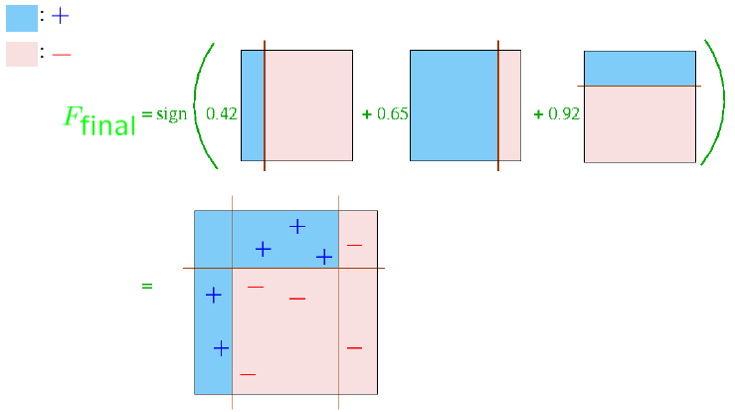
Final Classifier

Slide 15
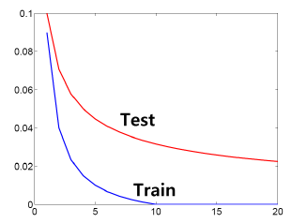
Test Error Behavior

Slide 16
Practical Advantages of AdaBoost
Fast
Simple and easy to program
No parameters to tune (except M)
Flexible – can combine with any learning algorithm
No prior knowledge needed about weak learner
Probably effective, provided can consistently find rough rules of thumb
  Shift in mind set – goal now is merely to find classifiers barely better than random guessing
Versatile
  Can use with data that is textual, numeric, discrete, etc.
  Has been extended to learning problems well beyond binary classification

