Slide 1
Machine Learning
Supervised Learning
  Classification and Regression
  K-Nearest Neighbor Classification
  Fisher’s Criteria & Linear Discriminant Analysis
  Perceptron: Linearly Separable
  Multilayer Perceptron & EBP & Deep Learning, RBF Network
  Support Vector Machine
  Ensemble Learning: Voting, Boosting(Adaboost)
Unsupervised Learning
  Principle Component Analysis
  Independent Component Analysis
  Clustering: K-means
Semi-supervised Learning & Reinforcement Learning

Slide 2
Support Vector Machine vs. Multi-Layer Perceptron
SVM
  Deterministic algorithm
  Nice Generalization properties with few parameters to tune
  Hard to learn –learned in batch mode using quadratic programming techniques
  Using kernels can learn very complex functions
Perceptron and MLP
  Nondeterministic algorithm
  Generalizes well but need a lot of tuning
  Can be learned in incremental fashion
  To learn complex functions—use multilayer perceptron

Slide 3
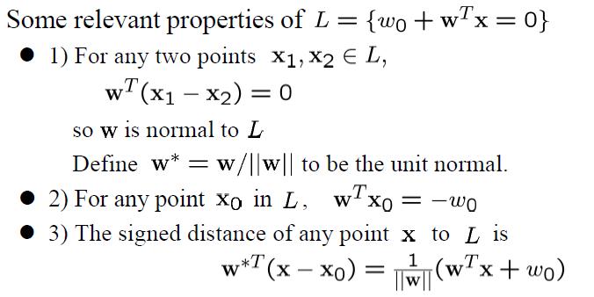
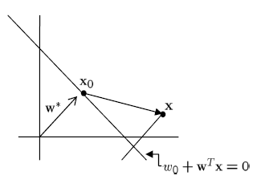
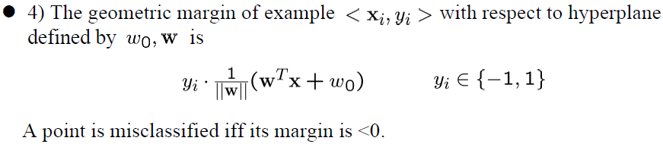
Linear Separator: Properties

Slide 4
Perceptron Learning Algorithm: Formulation

Slide 5
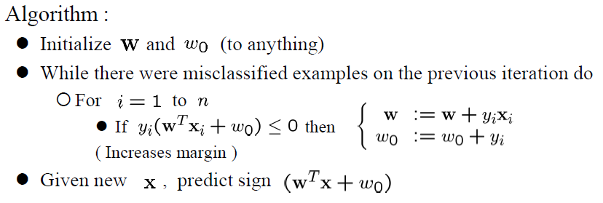
Perceptron Learning Alg.: Pseudo Code

Slide 6
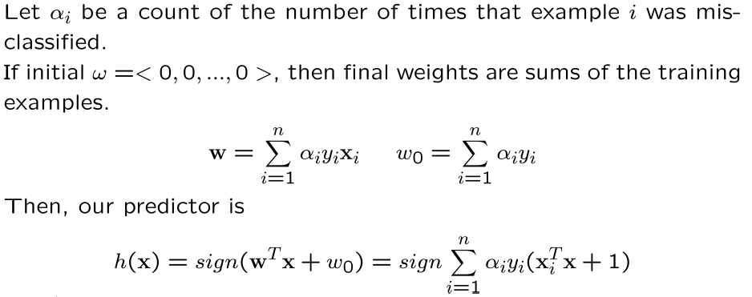
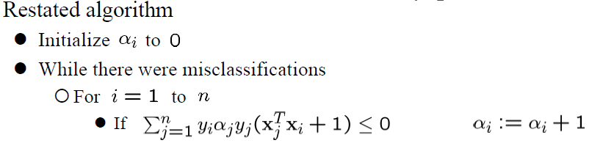
Perceptron Learning Alg.: Dual Representation

Slide 7
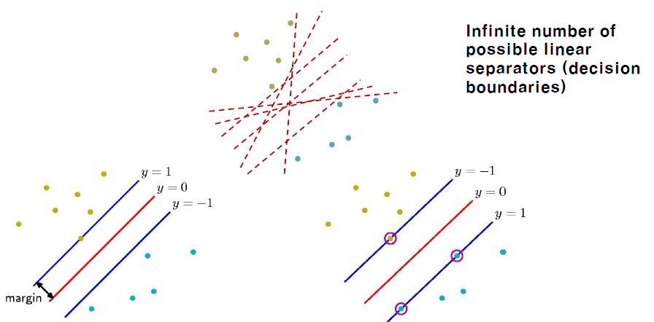
Support Vector Machine
Maximizing the margin leads to a particular choice of decision boundary. The location of the boundary is determined by a subset of the data points, known as support vectors, which are indicated by the circles.

Slide 8
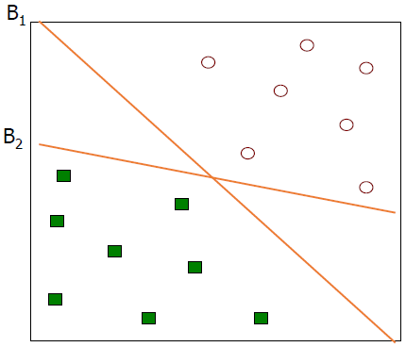
Support Vector Machine
Find a linear hyperplane (decision boundary) that separates the data:
  Which one is better? B1 or B2?
  How do you quantify the “goodness”?

Slide 9
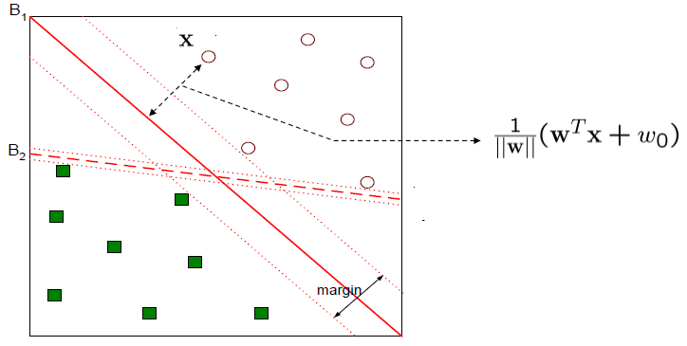
Support Vector Machine
Find a linear hyperplane (decision boundary) that separates the data:
  Which one is better? B1 or B2?
  How do you quantify the “goodness”?
  Find hyperplane maximizes the margin => B1 is better than B2

Slide 10
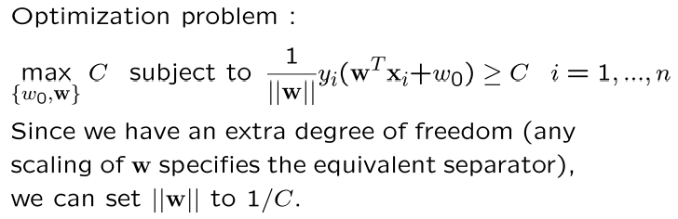
Support Vector Machine
Support vector machines
  Names a whole family of algorithms. We’ll start with the maximum margin separator. The idea is to find the separator with the maximum margin from all the data points. We’ll see, later, a theoretical argument that this might be a good idea. Seems a little less haphazard than a perceptron.

Slide 11
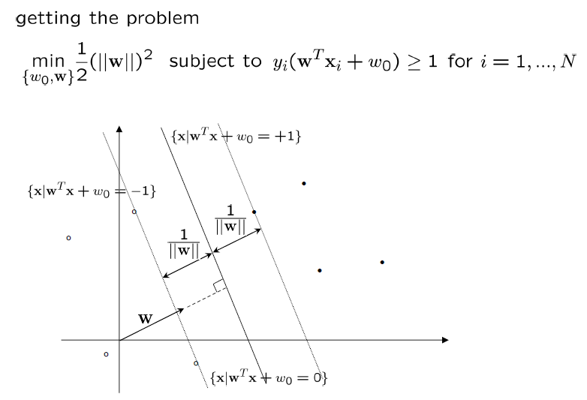
Support Vector Machine: Formulation

Slide 12
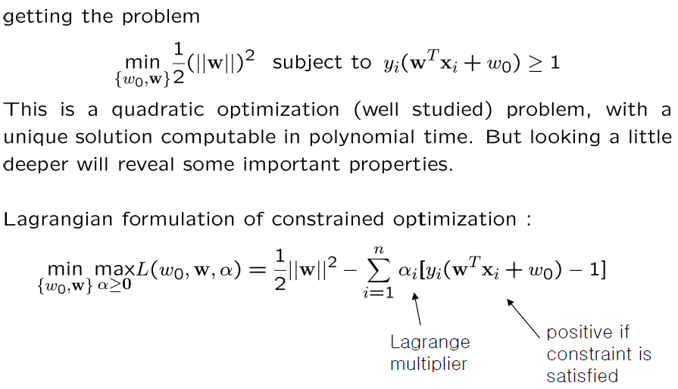
Support Vector Machine: Formulation

Slide 13
Support Vector Machine: Kuhn-Tucker Theorem

Slide 14
Support Vector Machine: Lagrange Formulation

Slide 15
Support Vector Machine: Solution

Slide 16
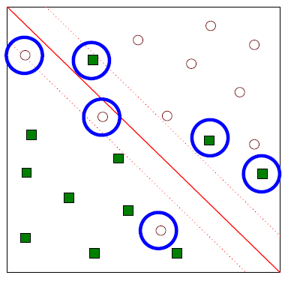
Support Vector Machine
What if the problem is not linearly separable?

Slide 17
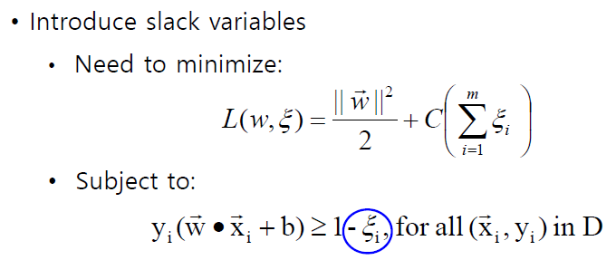
Support Vector Machines
What if the problem is not linearly separable?

Slide 18
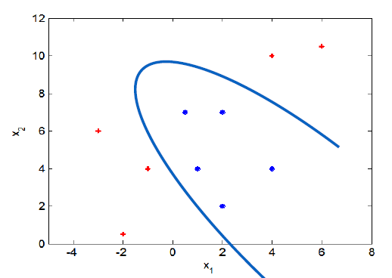
Support Vector Machines
What if decision boundary is not linear?

Slide 19
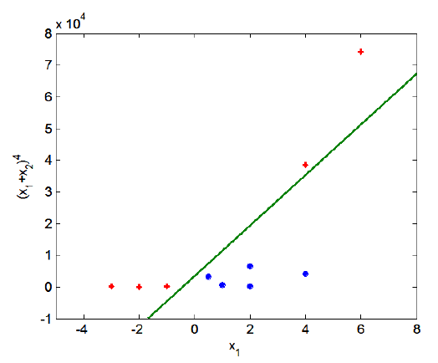
Support Vector Machines
Transform data into higher dimensional space : Kernel trick

Slide 20
Support Vector Machines : Kernel machines

Slide 21
Kernel machines : Usage

Slide 22
Kernel machines : Kernel function

Slide 23
Kernel machines : Kernel function
Change all inner products to kernel functions
Original
With kernel function

Slide 24
Kernel examples

Slide 25
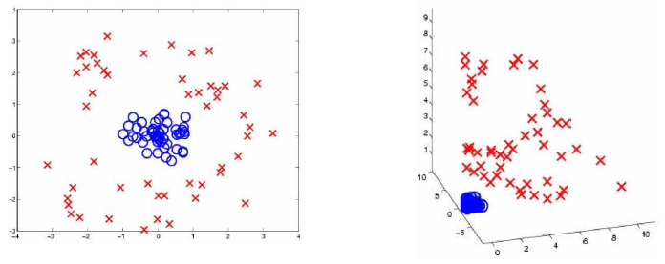
SVM- not linear separable

Slide 26
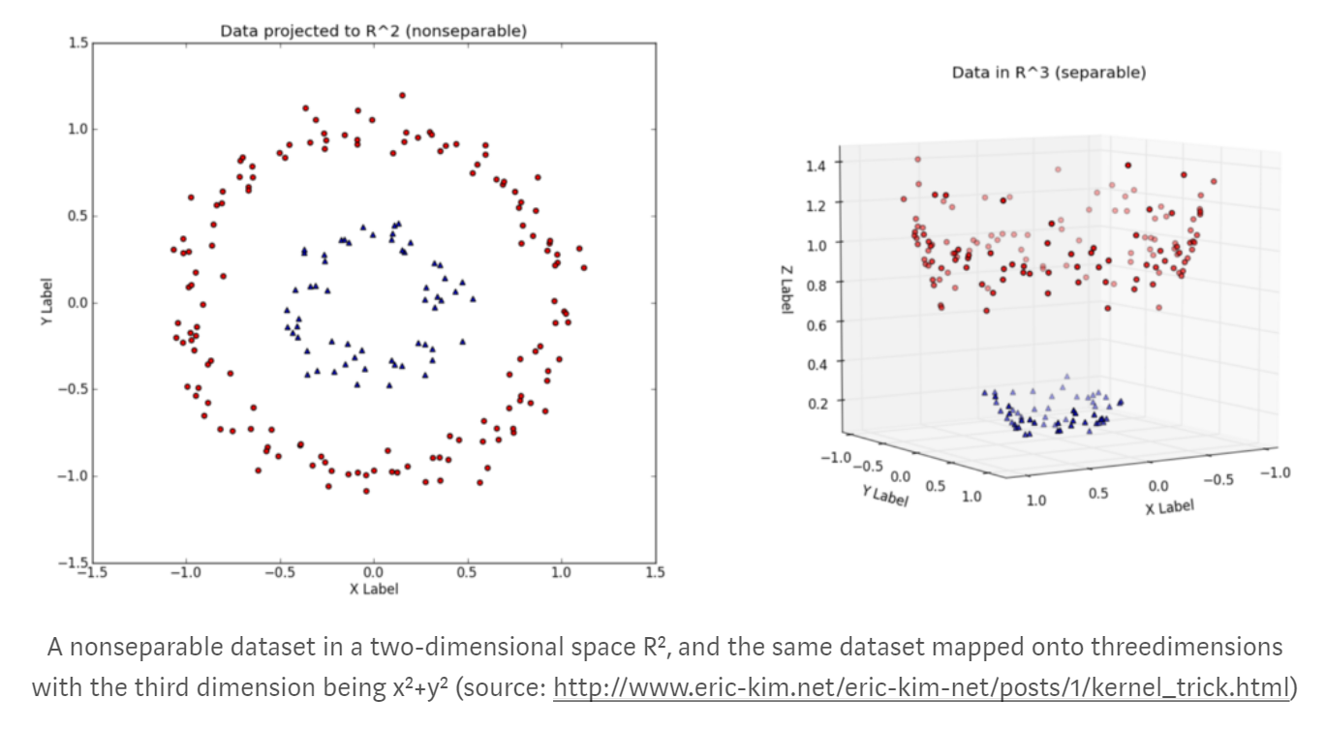

Slide 27
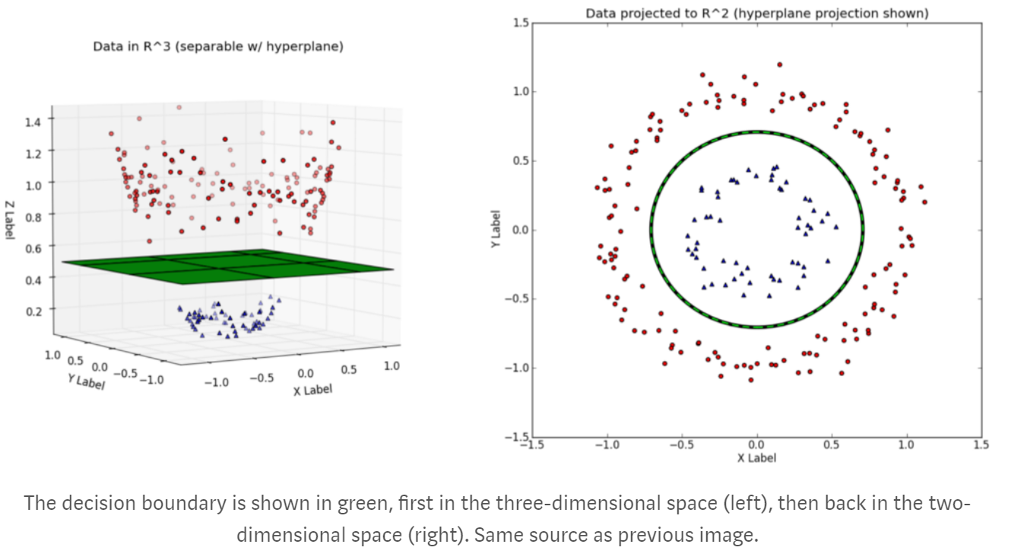

Slide 28
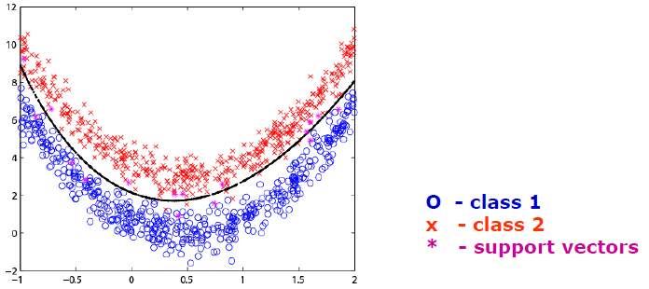
SVM- not linear separable

Slide 29
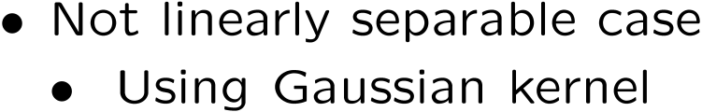
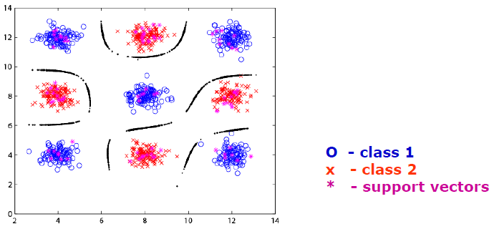
SVM- not linear separable

Slide 30
Kernel machines : Example

Slide 31
Kernel machines : Example

Slide 32
Kernel machines

Slide 33
Support Vector Machine: Advantages
What’s good about this?
  few support vectors in practice → sparse representation
  maximizing margin means choosing the “simplest” possible hypothesis
  generalization error is related to the proportion of support vectors

