Slide 1
Machine Learning
Supervised Learning
  Classification and Regression
  K-Nearest Neighbor Classification
  Fisher’s Criteria & Linear Discriminant Analysis
  Perceptron: Linearly Separable
  Multilayer Perceptron & EBP & Deep Learning, RBF Network
  Support Vector Machine
  Ensemble Learning: Voting, Boosting(Adaboost)
Unsupervised Learning
  Principle Component Analysis
  Independent Component Analysis
  Clustering: K-means
Semi-supervised Learning & Reinforcement Learning

Slide 2
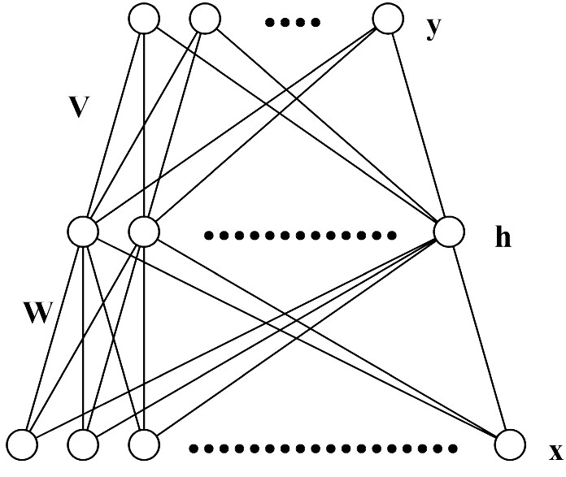

Multi-Layer Perceptron (MLP)
Each layer receives its inputs from the previous layer and forwards its outputs to the next – feed forward structure
Output layer: sigmoid activation function for classification, linear activation function for regression problem
Referred to as a two-layer network (two layer of weights)

Slide 3
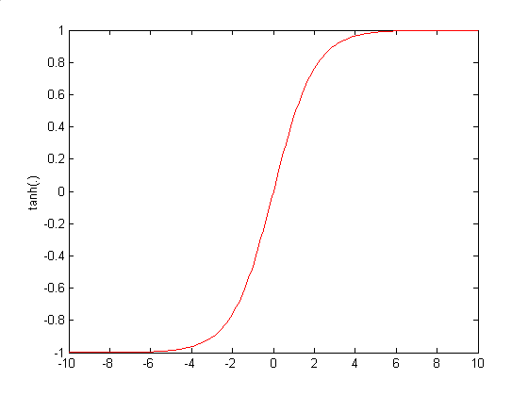
Architecture of MLP (N-H-M): Forward Propagation

Slide 4
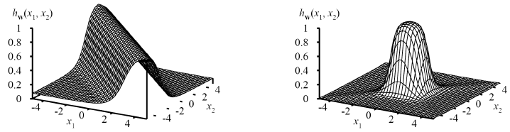
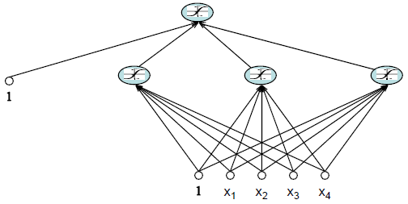
Expressiveness of MLPs : Representational Power
MLP with 3 layers can represent arbitrary function
  Each hidden unit represents a soft threshold function in the input space
  Combine two opposite-facing threshold functions to make a ridge
  Combine two perpendicular ridges to make a bump
  Add bumps of various sizes and locations to fit any surface
Universal approximator
  A two layer (linear output) network can approximate any continuous function on a compact input domain to arbitrary accuracy given a sufficiently large number of hidden units

Slide 5
MLP Learning
Start from a untrained network
Present a training example Xi to the input layer, pass the signals through the network and determine the output at the output layer
Compare output to the target values, any difference corresponds to an error.
We will adjust the weights to reduce this error on the training data

Slide 6
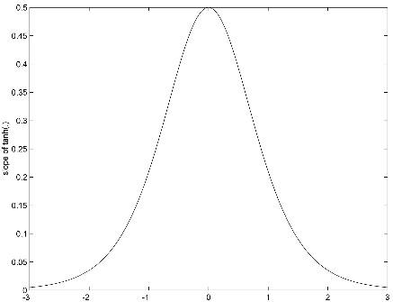
Training of MLP : Error Back-Propagation Algorithm

Slide 7
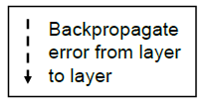
The Error Backpropagation Algorithm
Forward Pass Given X, compute hidden units and output units.
Compute Errors Compute error for each output unit
Compute Output Deltas
Compute Hidden Deltas
Compute Gradient
– Compute gradient for hidden-to-output weights.
– Compute gradient for input-to-hidden weights.
For each weight take a gradient step

Slide 8
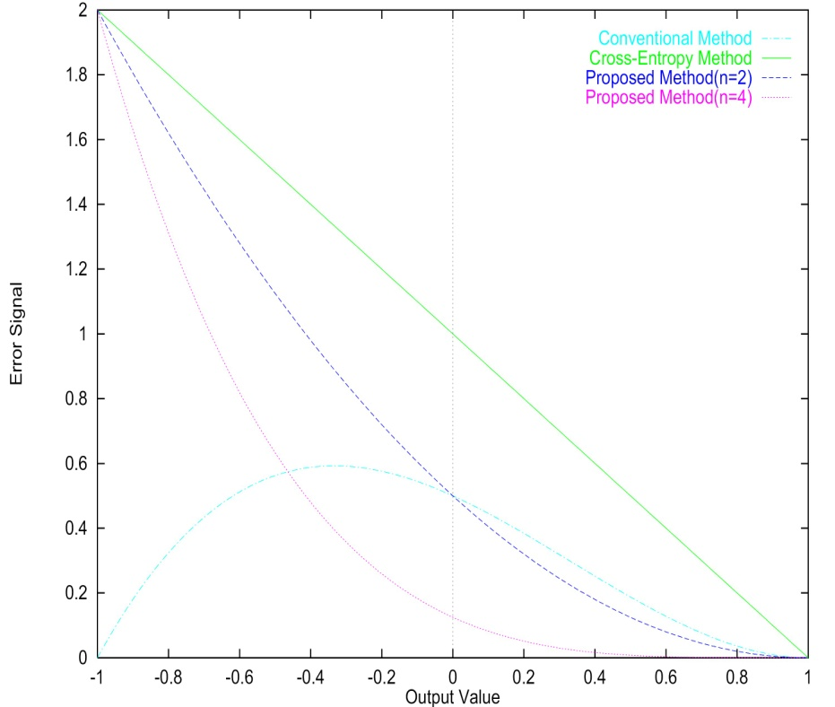
Training of MLP : Error Back-Propagation Algorithm

Slide 9
Training of MLP : Error Back-Propagation Algorithm

Slide 10

Error Backpropagation Training
Create a three layer network with N hidden units, fully connect the network and assign small random weights
Until all training examples produce correct output or MSE ceases to decrease
– For all training examples, do
Begin Epoch
For each training example do
– Compute the network output
– Compute the error
– Back-propagate this error from layer to layer and adjust weights to decrease this error
End Epoch

Slide 11
Remarks on Training
No guarantee of convergence, may oscillate or reach a local minima.
However, in practice many large networks can be adequately trained on large amounts of data for realistic problems, e.g.
  – Driving a car
  – Recognizing handwritten zip codes
  – Play world championship level Backgammon
Many epochs (thousands) may be needed for adequate training, large data sets may require hours or days of CPU time.
Termination criteria can be:
  – Fixed number of epochs
  – Threshold on training set error
  – Increased error on a validation set
To avoid local minima problems, can run several trials starting from different initial random weights and:
  – Take the result with the best training or validation performance.
  – Build a committee of networks that vote during testing, possibly weighting vote by training or validation accuracy

Slide 12
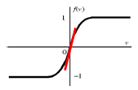

Notes on Proper Initialization
Start in the “linear” regions
  keep all weights near zero, so that all sigmoid units are in their linear regions. Otherwise nodes can be initialized into flat regions of the sigmoid causing for very small gradients
Break symmetry
  – If we start with the weights all equal, what will happen?
  – Ensure that each hidden unit has different input weights so that the hidden units move in different directions.
Set each weight to a random number in the range
where “fan-in” is the number of inputs to the unit.

Slide 13
Batch, Online, and Online with Momentum
Batch: Sum the gradient for each example i. Then take a gradient descent step.
Online: Take a gradient descent step with each input as it is computed (this is the algorithm we described)
Momentum factor: Make the t+1-th update dependent on the t-th update
α is called the momentum factor, and typically take values in the range [0.7, 0.95]. This tends to keep weight moving in the same direction and improves convergence..

Slide 14
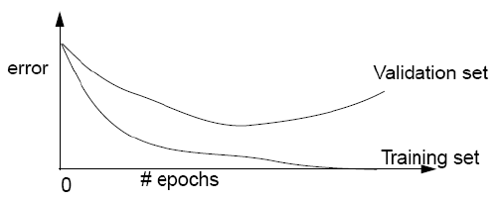
Overtraining Prevention
Running too many epochs may overtrain the network and result in overfitting. Tries too hard to exactly match the training data.
Keep a validation set and test accuracy after every epoch. Maintain weights for best performing network on the validation set and return it when performance decreases significantly beyond this.
To avoid losing training data to validation:
    – Use 10-fold cross-validation to determine the average number of epochs that optimizes validation performance.
      We will discuss cross-validation later in the course
    – Train on the full data set using this many epochs to produce the final result.

Slide 15
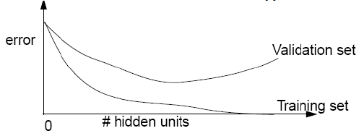
Over-fitting Prevention
Too few hidden units prevent the system from adequately fitting the data and learning the concept.
Too many hidden units leads to over-fitting.
Can also use a validation set or cross-validation to decide an appropriate number of hidden units.
Another approach to preventing over-fitting is weight decay, in which we multiply all weights by some fraction between 0 and 1 after each epoch.
  - Encourages smaller weights and less complex hypotheses.
  - Equivalent to including an additive penalty in the error function proportional to the sum of the squares of the weights of the network.

Slide 16
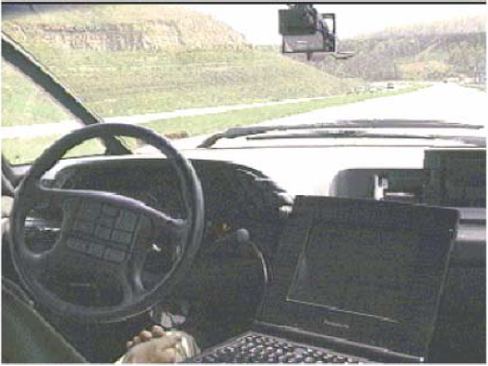
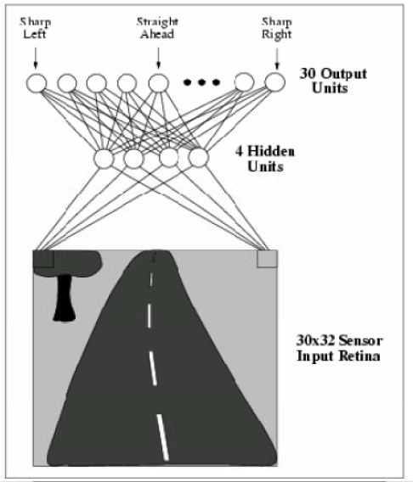
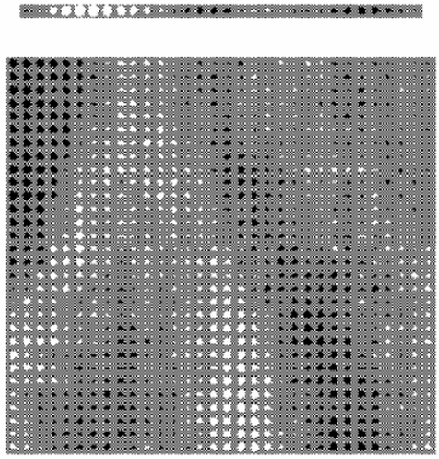
Example

Slide 17
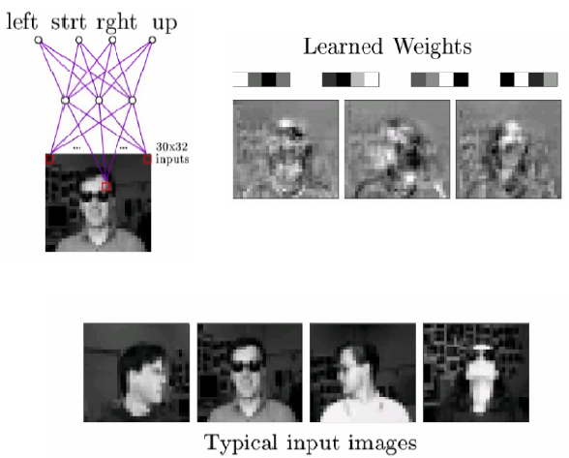
Example

Slide 18
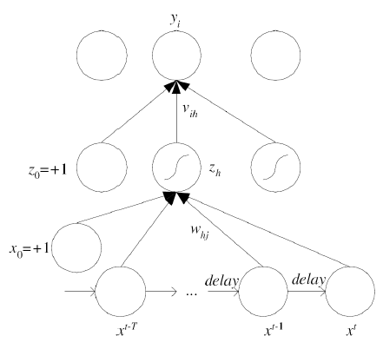
Learning Time Series Data
Time-delay neural networks

Slide 19
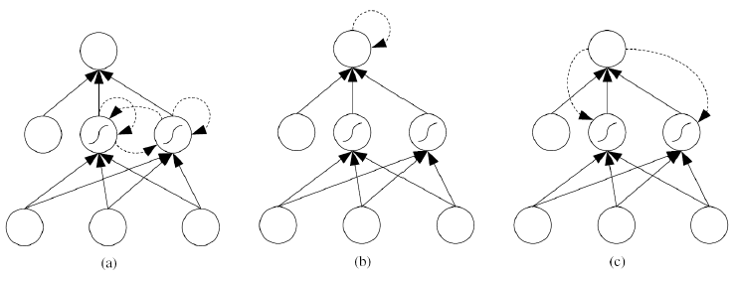
Learning Time Series Data Recurrent neural networks
Recurrent connection to self units, or to the previous layer
  Acts as a short-term memory

Slide 20
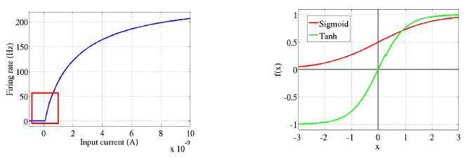
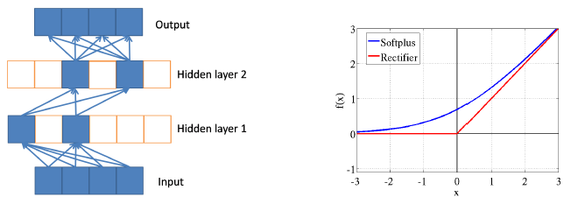
Deep Rectifier Networks
In order to efficiently represent symmetric/antisymmetric behavior in the data, a rectifier network would need twice as many hidden units as a network of symmetric/antisymmetric activation functions.

Slide 21
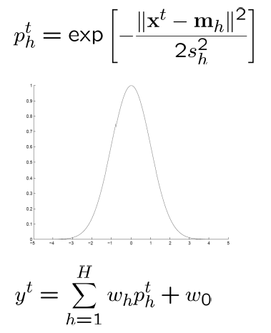
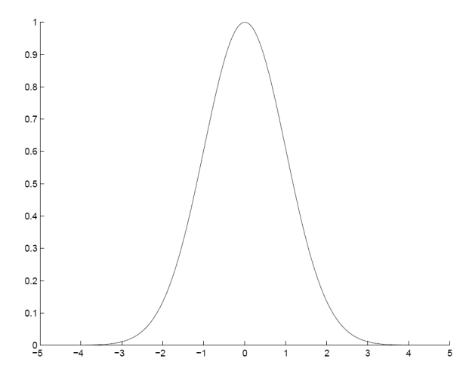
Radial Basis Function Networks
Locally-tuned units:

Slide 22
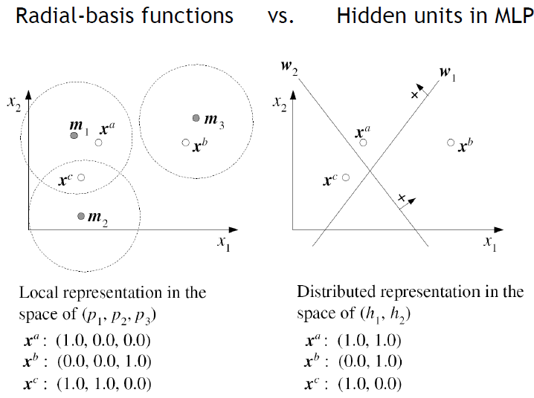
Local vs. Distributed Representation

Slide 23

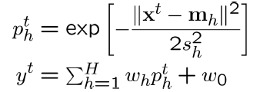
Training RBF Network
Parameters:
Hybrid learning
• First layer centers and spreads (Unsupervised k-means)
• Second layer weights (Supervised gradient descent)
Fully supervised
•Similar to backpropagation in MLP, gradient descent for all parameters

Slide 24
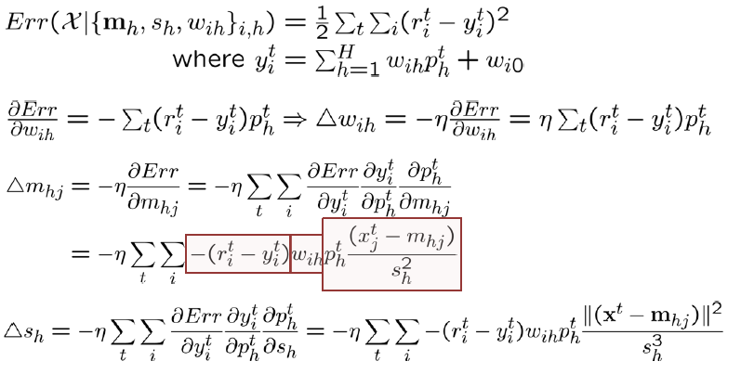
RBF Network: Fully Supervised Method
Similar to backpropagation in MLP

