Slide 1
Machine Learning
Supervised Learning
  Classification and Regression
  K-Nearest Neighbor Classification
  Fisher’s Criteria & Linear Discriminant Analysis
  Perceptron: Linearly Separable
  Multilayer Perceptron & EBP & Deep Learning, RBF Network
  Support Vector Machine
  Ensemble Learning: Voting, Boosting(Adaboost)
Unsupervised Learning
  Principle Component Analysis
  Independent Component Analysis
  Clustering: K-means
Semi-supervised Learning & Reinforcement Learning

Slide 2


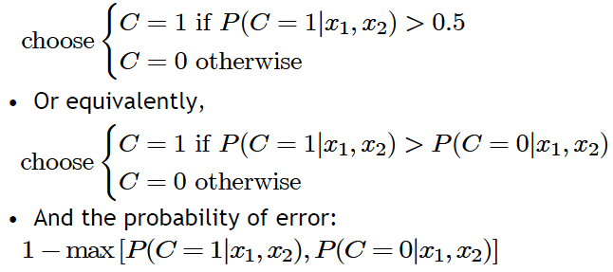
Classification
Credit scoring example:
  Inputs are income and savings
  Output is low-risk vs. high-risk
Formally speaking
Decision rule: if we know

Slide 3
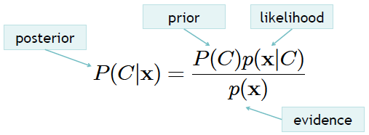
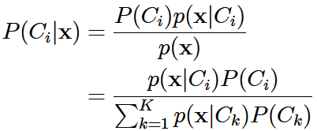

Bayes’ Rule
Bayes rule for one concept
Bayes rule for K > 1 concepts
Decision rule using Bayes rule (Bayes optimal classifier):

Slide 4



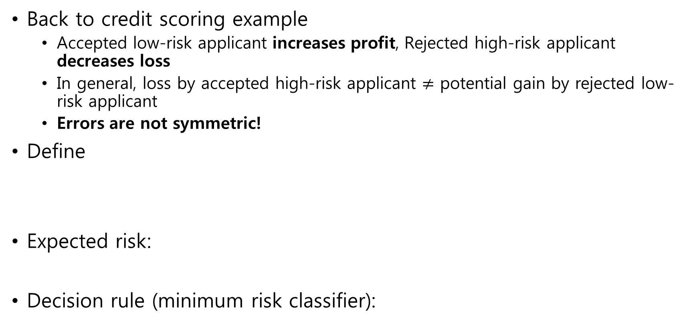
Losses and Risks
Back to credit scoring example
  Accepted low-risk applicant increases profit, Rejected high-risk applicant decreases loss
  In general, loss by accepted high-risk applicant $≠$ potential gain by rejected low-risk applicant
  Errors are not symmetric!
Define
Expected risk:
Decision rule (minimum risk classifier):

Slide 5
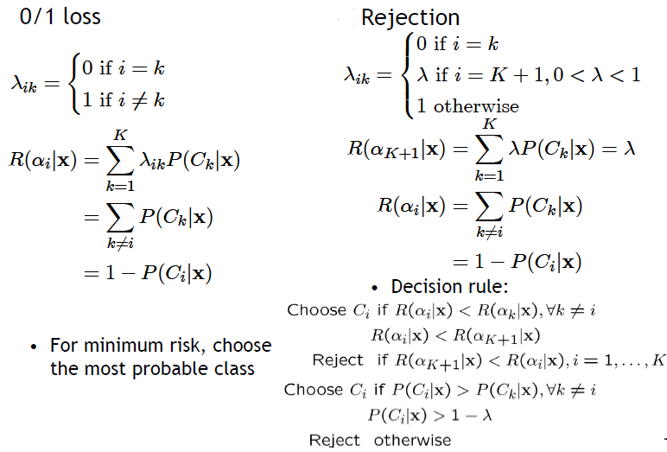
More on Losses and Risks

Slide 6
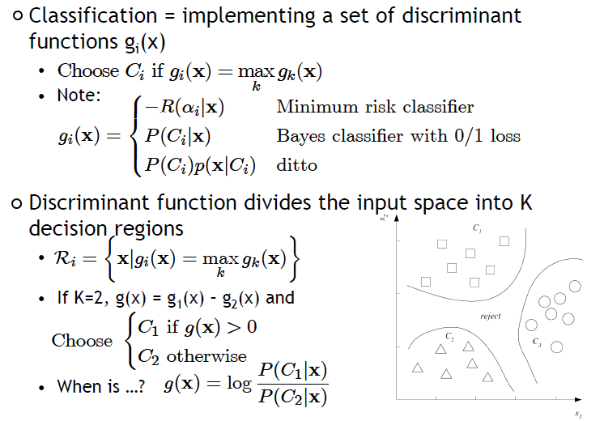
Discriminant Functions

Slide 7

Likelihood-based vs. Discriminant-based
Likelihood-based classification
Discriminant-based classification
Estimating the boundaries is enough; no need to accurately estimate the densities inside the boundaries!

Slide 8


Linear Discriminant
Linear discriminant
Advantages:
  Simple: O(d) space/computation
  Knowledge extraction: Weighted sum of attributes; positive/negative weights, magnitudes (credit scoring)
  Optimal when are Gaussian with shared covariance matrix; useful when classes are (almost) linearly separable

Slide 9
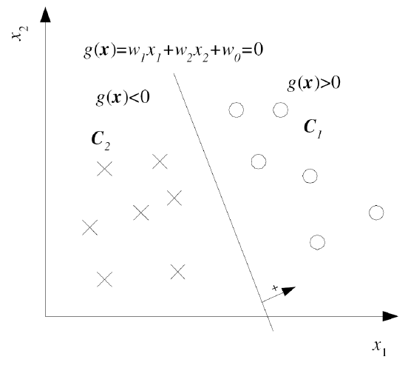
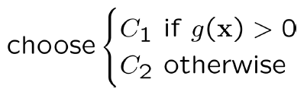
Two Class Case

Slide 10
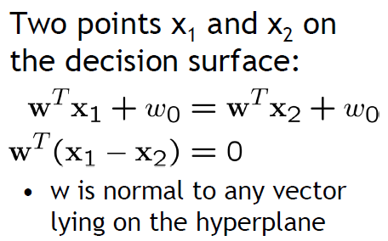
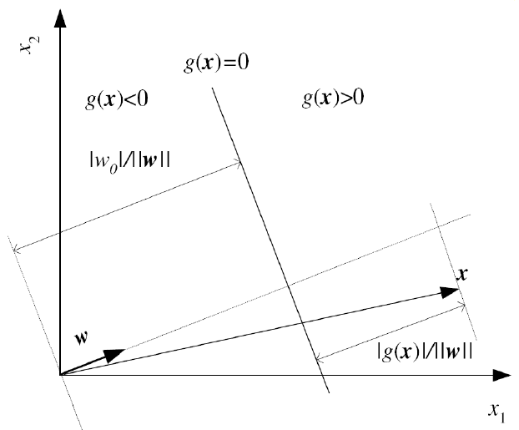
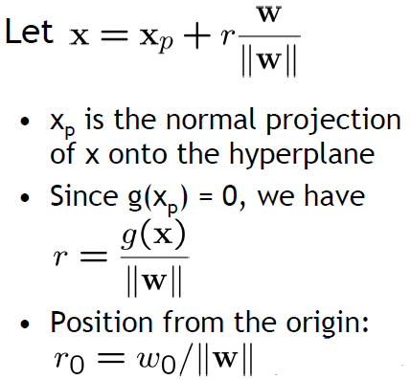
Geometric View

Slide 11
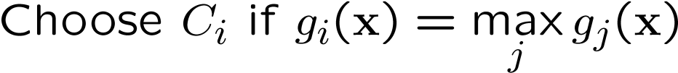
Multiple Classes (One-vs-All)

Slide 12
Pairwise Separation (One-vs-One)

Slide 13
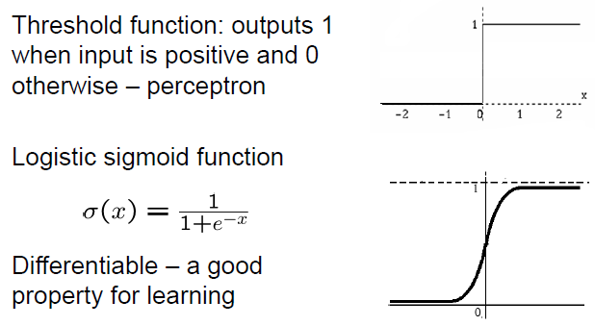


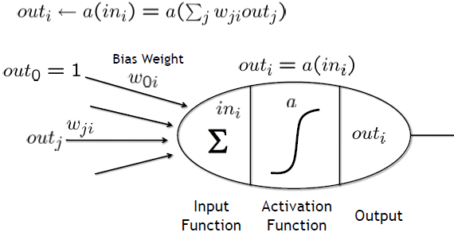
Single-Layer Perceptron
Classification

Slide 14
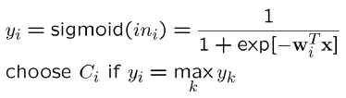
Single-Layer Perceptron with K Outputs

Slide 15
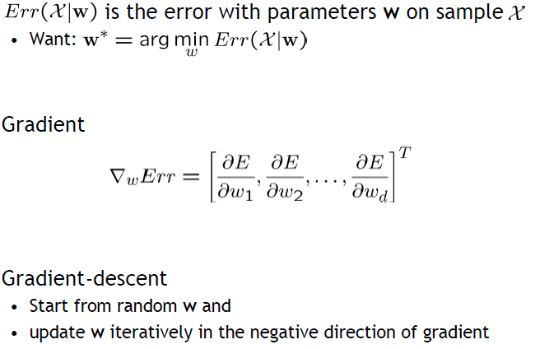
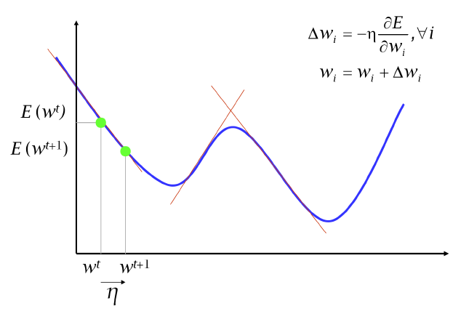
Gradient Descent

Slide 16
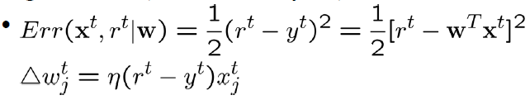
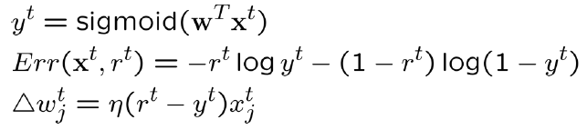
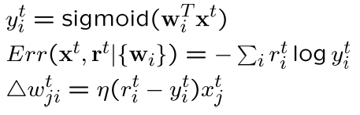
Training Perceptron
Regression (Linear output)
Classification
  Single sigmoid output
  K>2 softmax outputs

Slide 17
Training Perceptron
Online learning (instances seen one by one) vs. batch learning (whole sample)
  No need to store the whole sample
  Problem may change in time
  Wear and degradation in system components
Stochastic gradient descent
  Update after a single pattern

Slide 18
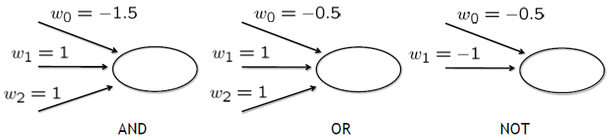
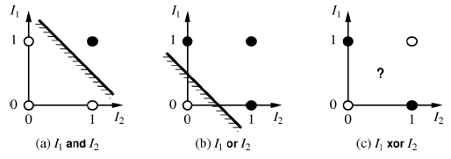

Expressiveness of Perceptrons
Consider perceptron with a = step function
  Can represent AND, OR, NOT, majority, etc., but not XOR
  Represents a linear separator in input space:

Slide 19
Homework: Perceptron Learning for OR Problem-→ Sigmoid Output
/* Perceptron Learning for OR problem with Linear Output*/
#include <stdio.h>
#include <stdlib.h>
#include <string.h>
#include <math.h>
/*parameters*/
#define NUMEPOCH 100 // training epoch
#define NUMIN 2 // input
#define NUMP 4 // no. training sample
#define RWMAX 0.1 // max of weights
#define wseed 100 // weight seed
#define eta 0.1 //learning rate
double rw[NUMIN+1];
main(argc,argv)
int argc;
char *argv[];
{
FILE *fp;
double x[NUMP][NUMIN+1], y[NUMP], ys[NUMP], t{NUMP], mse;
int i, j, k, p, epoch;
x[0][0]=0.; …..x[0][2]=1.;
t[0]=0.; …….
srand(wseed);
for (i=0; i<MUNIN+1; i++)
rw[i]=RWMAX*((double)rand()*2/RAND_MAX-1.);
// Begin Training
for (epoch=0; epoch<NUMEPOCH; epoch++){
mse=0.;
for (p=0; p<NUMP; p++) {
for (i=0; i<NUMIN+1; i++) y[p]=rw[i]*x[p][i];
mse+=pow((t[p]-y[p]),2.0)/NUMP;
for (i=0; i<NUMIN+1; i++) rw[i]+=eta*(t[p]-y[p])*x[p][i];
} // end of p
printf(“%d %e\n”, epoch, mse);
} // end of epoch
} // end of main

