Slide 1
Machine Learning
Supervised Learning
Classification and Regression
K-Nearest Neighbor Classification
Fisher’s Criteria & Linear Discriminant Analysis
Perceptron: Linearly Separable
Multilayer Perceptron & EBP & Deep Learning, RBF Network
Support Vector Machine
Ensemble Learning: Voting, Boosting(Adaboost)
Unsupervised Learning
Principle Component Analysis
Independent Component Analysis
Clustering: K-means
Semi-supervised Learning & Reinforcement Learning

Slide 2
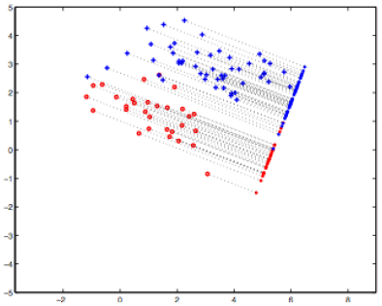
Linear Discriminant Analysis (LDA)
Problem: Given a set of data points, each of which is labelled with a class, such as the classes 0 to 9 in the digits data, find the best set of basis vectors for projecting the data points such that classification is improved.
Idea: Form the projection such that the variability across the different classes is maximized, while the variability within each class is minimized.

Slide 3
LDA: Supervised Linear Projections
Suppose we have data points that are labelled either class 1 or class 2. N1 data points for class 1 and N2 data points for class 2,
And we wish to find a linear projection
And, for classification, for a new points , if its projection is close to class 1 projected data, we expect x to belong to class 1.

Slide 4
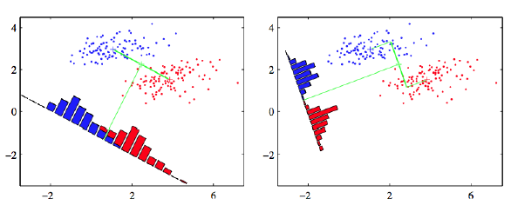
LDA: Maximize Difference of Means
Considering the simple problem of projecting onto one dimension
The two classes should be well separated in this single dimension
A simple idea is to maximize the difference of the means in the projected space
What is a problem with this solution?

Slide 5
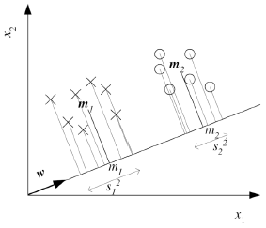
LDA: A Better Idea
Fisher's idea: Fisher's linear discriminant
Maximize a function that will give a large separation between the projected class means
While also giving a small variance within each class, thereby minimizing the class overlap

Slide 6
LDA: Fisher Linear Discriminant
Find w that maximizes
Between-class scatter (numerator):
Within-class scatter (denominator):

Slide 7
LDA: Fisher Linear Discriminant
Find w that maximizes
Solution:
Parametric solution:

Slide 8
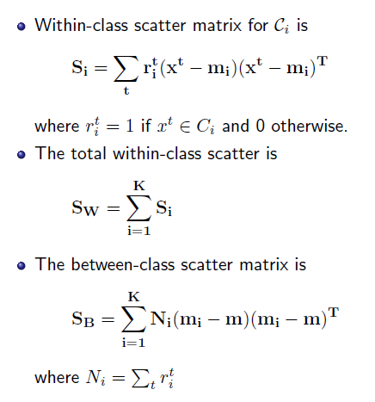
More than 2 Classes (K > 2)
Projection from d-dim space to (c-1)-dim space:

Slide 9
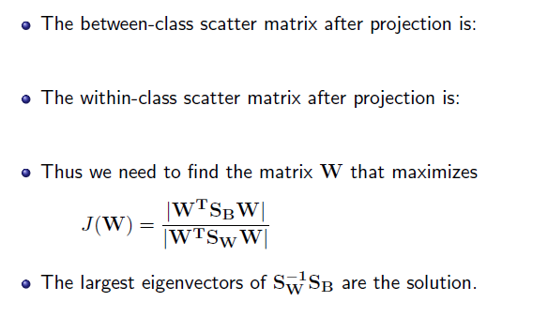
More than 2 Classes (K > 2)

Slide 10
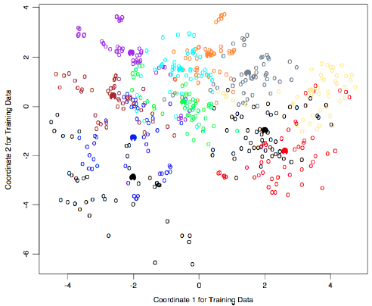
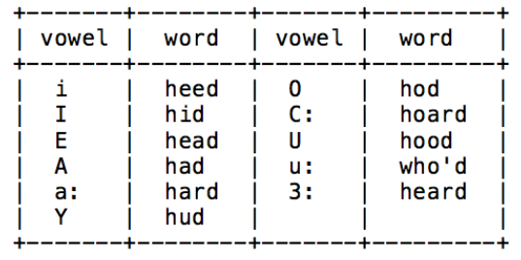
LDA on Vowels Data
11 vowels from words spoken by fteen speakers. (Source: David Deterding, Mahesan Niranjan, Tony Robinson, see Hastie book website for data)

Slide 11
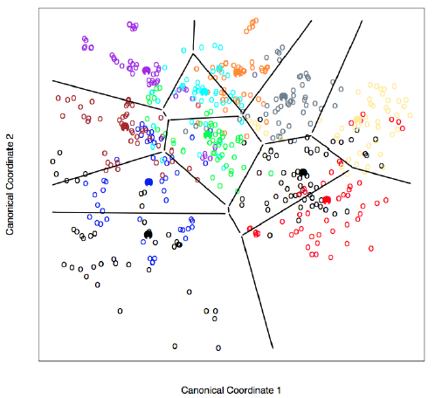
LDA on Vowels Data: Decision Boundaries

