Slide 1
Machine Learning
Supervised Learning
  Classification and Regression
  K-Nearest Neighbor Classification
  Fisher’s Criteria & Linear Discriminant Analysis
  Perceptron: Linearly Separable
  Multilayer Perceptron & EBP & Deep Learning, RBF Network
  Support Vector Machine
  Ensemble Learning: Voting, Boosting(Adaboost)
Unsupervised Learning
  Principle Component Analysis
  Independent Component Analysis
  Clustering: K-means
Semi-supervised Learning & Reinforcement Learning

Slide 2
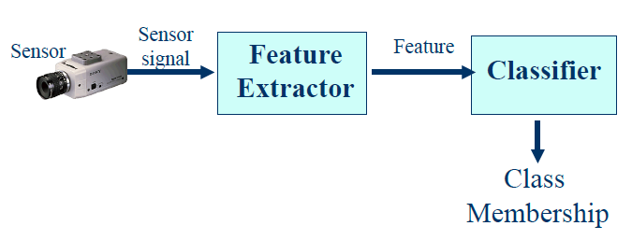
General Classification Process

Slide 3
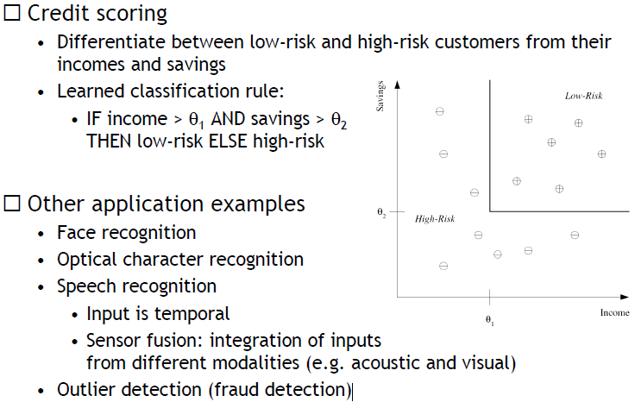
Machine learning: Classification

Slide 4
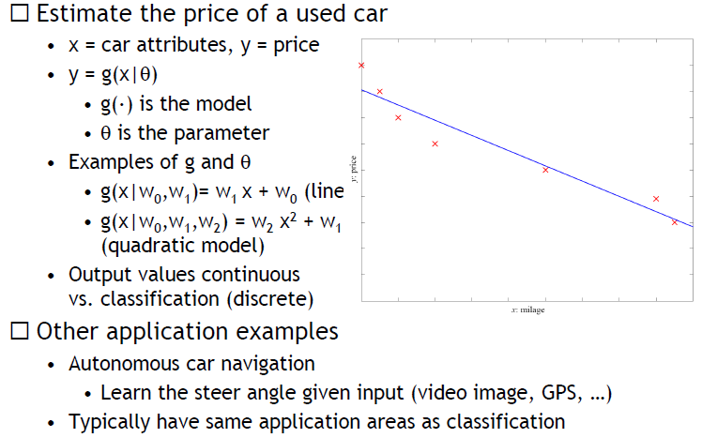
Machine learning: Regression

Slide 5
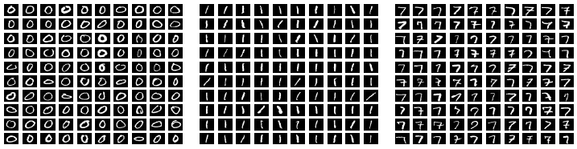

k-Nearest Neighbors Algorithm
Handwritten Digit Example
  Some of the train examples of the digit zero, one and seven.
Do As Your Neighbor Does

Slide 6
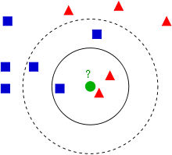
k-Nearest Neighbors Algorithm
Example of k-NN classification. The test sample (green circle) should be classified either to the first class of blue squares or to the second class of red triangles. If k = 3 (solid line circle) it is assigned to the second class because there are 2 triangles and only 1 square inside the inner circle. If k = 5 (dashed line circle) it is assigned to the first class (3 squares vs. 2 triangles inside the outer circle).

Slide 7
k-Nearest Neighbors Algorithm
In pattern recognition, the k-Nearest Neighbors algorithm (or k-NN for short) is a non-parametric method used for classification and regression. In both cases, the input consists of the k closest training examples in the feature space. The output depends on whether k-NN is used for classification or regression:
In k-NN classification, the output is a class membership. An object is classified by a majority vote of its neighbors, with the object being assigned to the class most common among its k nearest neighbors (k is a positive integer, typically small). If k = 1, then the object is simply assigned to the class of that single nearest neighbor.
In k-NN regression, the output is the property value for the object. This value is the average of the values of its k nearest neighbors.

Slide 8
k-Nearest Neighbors Algorithm
k-NN is a type of instance-based learning, or lazy learning, where the function is only approximated locally and all computation is deferred until classification. The k-NN algorithm is among the simplest of all machine learning algorithms.
Both for classification and regression, it can be useful to assign weight to the contributions of the neighbors, so that the nearer neighbors contribute more to the average than the more distant ones. For example, a common weighting scheme consists in giving each neighbor a weight of 1/d, where d is the distance to the neighbor.^{[2]}
The neighbors are taken from a set of objects for which the class (for k-NN classification) or the object property value (for k-NN regression) is known. This can be thought of as the training set for the algorithm, though no explicit training step is required.
A shortcoming of the k-NN algorithm is that it is sensitive to the local structure of the data. The algorithm has nothing to do with and is not to be confused with k-means, another popular machine learning technique

Slide 9
k-NN: Algorithm
The training examples are vectors in a multidimensional feature space, each with a class label. The training phase of the algorithm consists only of storing the feature vectors and class labels of the training samples.
In the classification phase, k is a user-defined constant, and an unlabeled vector (a query or test point) is classified by assigning the label which is most frequent among the k training samples nearest to that query point.
A commonly used distance metric for continuous variables is Euclidean distance. For discrete variables, such as for text classification, another metric can be used, such as the overlap metric (or Hamming distance).
A drawback of the basic "majority voting" classification occurs when the class distribution is skewed. That is, examples of a more frequent class tend to dominate the prediction of the new example, because they tend to be common among the k nearest neighbors due to their large number.^{[4]} One way to overcome this problem is to weigh the classification, taking into account the distance from the test point to each of its k nearest neighbors. The class (or value, in regression problems) of each of the k nearest points is multiplied by a weight proportional to the inverse of the distance from that point to the test point. Another way to overcome skew is by abstraction in data representation.

Slide 10
k-NN: Parameter selection
The best choice of k depends upon the data; generally, larger values of k reduce the effect of noise on the classification,^{[5]} but make boundaries between classes less distinct. A good k can be selected by various heuristic techniques (see hyperparameter optimization). The special case where the class is predicted to be the class of the closest training sample (i.e. when k = 1) is called the nearest neighbor algorithm.
The accuracy of the k-NN algorithm can be severely degraded by the presence of noisy or irrelevant features, or if the feature scales are not consistent with their importance. Much research effort has been put into selecting or scaling features to improve classification. A particularly popular approach is the use of evolutionary algorithms to optimize feature scaling. Another popular approach is to scale features by the mutual information of the training data with the training classes.
In binary (two class) classification problems, it is helpful to choose k to be an odd number as this avoids tied votes. One popular way of choosing the empirically optimal k in this setting is via bootstrap method.

Slide 11
k-NN: Feature Extraction
When the input data to an algorithm is too large to be processed and it is suspected to be redundant (e.g. the same measurement in both feet and meters) then the input data will be transformed into a reduced representation set of features (also named features vector).
Transforming the input data into the set of features is called feature extraction.
If the features extracted are carefully chosen, it is expected that the features set will extract the relevant information from the input data in order to perform the desired task using this reduced representation instead of the full size input.
Feature extraction is performed on raw data prior to applying k-NN algorithm on the transformed data in feature space.

Slide 12
k-NN: Dimension reduction
For high-dimensional data (e.g., with number of dimensions more than 10) dimension reduction is usually performed prior to applying the k-NN algorithm in order to avoid the effects of the curse of dimensionality.
The curse of dimensionality in the k-NN context basically means that Euclidean distance is unhelpful in high dimensions because all vectors are almost equidistant to the search query vector (imagine multiple points lying more or less on a circle with the query point at the center; the distance from the query to all data points in the search space is almost the same).
Feature extraction and dimension reduction can be combined in one step using principal component analysis (PCA), linear discriminant analysis (LDA), or canonical correlation analysis (CCA) techniques as a pre-processing step, followed by clustering by k-NN on feature vectors in reduced-dimension space. In machine learning this process is also called low-dimensional embedding.

Slide 13
k-NN Regression
In k-NN regression, the k-NN algorithm is used for estimating continuous variables. One such algorithm uses a weighted average of the k nearest neighbors, weighted by the inverse of their distance. This algorithm works as follows:
Compute the Euclidean or Mahalanobis distance from the query example to the labeled examples.
Order the labeled examples by increasing distance.
Find a heuristically optimal number k of nearest neighbors, based on RMSE. This is done using cross validation.
Calculate an inverse distance weighted average with the k-nearest multivariate neighbors.

Slide 14
K – Nearest Neighbor Algorithm
1. Data -> Feature Extraction ( X )
2. Assign y on X -> ( x , y )
∙ classification : y is a class membership
∙ regression : y is a property value
3. Restore ( x , y ) set : training set
4. For a nevel X^*
∙classification : ∙K nearest neighbors among training samples
-> majority voting : -> output : class membership
∙regression : ∙ K nearest neighbors among training samples
-> average of K nearest neighbor’s property values
5. Distance measure
∙continuous -> Euclidean distance
∙discrete -> Hamming
6. considering distance -> weight : 1/d -> weighted average
-> weighted voting
7.∙ Feature Extraction : Relevant Information for desired task
∙ Dimension Reduction _ curse of Dimensionality
8. Determine the value of K : Heuristic
Approach

