Slide 1
Human Computer Interaction
Sang-Hoon Oh
Division of Information Communication Convergence Engineering
Mokwon University

Slide 2
Contents
HCI?
Mathematical Backgrounds
Introduction to Machine Learning
Machine Learning
  Supervised Learning
  Unsupervised Learning
  Semi-supervised Learning & Reinforcement Learning

Slide 3
HCI
Human–computer interaction (HCI) researches the design and use of computer technology, focusing particularly on the interfaces between people (users) and computers. Researchers in the field of HCI both observe the ways in which humans interact with computers and design technologies that lets humans interact with computers in novel ways.
As a field of research, Human-Computer Interaction is situated at the intersection of computer science, behavioral sciences, design, media studies, and several other fields of study. The term was popularized by Stuart K. Card and Allen Newell of Carnegie Mellon University and Thomas P. Moran of IBM Research in their seminal 1983 book, The Psychology of Human-Computer Interaction, although the authors first used the term in 1980^{[1]} and the first known use was in 1975.

Slide 4
HCI
The Association for Computing Machinery defines human-computer interaction as "a discipline concerned with the design, evaluation and implementation of interactive computing systems for human use and with the study of major phenomena surrounding them".
HCI is also sometimes referred to as human–machine interaction (HMI), man–machine interaction (MMI) or computer–human interaction (CHI).

Slide 5
HCI
Much of the research in the field of Human-Computer Interaction takes an interest in:
methods for designing novel computer interfaces, thereby optimizing a design for a desired property such as, e.g., learnability or efficiency of use. An example of a design method that has been continuously developed by HCI researchers is Participatory Design.
methods for implementing interfaces, e.g., by means of software tool kits and libraries
methods for evaluating and comparing interfaces with respect to their usability or other desirable properties
methods for studying human computer use and its sociocultural implications more broadly
models and theories of human computer use as well as conceptual frameworks for the design of computer interfaces, such as, e.g., cognitivist user models, Activity Theory or ethnomethodological accounts of human computer use^{[12]}
perspectives that critically reflect upon the values that underlie computational design, computer use and HCI research practice^{[13]}

Slide 6
HCI
Researchers in HCI are interested in developing new design methodologies, experimenting with new devices, prototyping new software systems, exploring new interaction paradigms, and developing models and theories of interaction.
There is also a focus in HCI on how to implement the computer software and hardware mechanisms to support human–computer interaction.

Slide 7
Machine Learning
Supersivsed Learning
  Classification and Regression
  K-Nearest Neighbor Classification
  Fisher’s Criteria & LDA
  Perceptron: Linearly Separable
  Multilayer perceptron & EBP & Deep Learning
  RBF Network
  SVM
  Ensemble Learning(CS570): Voting, Boosting(Adaboost)
Unsupervised Learning : PCA, ICA, NMF, Clustering: K-means, SOM
Semi-supervised Learning
Active Learning
Reinforcement Learning

Slide 8
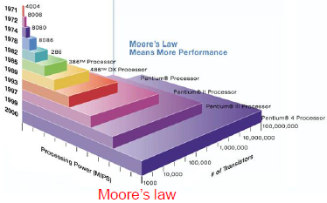
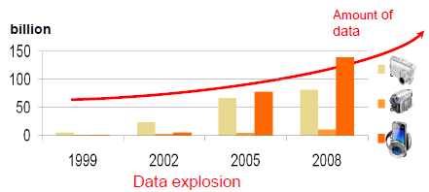
Motivation for machine learning
○ Advances in computer technology (store/access/process) can be used to analyze data (1) to make predictions, (2) for understanding and (3) control.
  ● Moore’s law : Describes a trend in the history of computer hardware. The number of transistors that can be inexpensively placed on an integrated circuit is increasing exponentially, doubling approximately every two years. The law is named after Intel co-founder Gordon E. Moore, who described the trend in his 195 paper. The term “Moore’s law” was coined around 1970 by the Caltech professor, Carver Mead.
  ● Data explosion : amount of data generated and stored grows at astounding rate (currently approximately 45GB/person x 7 billion = 315 Exabyte).
○ May not understand the details of the process that explains the generation of the data (consumer behavior- buy beer with chips, ice cream in summer…), however, need a technique to make a good and useful approximation in detecting certain patterns and regularities.

Slide 9
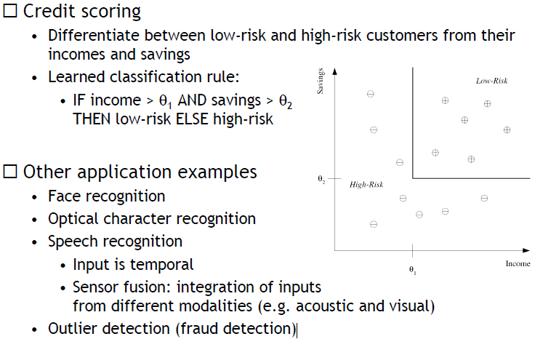
Machine learning: Classification

Slide 10
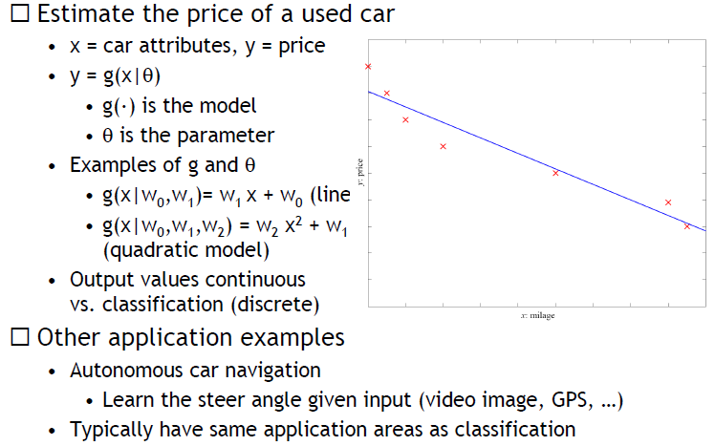
Machine learning: Regression

Slide 11
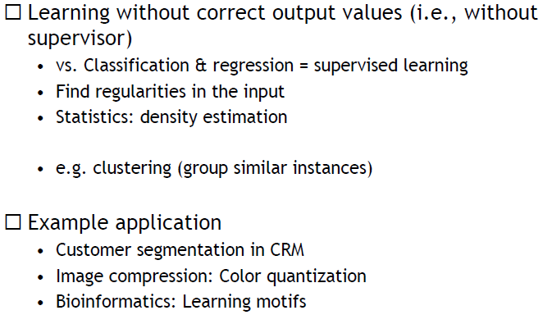
Machine learning: Unsupervised Learning

Slide 12
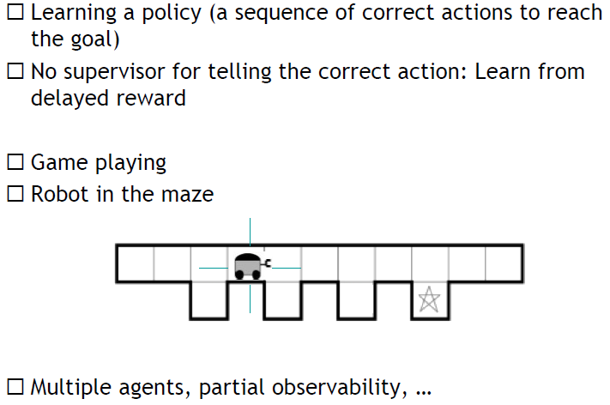
Machine learning: Reinforcement Learning

Slide 13
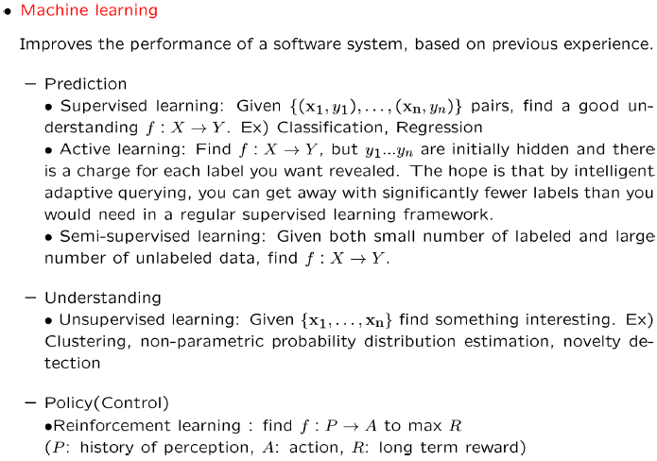
Introduction to machine learning

Slide 14
Applications
○Medicine/Biology
(Predict) Patient hospitalized due to heart attack will have second attack based on demographic, diet and clinical measurements.
(Predict) Glucose in the blood of diabetic person based on infrared absorption spectrum of person’s blood.
(Predict) Risk factor prostate cancer based on clinical and demographic variables).
Bioinformatics.
○Economy/finance
(Predict) Price of stock in 6 months based on company performance, economic data.
(Predict) Credit card fraud based on gender, demographic, credit history
○IT
(Predict) Numbers in a handwritten ZIP code based on digitized image of ZIP code
(Predict) Spam mail based on text in mail
(Predict) Text based on speech (Speech Recognition)
(Understanding) Call patterns are analyzed for network optimization.
○Astronomy/Physics
(Understanding) Discovering astronomical features
○Intelligence
(Policy) Flying helicopters upside down based on altitude, wind factor …
○http://mmp.kaist.ac.kr/~ee531/invertedFlight.wmv
(Policy) Playing game based on move by opponent.
(Policy) Robot navigation based on sensor input.

Slide 15
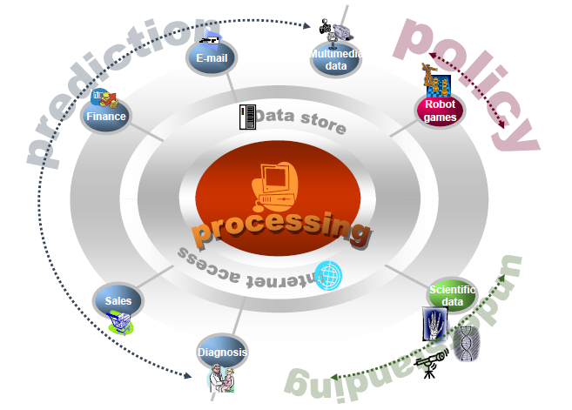
Applications: Summary

