Slide 1
AI 실습

Slide 2
Contents
K-Nearest Neighbor Algorithm
Evalution of Classifiers(인식기의 성능 평가)
Perceptron
Feed-Forward Neural Networks: Multi-Layer Perceptron
CNN(Convolutional Neural Network)

Slide 3
9.1. CNN (Convolutional Neural Network)의 역사적 배경과 특징
전방향 신경회로망/다층퍼셉트론 (Chap. 5)
  완전 연결(Fully-Connected)
  학습시킬 가중치가 아주 많음(Too many weights for training)
  학습속도가 느리고 계산량도 큼
  학습데이터에 대한 과도한 학습으로 일반화 성능 저하
  국소연결 망(Locally-Connected Networks) (포유류의 시각경로)
시각경로(Visual Pathway)
  Hubel and Wiesel (1950s and 1960s)
    Cat and monkey visual cortexes contain neurons that individually respond to small regions of the visual field. → Receptive Field(감수영역)
    Simple Cells in V1 layer, whose output is maximized by straight edges having particular orientations within their receptive field
    Complex Cells in V1 and V2 layer, which have larger receptive fields, whose output is insensitive to the exact position of the edges in the field.

Slide 4
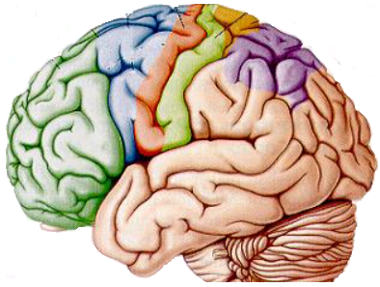
시각경로
  Keiji Tanaka (1990s)
    Monkey visual cortexes
    Input End: Visual cells respond to simple features
    Output End: Visual cells respond to complex features
where
V2
V1
V4
TEO
what
TE
TE
TEO
V4
V2
Mature Elaborate Cells
Immature Elaborate Cells
Primary Cells

Slide 5
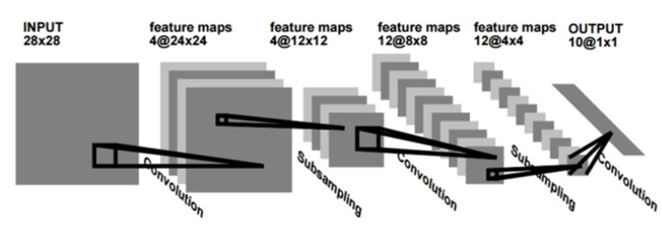
Neural Networks
  LeCun (1990s)
    LeNet1

Slide 6









9.3. CNN(Convolutional Neural Network)
CNN
  구성: Convolution layer, Pooling Layer, and Fully-Connected Layer
Convolution Layer
  1-D convolution
  H convolution nodes : depth H
  Feature Map (2-D)
    H vectors
    I elements
$$h_{j}(1)$$
$$h_{j}(2)$$
$$h_{j}(3)$$
$$h_{j}(I)$$
$$w_{j}$$
$$x_{1}$$
$$x_{2}$$
$$x_{d}$$

Slide 7




Convolution Layer
  2-D convolution
  Feature Map (3-D)
  Padding
  Stride
  Local Connectivity (receptive field of neuron)
  Parameter Sharing (filter or kernel)
$$h_{j}$$
$$w_{j}[i,k]$$
$$x$$

Slide 8
Pooling Layer
  A form of nonlinear down sampling
    The exact location of a feature is less important than its rough location relative to other features. The pooling layer serves to progressively reduce the spatial size of the representation, to reduce the number of parameters, and amount of computation in the network, and hence to also control overfitting. It is common to periodically insert a pooling layer between successive convolutional layers in a CNN architecture. The pooling operation provides another form of translation invariance.
  Max pooling is the most common
    It partitions the input image into a set of non-overlapping rectangles and, for each such sub-region, outputs the maximum.
  Average Pooling, L2-norm Pooling

Slide 9








Pooling Layer
Pooling
Pooling
Pooling
Pooling
Pooling
Pooling
$$h_{j}(1)$$
$$h_{j}(2)$$
$$h_{j}(3)$$
$$h_{j}(4)$$
$$h_{j}(5)$$
$$h_{j}(6)$$
$$h_{j}(I)$$
$$h_{j}$$

Slide 10



ReLU Layer
  ReLU(Rectified Linear Unit) for feature maps (before pooling)
  Other functions are also used to increase nonlinearity
Convolution
Activation Function
Pooling
INPUT

Slide 11
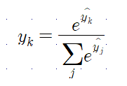

Fully Connected Layer
  After several convolutional and max pooling layers, the high-level reasoning in the neural network is done via fully connected layers. Neurons in a fully connected layer have connections to all activations in the previous layer, as seen in regular (non-convolutional) artificial neural networks.
  SoftMax Output Node
  CE(Cross-Entropy) Loss Function

Slide 12
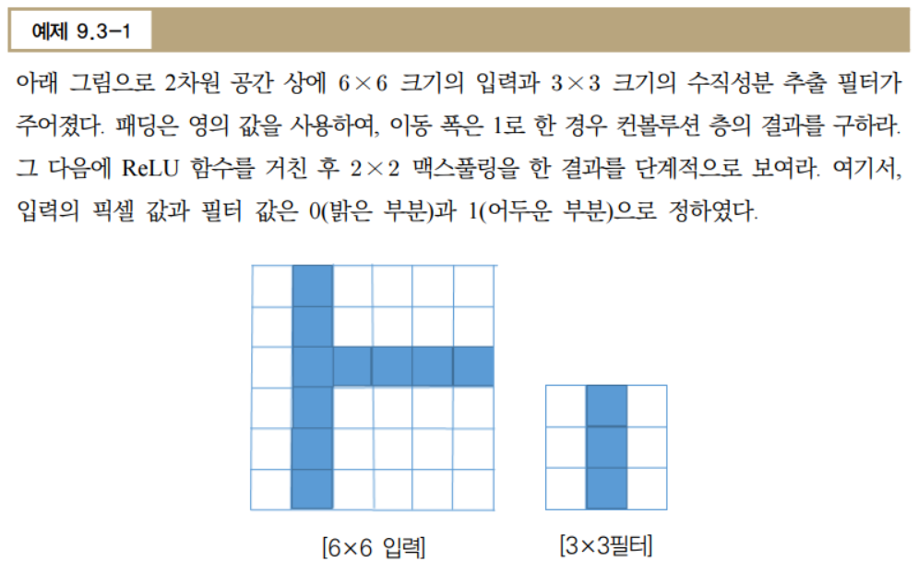

Slide 13
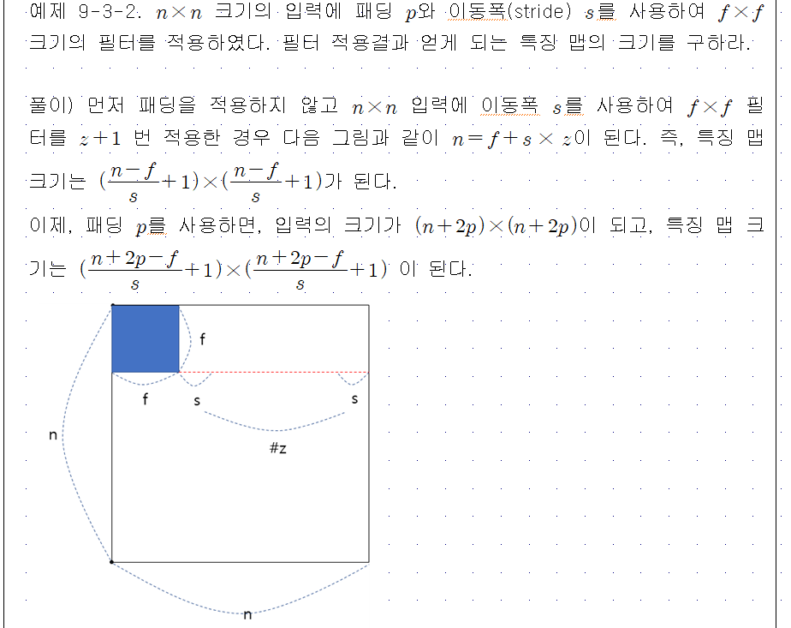

Slide 14
9.4. 파라미터 선정과 학습기법
파라미터 선정
  필터의 개수
  Since feature map size decreases with depth, layers near the input layer will tend to have fewer filters while higher layers can have more. To equalize computation at each layer, the product of feature values v_{a} with pixel position is kept roughly constant across layers.
  필터 형태
  Common filter shapes found in the literature vary greatly, and are usually chosen based on the dataset.
  Max pooling shape
  Typical values are 2×2. Very large input volumes may warrant 4×4 pooling in the lower layers. However, choosing larger shapes will dramatically reduce the dimension of the signal, and may result in excess information loss. Often, non-overlapping pooling windows perform best.

Slide 15
과도한 학습 방지 기법
  낙오(Dropout)
  Because a fully connected layer occupies most of the parameters, it is prone to overfitting.
  One method to reduce overfitting is dropout. At each training stage, individual nodes are either "dropped out" of the net with probability 1-p so that a reduced network is left; incoming and outgoing edges to a dropped-out node are also removed. Only the reduced network is trained on the data in that stage. The removed nodes are then reinserted into the network with their original weights.
  파라미터 수 제한
  Another simple way to prevent overfitting is to limit the number of parameters, typically by limiting the number of hidden units in each layer or limiting network depth. For convolutional networks, the filter size also affects the number of parameters. Limiting the number of parameters restricts the predictive power of the network directly, reducing the complexity of the function that it can perform on the data, and thus limits the amount of overfitting.
  가중치 감쇄(Weight decay)
  A simple form of added regularizer is weight decay, which simply adds an additional error, proportional to the sum of weights (L1 norm) or squared magnitude (L2 norm) of the weight vector, to the error at each node. The level of acceptable model complexity can be reduced by increasing the proportionality constant, thus increasing the penalty for large weight vectors.

Slide 16
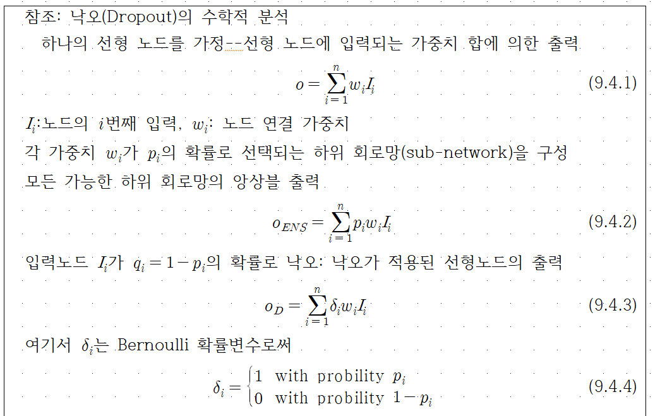

Slide 17
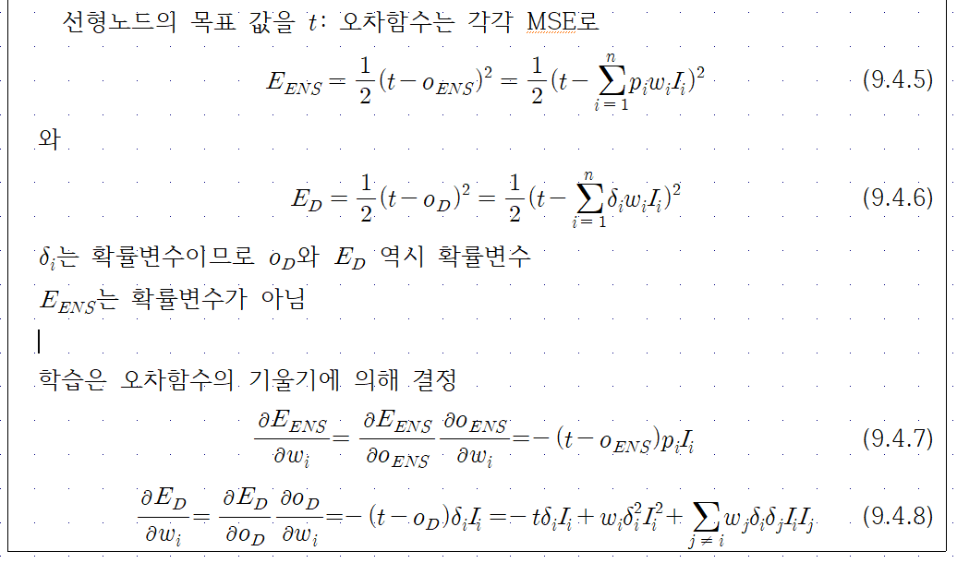

Slide 18
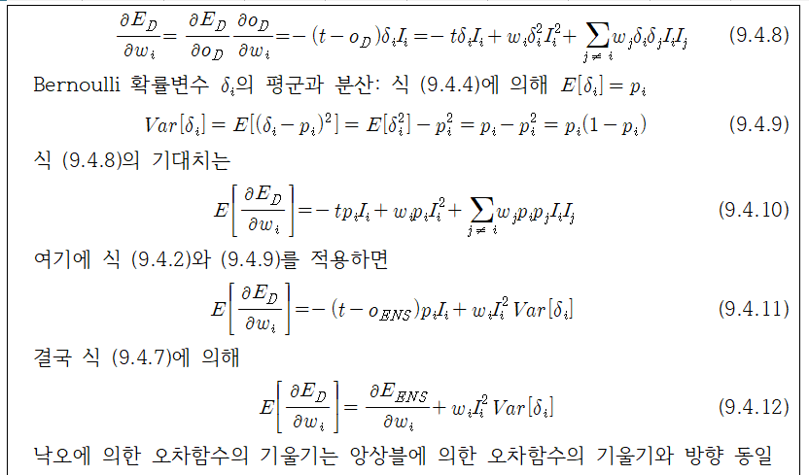

Slide 19
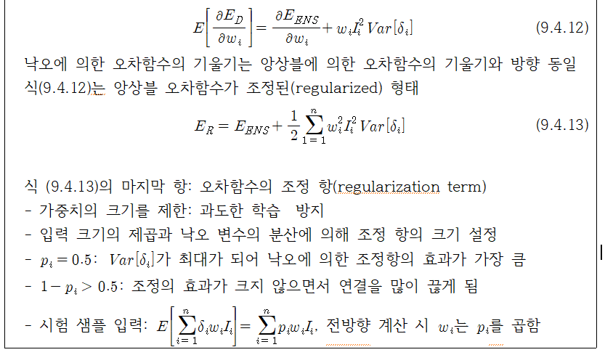

Slide 20
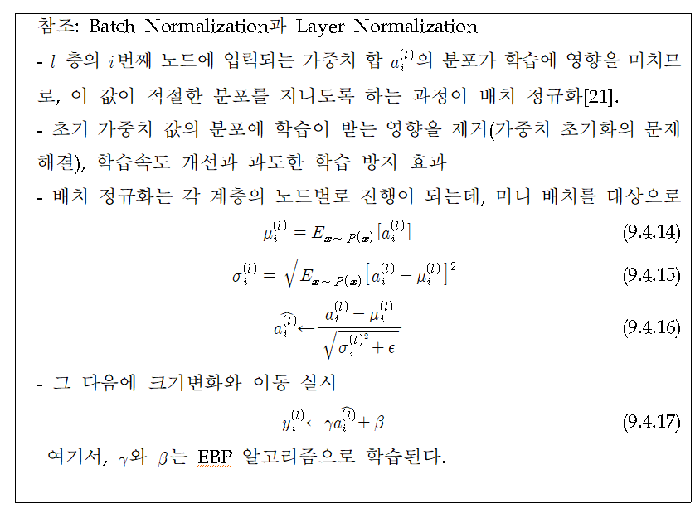

Slide 21
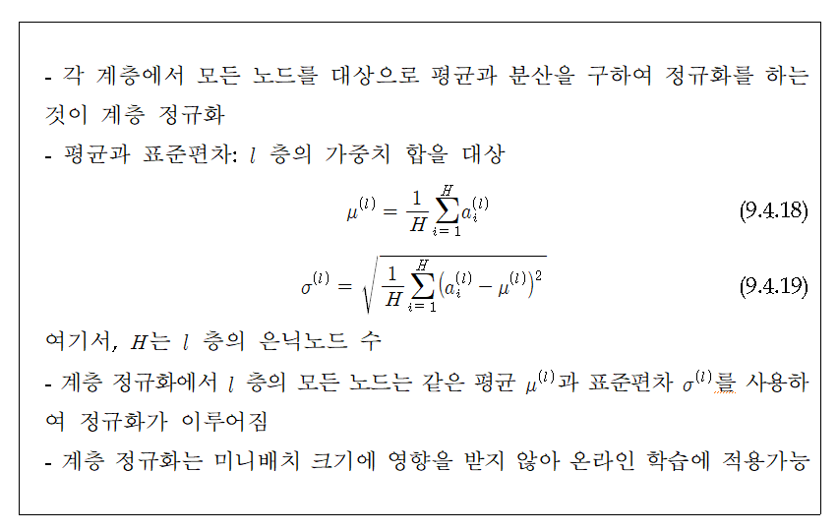

Slide 22
9.5. 다양한 컨볼루션
Dilated Convolutions
  Dilated convolutions introduce another parameter to convolutional layers called the dilation rate. This defines a spacing between the values in a kernel. A 3x3 kernel with a dilation rate of 2 will have the same field of view as a 5x5 kernel, while only using 9 parameters. Imagine taking a 5x5 kernel and deleting every second column and row.

Slide 23
Transposed Convolutions
  An actual deconvolution reverts the process of a convolution.
  A transposed convolution is somewhat similar because it produces the same spatial resolution a hypothetical deconvolutional layer would. However, the actual mathematical operation that’s being performed on the values is different. A transposed convolutional layer carries out a regular convolution but reverts its spatial transformation.
  To achieve this, we need to perform some fancy padding on the input.

Slide 24
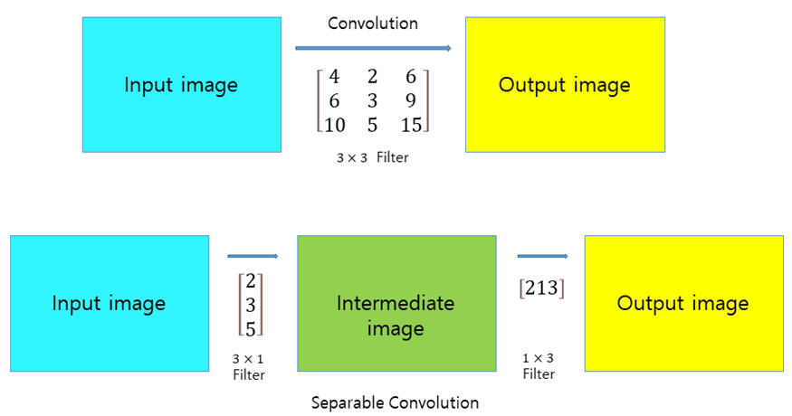

Separable Convolutions
  To save computational cost by substituting $f×f$ convolution filters with the combination $f×1$ and 1$×f$ convolution filters.

Slide 25
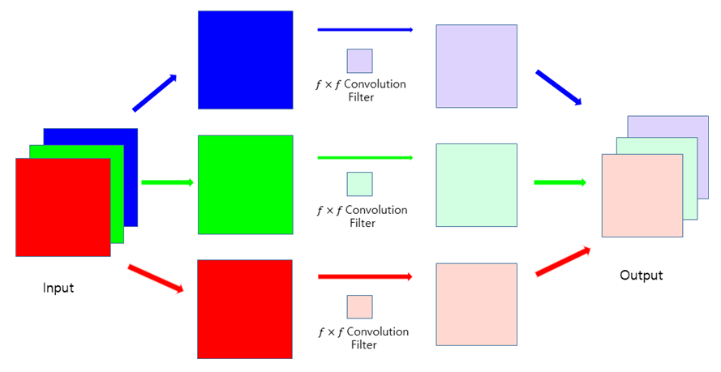

Depthwise Convolutions
  Assuming $n×n×c$sized input with $c$ channels and $f×f×c$ convolution filters.
  Step 1:Convolution of each $n×n$ input with $f×f$ filter
  Step 2: Combining the convolution results ..Output with $c$ channels

Slide 26
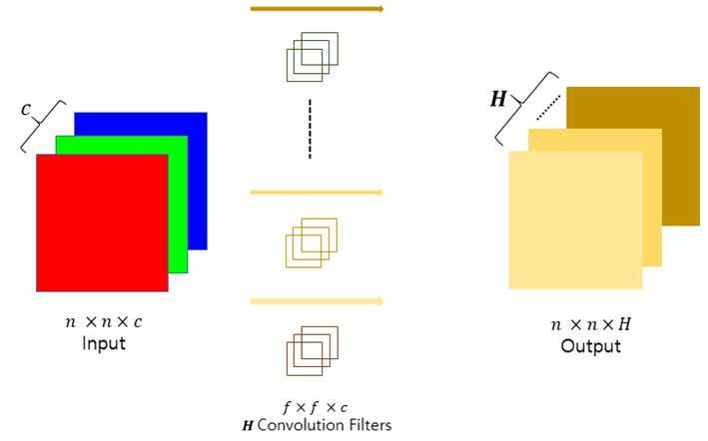

Depthwise Separable Convolutions
  Assuming convolution of $n×n×c$ input with $H$ $f×f×c$ filters (stride 1) attains $n×n×H$ output
  To save computational costs but attain $n×n×H$ output.
  How? – depthwise separable convolution!

Slide 27
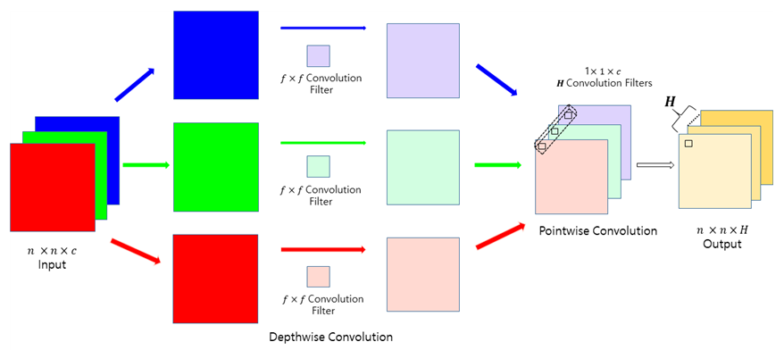

Depthwise Separable Convolutions
  ① Depthwise convolution : $n×n×c$ output
  ② Convolution of $n×n×c$ data with $H$ $1×1×c$ filters
  Pointwise convolution : convolution with $1×1×c$ filters
    Combining c channel data into 1 channel $1×1×c$ filters

Slide 28
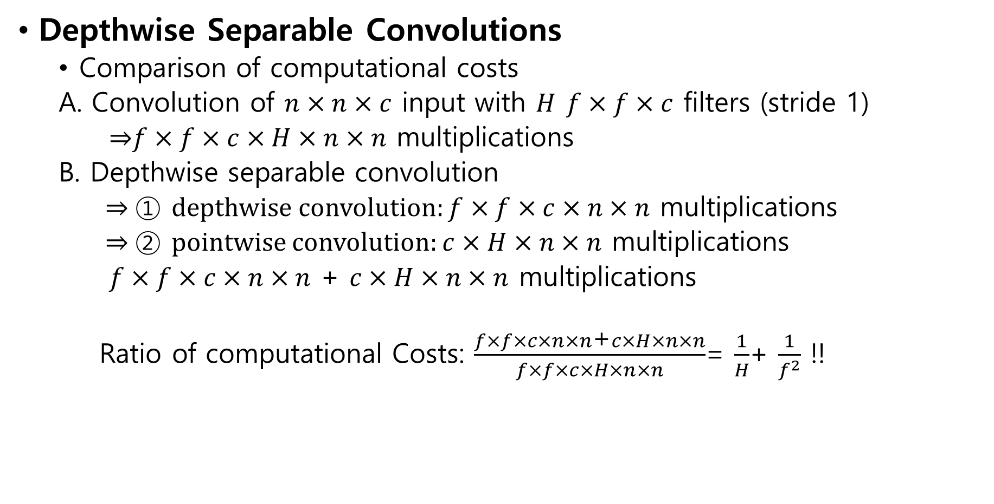
Depthwise Separable Convolutions
  Comparison of computational costs
  A. Convolution of $n×n×c$ input with $H$ $f×f×c$ filters (stride 1)
  ⇒$f×f×c×H×n×n$ multiplications
  B. Depthwise separable convolution
  ⇒ ① depthwise convolution: $f×f×c×n×n$ multiplications
  ⇒ ② pointwise convolution: $c×H×n×n$ multiplications
  $f×f×c×n×n$ + $c×H×n×n$ multiplications
  Ratio of computational Costs: $\frac{f×f×c×n×n\text{+}c×H×n×n}{f×f×c×H×n×n}$= $\frac{1}{H}$+ $\frac{1}{f^{2}}$ !!

Slide 29
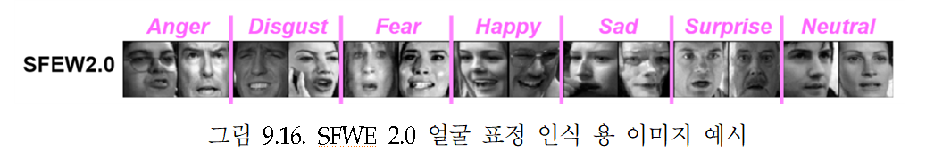
9.6. Applications
Facial Expression Recognition
EmotiW(Emotion Recognition in the Wild)
  Sub-competition: SFEW(Static Facial Recognition in the Wild)

Slide 30
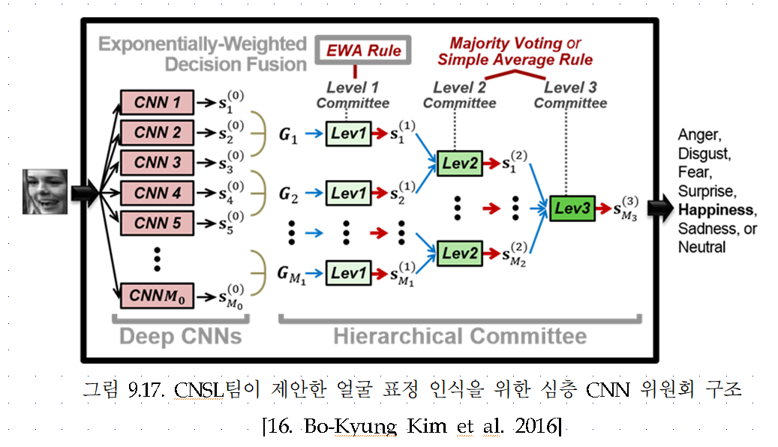
EmotiW(Emotion Recognition in the Wild)
  Sub-competition: SFEW(Static Facial Recognition in the Wild)

Slide 31
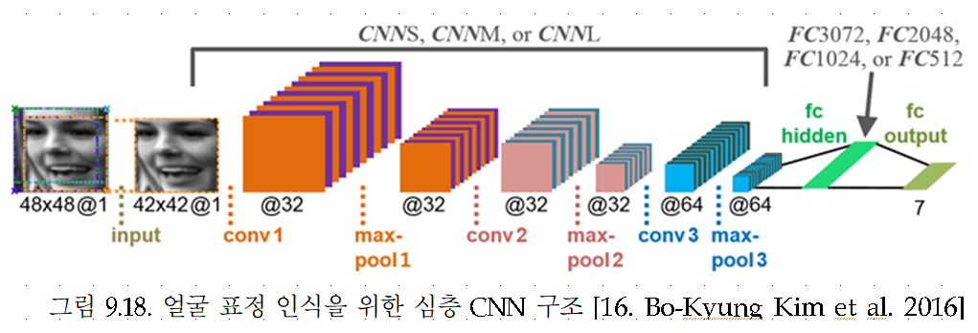
EmotiW(Emotion Recognition in the Wild)
  Sub-competition: SFEW(Static Facial Recognition in the Wild)

Slide 32
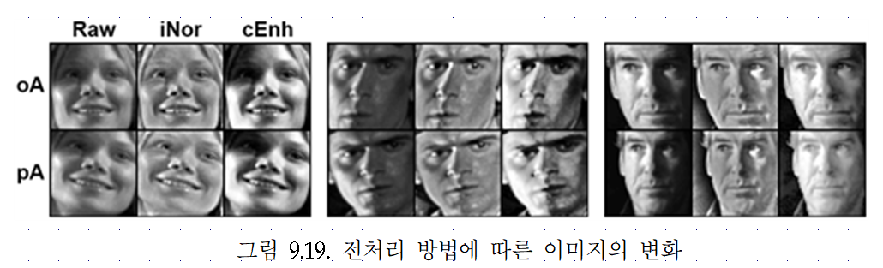
EmotiW(Emotion Recognition in the Wild)
  Sub-competition: SFEW(Static Facial Recognition in the Wild)

Slide 33
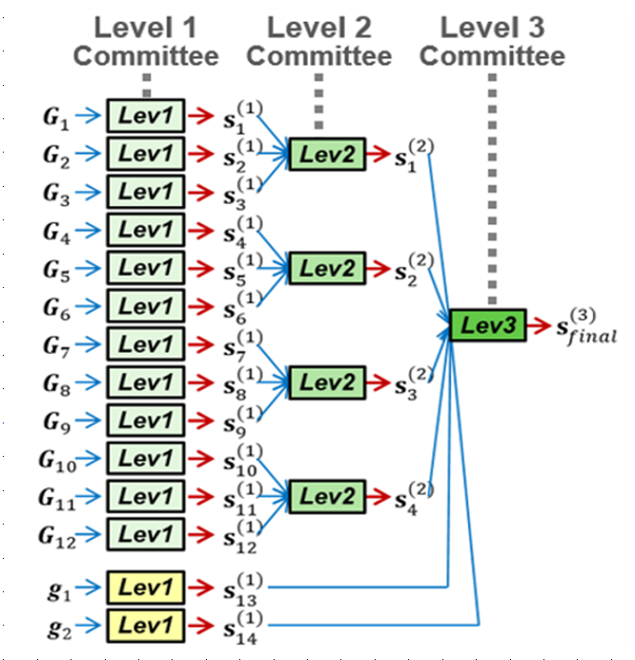
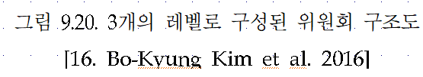
EmotiW(Emotion Recognition in the Wild)
  Sub-competition: SFEW(Static Facial Recognition in the Wild)

Slide 34
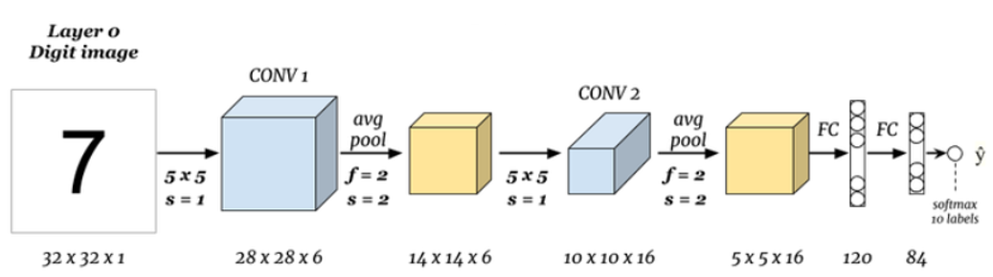






LeNet-5: MNIST 필기체 인식
$$n:input size$$
$$f:filter size$$
Convolution Results: $\left[\frac{n+2p−f}{s}+1 \right]$ $×$ $\left[\frac{n+2p−f}{s}+1 \right]×N_{c}$
$$p:padding$$
$$s:stride$$
$$N_{c}:number of filters (channels )$$
Kernel shape: 5$×$5$×$6
32x32 입력에 컨볼루션층과 풀링층을 적용
완전연결층을 거친 후 10개의 SoftMax 출력노드로 필기체 숫자 인식

Slide 35
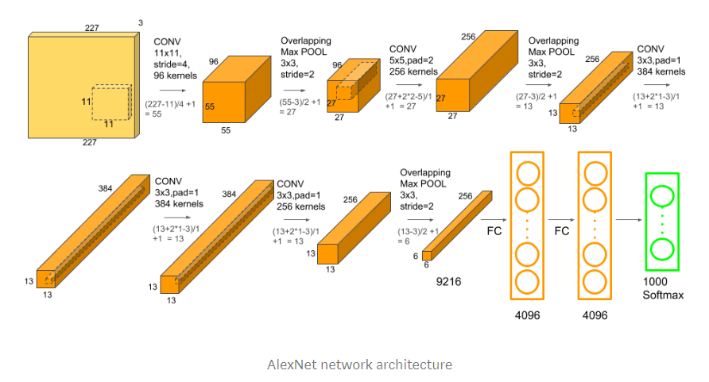









AlextNet: ILSVRC2012(120만장의 영상을 1000개의 클래스로 구분)
$$n:input size$$
$\left[\frac{n+2p−f}{s}+1 \right]$ $×$ $\left[\frac{n+2p−f}{s}+1 \right]×N_{c}$
$$f:filter size$$
$$p:padding$$
Kernel shape: 11$×11×3$
Kernel shape: 5$×5×96$
Kernel shape: 3$×3×256$
$$s:stride$$
$$N_{c}:number of filters$$
227x227 RGB영상에 컨볼루션층과 풀링층통과
컨볼루션층 통과
풀링층 거친 후 완전연결층으로 결과 출력
ILSVRC2012
Top-5 error 17%

Slide 36
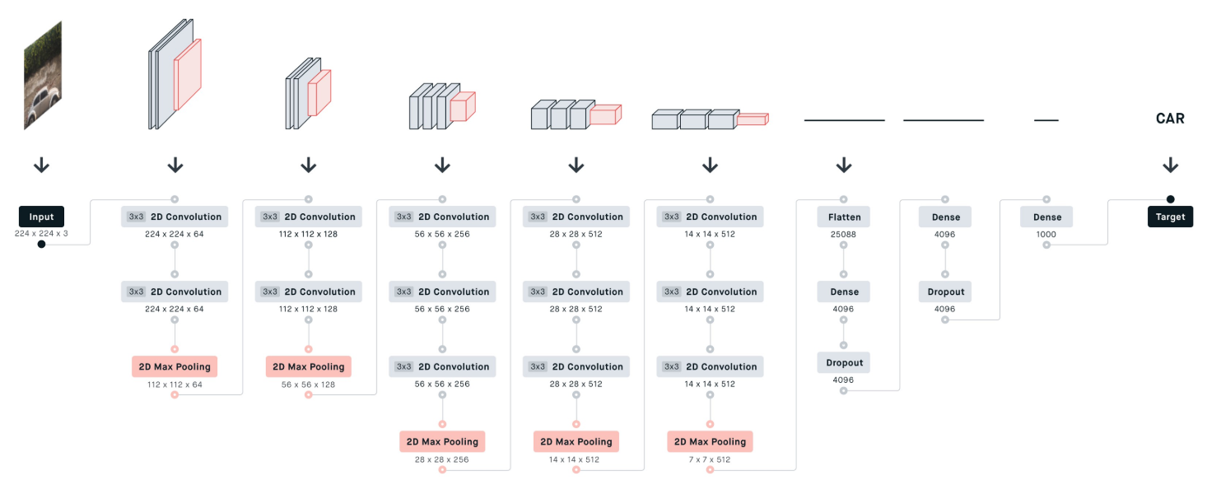
VGG-16: ILSVRC2014
층수를 늘리고 3x3 컨볼루션 필터 사용(s=1,p=1),
완전연결층: 25088-4096-4096-1000

Slide 37
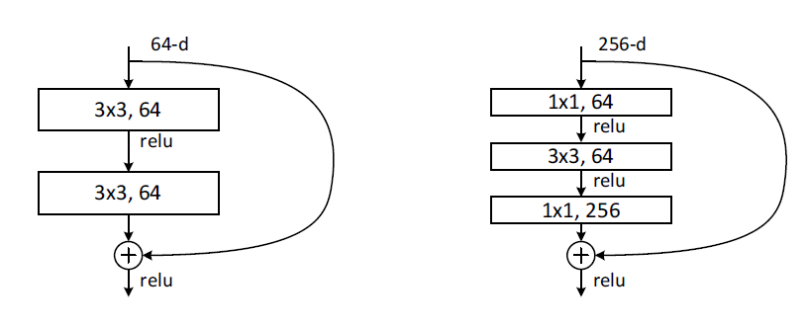
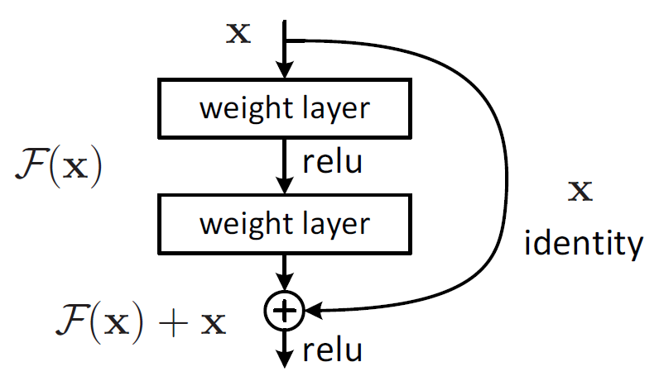
ResNet: ILSVRC2015
층수가 아주 많아지면 성능의 저하 문제 발생: 해결책으로 잔류학습 블록을 제시
가정: 원하는 사상 H(x)를 직접 학습하는 것 보다 F(x)=H(x)-x 를 학습하는 것이 쉽다.
잔류학습 블록을 제시함.
신경회로망이 F(x)를 학습 후, 잔류학습 블록에서 F(x)+x를 출력함(ReLU 활성화 함수).
Skip connections
Residual Learning Block
Residual Learning Block for ReseNet-34
Residual Learning Block for ReseNet-50/101/152

Slide 38
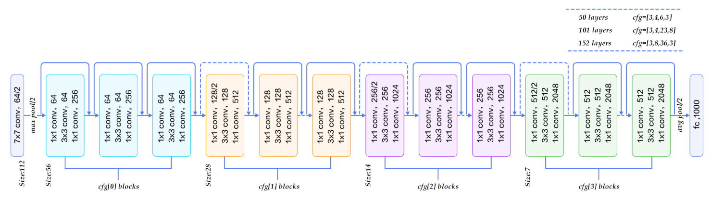
ResNet: ILSVRC2015
구조: 영상입력-7x7 컨볼루션층-cfg[0]블럭-cfg[1]블럭-cfg[2]블럭-cfg[3]블럭-완전연결 fc 1000
리스트 cfg는 아래 그림의 cfg[0], cfg[1], cfg[2], cfg[3] 블록을 주어진 수 만큼 지님을 나타냄
아래 그림은 cfg=[3,3,3,3]을 나타냄
예) 152층: (cfg[0] 3층+cfg[1] 8층+cfg[2] 36층+cfg[3] 3층)x3+2=152
ILSVRC2015
ResNet-152: Top-5 error 4.49%

Slide 39
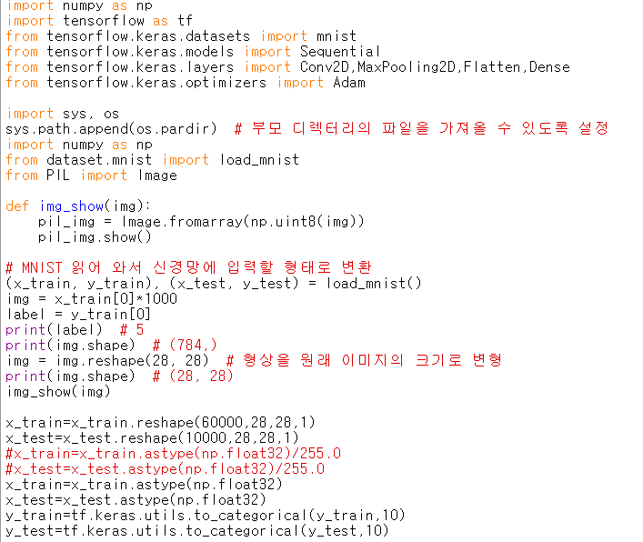

실습
6-1b.py

Slide 40
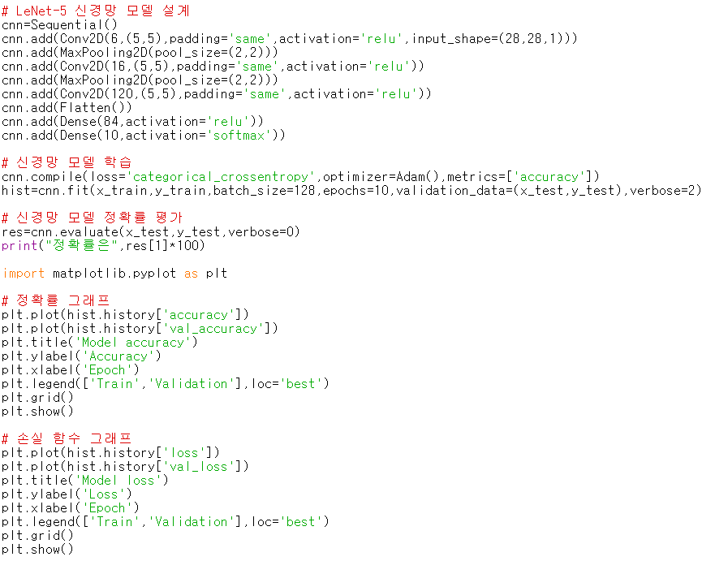
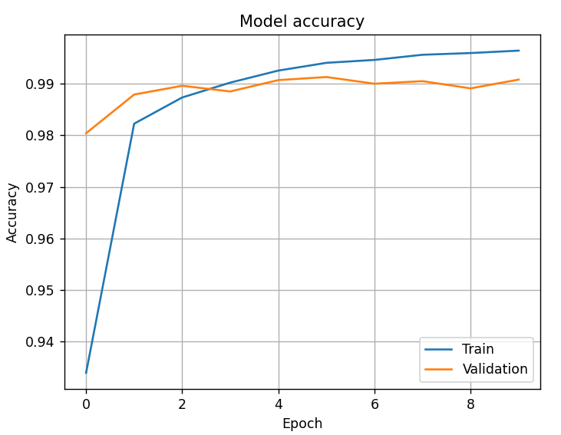
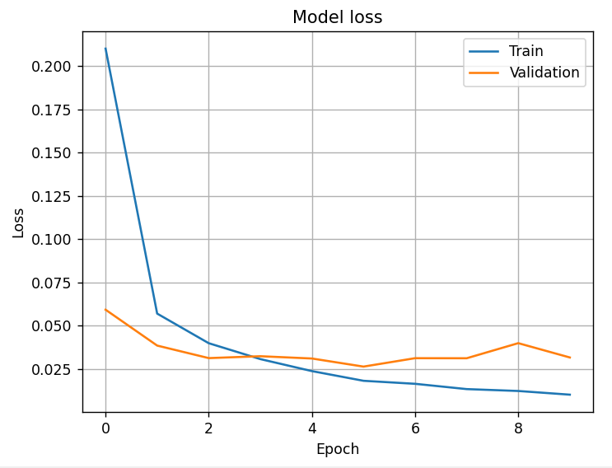
실습

Slide 41
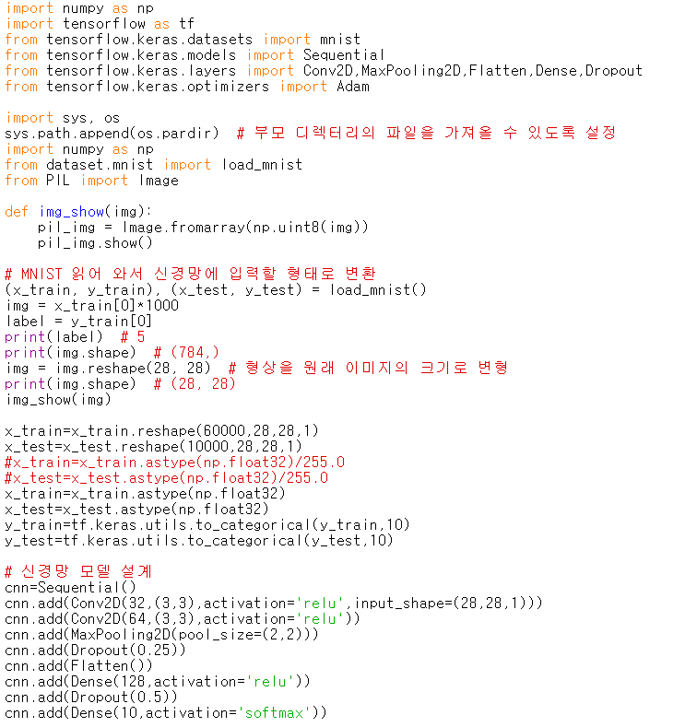
실습
6-2b.py
구조:C-C-P-dropout-FC-dropout-FC

Slide 42
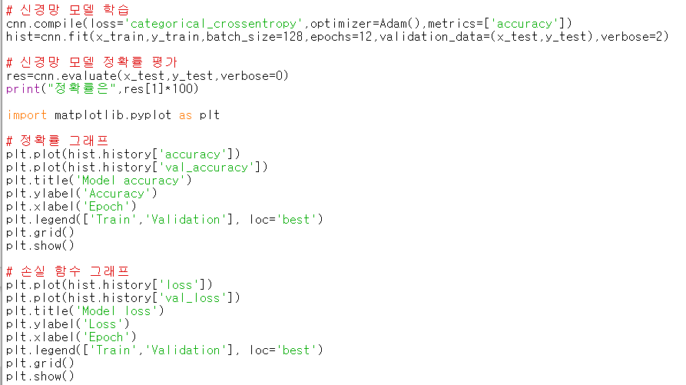
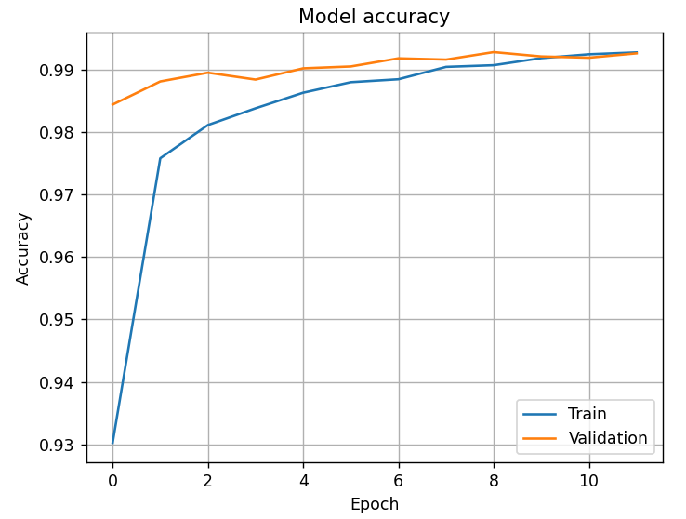
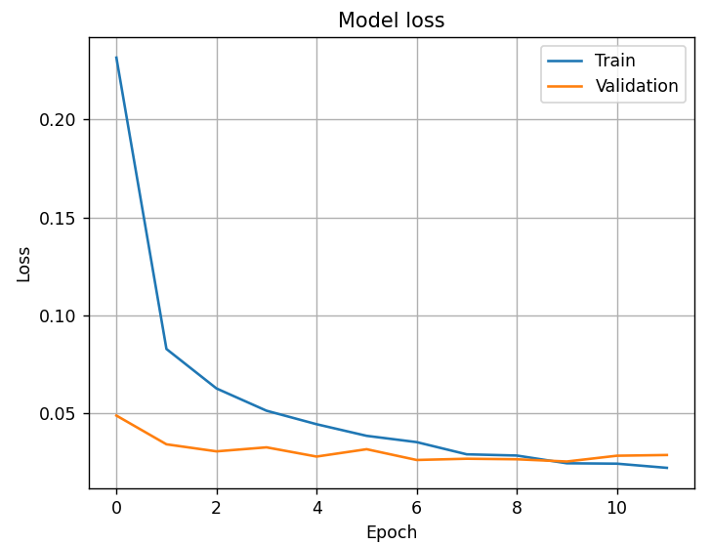

Slide 43
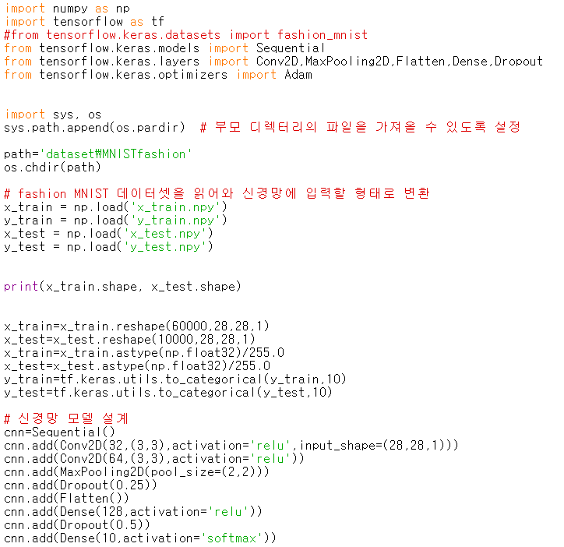
실습
6-3b.py
구조:C-C-P-dropout-FC-dropout-FC

Slide 44
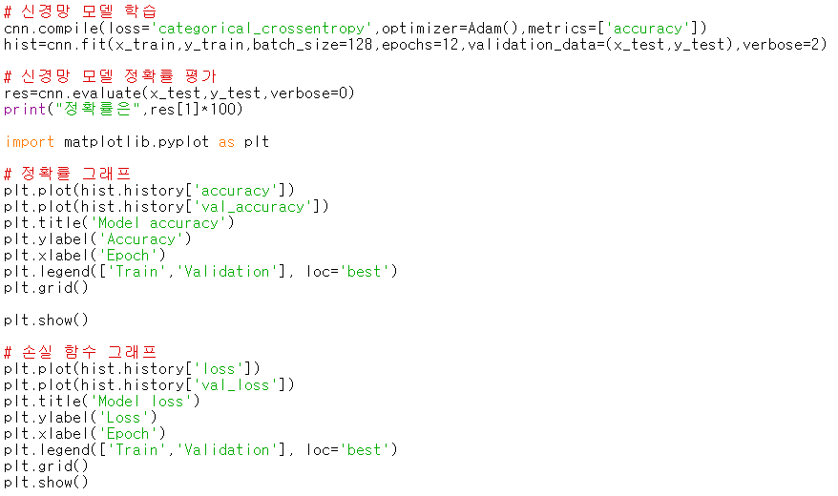
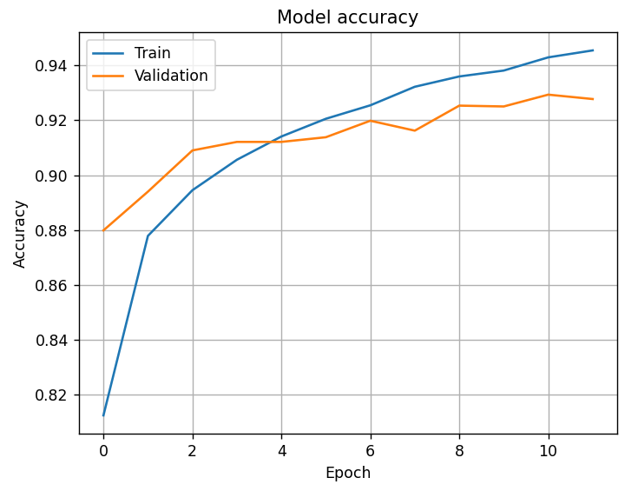
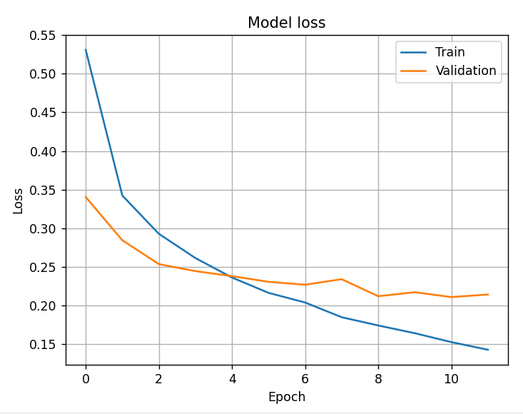

Slide 45
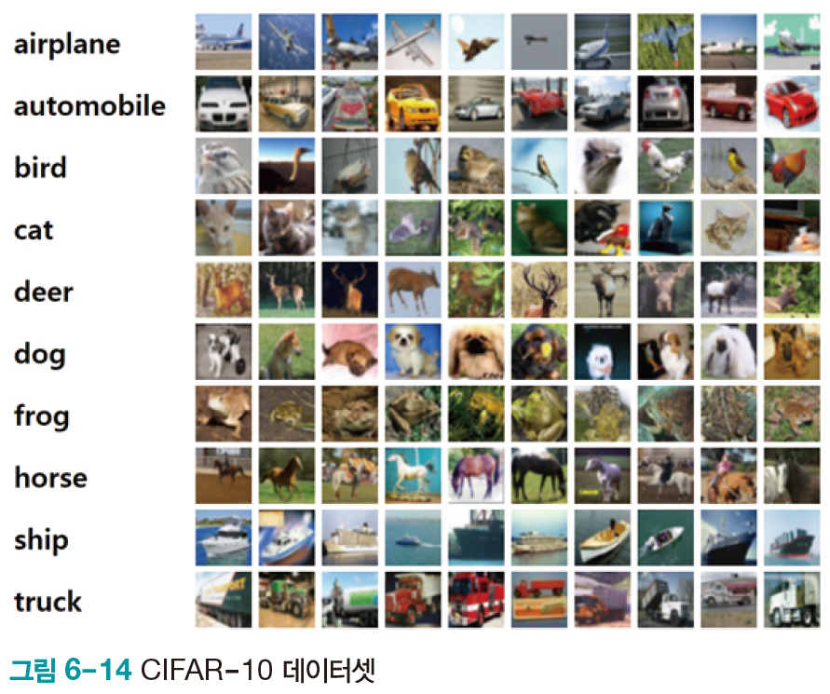
6.4.4 자연 영상 인식
딥러닝 프로그래밍에서 주로 사용하는 자연 영상 데이터베이스
  ImageNet
  MSCoCo
  CIFAR: 작아서 MNIST 다음에 주로 사용
CIFAR-10
  {airplane, automobile, bird, cat, deer, dog, frog, horse, ship, truck}의 10부류
  영상은 32*32 맵으로 표현

Slide 46
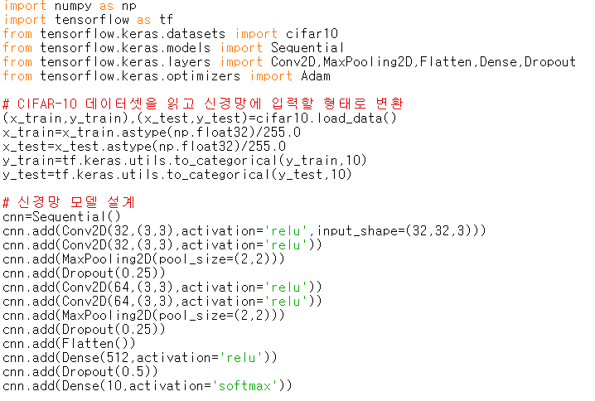
실습
6-4.py
Colab에서 실행

Slide 47
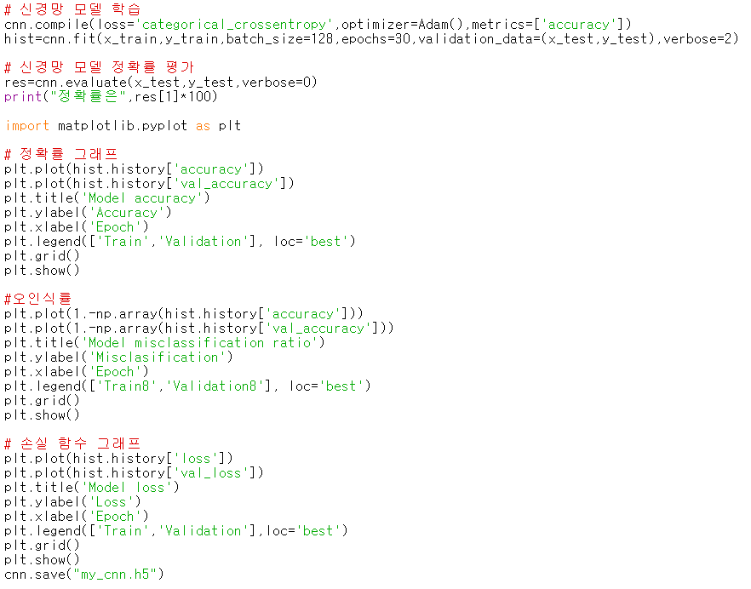
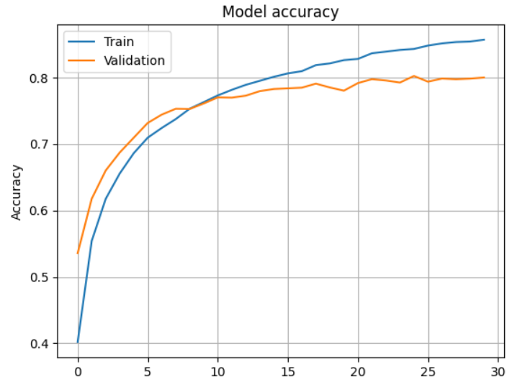
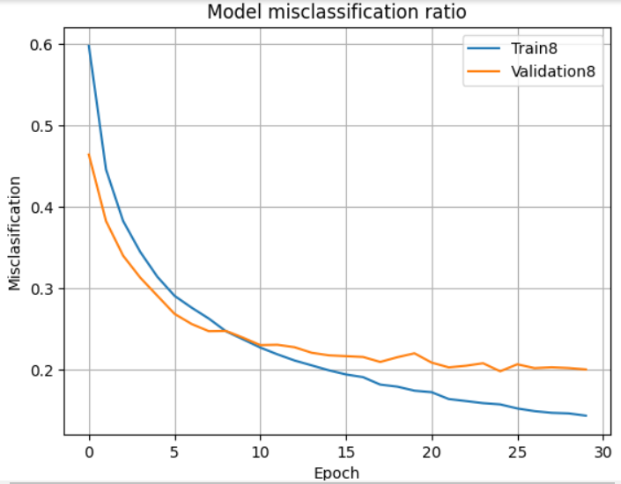
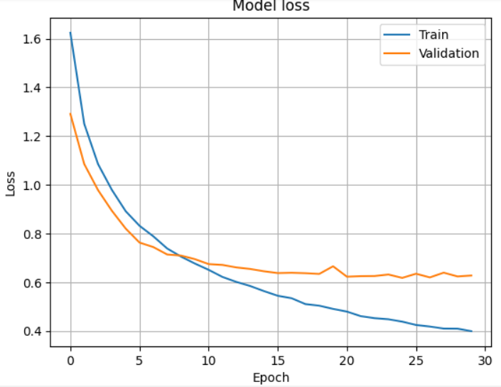

Slide 48


6-5.py
Colab에서 실행
저장된 모델 ‘my_cnn.h5’ 불러와서 사용

