Slide 1
AI 실습

Slide 2
Contents
K-Nearest Neighbor Algorithm
Evalution of Classifiers(인식기의 성능 평가)
Perceptron

Slide 3
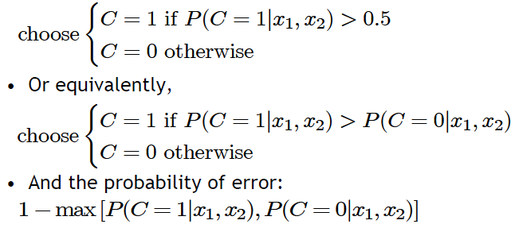
4.1. Classification(인식)
Credit scoring example:
Inputs are income and savings
Output is low-risk vs. high-risk
Formally speaking
Decision rule: if we know ㅎ 화
Savings
Low-risk
High-risk
Income

Slide 4
4.3. Losses and Risks (손실과 위험)
4.2. Bayes’ Optimal Classifier
Credit scoring problem
Accept low-risk applicant → increasing profits
Reject high-risk applicant → decreasing losses
increased loss by accepted high-risk applicant $≠$ decreased gains by rejected low-risk applicant
Errors are not symmetric! → Maximizing gains? Minimizing Losses?
Define
$α_{i}$: Action assigning input to class $C_{i}$
$λ_{ik}$: Loss of $α_{i}$although the real class is $C_{k}$
Expected risk:
Decision rule (minimum risk classifier):

Slide 5
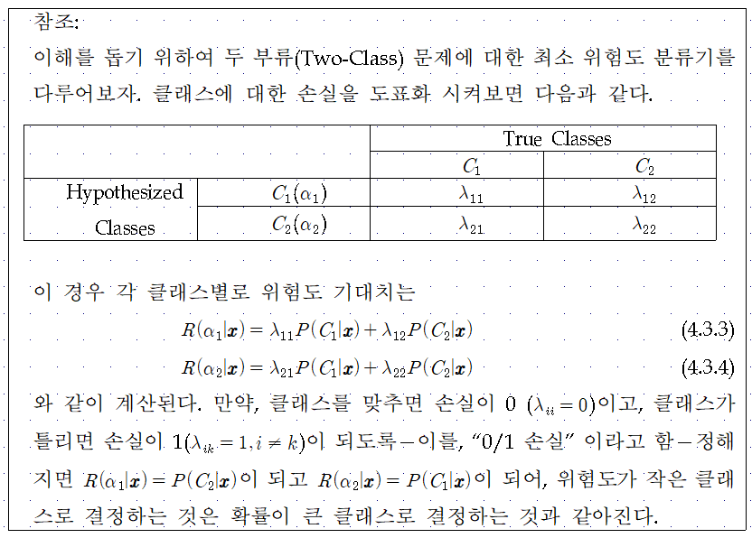

Slide 6
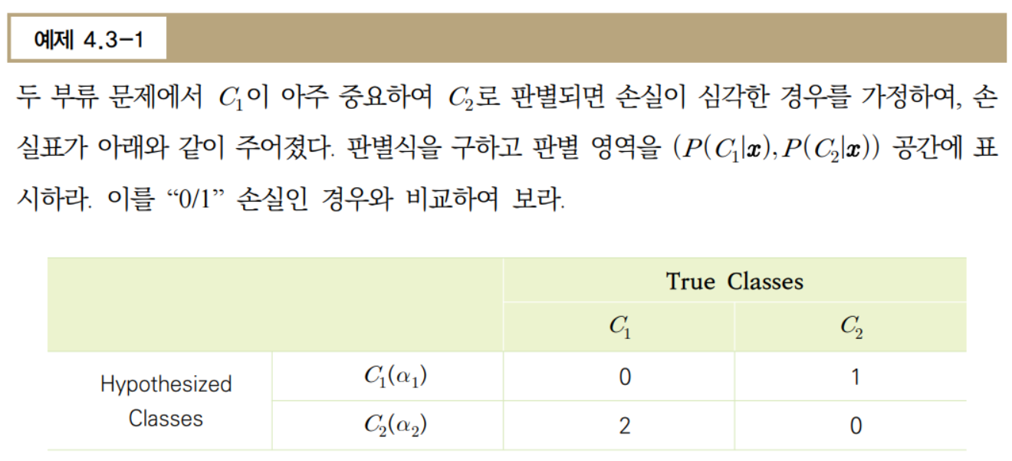

Slide 7
4.4. Discriminant Functions(구별함수)
인식 = 구별함수 $g_{i}(x)$
$$x_{2}$$
$$C_{3}$$
$$C_{1}$$
Reject
$$C_{2}$$
경계면을 찾아 내어도 충분함.
경계면 내의 지점에 대한 확률값을 알아낼 필요 없음
=> 구별함수
$$x_{1}$$
4.5. Linear Discriminant Function
$$g_{i}\left(x\right)=\sum_{j=1}^{d}{w_{ij}x_{j}}+w_{i0}$$

Slide 8
$$x_{2}$$
$$g\left(x\right)=w_{1}x_{1}+w_{2}x_{2}+w_{0}=0$$
$$g\left(x\right)<0$$
$$C_{1}$$
$$g\left(x\right)>0$$
$$C_{2}$$
$$x_{1}$$

Slide 9
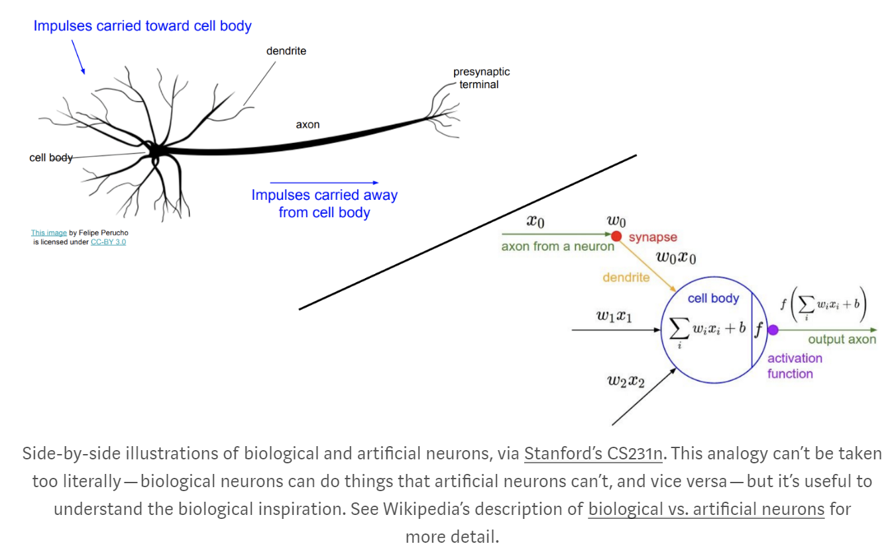
4.6. 단층퍼셉트론(Single Layer Perceptron)

Slide 10
4.6. 단층퍼셉트론(Single Layer Perceptron)
$$y$$
$$f(.)$$
$$\sum_{k=0}^{d}{w_{k}x_{k}}$$
$$w_{d}$$
$$w_{0}$$
$$w_{1}$$
$$w_{2}$$
$$x_{0}=1$$
$$x_{1}$$
$$x_{2}$$
$$x_{d}$$

Slide 11
Gradient Descent (경사 강하법)
4.7. Training Perceptron (퍼셉트론 학습)
Training Sample
Perceptron Output $y^{t}$ Desired Output $r^{t}$
Regression (Linear Output)
$${E(W}^{t})$$
$${E(W}^{t+1})$$
$$W^{t+1}$$
$$W^{t}$$

Slide 12
Gradient Descent
Training Sample
Perceptron Output $y^{t}$ Desired Output $r^{t}$
Classification (Sigmoid Output)

Slide 13
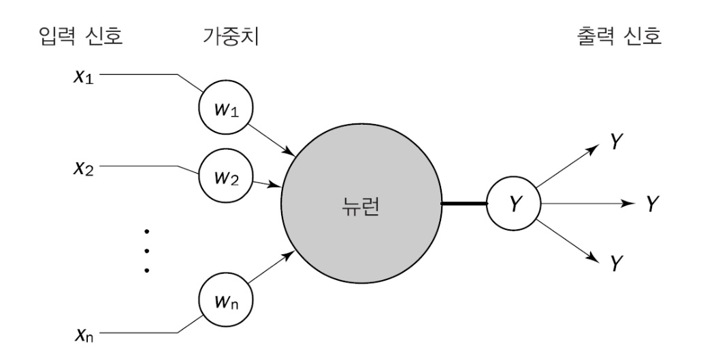
Logistic Regression vs. Perceptron
[Scikit-Learn class]
Logistic Regression: 시그모이드 출력에 Cross_Entropy Loss 함수 사용한 경우에 해당
Perceptron: Threshold 출력에 해당
$$Δw_{i}=η\left(t−y\right)χ_{i}$$

Slide 14
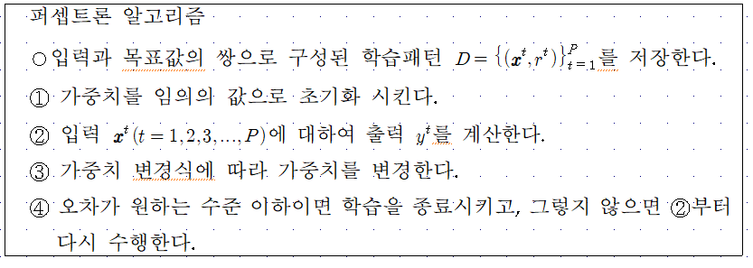

Slide 15
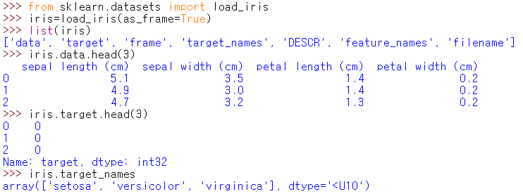
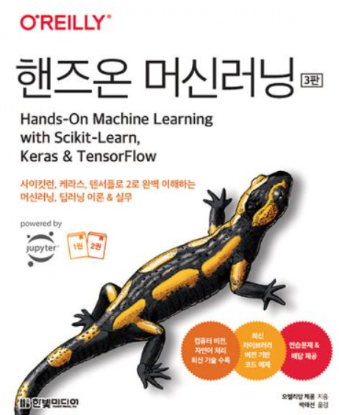
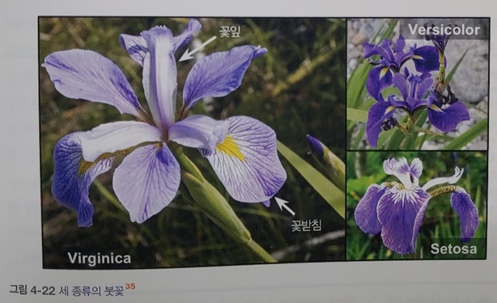
Perceptron 실습
perceptron-10장-p217~218-p378-3rdEd.py

Slide 16
Perceptron 실습
perceptron-10장-p217~218-p378-3rdEd.py

Slide 17
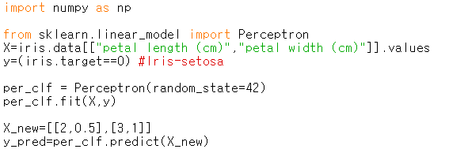
Perceptron 실습
perceptron-10장-p217~218-p378-3rdEd.py

Slide 18
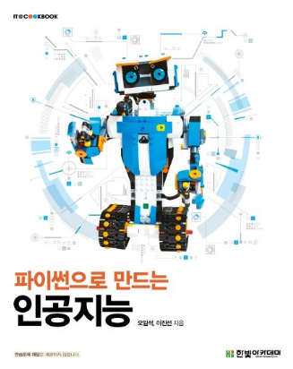
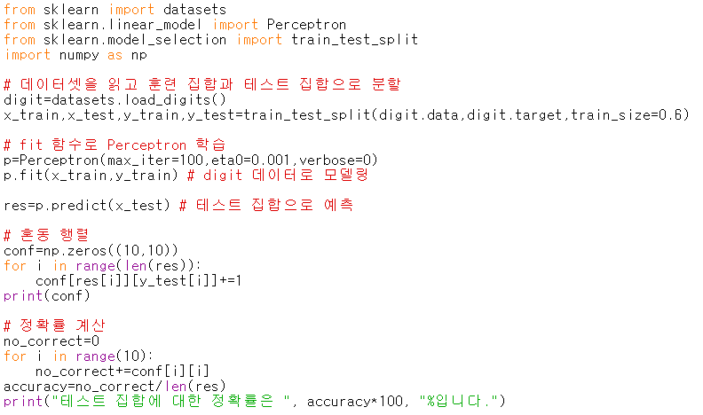
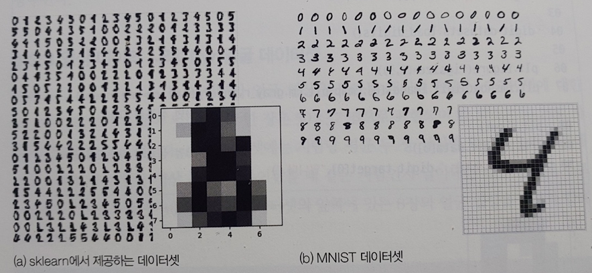
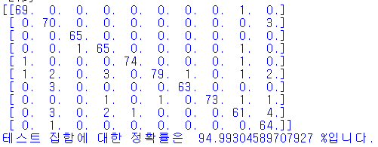
4-2.py

