Slide 1
AI 실습

Slide 2
Contents
K-Nearest Neighbor Algorithm
Evalution of Classifiers(인식기의 성능 평가)

Slide 3
Classification(인식)
Classification
Ex) Credit scoring
Low-risk and high-risk customers from their incomes and savings
Class membership
Input Features (입력 특징)
Other examples
Handwritten digit recognition
Speech Recognition
Fraud detection
Savings
Low-risk
High-risk
Income

Slide 4
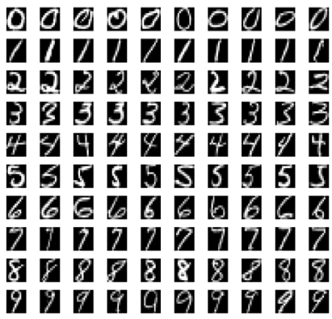
2.1. k-Nearest Neighbors Algorithm의 개요
Handwritten Digit Example
Do As Your Neighbor Does
학습 데이터 집합 $D=\{x^{n}c^{n}$}, $n=1,2,…,N$
새로운 입력${ x}^{∗}$에 대한 class $c{(x}^{∗})=?$
학습 데이터 집합에서 가장 가까운 입력을 찾아 그 class를 이용하여 결정

Slide 5
k-NN classifier 의 예시
Green Circle(The test sample) should be classified either to the first class(blue squares) or to the second class(red triangles).
If k = 3 , there are 2 triangles vs. only 1 square inside the inner circle.
If k = 5 , there are 3 squares vs. 2 triangles inside the outer circle.
?

Slide 6
2.2. k-Nearest Neighbors Algorithm에 의한 분류
분류(Classification)
Ex) Credit scoring
Low-risk and high-risk customers from their incomes and savings
Class membership
Input Features (입력 특징)
Other examples
Handwritten digit recognition
Speech Recognition
Fraud detection
Savings
Low-risk
High-risk
Income

Slide 7
k-Nearest Neighbors Algorithm
학습이 없이 예제에 기반한 알고리즘
학습 데이터 집합 $D=\{x^{n}c^{n}$}, $n=1,2,…,N$
새로운 입력${ x}^{∗}$에 대한 class $c{(x}^{∗})=?$
학습 데이터 집합에서 가장 가까운 입력을 찾아 그 class를 이용하여 결정
거리가 가까운 입력 k를 찾아내면, 그 입력에 해당하는 class 정보의 다수 투표로 새로운 입력${ x}^{∗}$에 대한 class $c{(x}^{∗})$를 결정
거리 측정 기준? Euclidean distance, Minkowski Metric
분포가 치우쳐 있을 때 성능이 심각하게 저하 됨.
거리 정보 d를 이용하면 더 정확한 결정을 할 수 있음

Slide 8
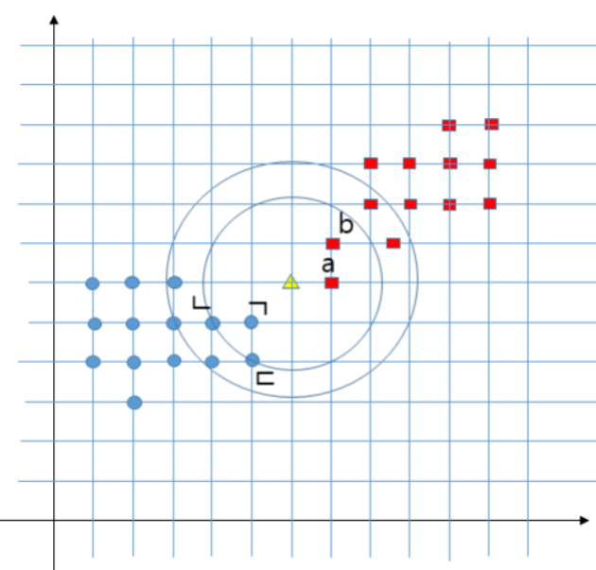

Slide 9
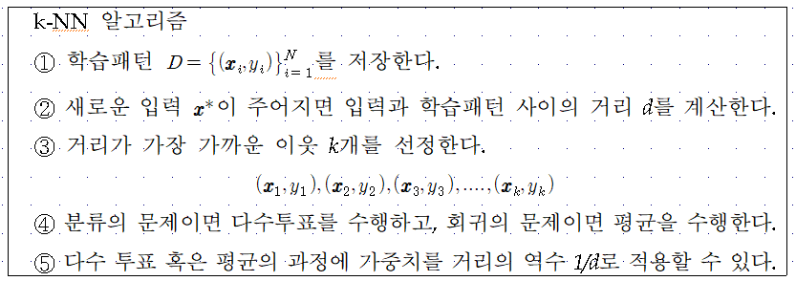
k-NN Algorithm

Slide 10
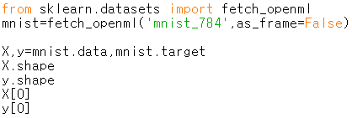
k-NN Algorithm 실습
3장
MNIST 데이터셋
DESCR: 데이터 셋 설명
data: 입력데이터 2D numpy 배열
target: Label
knn-3장-3rdEd.py

Slide 11
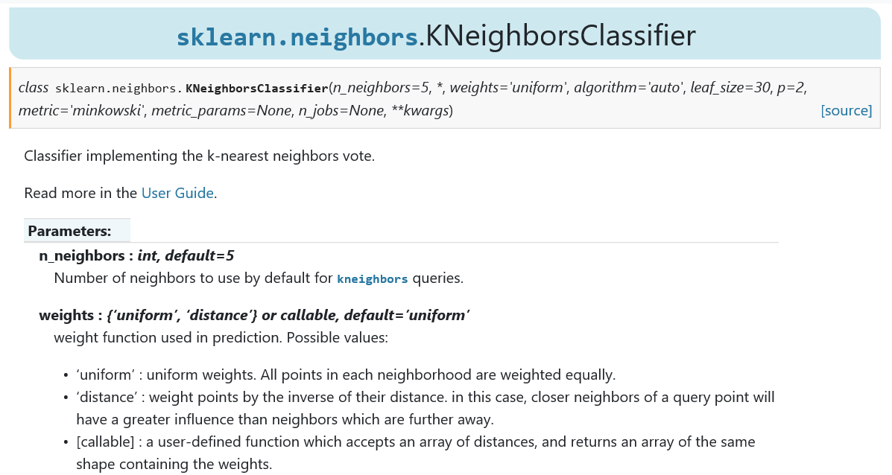

Slide 12
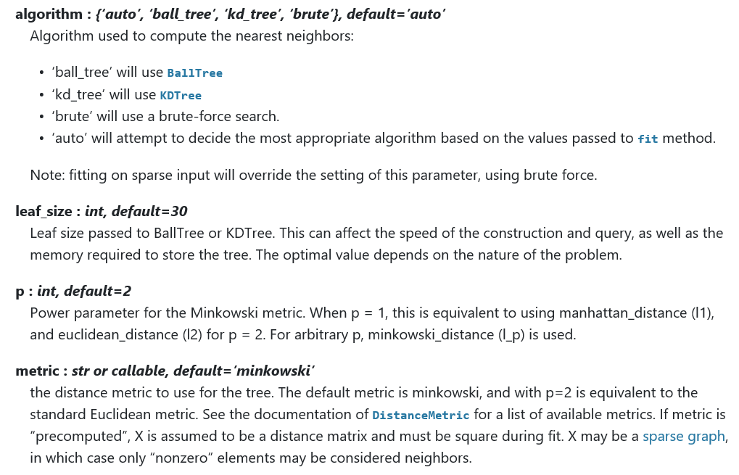

Slide 13
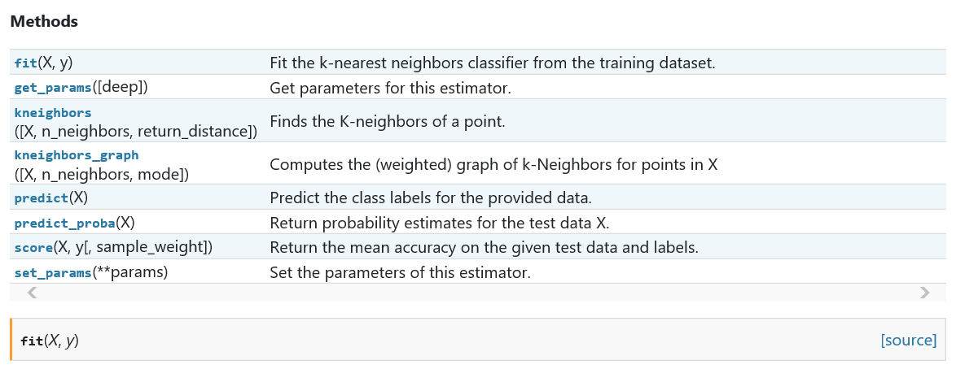
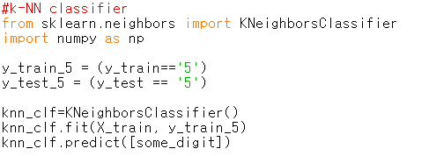

Slide 14
8.4. Evaluation of Classifiers(인식기의 평가)
“Accuracy(정확도)” or “Recognition Ratio(인식률)”
“Precision(정밀도) and Recall(상기율)”
TP : True Positive
FP : False Positive
TN : True Negative
FN : False Negative Positive
True Class
p
n
Hypothesized Class
True Positive
False Positive
Precision
P
False Negative
True Negative
N
Recall
False Alarm
[Confusion Matrix]

Slide 15
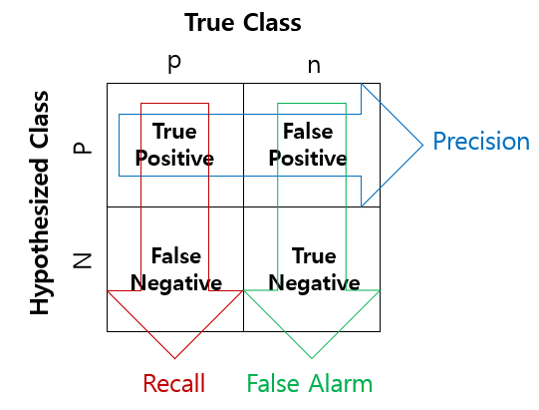
A precision score of 1.0 for a class C: every item labeled as belonging to class C (P) does indeed belong to class C (but says nothing about FN the number of items from class C that were not labeled correctly).
A recall of 1.0: every item from class C (p) was labeled as belonging to class C (but says nothing about FP how many other items were incorrectly also labeled as belonging to class C)
An inverse relationship between precision and recall, where it is possible to increase one at the cost of reducing the other. (FP와 FN이 서로 경쟁관계)
$$F1=\frac{2}{\frac{1}{Precision}+\frac{1}{Recall}}$$

Slide 16
ROC(Receiver Operating Characteristic)
a graphical plot that illustrates the diagnostic ability of a binary classifier system as its discrimination threshold is varied.
plotting the true positive rate (TPR) against the false positive rate (FPR) at various threshold settings.
1
Perfect Classifier
A Classifier of Unconditionally Issuing Positive Class
True Class
p
n
Random Guess
Hypothesized Class
Better
0.5
True Positive
False Positive
True Positive Rate
P
Worse
False Negative
True Negative
A Classifier of Never Issuing a Positive Class
A Never-Guessing Classifier
N
0
0
0.5
1
Recall
False Alarm
False Positive Rate

Slide 17
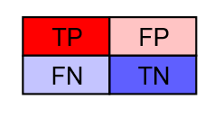
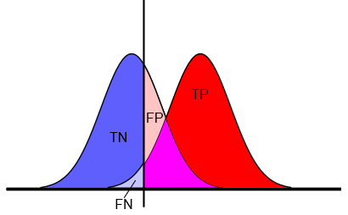
Curves in ROC Space : Useful for Imbalanced Data!... AUC(Area Under Curve)
Given a threshold T, the instance is classified as “positive” if X>T, and “negative” otherwise.
X follows a probability density $f_{1}(x)$ if the instance actually belongs to class “positive”, and $f_{0}(x)$ if otherwise.
1
Threshold
T
0.5
True Positive Rate
$$f_{0}(x)$$
$$f_{1}(x)$$
0
0
0.5
1
$$x$$
False Positive Rate

Slide 19
K겹 교차검증(k-fold cross-validation)
Test data
Training data
1st
2nd
3rd
4th
5th
performance1
performance2
performance3
performance4
performance5
K iterations (K-folds)
$$\frac{1}{5}\sum{{performance}_{i}}$$

Slide 20
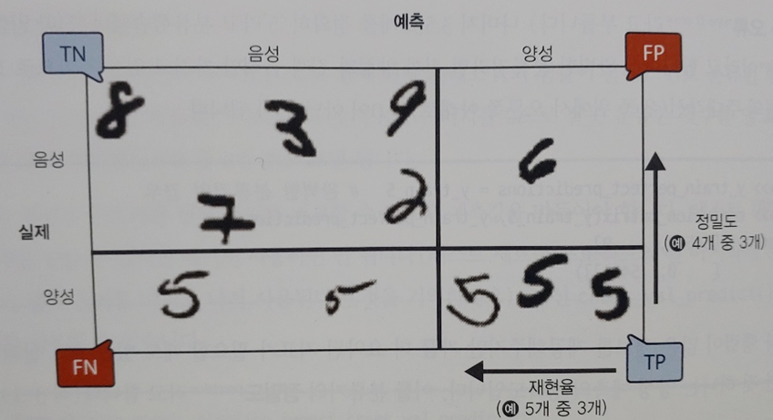
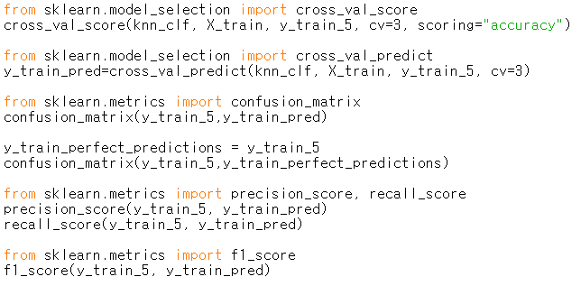
ROC 와 AUC관련 기능은 KNeighborsClassifier에서 제공되지 않음

Slide 23
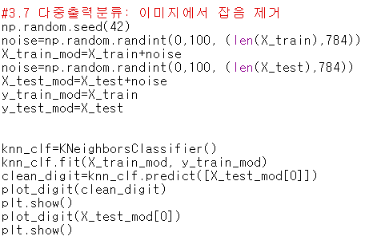
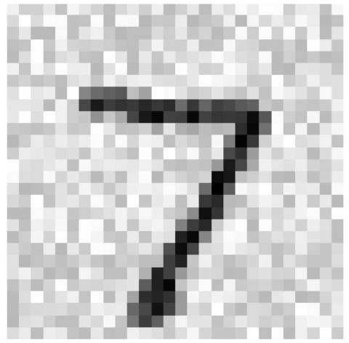
출력 수=픽셀 개수
레이블: 0~255 사이 값

Slide 24
2.3. k-Nearest Neighbors Algorithm에 의한 회귀
회귀(Regression)
Ex) The price of a used car
출력: 연속(회귀) vs. 이산(discrete) (분류)
Other examples
Stock price prediction
Oil price prediction
Water level prediction
Price
Milage

Slide 25
입력은 특징값들로 구성
출력은 입력에 해당하는 성질값으로 k 근접 이웃에 해당하는 성질값들의 평균으로 주어짐
거리 측정 기준? Euclidean distance, Minkowski Metric
분포가 치우쳐 있을 때 성능이 심각하게 저하 됨.
거리 정보 d를 이용하면 더 정확한 결정을 할 수 있음

Slide 27
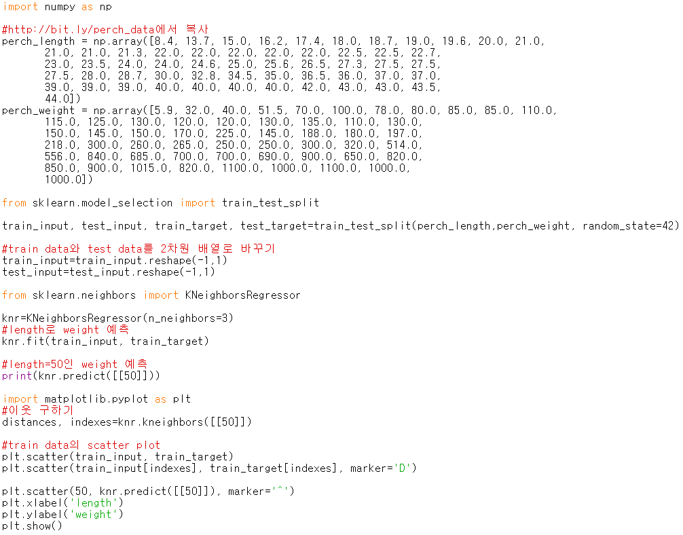
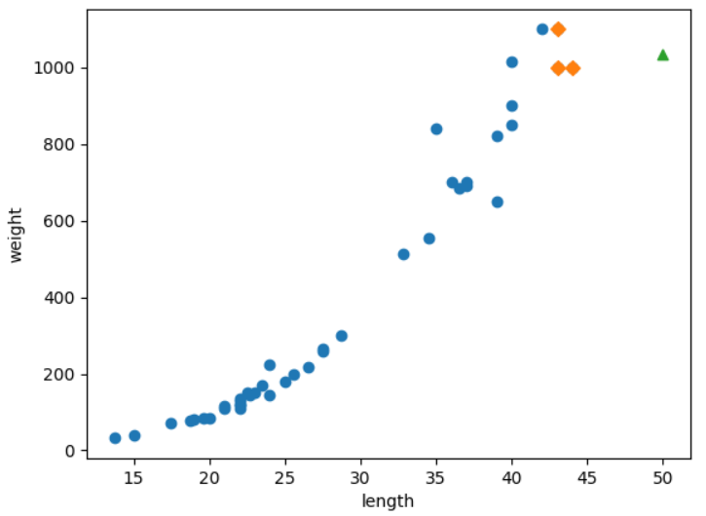
k-NN 실습
knn-3장-p.131.py

