Slide 1
Dimensionality Reduction
MNIST Dataset
LeCun 교수가 만들어 공개한 dataset
60,000 training data and 10,000 test data
Handwritten digit images (size 28ⅹ28) with 0~1 values
Each image can be flattened to 784 dimensional vector (1-D numpy array)

Slide 2
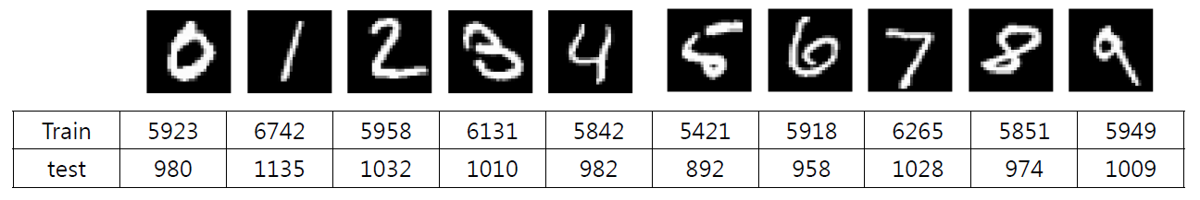
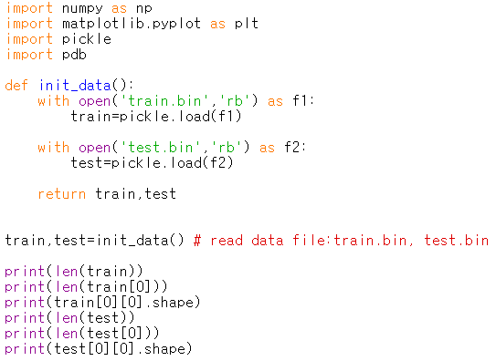
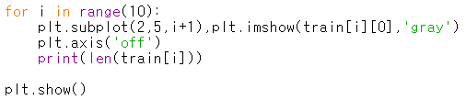

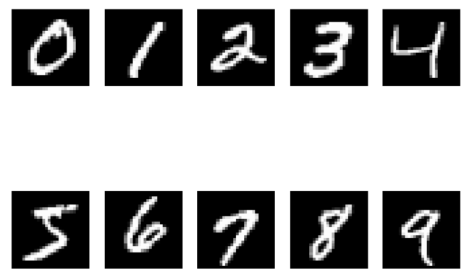
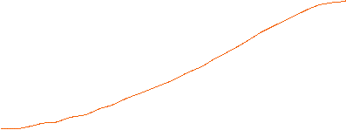
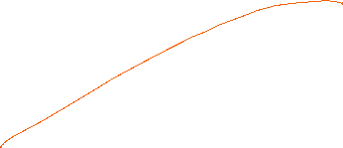
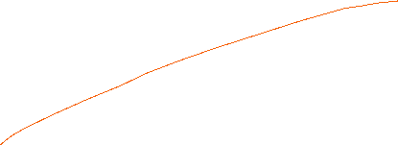
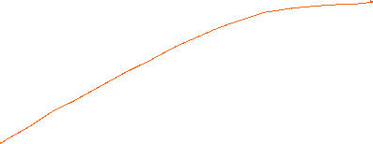
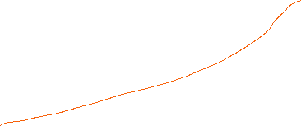
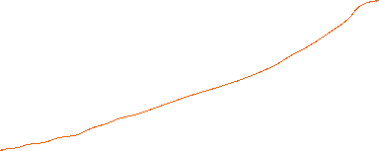
MNIST dataset
0MNIST.py

Slide 3
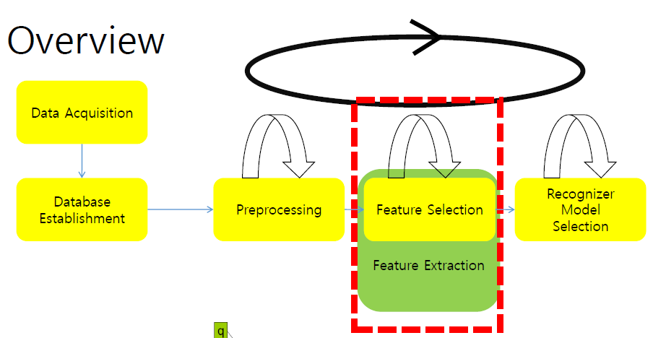

Slide 4
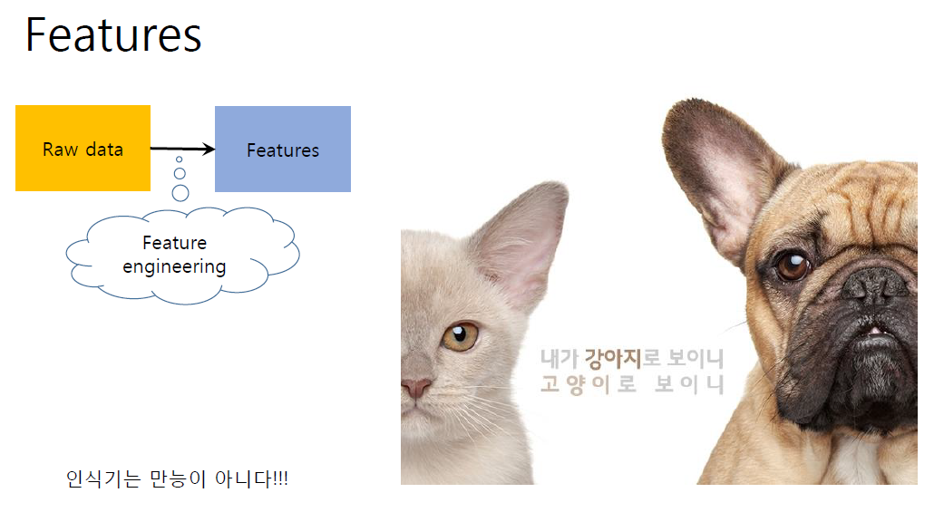

Slide 5
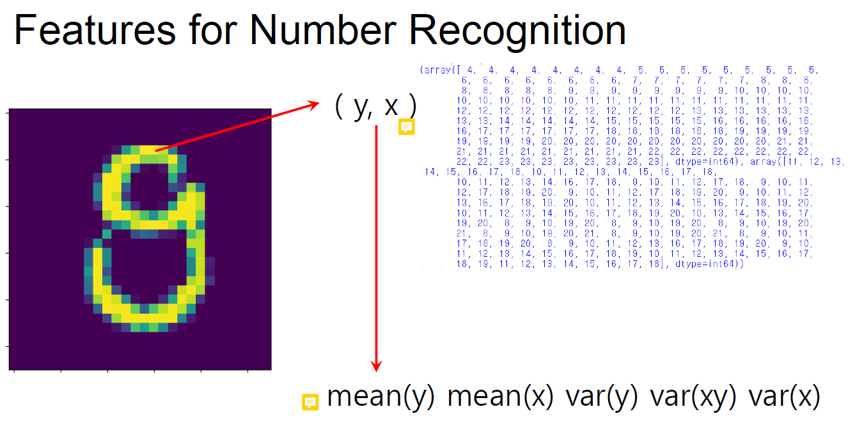
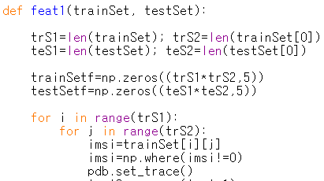
0이 아닌 위치의 좌표 값

Slide 6
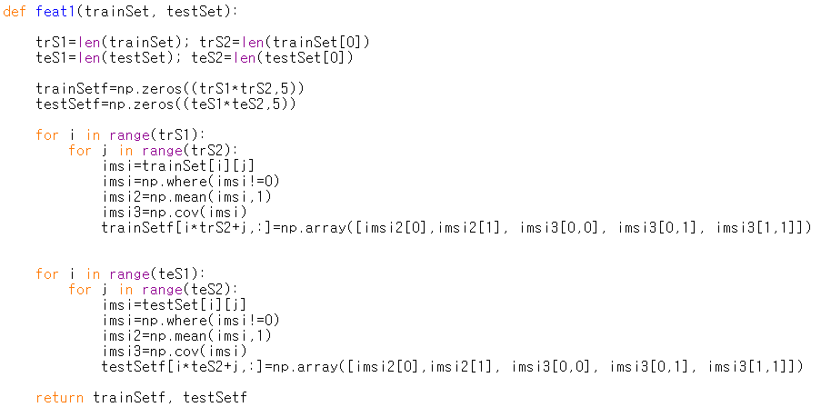
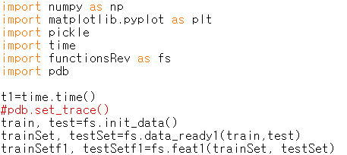
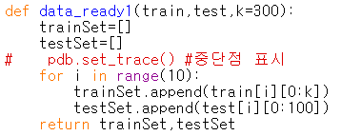
functionsRev.py
5
300
10
trainSet
trS1=10, trS2=300
teS1=10, teS2=100
100
trS1*trS2
10
testSet
0이 아닌 위치의 좌표 값
trainSetf
각 좌표 별 평균
3featSel1.py

Slide 7
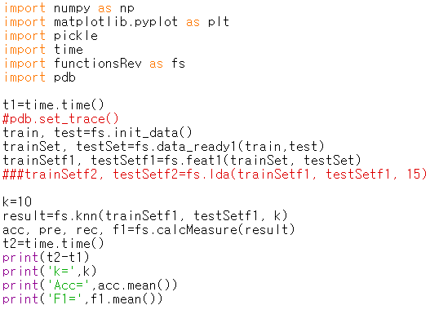
3featSel1.py

Slide 8
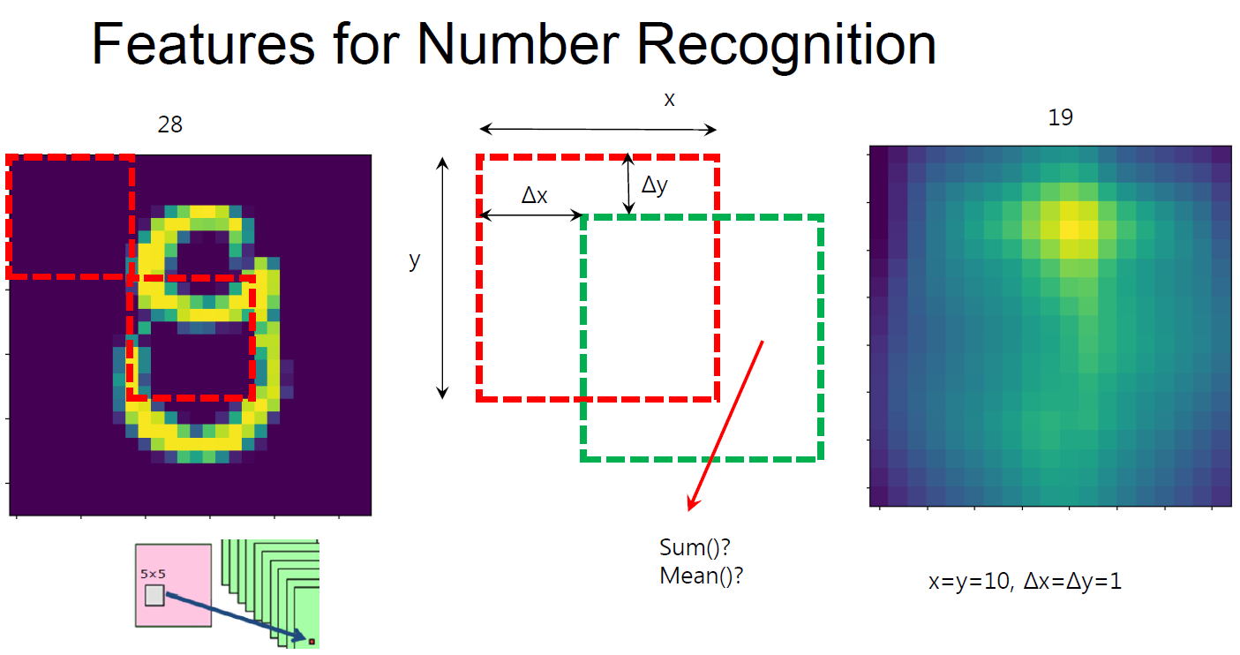

Slide 9
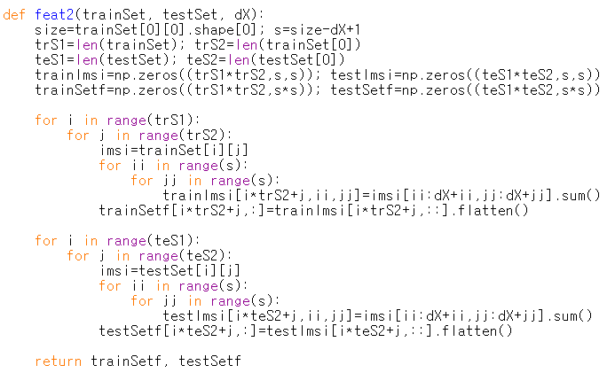
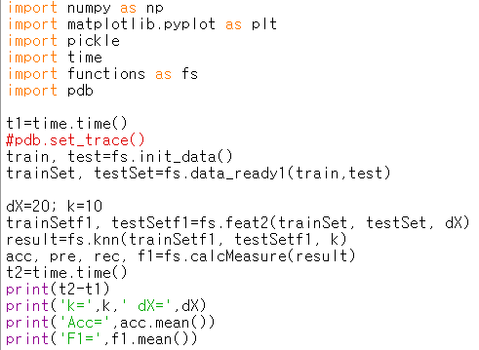


sxs
sxs
functionsRev.py
trS1*trS2
teS1*teS2
trainSetf
testSetf
3featSel2.py
dX
dX
Size 내의 값을 더하기
(s,s) 2차원 데이터를 sxs 1차원 데이터로..

Slide 10
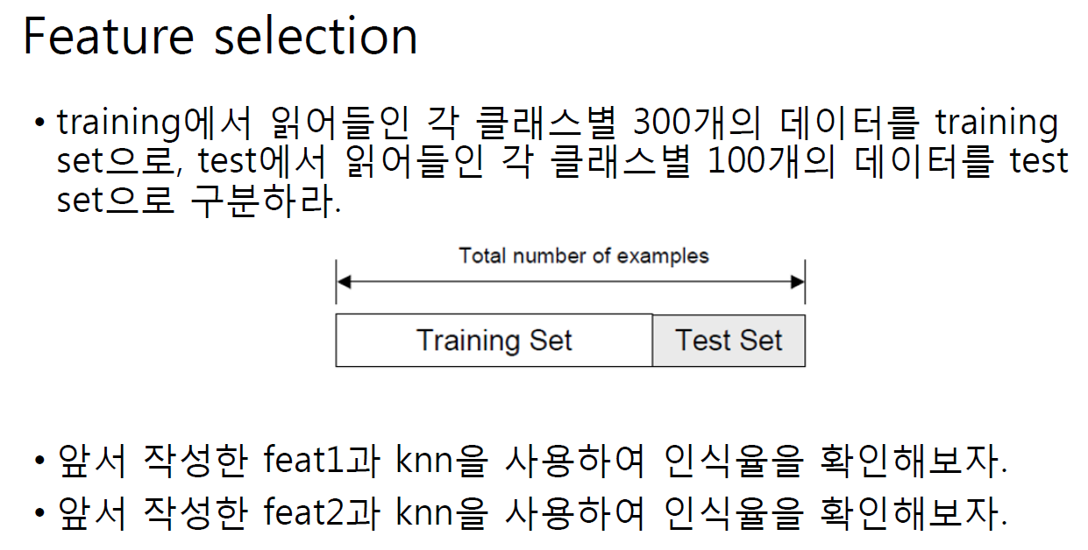

Slide 11
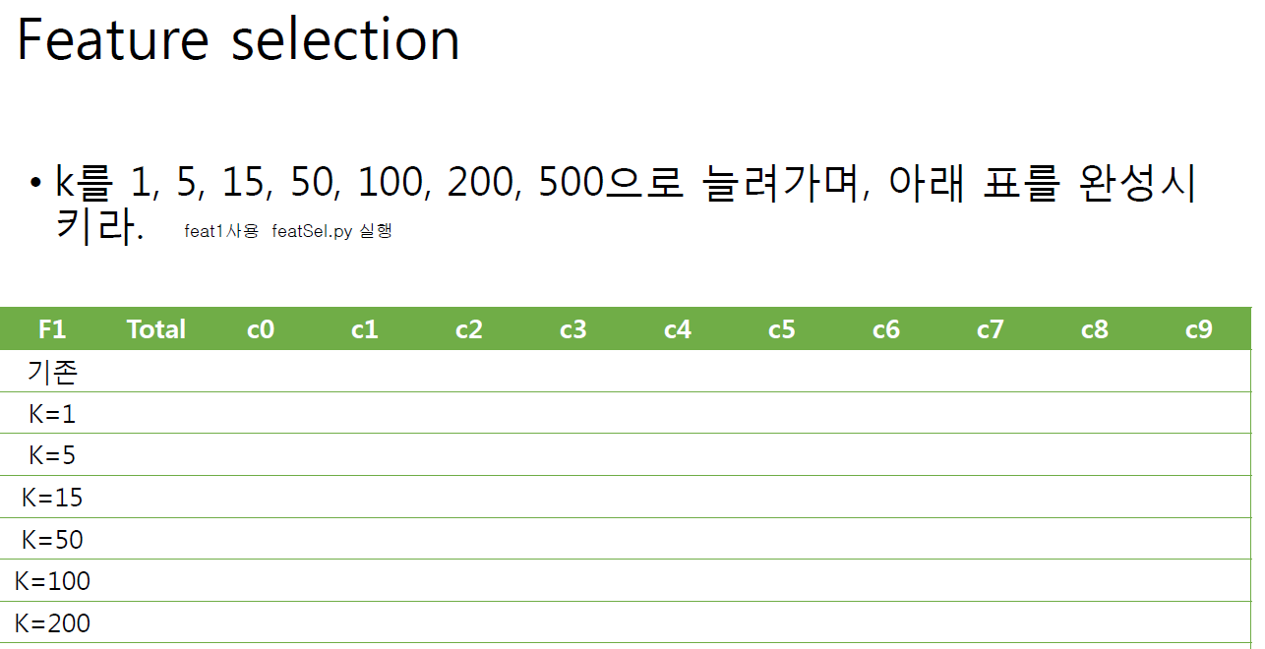

Feat1 사용, 3featSel1.py 실행

Slide 12
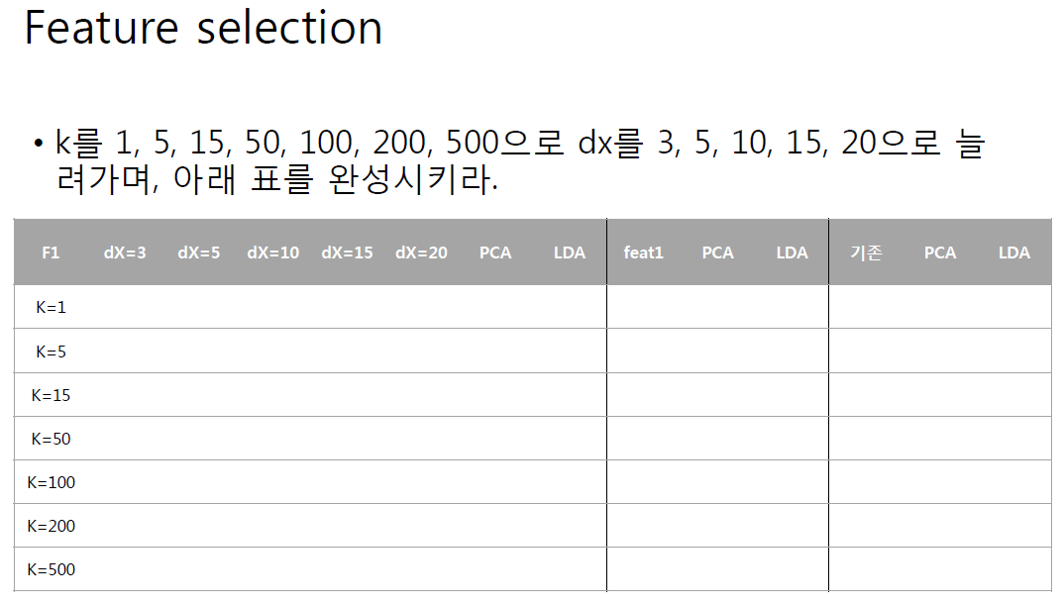
Feat2 사용, 3featSel2.py 실행

Slide 13
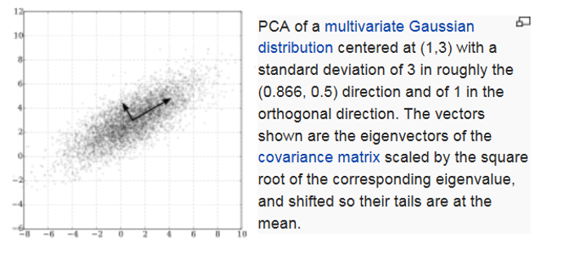
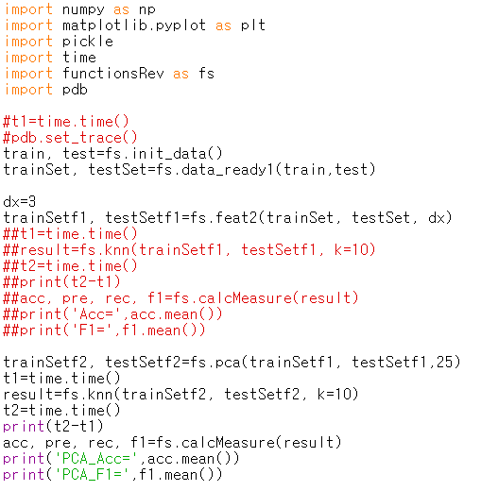
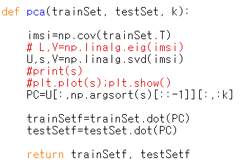



PCA(Principal Component Analysis)
4featSel3PCAF2.py
sxs
functionsRev.py
trS1*trS2
PCA 성분 추출
trainSetf1
S=28-dX+1
Eigenvalue(s) 크기의 역순으로 k개의 eigenvector를 선정

Slide 14
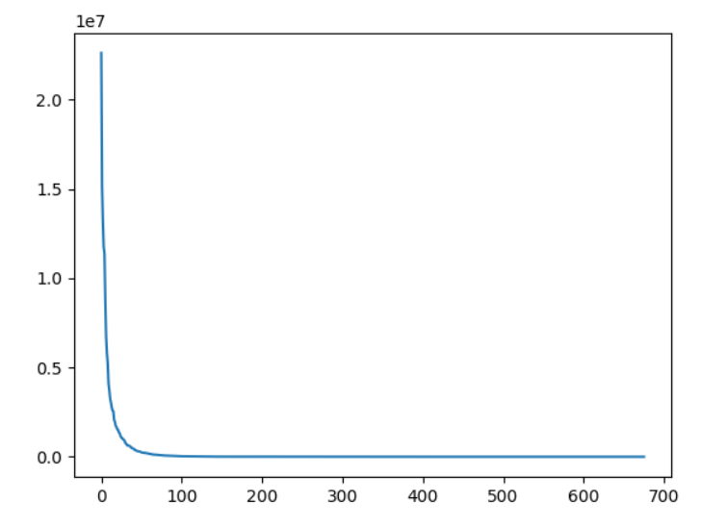




PCA(Principal Component Analysis)
4featSel3PCAF2.py
sxs
functionsRev.py
trS1*trS2
PCA 성분 추출
trainSetf1
S=28-dX+1
Eigenvalue(s) 크기의 역순으로 k개의 eigenvector를 선정

Slide 15









LDA(Linear Discriminant Analysis)
Fisher's idea: Fisher's linear discriminant
  Maximize a function that will give a large separation between the projected class means
  While also giving a small variance within each class, thereby minimizing the class overlap
$$x_{2}$$
$$m_{2}$$
$$m_{1}$$
$$m_{2}$$
$$s_{2}^{2}$$
$$m_{1}$$
$$w$$
$$s_{1}^{2}$$
$$x_{1}$$

Slide 16
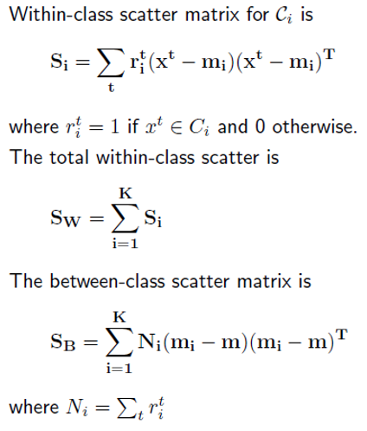
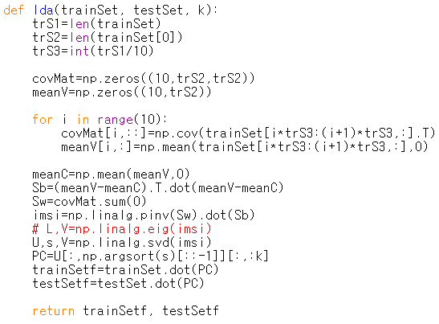

functionsRev.py

Slide 17
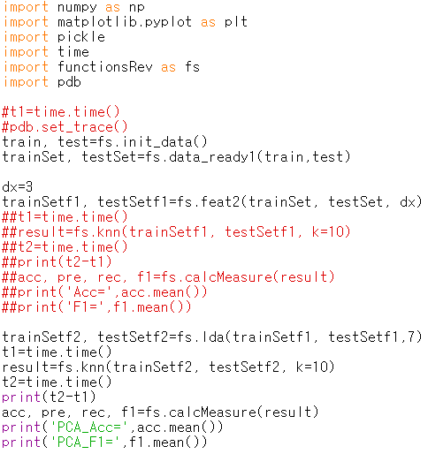
4featSel3LDAF2.py
4주MNIST/Homework2.xlsx
Homework#2
Template Matching |  |  |  | k-NN(300/digit) |  |  |  | k-NN(300/digit)-feature selection1
#template | F1 | Accuracy |  |  | F1 | Accuracy |  |  | F1 | Accuracy
#10 |  |  |  | k=1 |  |  |  | k=1
#50 |  |  |  | k=5 |  |  |  | k=5
#100 |  |  |  | k=15 |  |  |  | k=15
#200 |  |  |  | k=50 |  |  |  | k=50
#300 |  |  |  | k=100 |  |  |  | k=100
#500 |  |  |  | k=200 |  |  |  | k=200
#1000
k-NN(300/digit)-feature selection2 |  |  |  |  |  |  | k-NN(300/digit)-feature selection2
F1 | dx=3 | dx=5 | dx=10 | dx=15 | dx=20 |  | Acc | dx=3 | dx=5 | dx=10 | dx=15 | dx=20
k=1 |  |  |  |  |  |  | k=1
k=5 |  |  |  |  |  |  | k=5
k=15 |  |  |  |  |  |  | k=15
k=50 |  |  |  |  |  |  | k=50
k=100 |  |  |  |  |  |  | k=100
k=200 |  |  |  |  |  |  | k=200
F1 | k-NN | FeatSel1 | FeatSel2 | FeatSel2 | FeatSel2
 |  |  | dx=? | PCA 45 | LDA 7
k=1
k=5
k=15
k=50
k=100
k=200
Accuracy | k-NN | FeatSel1 | FeatSel2 | FeatSel2 | FeatSel2
 |  |  | dx=? | PCA 45 | LDA 7
k=1
k=5
k=15
k=50
k=100
k=200

Slide 18

Python Machine Learning Third Edition
Machine Learning and Deep Learning with Python, scikit-learn and Tensorflow 2
CHAPTER 5 Compressing Data via Dimensionality Reduction
Feature selection for dimensionality reduction: Feature Extraction (PCA, LDA)
unsupervised dimensionality reduction via principal component analysis
The main steps behind PCA
Extracting the principal components step by step
Total and explained variance
Feature transformation
Principal component analysis in scikit-learn
Supervised data compression via linear discriminant analysis
The inner workings of LDA
Computing the scatter matrices
Selecting linera discriminants for the new feature subspace
Projecting samples onto the new feature space
LDA via scikit-learn

Slide 19
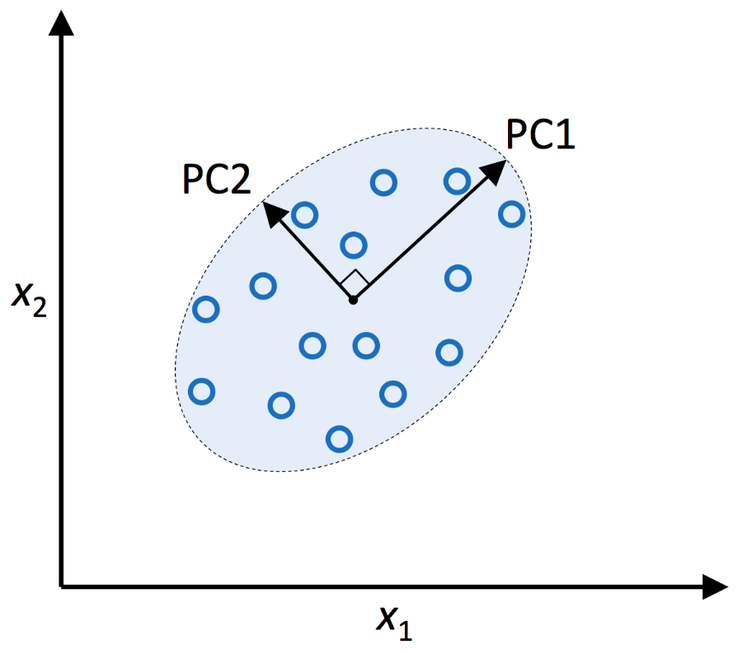
Unsupervised dimensionality reduction via principal component analysis
Feature Extraction
  Transform or project the data onto a new feature space
  An approach to data compression with the goal of maintaining most of the relevant information
  Improve the predictive performance by reducing the curse of dimensionality
The main steps behind principal component analysis(PCA)
  Standardize the d-dimensional dataset
  Construct the covariance matrix
  Decompose the covariance matrix into eigenvectors and eigenvalues
  Sort the eigenvalues by decreasing order to rank the corresponding eigenvectors
  Select k eigenvectors which corresponds to the k largest eigenvalues
  Construct a projection matrix W from the top k eigenvectors
  Transform the d-dimensional dataset X using the projection matrix W

Slide 20
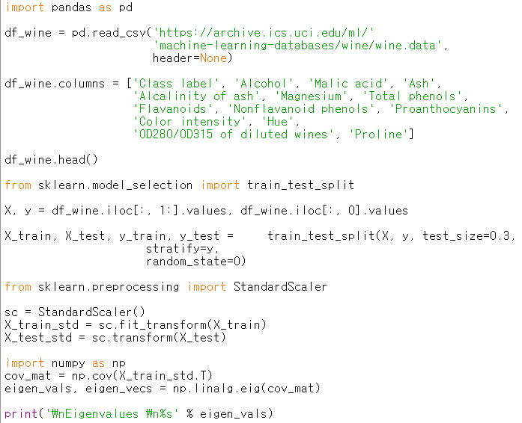





Extracting the principal components step by step
  Standardize the d-dimensional dataset
  Construct the covariance matrix
  Decompose the covariance matrix into eigenvectors and eigenvalues
ch05tmp1.py

Slide 21
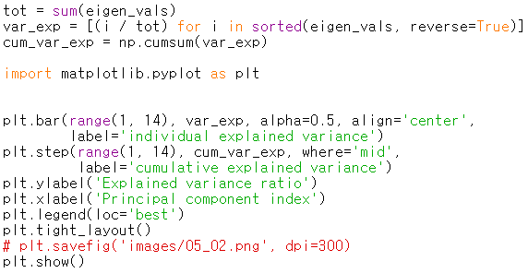
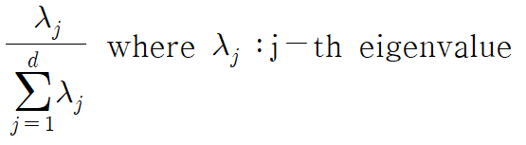
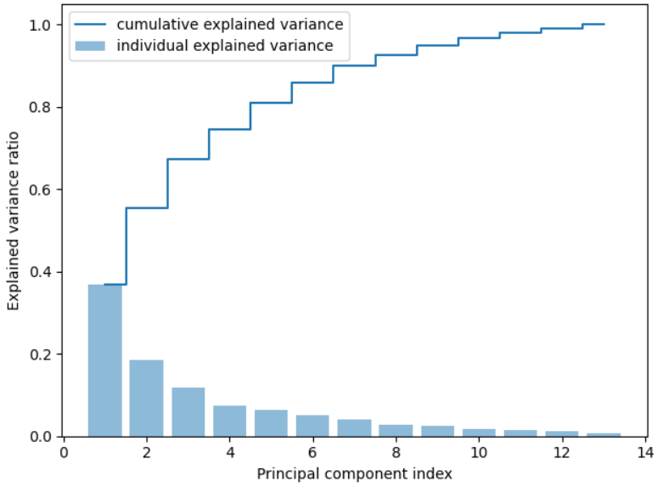







Total and explained variance
  Sort the eigenvalues by decreasing order to rank the corresponding eigenvectors
ch05tmp1.py
Variance explained ratios of eigenvalues

Slide 22
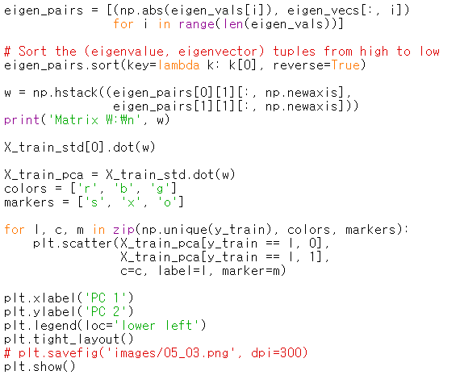
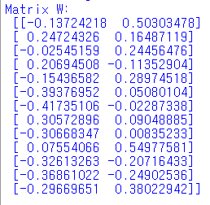
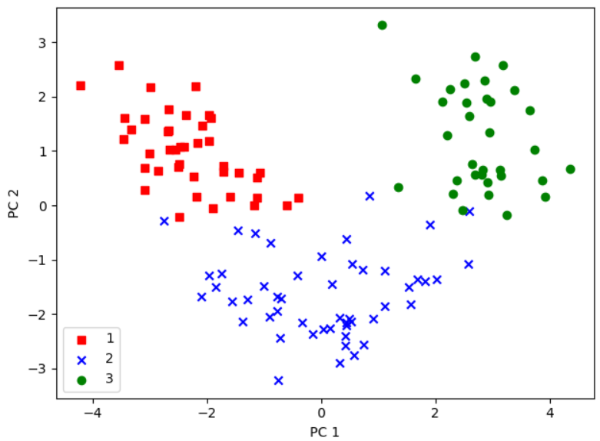
Feature transformation
  Select k eigenvectors which corresponds to the k largest eigenvalues
  Construct a projection matrix W from the top k eigenvectors
  Transform the d-dimensional dataset X using the projection matrix W
ch05tmp1.py
Make a list of (eigenvalue, eigenvector) tuples
W:13x2
x’=xW
x:1x13
eigenvalue index
X’=XW

Slide 23
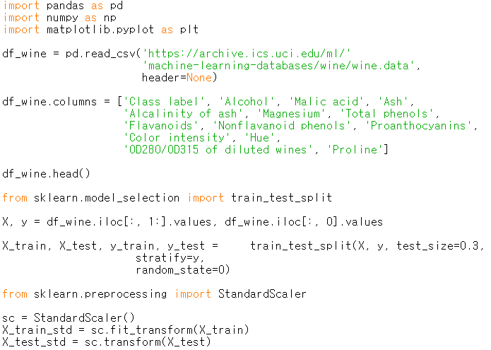


Principal component analysis in scikit-learn
  How to use the PCA class implemented in scikit-learn
ch05tmp2.py

Slide 24
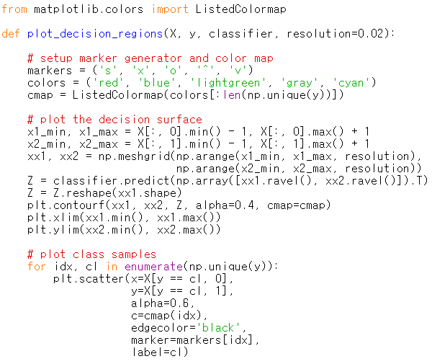

Principal component analysis in scikit-learn
ch05tmp2.py

Slide 25
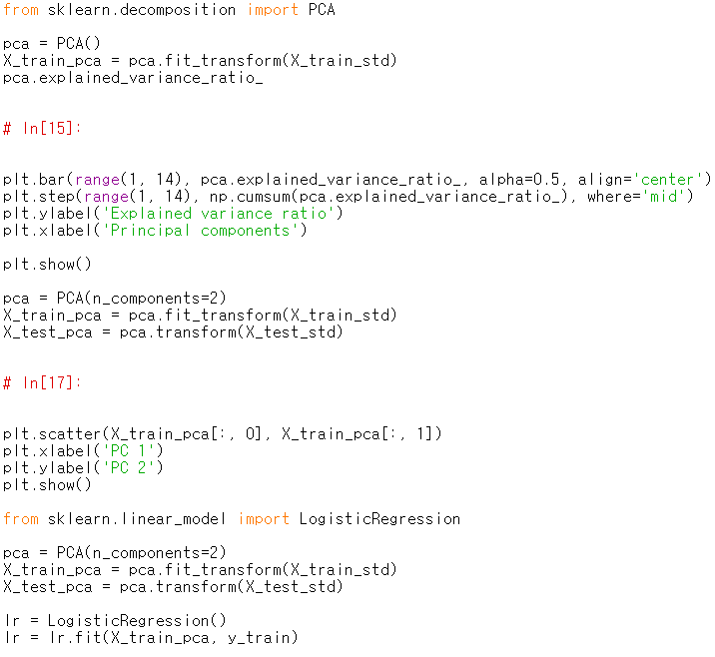
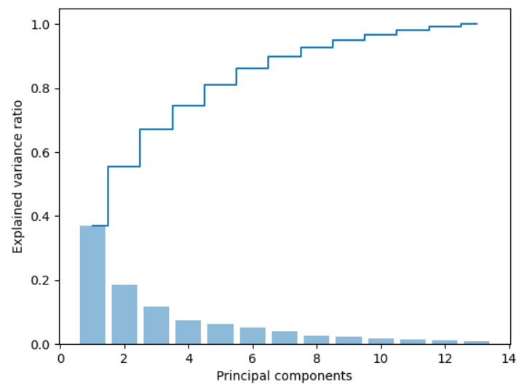
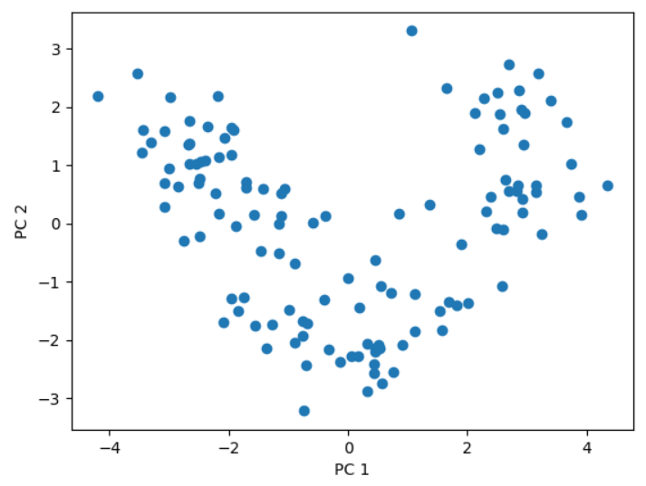










Principal component analysis in scikit-learn
ch05tmp2.py

Slide 26
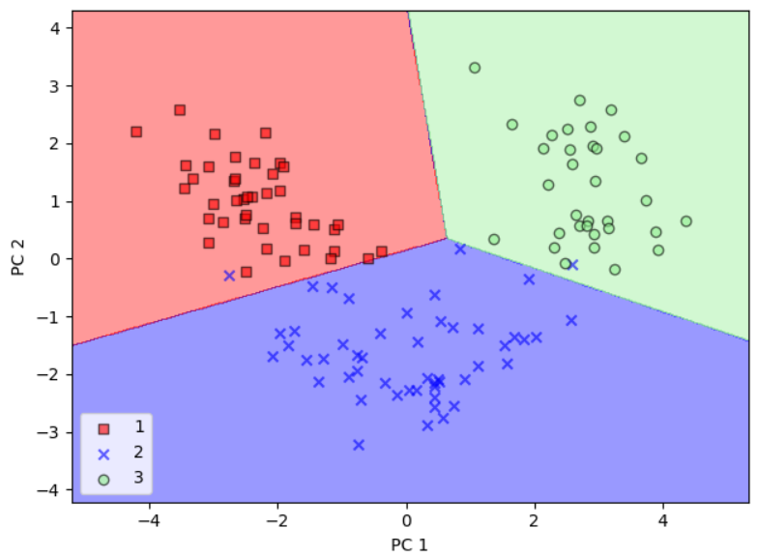
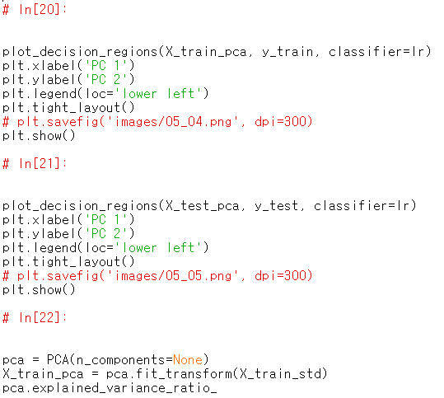
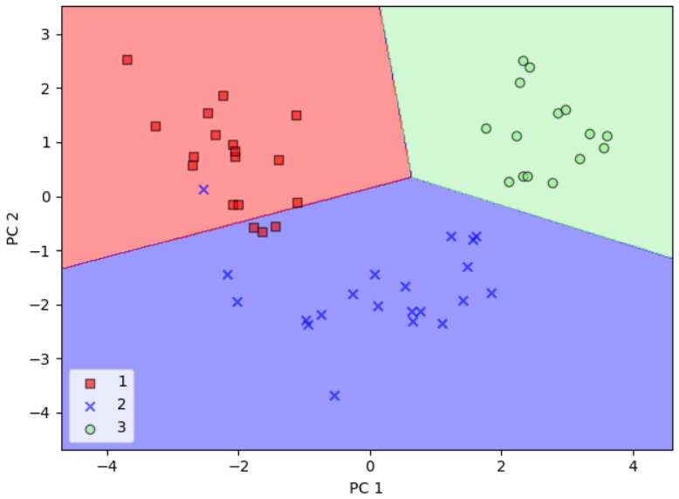



Principal component analysis in scikit-learn
ch05tmp2.py

Slide 27
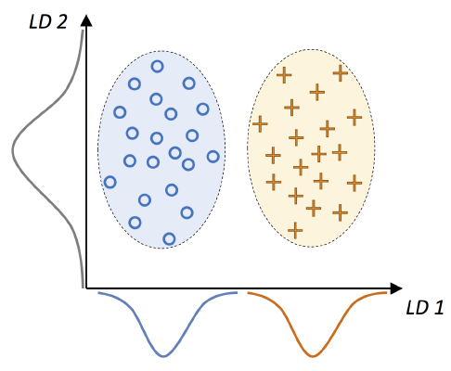
Supervised data compression via linear discriminant analysis
Linear Discriminant Analysis
  Find the feature subspace that optimizes class separability
PCA versus LDA

Slide 28
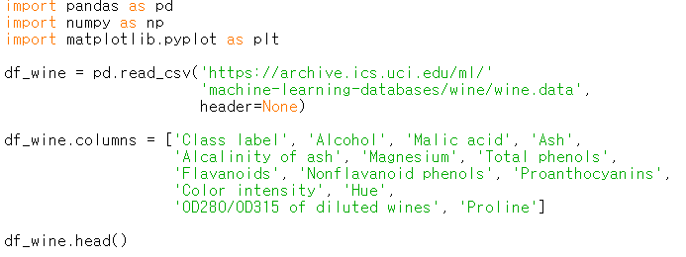
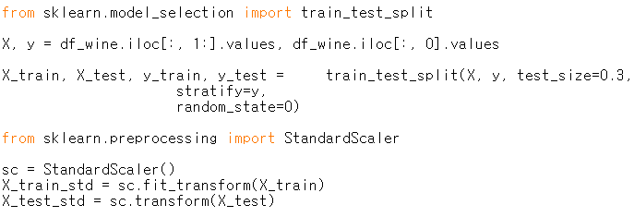




The inner workings of linear discriminant analysis(LDA)
  Standardize the d-dimensional dataset
  For each class, compute the d-dimensional mean vector
  Construct the between-scatter matrix $S_{B}$ and the within-class scatter matrix $S_{W}$
  Compute the eigenvectors and corresponding eigenvalues of the matrix $S_{W}^{−1}$ $S_{B}$
  Sort the eigenvalues by decreasing order to rank the corresponding eigenvectors
  Choose the k eigenvectors which corresponds to the k largest eigenvalues to construct a dxk dimensional transformation matrix W
  Project the samples onto te new feature subspace using the projection matrix W
Computing the scatter matrices
ch05tmp3.py

Slide 29





Computing the scatter matrices
ch05tmp3.py

Slide 30


Computing the scatter matrices
ch05tmp3.py

Slide 31







Selecting linear discriminants for the new feature subspace
  Compute the eigenvectors and corresponding eigenvalues of the matrix $S_{W}^{−1}$ $S_{B}$
  Sort the eigenvalues by decreasing order to rank the corresponding eigenvectors
  Choose the k eigenvectors which corresponds to the k largest eigenvalues to construct a dxk dimensional transformation matrix W
  Project the samples onto te new feature subspace using the projection matrix W
ch05tmp3.py

Slide 32



Selecting linear discriminants for the new feature subspace
  Choose the k eigenvectors which corresponds to the k largest eigenvalues to construct a dxk dimensional transformation matrix W
ch05tmp3.py

Slide 33



Projecting samples onto the new feature space
  Project the samples onto te new feature subspace using the projection matrix W
ch05tmp3.py

Slide 34






LDA via scikit-learn
ch05tmp3.py

